Slide 1

Learning Robust Neural Arithmetic Units
Bhumika Mistry
SUPERVISORS: KATE FARRAHI & JONATHON HARE
VLC Student Conference
20th January 2021

Slide 2
Contents
Background
Existing units
Aims
1 unit task
Show existing units fail to be robust
Proposed improvements
2 unit task
Conclusion
Definitions
Adding stochasticity
Correlation loss
Beta initialisation
2 operations
Input redundancy

Slide 3
What are Neural Arithmetic Units?
Branch of a research field: Neural Arithmetic Modules (NAMs)

Slide 4
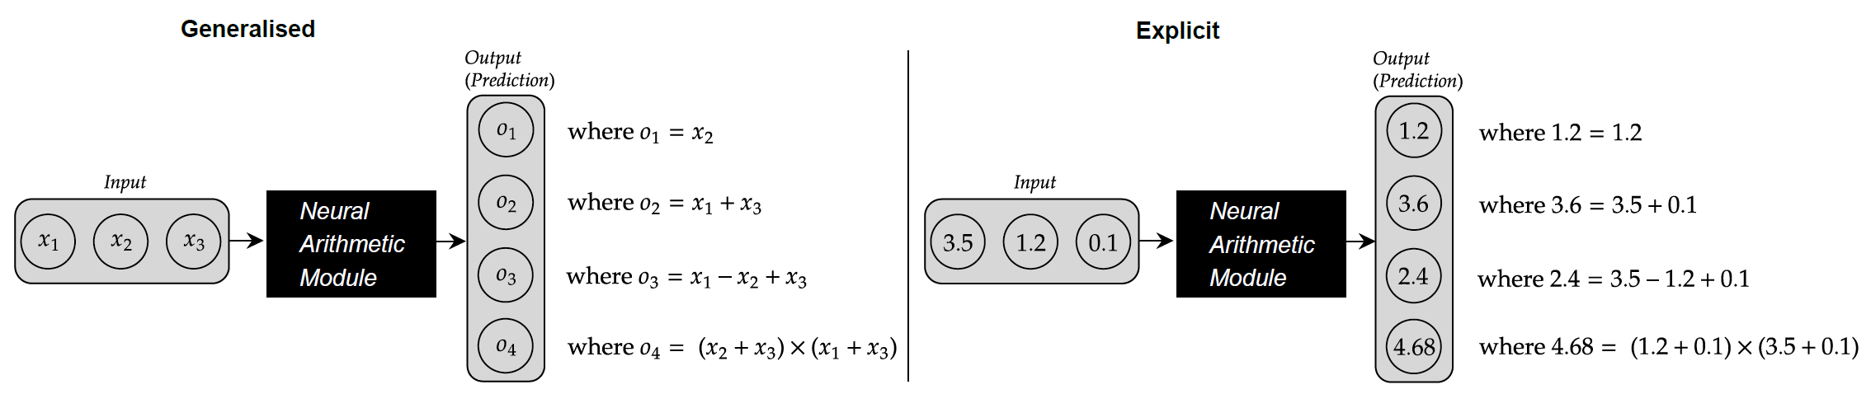
What is a Neural Arithmetic Module (NAM)?
Definitions?
Neural: neural networks
Arithmetic: ability to learn to model arithmetic operations
Module: encompasses a single unit and multiple units
Aims: ​
Be extrapolative (OOD generalization)​
Be interpretable​
Weights interpreted as selection/ operation​
Be utilised in larger systems
Notes:
Img: each output neuron will learn some arithmetic combo of the input values.
The NAM will learn the general version such that it works for all inputs
The general solution requires discrete weight values
Enforced via reg penalty

Slide 5
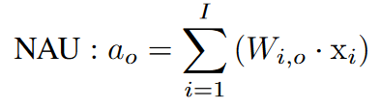
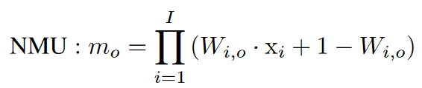
What are Neural Arithmetic Units¹?
Branch of a research field: Neural Arithmetic Modules (NAMs)
2 units (i.e., modules)
Neural Addition Unit (NAU)
Neural Multiplication Unit (NMU)
Weight Value | Effect
-1 | Subtraction
0 | No selection
1 | Addition
Weight Value | Effect
0 | No selection
1 | Multiplication
¹Madsen, A. and Johansen, A.R., 2020. Neural Arithmetic Units. In International Conference on Learning Representations.
Notes:
Interpretable -> add unit 1/-1 = +/-, 0= no sel and mul unit 1=mul and0-= no selection
Weights have inductive biases to be discrete
Enforced via reg penalties

Slide 6
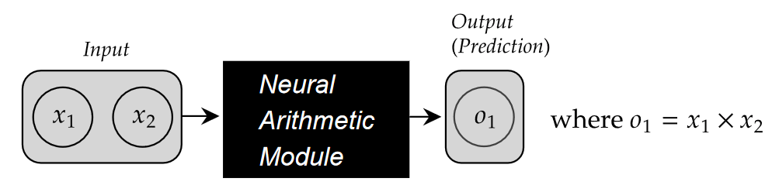
Robustness of NAMs
Be extrapolative (OOD generalization)
Robustness: Learn weights regardless of the distribution of the training data
How can we check robustness?
Success on different interpolation ranges
Difficulty? Simplest setting
2 inputs, 1 output, 1 operation
Focus on multiplication
Research question: Are existing NAMs robust?
Notes:
One Aim of NAUs = extrapolation
To achieve this it should also be robust
Why care? Little (if any) control of the input distribution for sub-components of the large network

Slide 7
Evaluation metrics
Success rate
If the extrapolation error is within the acceptable error margin
Convergence speed: Solved at iteration
The iteration which a success occurs
Sparsity error
Measures lack of discretisation of the weight matrix
Notes:
One Aim of NAUs = extrapolation
To achieve this it should also be robust
Desirable to have achieve robustness.
Sparsity error: Distance of the weight which is furthest away from an acceptable weight integer

Slide 8
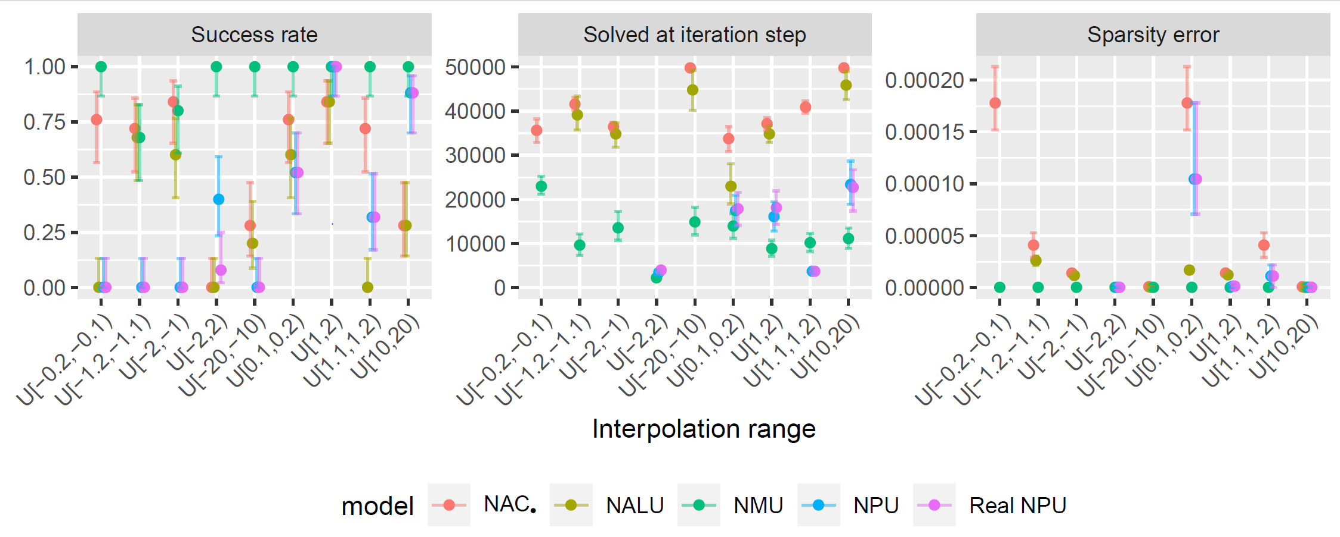
Are existing NAMs robust?
Answer: No
How can we fix this?
Observation: works well on some ranges over others
Notes:
25 seeds

Slide 9
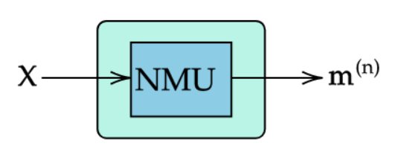
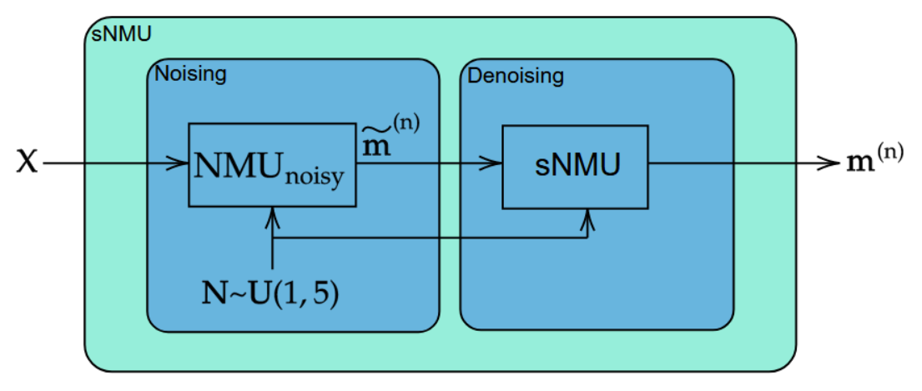
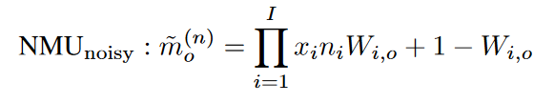

Stochastic-NMU (sNMU)
Intuition: Apply noise to the input to make the NMU think it is applied to a different range and remove the noise to revert to the solution for the original input.

Slide 10
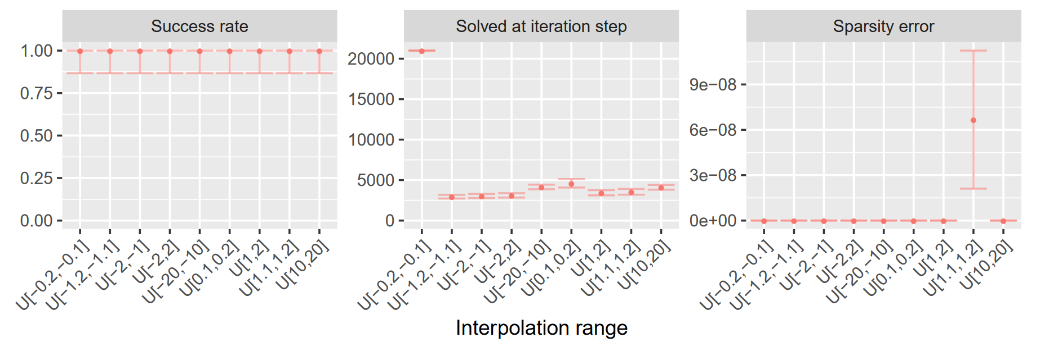
Results for the sNMU

Slide 11
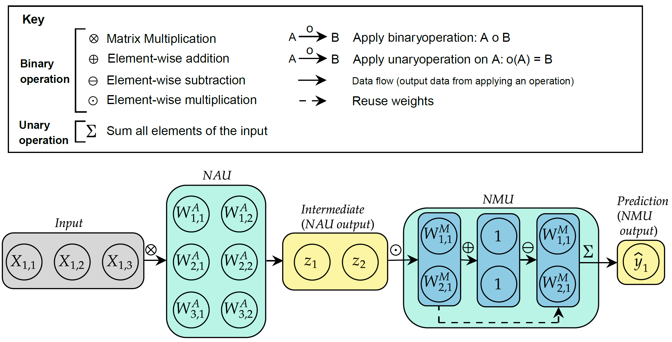
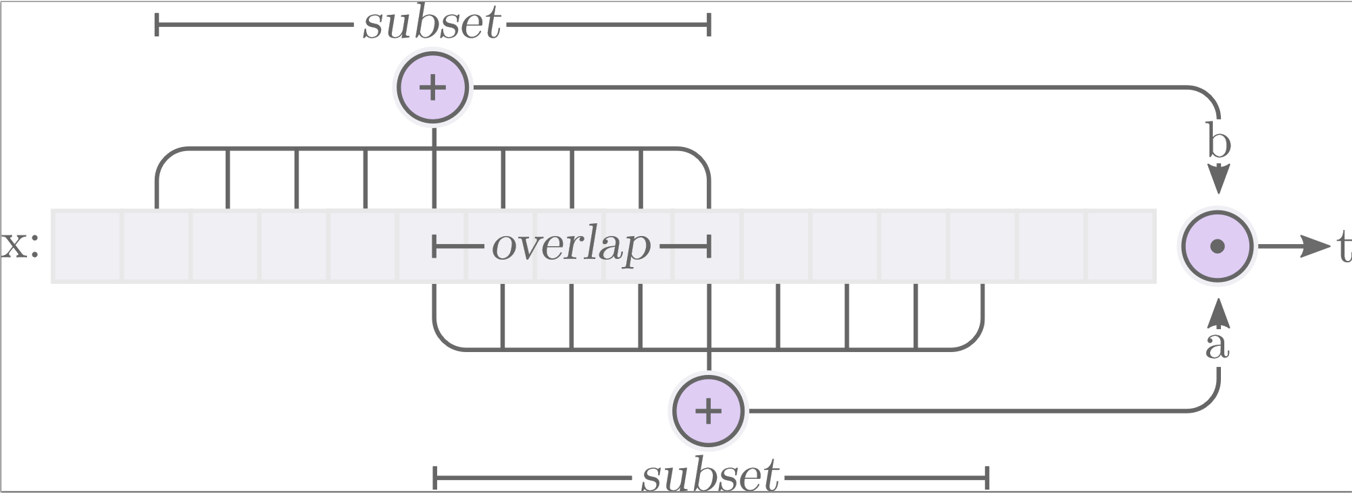
Increasing difficulty
Research question: Are NAMs robust when there is multiple operations and redundancy?
2 operations = 2 stacked NAMs
Addition followed by multiplication
Redundancy (for addition) = Not all input values are required for the operation
100 Inputs → Add Module → 2 Values → Multiplication Module → 1 Output

Slide 12
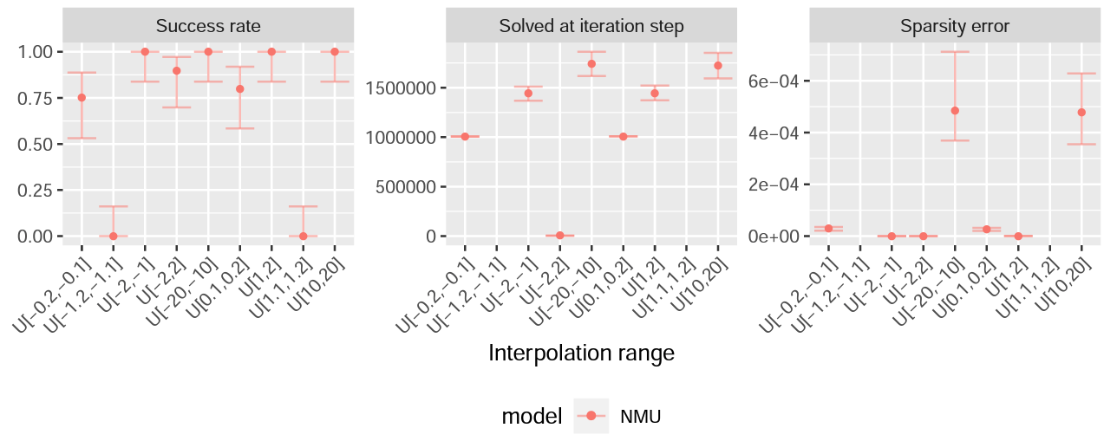



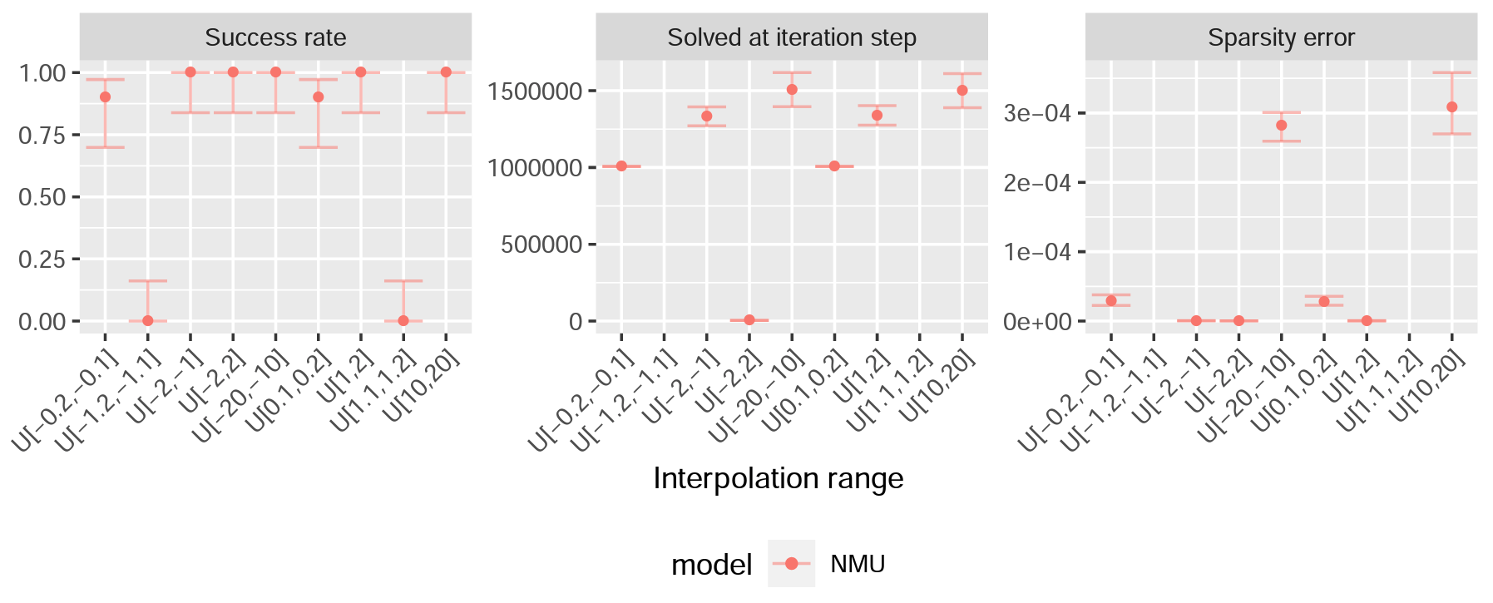

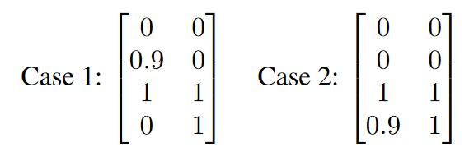
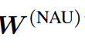
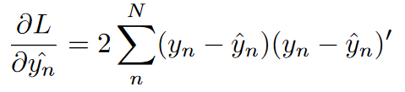

Are NAMs robust when there is multiple operations and redundancy?
Answer: No
Both NAU-NMU and NAU-sNMU have ranges with 0% success
Why? Mean squared error (MSE) train loss criterion
Misleading error values
Weak gradients for certain ranges
Notes:
Imagine a case where ideal NAU weights are the following, and the 2 cases which are not correctly converged …
The errors for the smaller input range have less difference between each case in comparison to the input with a larger range
For the smaller ranged input, the model gives lower error for having both incorrect selection and weight values over just having incorrect weight values

Slide 13
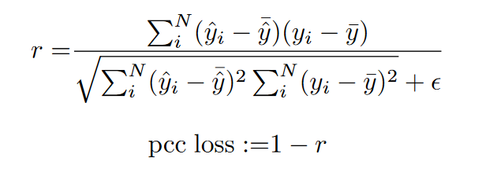
Solution: PCC Loss
Create a loss term from the Pearson’s Correlation Coefficient (PCC)
Range of the PCC loss is [0,2]
Enforce positive correlation between the predicted and target values
Numerical stability
Notes:
Means calculated over batches

Slide 14
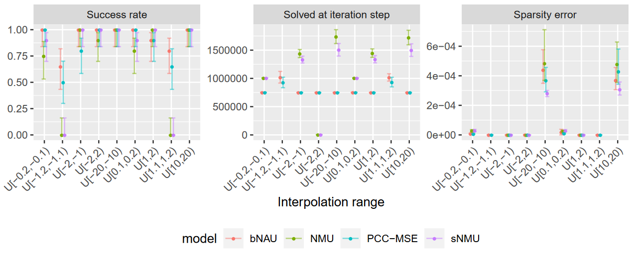
Observations
Performance: NMU < sNMU
Failure cases: Still get interpolation ranges which give 0% success
Solution: PCC-MSE loss
Train regime: PCC for 750,000 iterations and then switch to MSE loss
Performance: NAU-sNMU with MSE < NAU-sNMU with PCC-MSE
Failure cases: Initialisation for NAU weights
Solution: Beta initialisation
Performance: Glorot-NAU with PCC-MSE < Beta-NAU with PCC-MSE loss
Performance: NMU < sNMU < PCC-MSE < bNAU
Notes:
MSE is good at forcing discretization

Slide 15
Conclusion
We have shown that existing Neural Arithmetic Modules (NAMs) are not robust to different training ranges
We found some causes of this:
Sample range of the input values
MSE loss: Uninformative values, weak gradients
We proposed improvements:
Stochastic-NMU
PCC loss switched to MSE loss
Alternate initialisation: beta-NAU
Future work
See if these solutions improve other existing NAMs
Improve understanding on the type of input distributions which cause NAMs struggle

