Slide 1
Jet classification and identification using neural network
Baisakhi Mitra

Slide 2
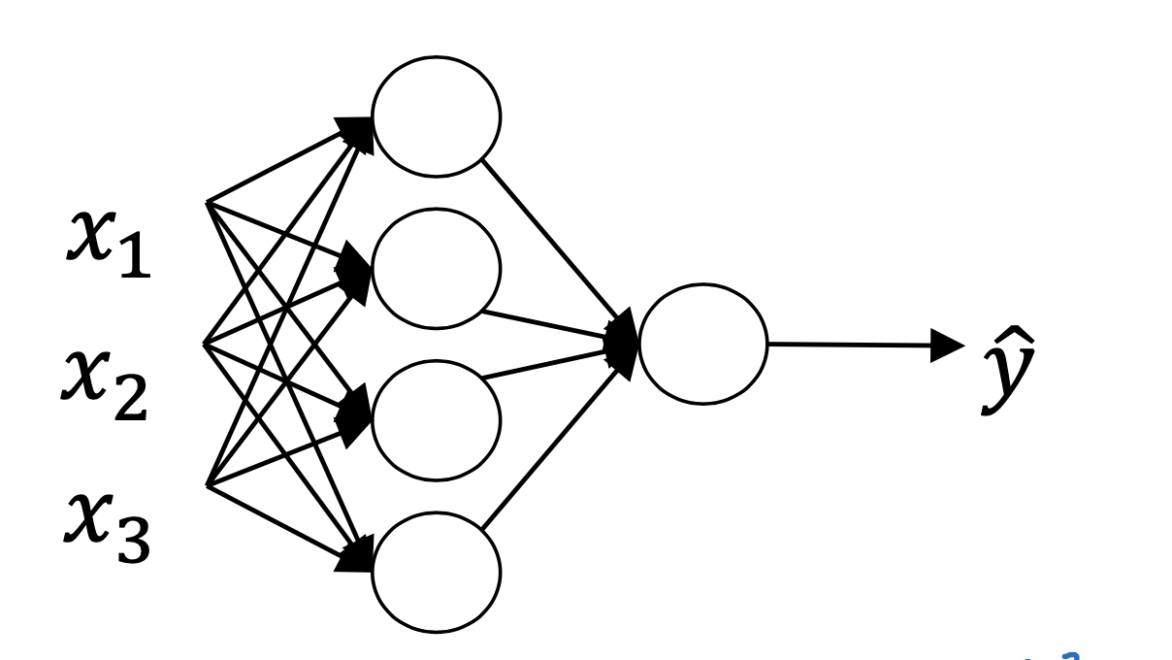

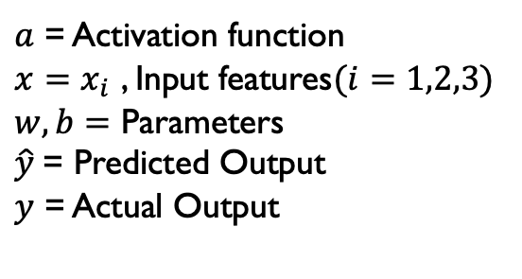
Neural Network: Building Blocks
$$a(w^{T}x+b)$$
$a$ = Activation function
$x=x_{i}$ , Input features$(i=1,2,3)$
$w,b=$ Parameters
$\hat{y}$= Predicted Output
$y$ = Actual Output
Given input features $(x_{i})$ , train Neural Network to minimize loss function: $ℒ=(y−\hat{y}$)

Slide 3
Steps to be performed
Jets: One high-energy particle decays to several low-energy particles. The collection of both decaying particles and decayed particles clustered together forms a jet.
Jet classification: At first, jets need to be distinguished based on the originating particle.
Divide a given dataset into two subsets. One set is used for training the neural network. The other set is used to validate the neural network.
Jet identification: After training and validating the neural network, use it to identify jets based on high-level features of the corresponding physical process.

Slide 4
Steps to be performed: For this example
Downloaded the data :
curl https://cernbox.cern.ch/s/zZDKjltAcJW0RB7/download -o Data-MLtutorial.tar.gz
Deep Neural Network (DNN) with 5 inner layers.
Used loss function as ‘loss=BinaryCrossentropy’
Training set: Validation set = 2:1
Total parameters: 1795
Use different Activation functions and study ‘loss’.
In the next mentioned tests, always ‘softmax’ is used as an Activation function in the last layer of the Neural Network. Only the activation function of previous layers varied.

Slide 5
Effect on Loss with different Activation Function
List of Activation functions available with ‘tensorflow.keras’:
elu: Exponential Linear Unit.
hard_sigmoid: Hard sigmoid activation function
linear: Linear activation function
mish: Mish activation function
relu: Rectified linear unit activation function
selu: Scaled Exponential Linear Unit activation function

Slide 6
Effect on Loss with different Activation Function
List of Activation functions available with ‘tensorflow.keras’:
sigmoid: Sigmoid activation function
softmax: Softmax converts a vector of values to a probability distribution.
softplus: Softplus activation function, softplus(x) = log(exp(x) + 1).
softsign: Softsign activation function, softsign(x) = x / (abs(x) + 1).
swish: Swish activation function, swish(x) = x * sigmoid(x).
tanh: Hyperbolic tangent activation function.

Slide 7
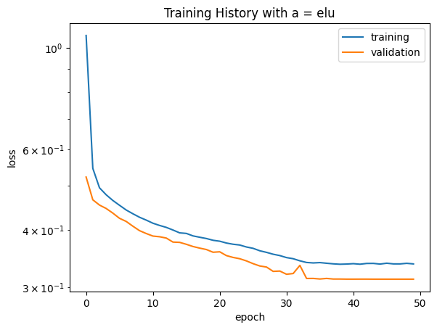
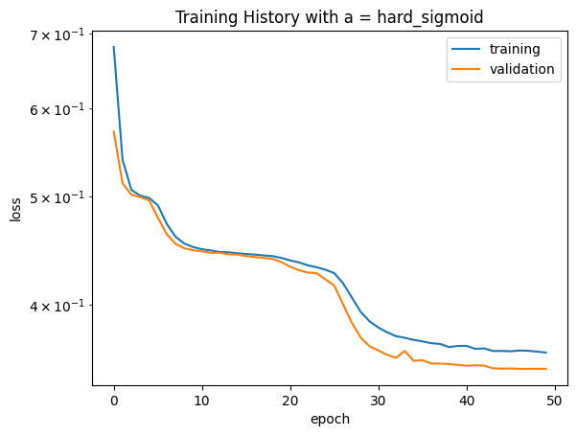
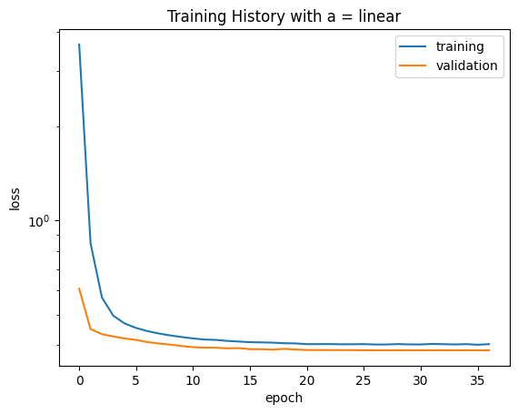
Loss for different activation functions (a)

Slide 8
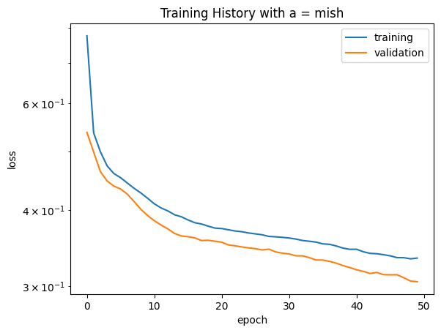
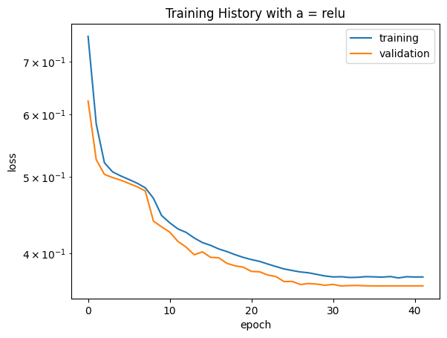
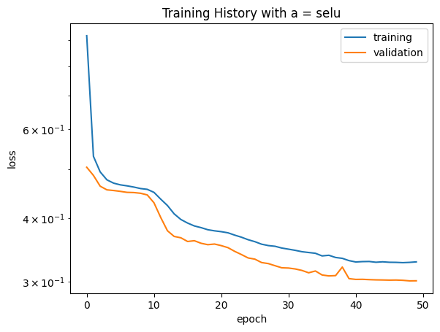
Loss for different activation functions (a)

Slide 9
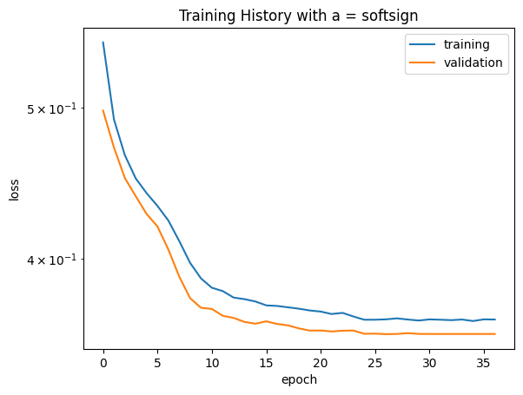
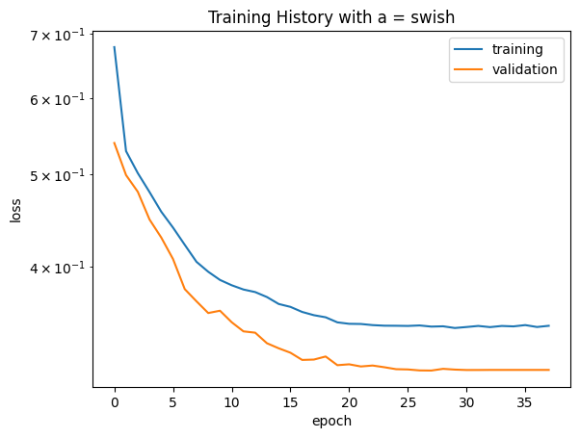
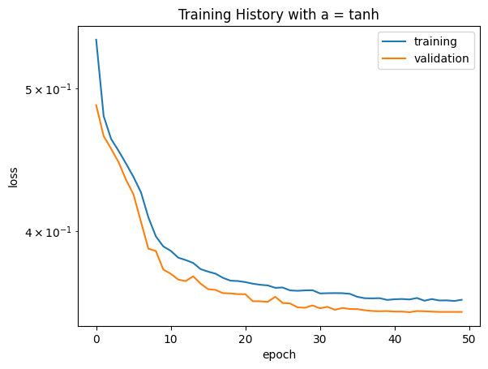
Loss for different activation functions (a)

Slide 10
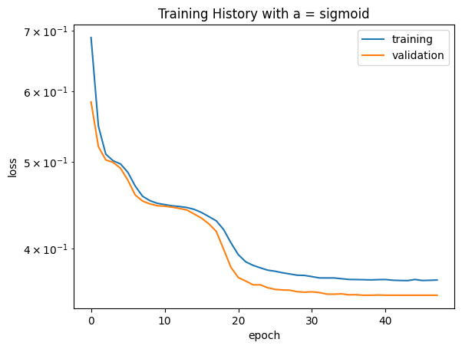
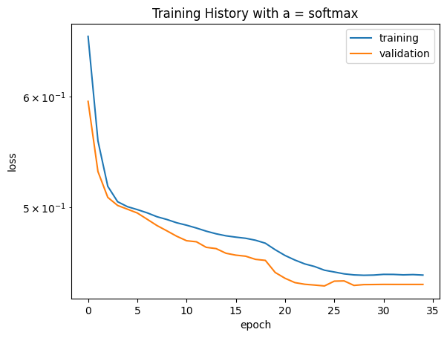
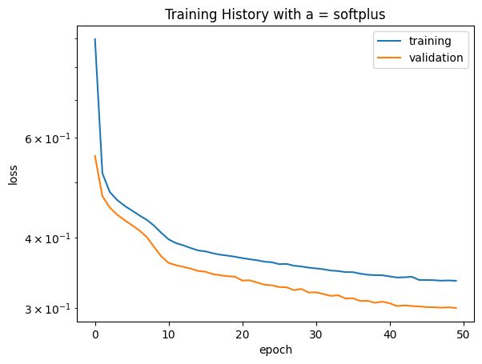
Loss for different activation functions (a)

Slide 11
Conclusion
softsign and tanh produce the least validation loss w.r.t other Activation functions.

