Slide 1
Jet classification and identification using neural network
Baisakhi Mitra

Slide 2
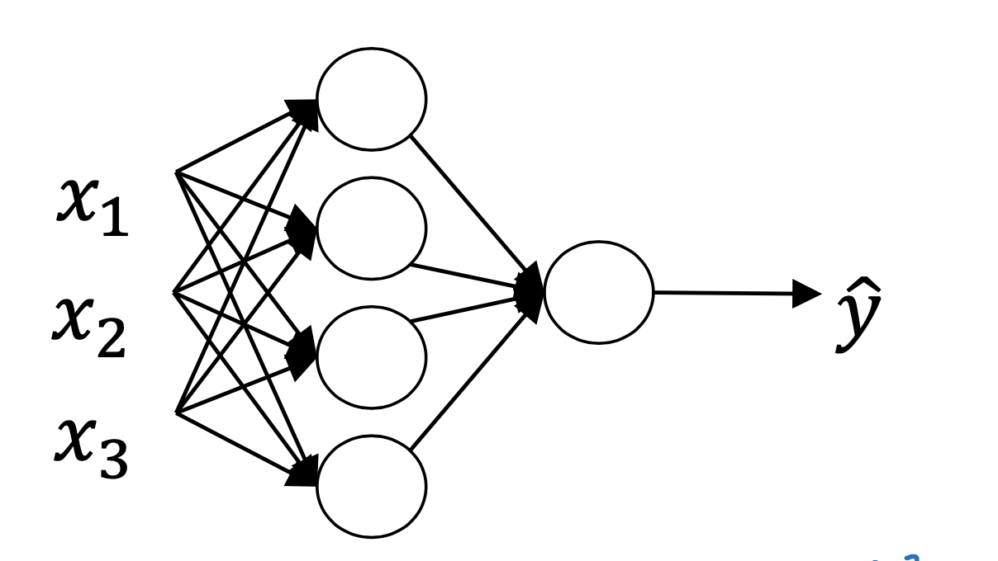

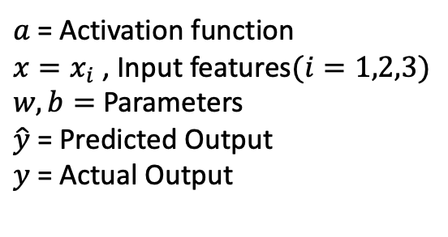
Neural Network: Building Blocks
$$a(w^{T}x+b)$$
$a$ = Activation function
$x=x_{i}$ , Input features$(i=1,2,3)$
$w,b=$ Parameters
$\hat{y}$= Predicted Output
$y$ = Actual Output
Given input features $(x_{i})$ , train Neural Network to minimize loss function: $ℒ=(y−\hat{y}$)

Slide 3
Steps to be performed
Jets: One high-energy particle decays to several low-energy particles. The collection of both decaying particles and decayed particles clustered together forms a jet.
Jet classification: At first, jets need to be distinguished based on the originating particle.
Divide a given dataset into two subsets. One set is used for training the neural network. The other set is used to validate the neural network.
Jet identification: After training and validating the neural network, use it to identify jets based on high-level features of the corresponding physical process.

Slide 4
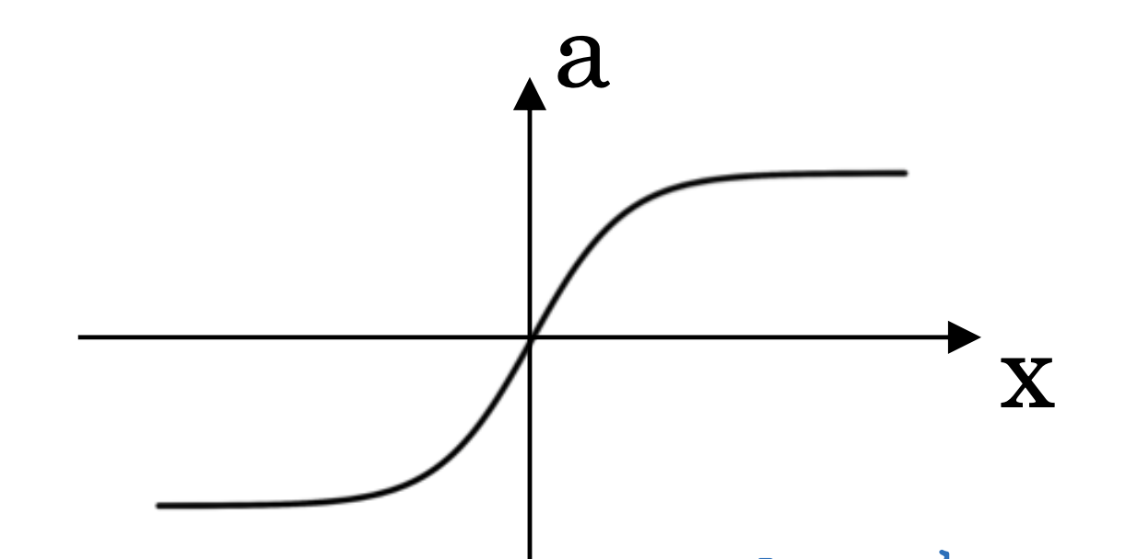
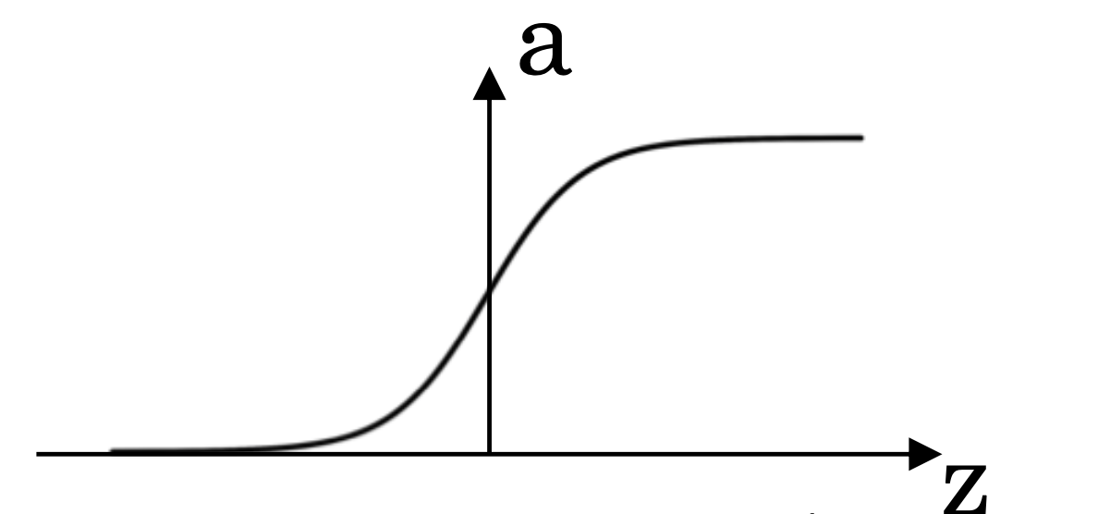
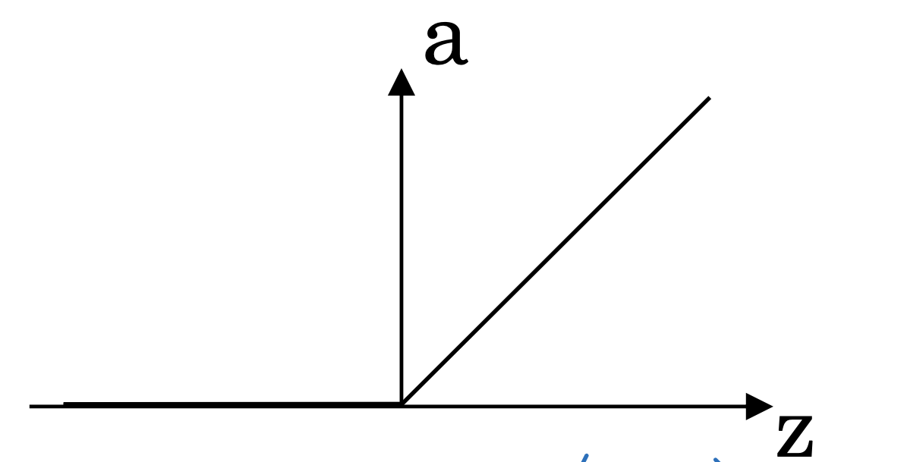
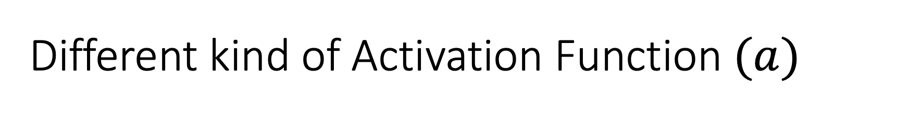
Different kind of Activation Function $(a)$
sigmoid
tanh
ReLU

Slide 5
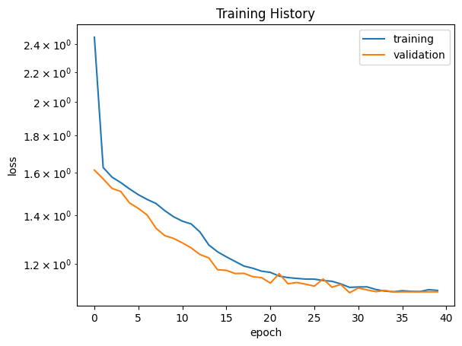
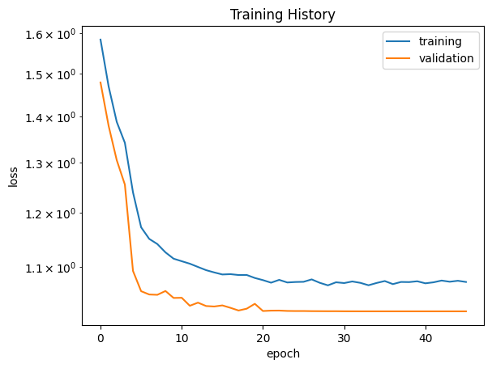
Effect on Loss with different Activation Function
With ReLU
With tanh

