Slide 1
Jet classification and identification using neural network
Baisakhi Mitra

Slide 2
Steps to be performed
Jets: One high-energy particle decays to several low-energy particles. The collection of both decaying particles and decayed particles clustered together forms a jet.
Jet classification: At first, jets need to be distinguished based on the originating particle.
Divide a given dataset into two subsets. One set is used for training the neural network. The other set is used to validate the neural network.
Jet identification: After training and validating the neural network, use it to identify jets based on high-level features of the corresponding physical process.

Slide 3
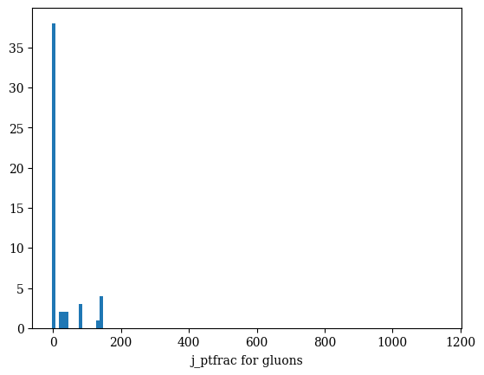
Histograms for different features

