Slide 1
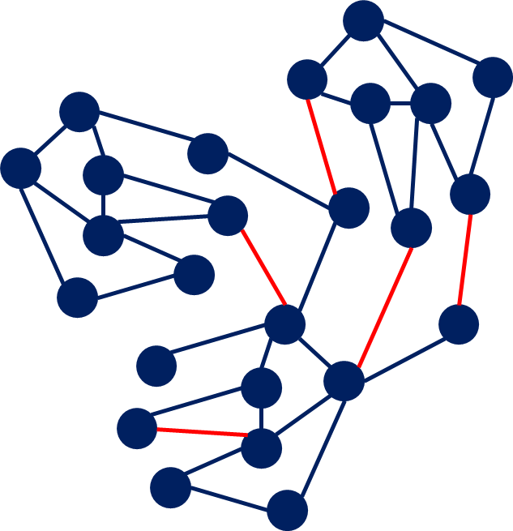
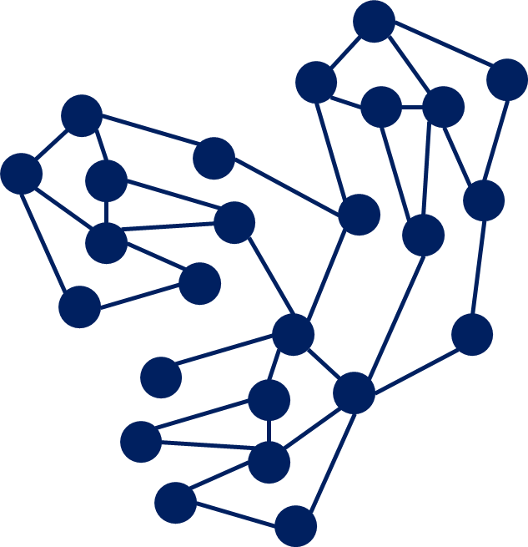
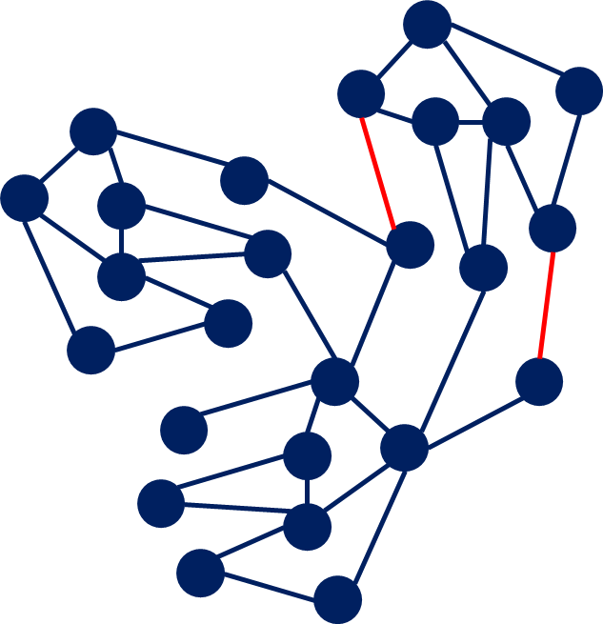
F₁+1,C₂^{max},I₂=0
F₁+1,C₂^{max},I₂=0
F₁+1,C₁^{max},I₂=0
F₁,C₁^{max},I₁=0
F₁,C₁^{max},I₁=1

Slide 3
State S_{t}
Agent
Reward R_{t}
Action A_{t}
Reward R_{t+1}
Environment
State S_{t+1}

