Slide 1
Baruch Makro Mari Mishel
Predict telomere length
Telomere: A telomere is a region of repetitive nucleotide sequences at each end of a chromosome, which protects the end of the chromosome from deterioration or from fusion with neighboring chromosomes.
With every division of the cell, the telomere length is getting shorter and shorter. Cancer patients has shorter telomere than other people with the same age and gander.
GOAL predict patients’ telomere length according to genome and gene mutations.

Slide 2
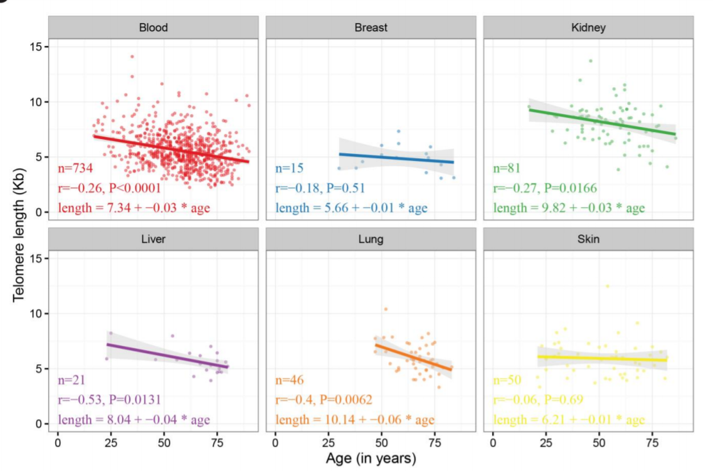
Research for this project
Our project is based on the following research:
Systematic analysis of
telomere length and somatic
alterations in 31 cancer types
Scatter plots for age and normal Telomer Length across each normal tissue type

Slide 3
Gene Ontology annotation project
המידע מהפרויקט מכיל מאגר נתונים על הגנים האנושיים. המאגר חוזה את התוצאה של שילוב מוטציות בשני גנים.
בעזרת מאגר זה ניתן לבנות עץ, שכן כל תוצאה היא האב של שתי המוטציות תחתיו.
The data from GOA project has databases on human genes. The database predicts the outcome on mutations in two genes. Using this database, we are able to build a tree in which the father is the outcome of two gene-children.

Slide 4
Building our Database
We have the following data: Clinical data – has lists of patients with their samples and clinical info such as gender and age. Mutations data – list of genes with mutations for each sample of patient. Only 3 types of mutations were taken: Missense Mutation, Frame Shift Del, Nonsense Mutation
The telomere lengths in the database are binary. The mean lengths is found (~1), length above are written as 1 and bellow as 0.
Crossing those databases with the patients’ database from previous research, we created a new database with genes binary vector for each sample- 1 for gene with a mutation and 0 for gene without a mutation.
Finally, using cross validation (20%-80%), an algorithm was built to predict telomere lengths.

Slide 5
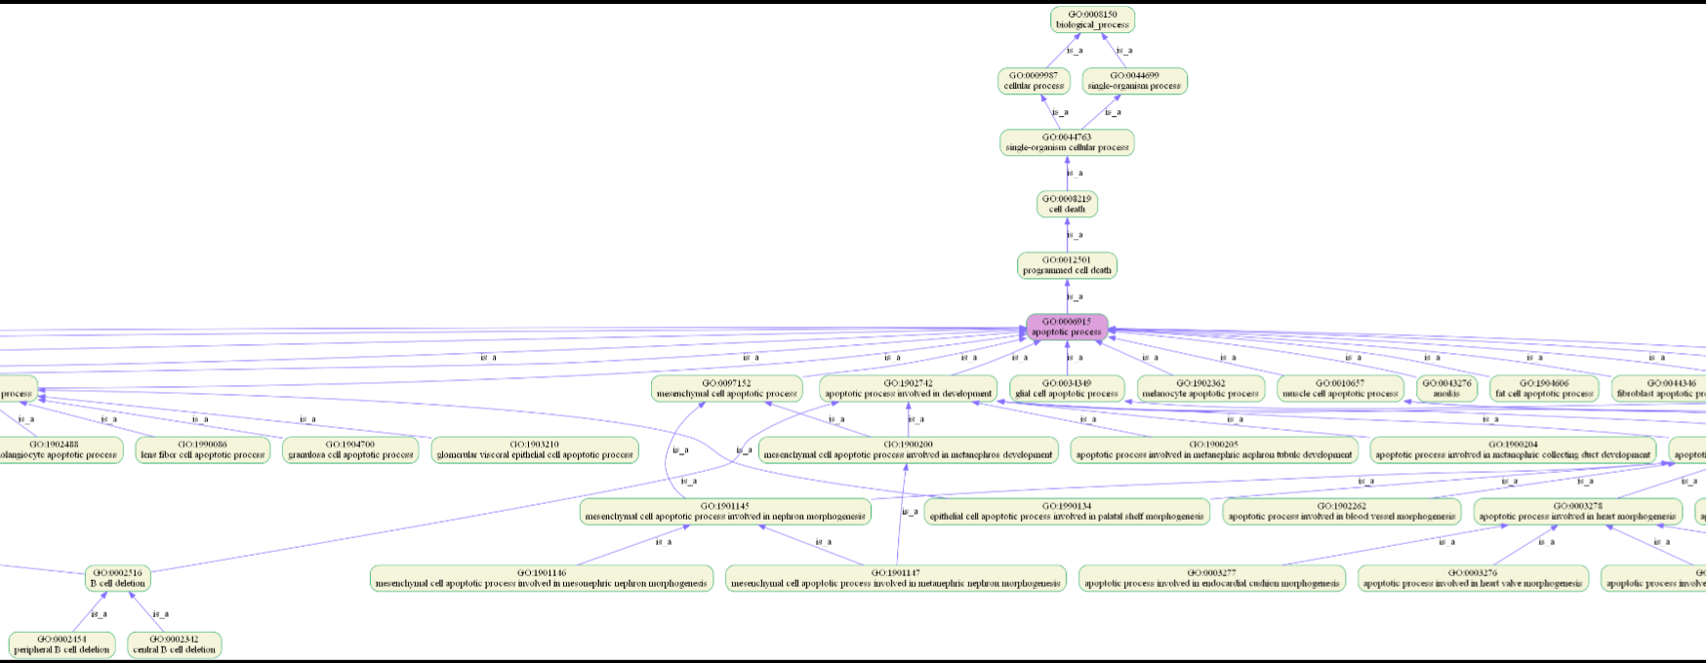
Ontotype Algorithm
The algorithm builds a graph with genes in leaves and GO terms in vertexes. Every sample with gene-vector influences graph values. Sub-graph:

Slide 6
Random forest classifier
Random Forest Algorithm
We used a random forest classifier algorithm with cross validation and calculate the ROC curve and AUC. This process was run twice:
On samples database with gander, age and gene-vector.
On samples database with only gender and age.
If the first run gives better results, we can conclude the genes and mutations data is useful in predicting telomere lengths.

Slide 7
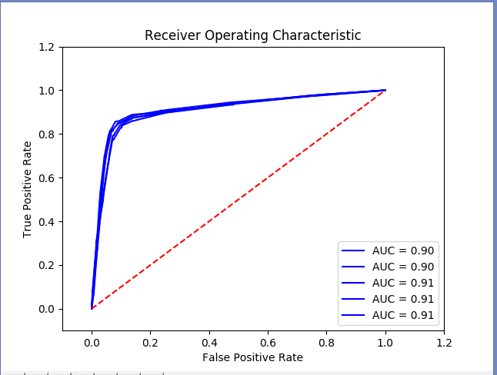
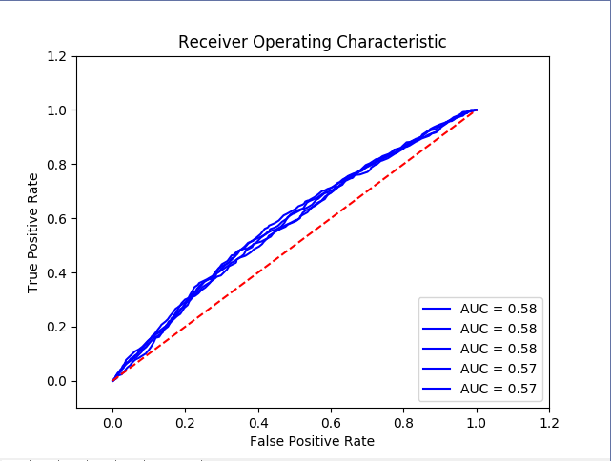
Prediction Results
First run results: AUC of Random Forest Classifier: 0.912412733529
Second run results:
AUC of Random Forest Classifier: 0.578167763269

