Slide 1
Predict telomere length
Telomere: A telomere is a region of repetitive nucleotide sequences at each end of a chromosome, which protects the end of the chromosome from deterioration or from fusion with neighboring chromosomes.
With every division of the cell, the telomere length is getting shorter and shorter. Cancer patients has shorter telomere than other people with the same age and gander.
GOAL predict patients’ telomere length according to genome and gene mutations.

Slide 2
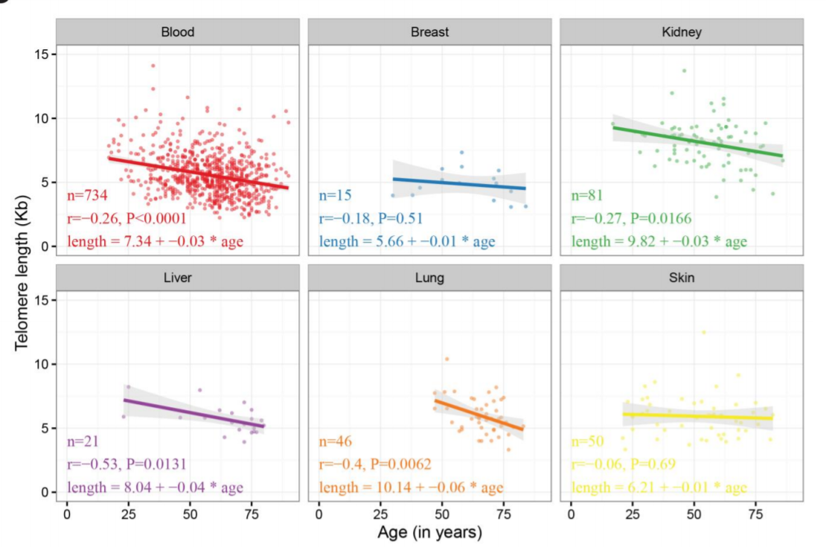
Research for this project
Our project is based on the following research:
Systematic analysis of
telomere length and somatic
alterations in 31 cancer types
Scatter plots for age and normal Telomer Length across each normal tissue type

Slide 3
Gene Ontology
Gene ontology (GO) is a major bioinformatics initiative to unify the representation of gene and gene product attributes across all species.
More specifically, the project aims to:
1) maintain and develop its controlled vocabulary of gene and gene product attributes
2) annotate genes and gene products, and assimilate and disseminate annotation data.
3) provide tools for easy access to all aspects of the data provided by the project, and to enable functional interpretation of experimental data using the GO, for example via enrichment analysis.

Slide 4
Building our Database
We have the following data: Clinical data – has lists of patients with their samples and clinical info such as gender and age. Mutations data – list of genes with mutations for each sample of patient. Only 3 types of mutations were taken: Missense Mutation, Frame Shift Del, Nonsense Mutation
The telomere lengths in the database are binary. The mean lengths is found (~1), length above are written as 1 and bellow as 0.
Crossing those databases with the patients’ database from previous research, we created a new database with genes binary vector for each sample- 1 for gene with a mutation and 0 for gene without a mutation. This database contains 11132 samples. There are 16395 different genes in the vector. An average sample has data about 300 genes.
Finally, using cross validation (20%-80%), an algorithm was built to predict telomere lengths.

Slide 5
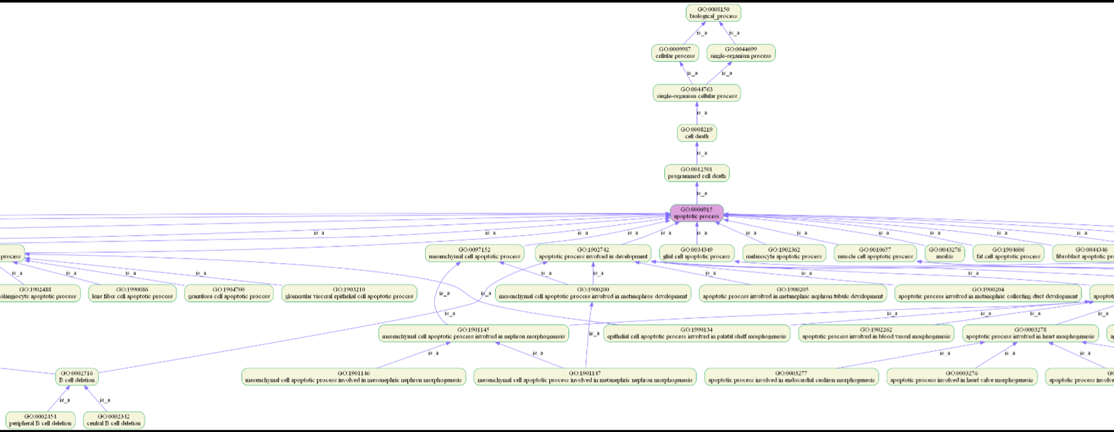
Ontotype Algorithm
The algorithm builds a graph with genes in leaves and GO terms in vertexes. Every sample with gene-vector influences graph values. There 17249 are features of age, gender and go-terms. Sub-graph:

Slide 6
Random Forest Algorithm
We used a random forest classifier algorithm with cross validation and calculate the ROC curve and AUC. This process was run three times:
On samples database with gander, age and gene-vector.
On samples database with only gender and age.
On samples database with gender, age and gene-vector, while the genes are randomized before the ontotype process for checking the corectness of the first run.
If the first run gives better results than the other two, we can conclude the genes and mutations data is useful in predicting telomere lengths.

Slide 7
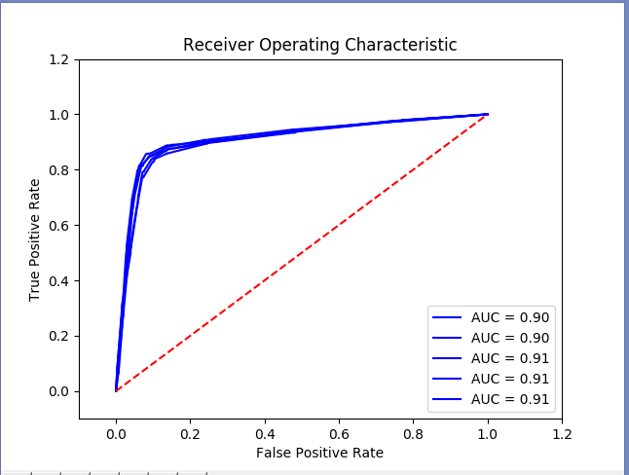
Prediction Results
Third run results: AUC of Random Forest Classifier: 0.912412733529

Slide 8
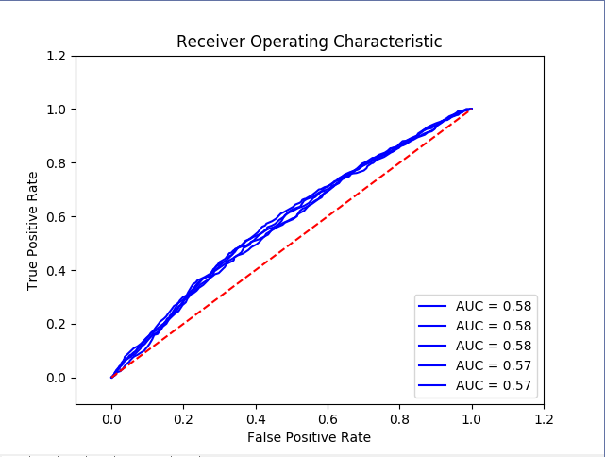
Prediction Results
Second run results:
AUC of Random Forest Classifier: 0.578167763269

Slide 9
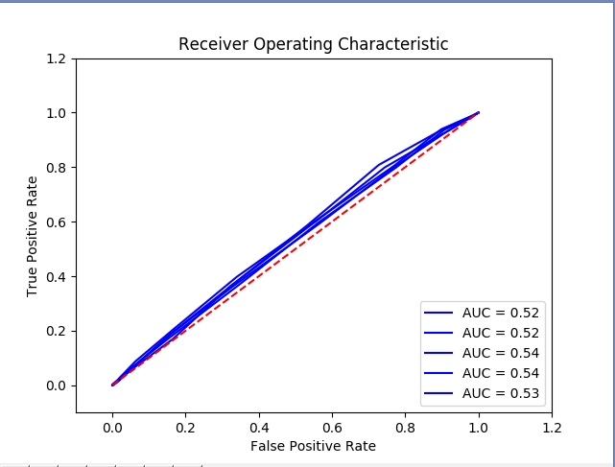
Prediction Results
Third run results: AUC of Random Forest Classifier: 0.532217214098
The results here are similar to the second run, and very far from the first run results. Therefore, the learning process was not affected by non biological parameters. Also, the results from the first run indicate about a connection between the telomere length and gene mutation.

