Slide 1
MAKE
DESAI SATYADHYAN

Slide 2
Contents
What is make?
Makefile
Working of make
Variable assignment
Automatic variables
Phony targets
VPATH and vpath
Recursive make

Slide 3
Make
Make is an utility to build and rebuild the program.
Make utility automatically determines which pieces of large program need to be recompiled and issues command to recompile them.
Determines
Makefile
Modification time

Slide 4
Makefile
Makefile describes the relationship among the files in program.
Rule in makefile looks like:
target: prerequisite....
<tab>recipe
<tab>recipe
Target: It is name of file generated by program, usually object and executable files.
Prerequisite:These are name of files on which target depends
Recipe:It is action that make carries out
Each recipe begins with tab character
# symbol is used to comment lines

Slide 5
Contd….
Simple makefile:
run : main.o sum.o diff.o prod.o div.o
gcc -o run main.o sum.o diff.o prod.o div.o
sum.o : sum.c
gcc -c sum.c
diff.o : diff.c
gcc -c diff.c
prod.o : prod.c
gcc -c prod.c
div.o : div.c
gcc -c div.c

Slide 6
Naming convention for makefile
Makefile name
Standard
Non-Standard
Filename
/Filename.mk
/Filename.make
GNUmakefile
Makefile
makefile
To run => make
To run => make -f filename
/ make --file filename

Slide 7
Working of makefile
Searches for makefile in current directory.
Starts from first rule ( Default goal ). This can be changed by
passing argument through command line.
Ex:- make target_name
assigning value to .DEFAULT_GOAL variable.
Ex:- .DEFAULT_GOAL = target_name

Slide 8
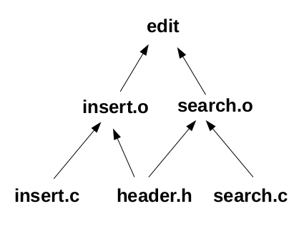
Contd….
constructs a dependency tree.
It executes all the dependencies that target depends on.
While recompiling the program it compares the timestamp of files with that of targets, then takes necessary decision.
Ex:-
edit : insert.o search.o
gcc -o insert.o search.o
insert.o:insert.c header.h
gcc -c insert.c header.h
search.o:search.c
gcc -c search.c header.h

Slide 9
Variables in makefile
Variables make makefile simpler.
#storing names of all prerequisites in variable obj
obj = main.o sum.o diff.o prod.o div.o
#substitution of variable obj
run : $(obj)
gcc -o run $(obj)
sum.o : sum.c
gcc -c sum.c
diff.o : diff.c
gcc -c diff.c
prod.o : prod.c
gcc -c prod.c
div.o : div.c
gcc -c div.c
.PHONY : clean
clean:
rm *.o

Slide 10
Contd..
Letting make deduce its own recipes.
#storing names of all prerequisites in variable obj
obj = main.o sum.o diff.o prod.o div.o
#substitution of variable obj
run : $(obj)
gcc -o run $(obj)
$(obj) : header.h
clean:
rm *.o

Slide 11
Variable assignment
Simple assignment (:=)
  ex:- CC := gcc
Recursive assignment (=)
  ex:- CC = gcc
Conditional assignment (?=)
  ex:-CC ?= gcc
Appending (+=)
  ex:- CC += gcc
  CC += -O

Slide 12
Automatic variables
Automatic variables are used in action matching filename.
$@ = Specifies the target name.
$< = Specifies the first prerequisite name.
$^ = Specifies all the names of files in prerequisite followed by spaces.
$? = Specifies the name of file that are newer than target .

Slide 13
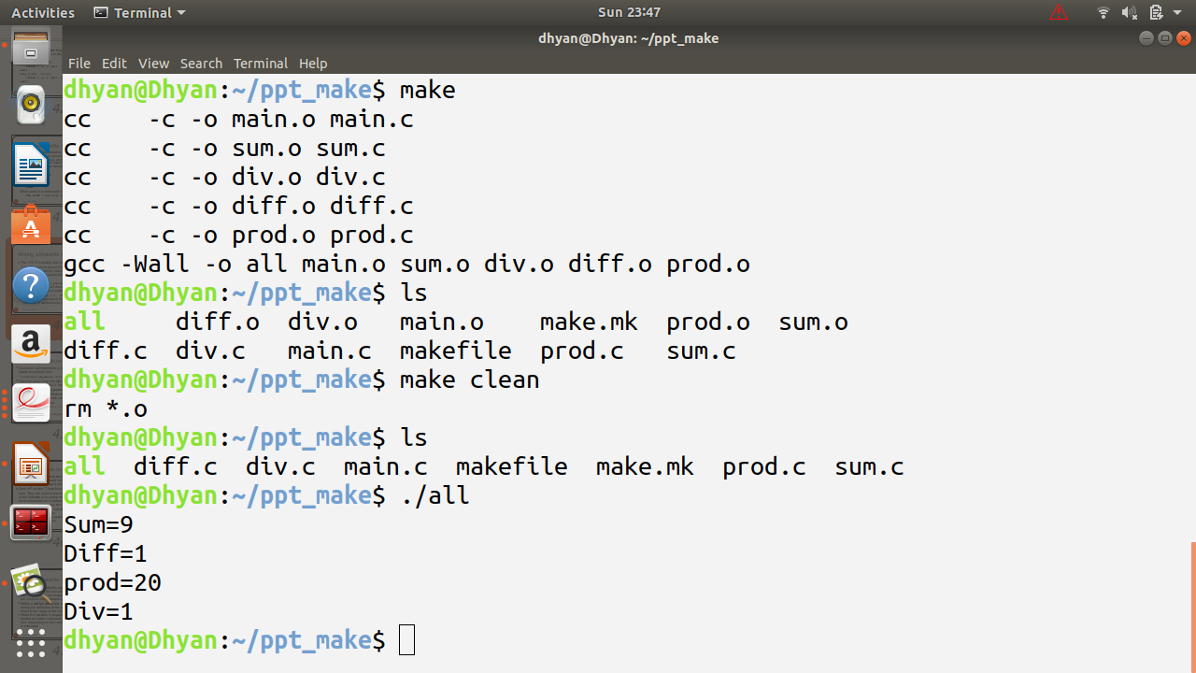
Contd..
Makefile using automatic variables
src = main.o sum.o div.o diff.o prod.o
flags = -Wall -o
all : $(src)
gcc $ (flags) $@ $^
main.o:
sum.o:
diff.o:
div.o:
.PHONY : clean
clean :
rm *.o

Slide 14
VPATH variable
The VPATH variable
Value of VPATH tells, which all directories make should search .
For example,
VPATH = src:../headers
specifies a path containing two directories, src and ../headers, which make searches in
that order
the following rule,
main.o : main..c
is interpreted as :-
main..o : src/main.c

Slide 15
vpath directive
It is similar to VPATH variable, but it is more selective.
vpath string contains '%' character.
Ex:-
vpath %.h ../headers
Vpath directive tells make to search for all files ending with .h in headers directory.

Slide 16
Wildcard variable
A single file name can specify many files using wildcard characters.
Wildcard characters are * , ? , […]
Wildcard expansion takes place in target, rule, prerequisite.
Ex:-
Run : main.o sum.o diff.o prod.o div.o
gcc -o run *.o
Run : *.o
gcc -o run *.o

Slide 17
Contd..
Example1:-
var = *.o
run : $(var)
gcc ­-o run $(var)
The above examples works fine, but not advisible
Example2:-
var = $(patsubst %.c,%.o,$(wildcard *.c))
run : $(var)
gcc -­o run $(var)
OR
var = $(wildcard *.c)
obj = $(var: .c = .o)

Slide 18
Phony Targets
Don’t contain any prerequisite.
Avoid filename clashes.
.PHONY : Clean
Clean :
<tab> rm *.o

Slide 19
Recursive makefile
Makefiles in one or more subdirectories that are also executed by
running make commands in the parent directory
Example:-
subsytem:
cd subdir && $(MAKE)
subsytem:
$(MAKE) -­C subdir

Slide 20
Contd..
Recursive makefile.
SUBDIRS = main sum diff prod div
obj = $(wildcard main/*.o sum/*.o diff/*.o div/*.o prod/*.o )
all: subdirs $(obj)
gcc -o $@ $(obj)
subdirs:
@for dir in $(SUBDIRS); do \
$(MAKE) -C $$dir; \
done

Slide 21
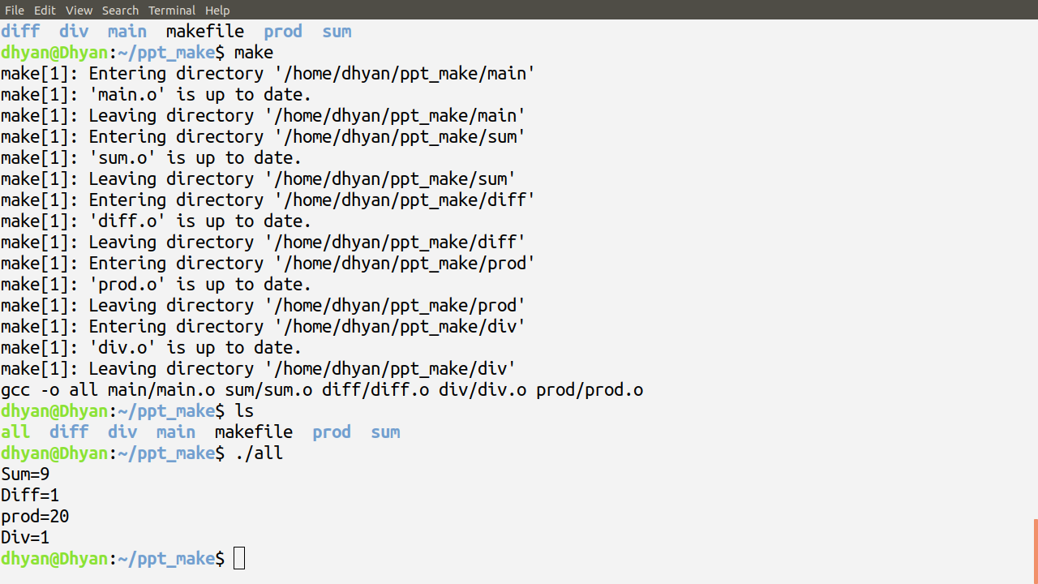
Contd..

Slide 22
Summary
Make
Makefile

Slide 23
References
https://www.gnu.org/s/make/manual/make.pdf

