Slide 1
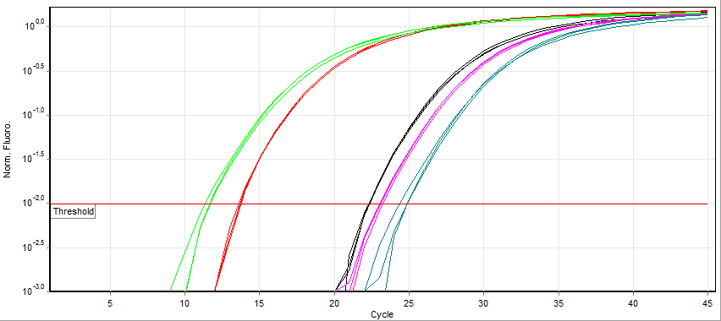
Ct-value (~ 14)

