Slide 1
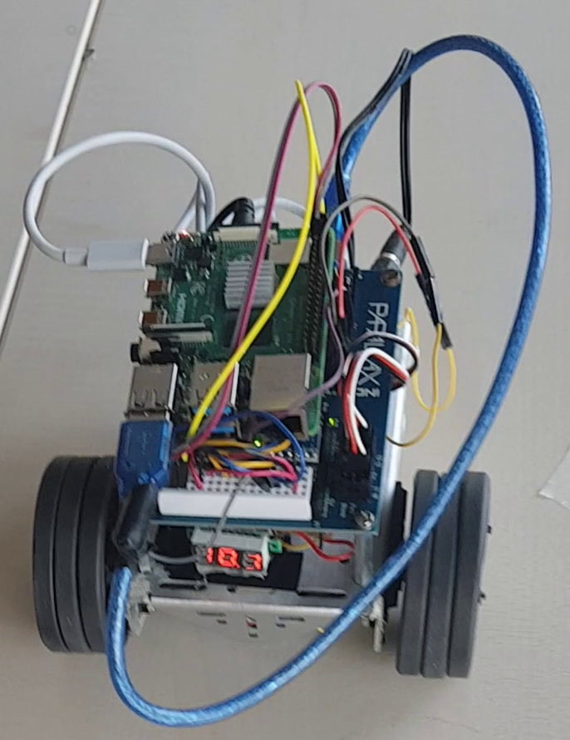
actions
agent
target
position
observations

