Slide 1

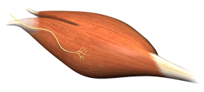
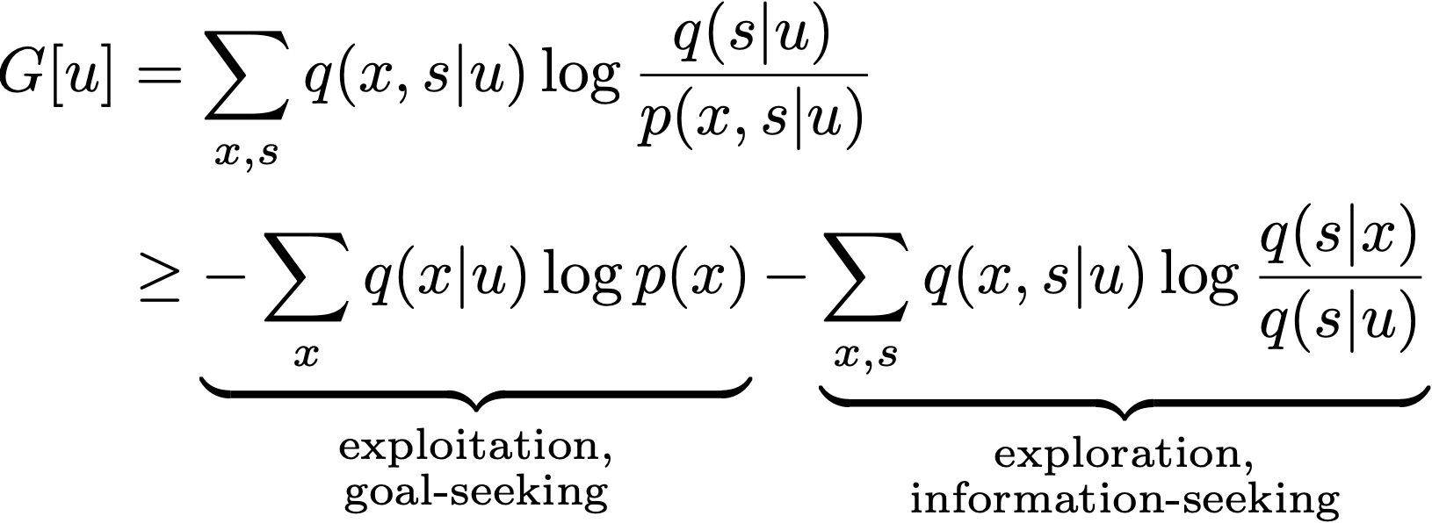

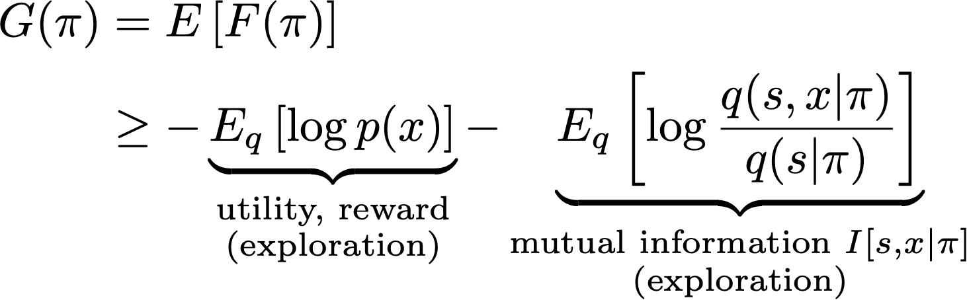
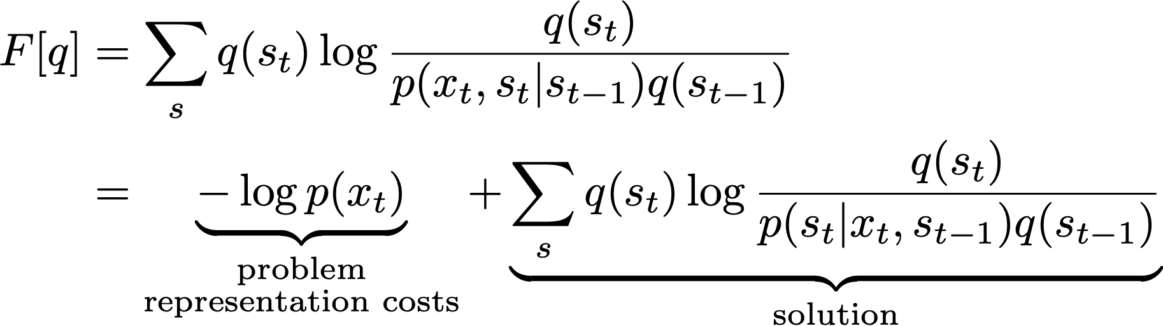

one solution approach to all problems
The Brain’s Design Cycle: Free Energy Minimization
no exploration-exploitation dilemma!
real-time
action
perception

Slide 2

real-time
action
perception

