Slide 1

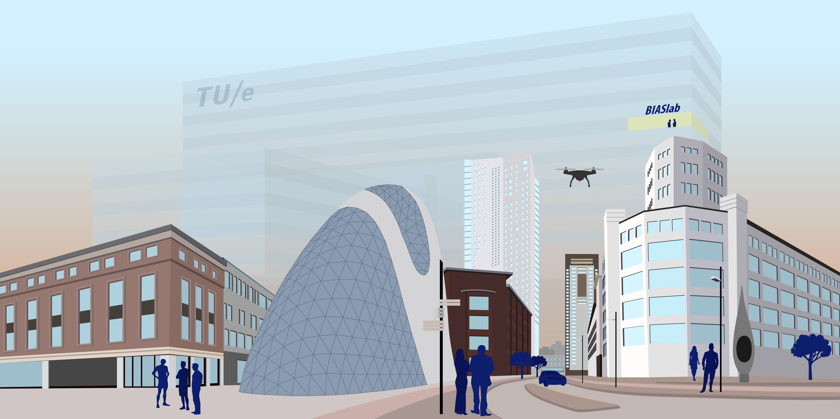

Natural Artificial Intelligence

Slide 2
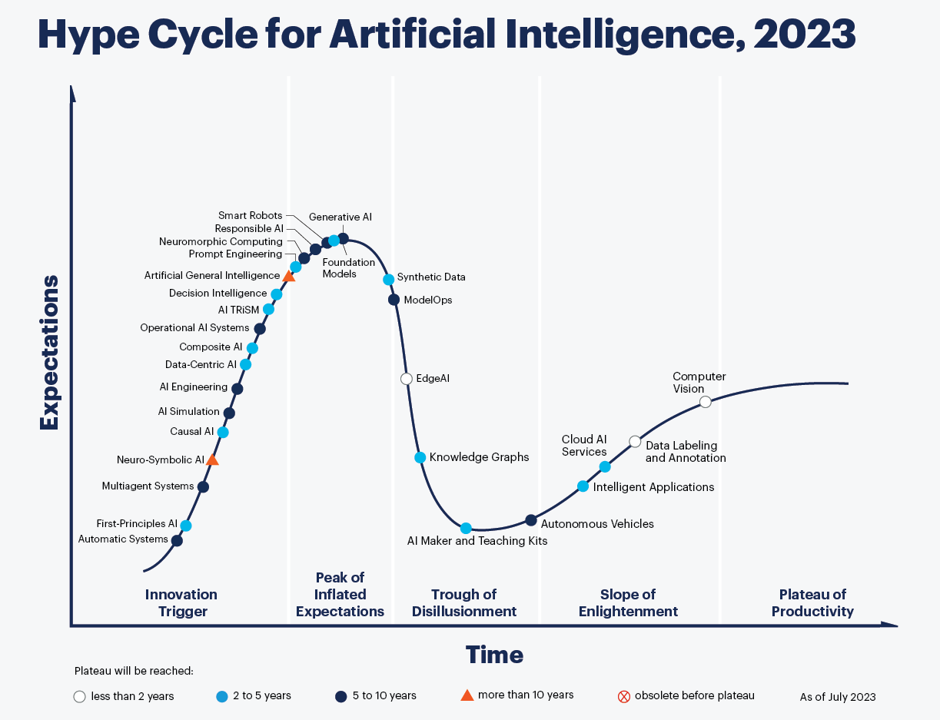
Source: gartner.com, 17-aug 2023
Generative AI
First-Principles AI
(Natural AI)

Slide 3
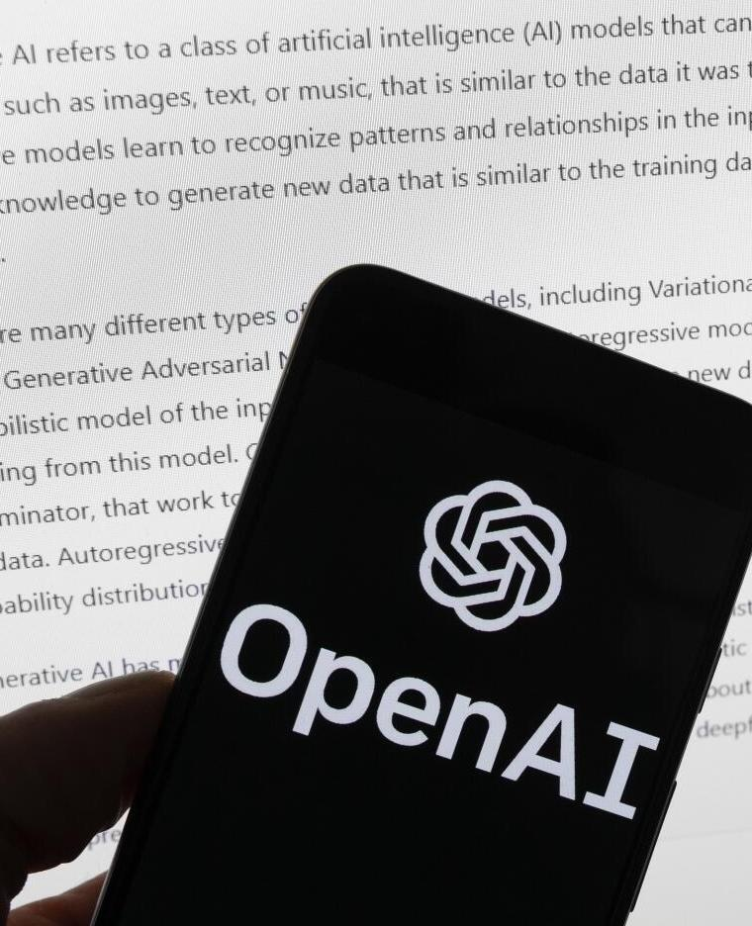


Generative AI
Natural Intelligence
Natural AI
~10 trillion (10^14) synapses
~100 billion (10^11) neurons
~10 million sensory neurons
~50K muscle spindles
~850K km length of nerve fibers
no real-time
learning
real-time
learning
hallucination
corrected
hallucination
The brain knows nothing about control theory, signal processing, (computer) vision, machine learning, etc.
“Everything is what it is because it got that way.” (D'Arcy Wentworth Thompson, 1860-1948)
resource-
hungry
0 engineers,
20 watts
black box
explainable
Music, text, video generation
robot, drone
autonomous driving
productivity
smart cities
extended reality

Slide 4
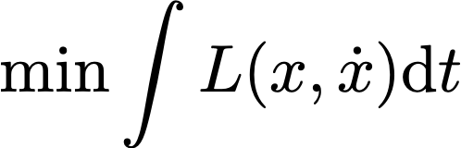
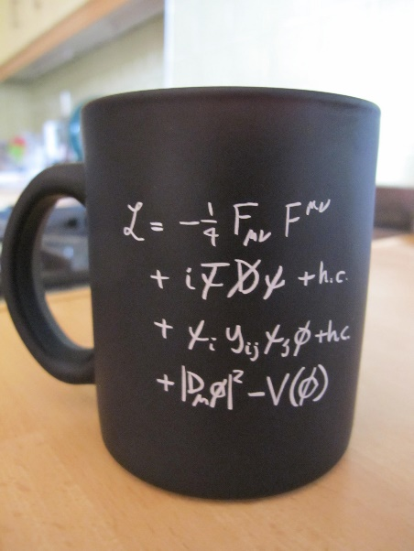
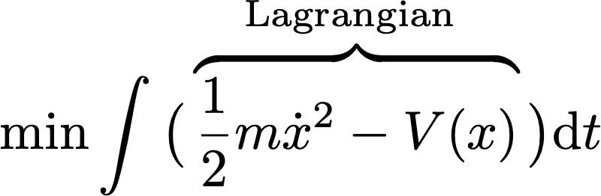
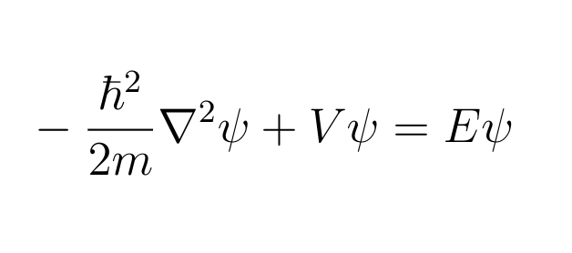
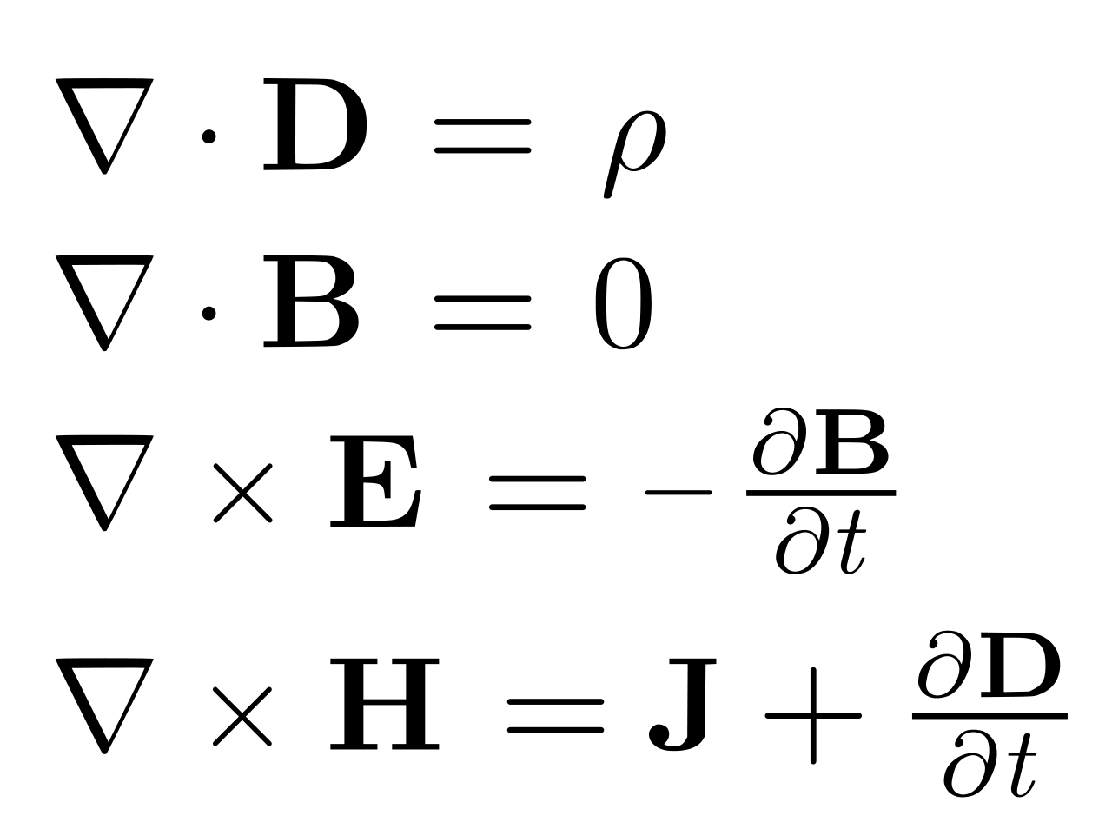
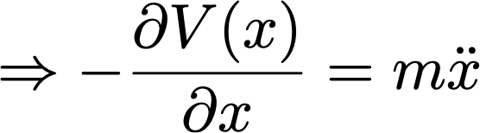
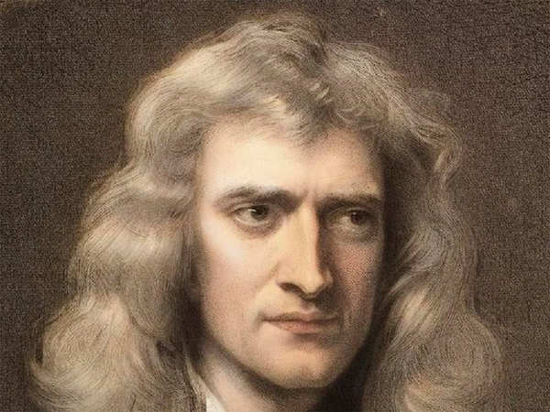
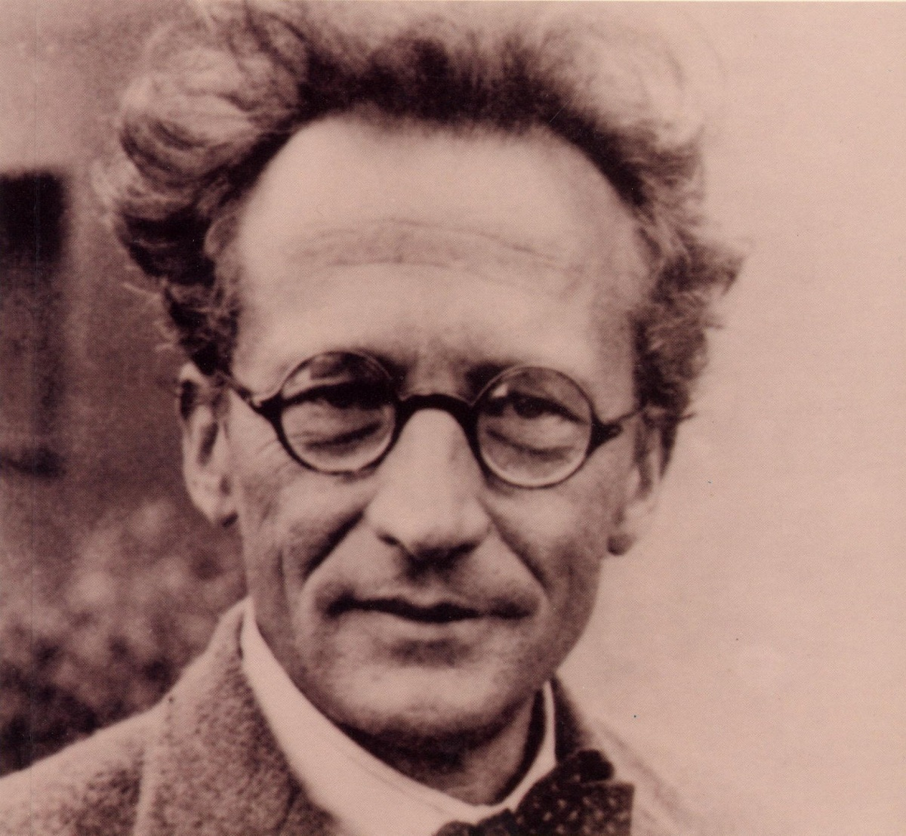
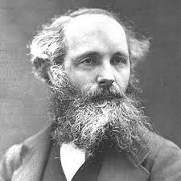



The Principle of Least Action
“In nature, energy differences of any kind are neutralized as fast a possible”
$$t_{0}$$
$$t_{1}$$
$$m$$
Lagrangian of
Standard Model
Of Physics
Movement of
big things
(classical mechanics)
Movement of
small things
(quantum mechanics)
Movement of
electromagnetic fields
(electrodynamics)
Isaac Newton
Erwin Schrodinger
James C. Maxwell

Slide 5


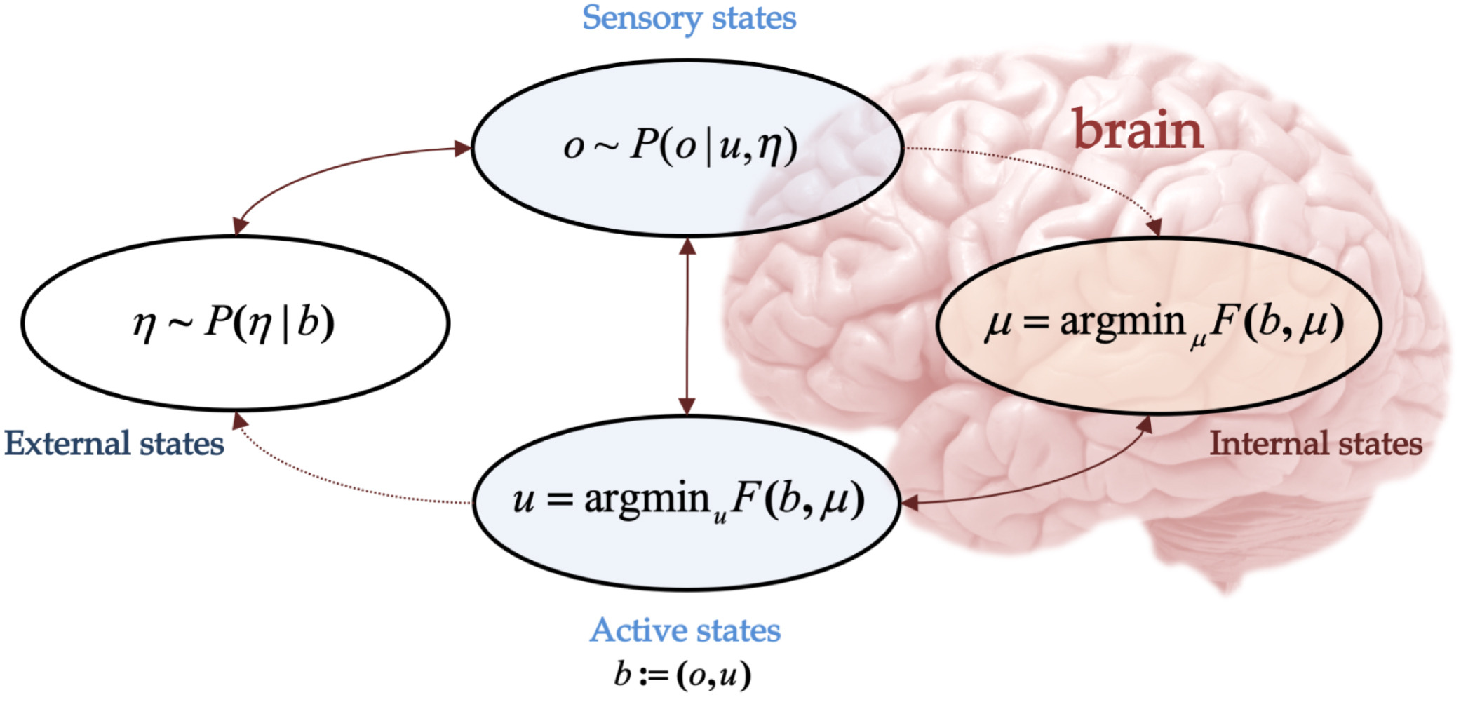
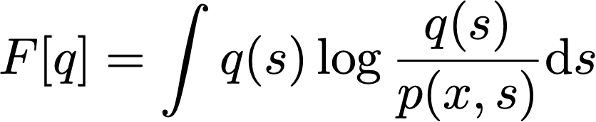
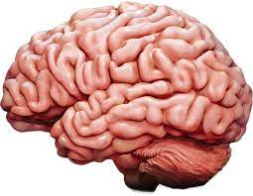

The Free Energy Principle
and that’s all brains do!!
Movement of
beliefs
(Bayesian mechanics)
Karl Friston
The Gardener, by Giuseppe Arcimboldo, ca 1590

Slide 6
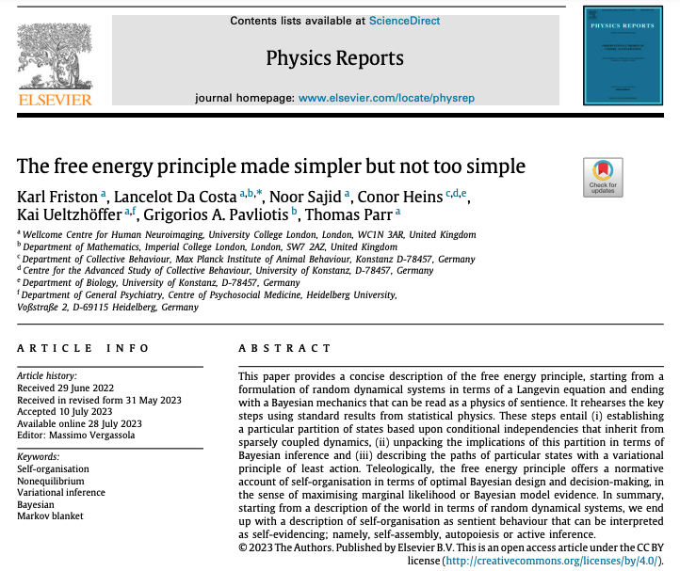
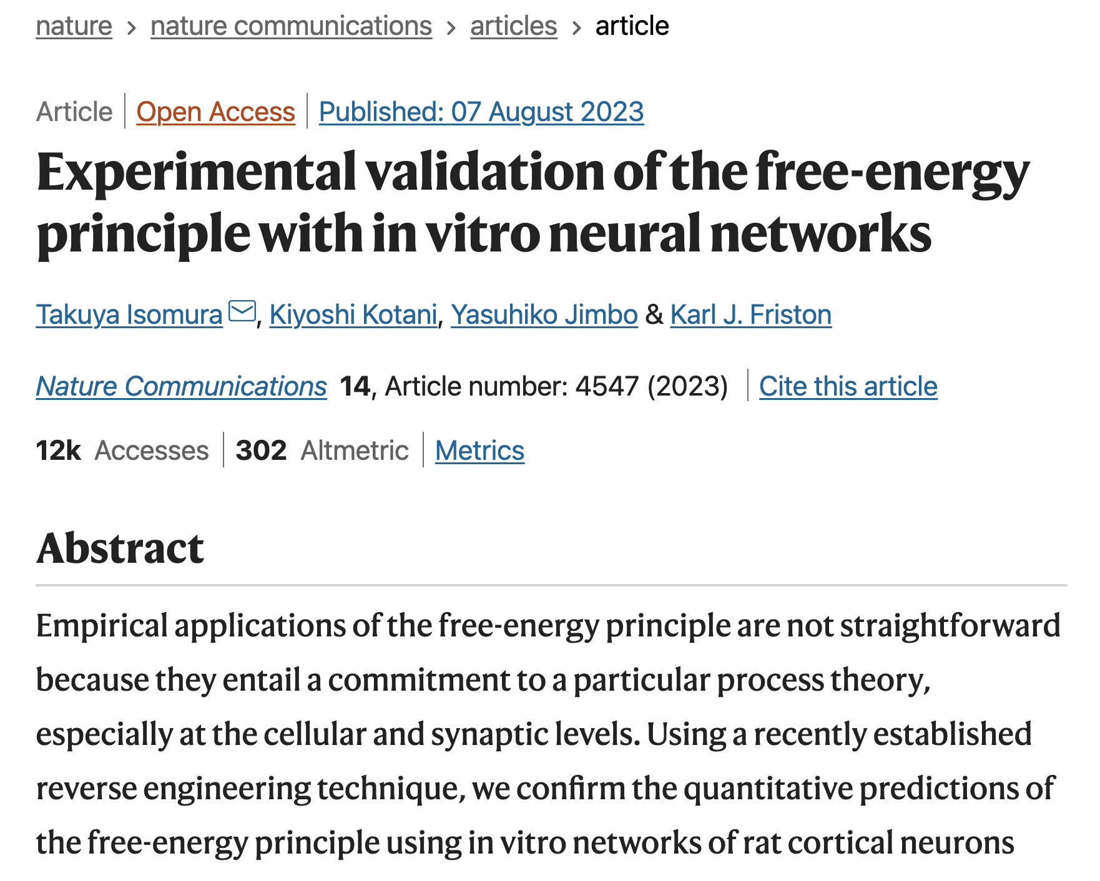
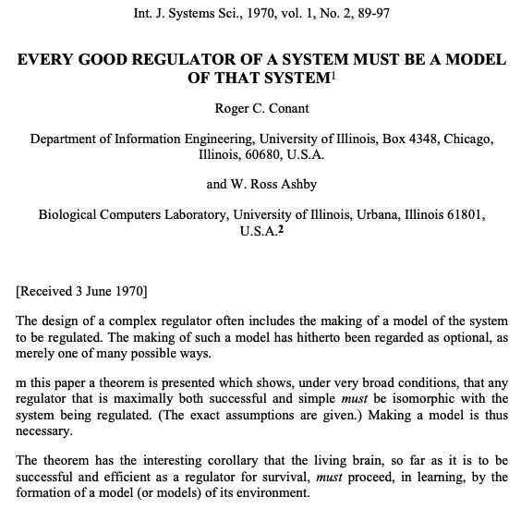
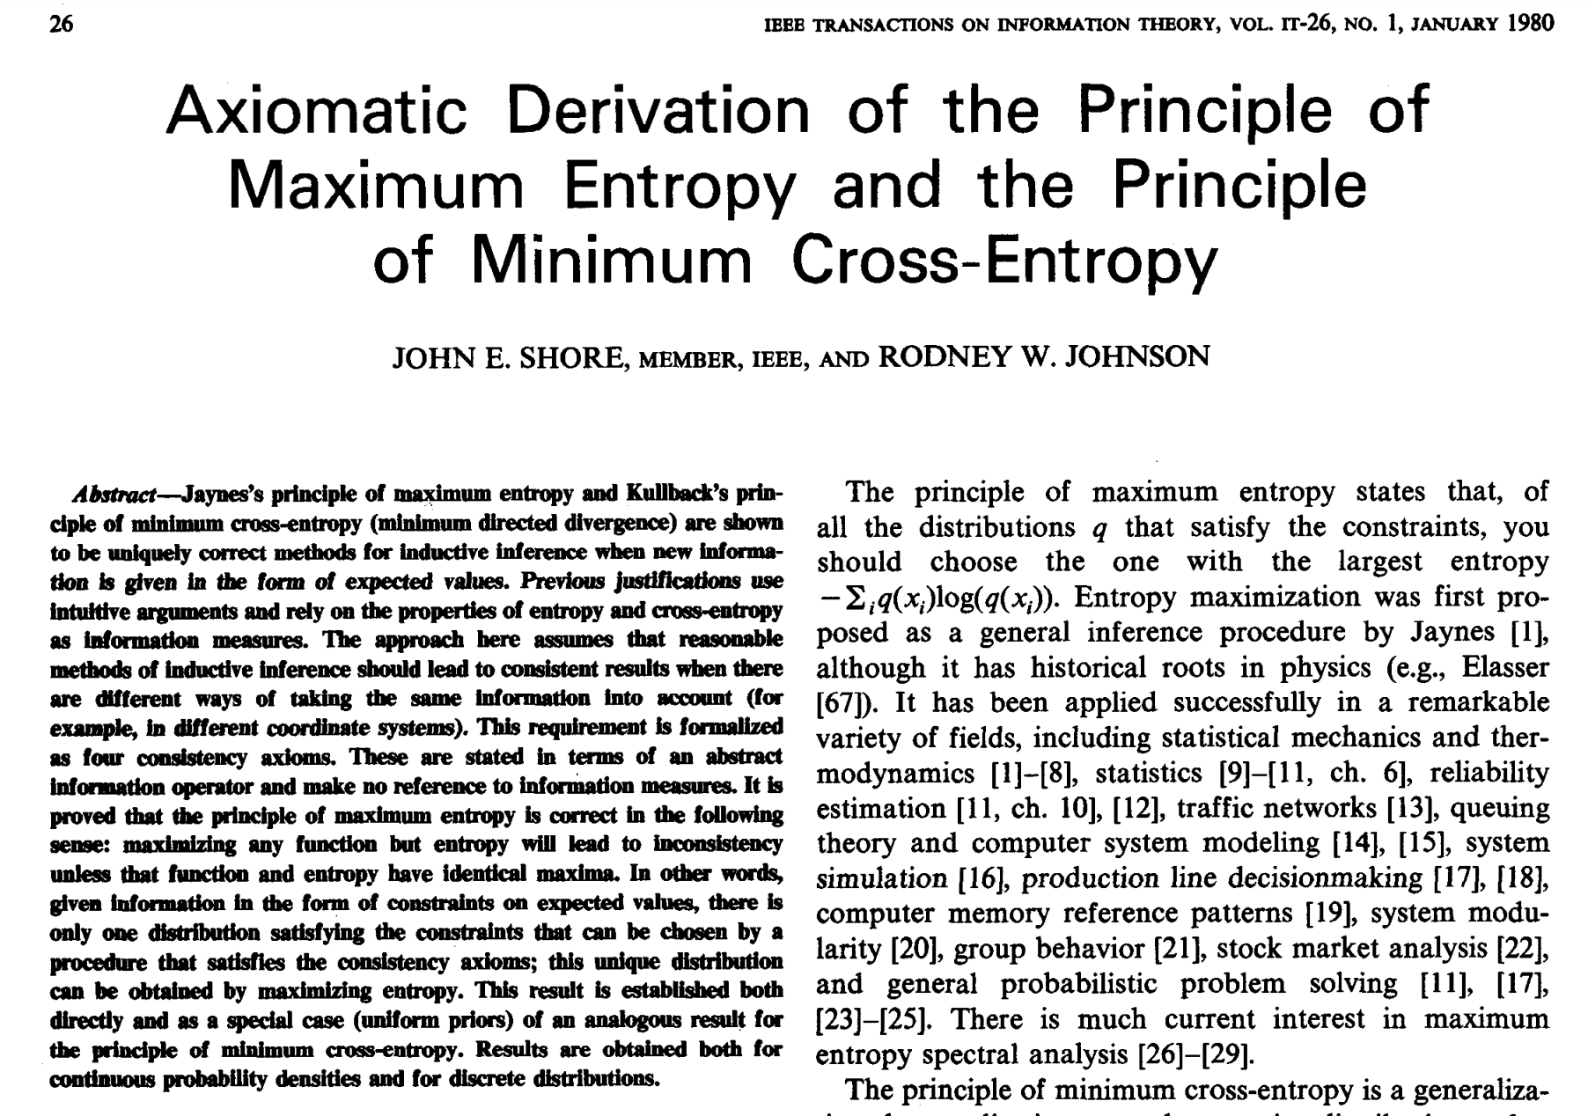
FEP Evidence
Physics
Perception
Cybernetics
Math/stats
In-vitro

Slide 7
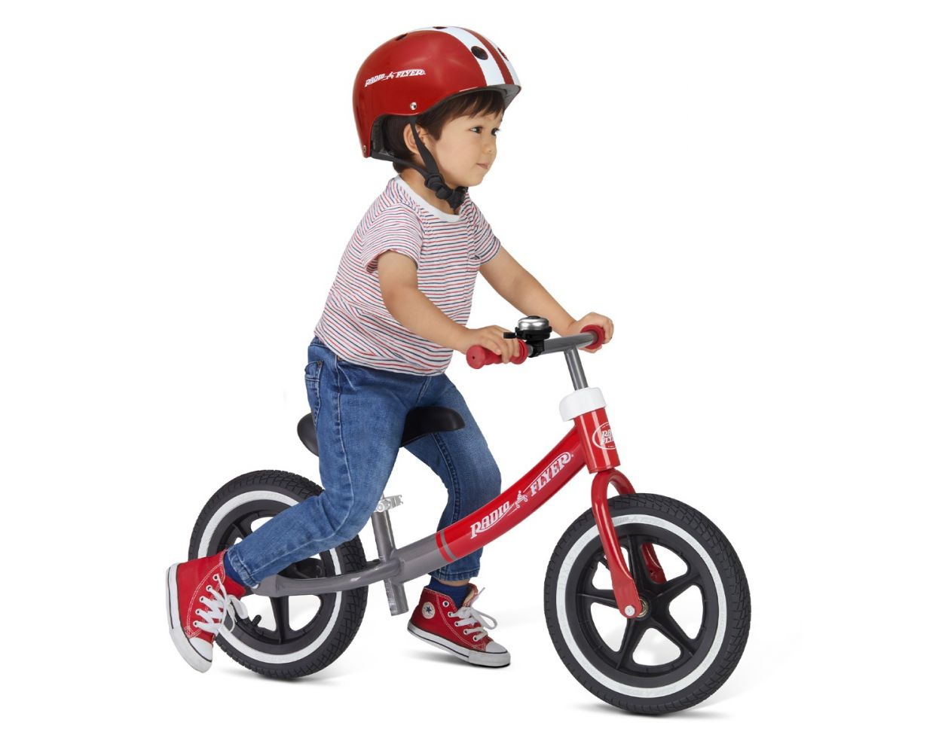

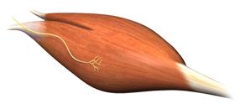


Active Inference (AIF) is an Automated Bayes-optimal
Scientific Inquiry Loop with an Engineering Twist
actions / control
Goal Constraints
“keep feet off the ground”
Bayes-optimal
trial design
Probabilistic
Generative
Model
Bayes-optimal
perception
(+ learning)
sensorium

Slide 8

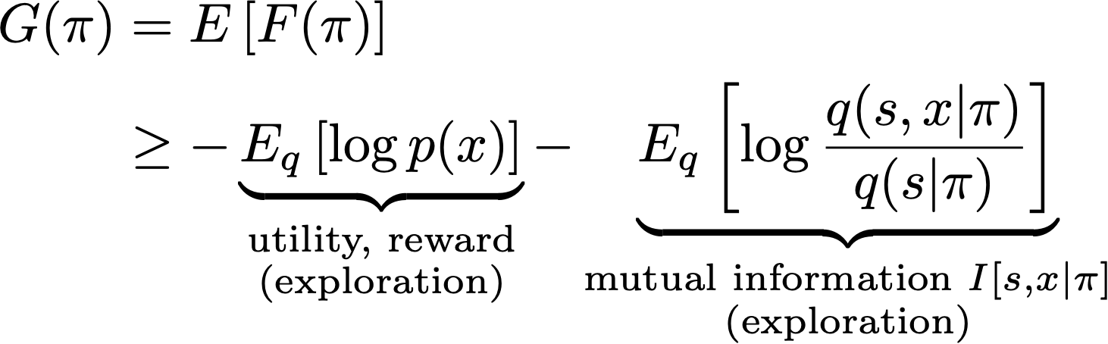
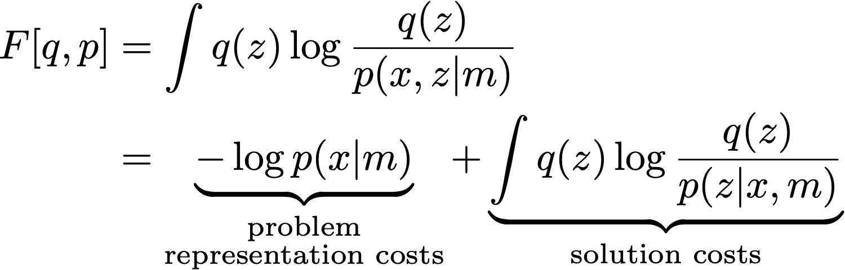
The Engineering Challenge
  neural self-organization (Free Energy Principle)
  Natural Artificial Intelligence
VFEM is the only ongoing process for perception, behavior, learning, ...
VFEM is the only ongoing process for signal processing, control, machine learning, …

Slide 9
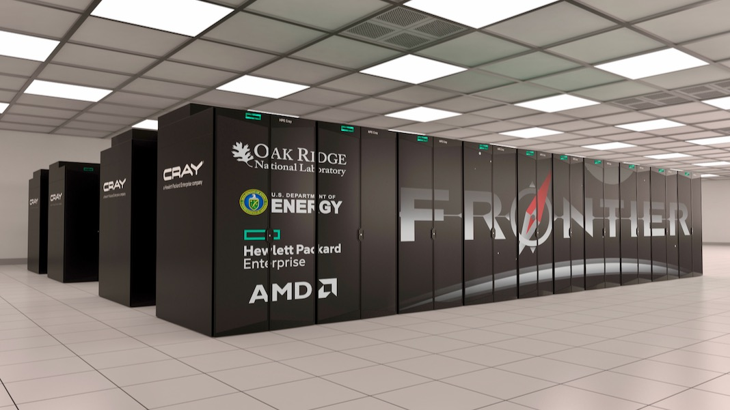
The Computational Task
Spontaneous (automated) minimization of a very-high dimensional, time-varying function in real-time for a few watts ☹
Size: >10¹⁴ (100 trillion) synapses
Sensing: ~10⁷ (10 million) bits/sec
Power: <20 Watts
Latency: msec (real-time)
Frontier Supercomputer (~ 1 exaflops*)
40 Mega-Watts
Consumes about 1 million times more power for similar computational load.
*: at least "10¹⁸ IEEE-754 Double Precision operations per second

Slide 10
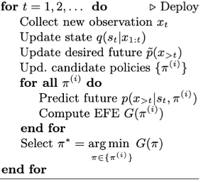
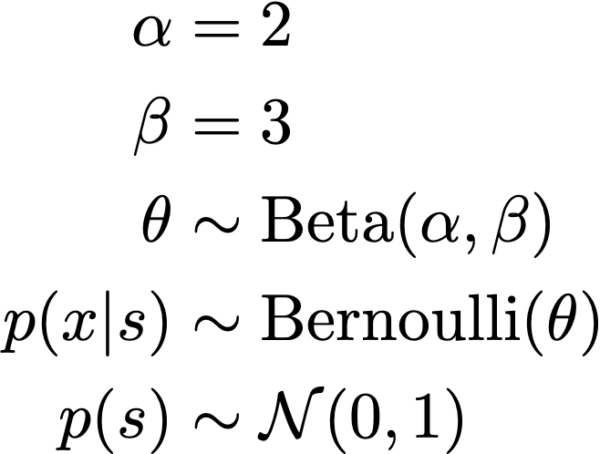
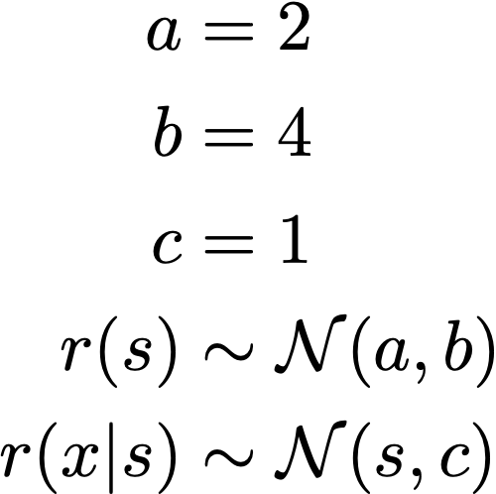

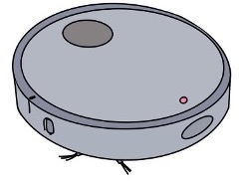



Toward User-friendly Synthetic AIF Agent Design
Rewarding behavior
“Move around apartment and apply suction until the floor is clean. Do not touch objects. When done, return to dock.”
Long-term goal
Automated Model, Prior and Inference Specification
Automated Inference
Specify Model
Specify Prior
Specify Inference
$$p(x,s,u,θ)$$
$$r(x,s)$$
few specialists

Slide 11
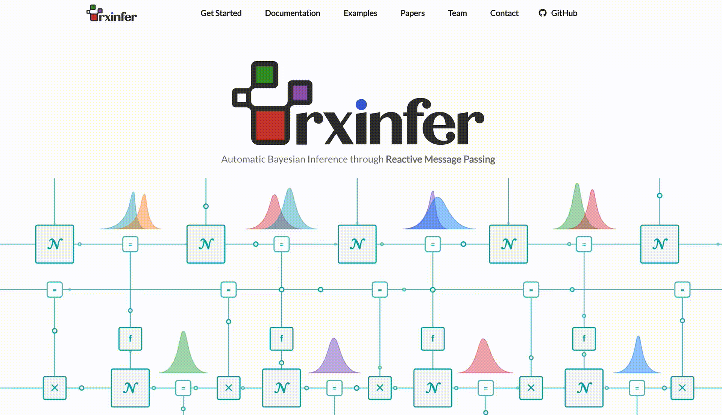
A Software Toolbox for Scalable, Real-time, Automated Free Energy Minimization
http://rxinfer.ml

Slide 12

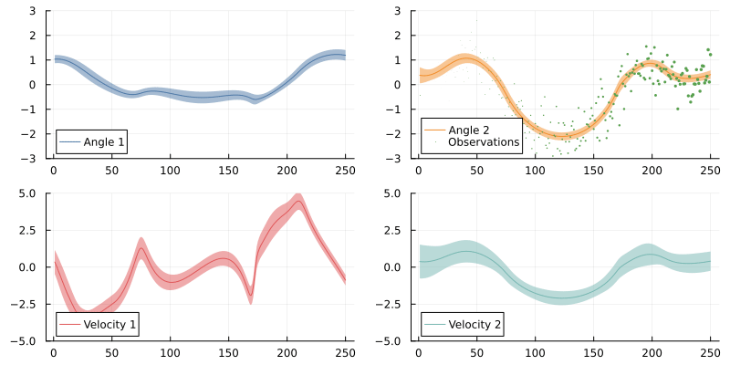
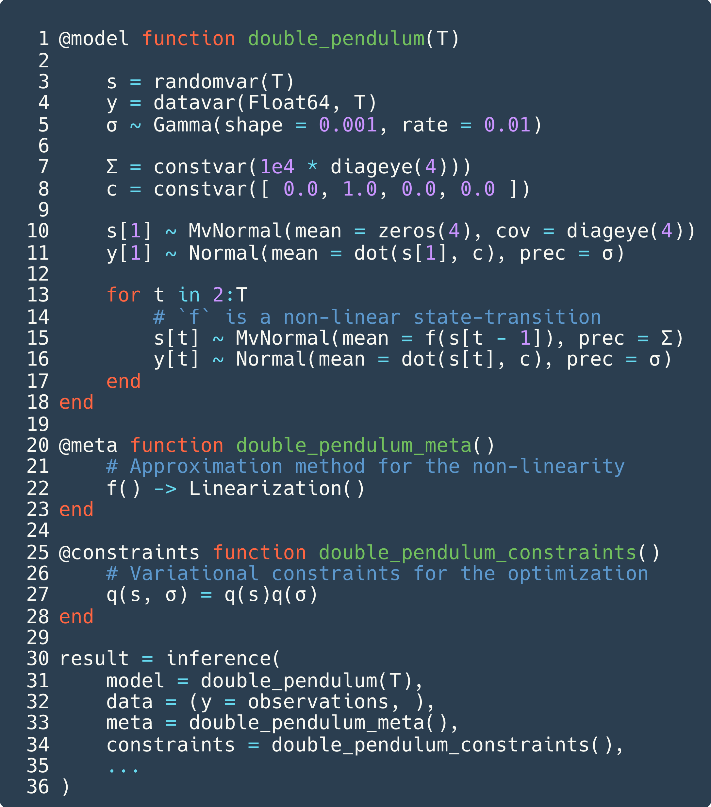
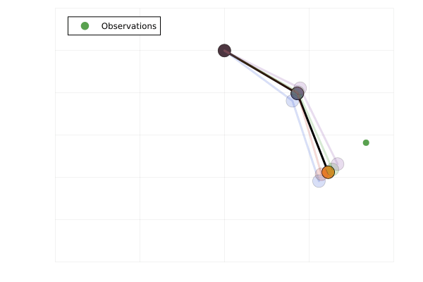
Continual Real-time Inference in Hierarchical Dynamical Systems on Infinite Data Streams

Slide 13
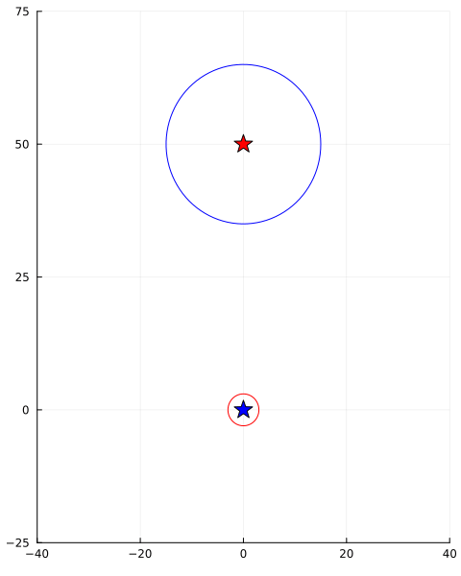
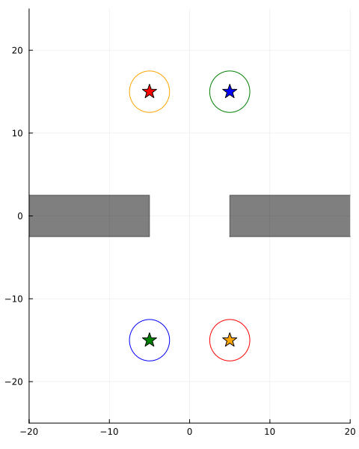
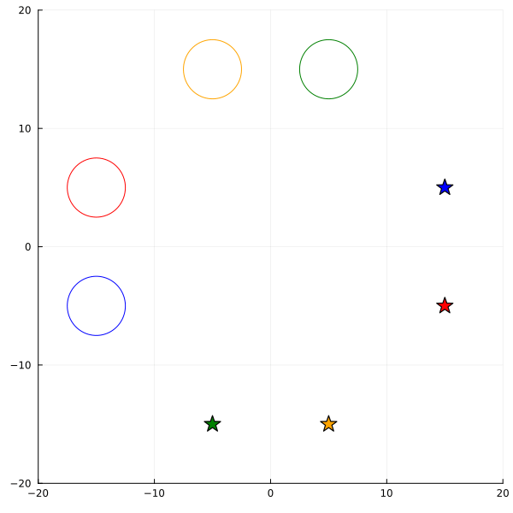
Smart Navigation and Collision Avoidance

Slide 14
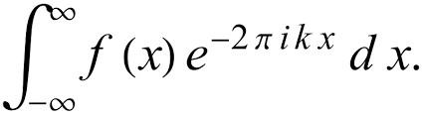
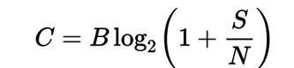
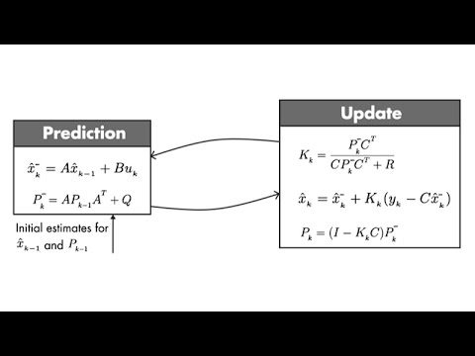
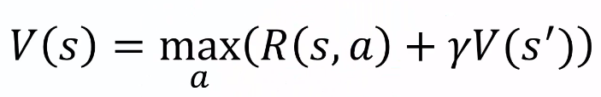
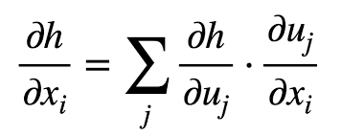
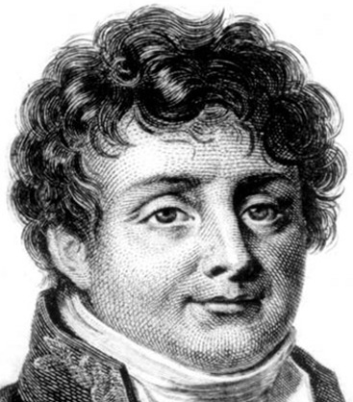
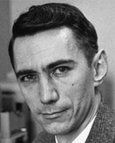
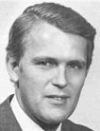
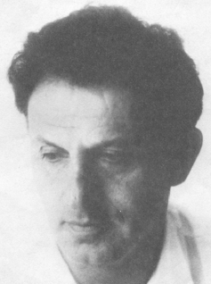
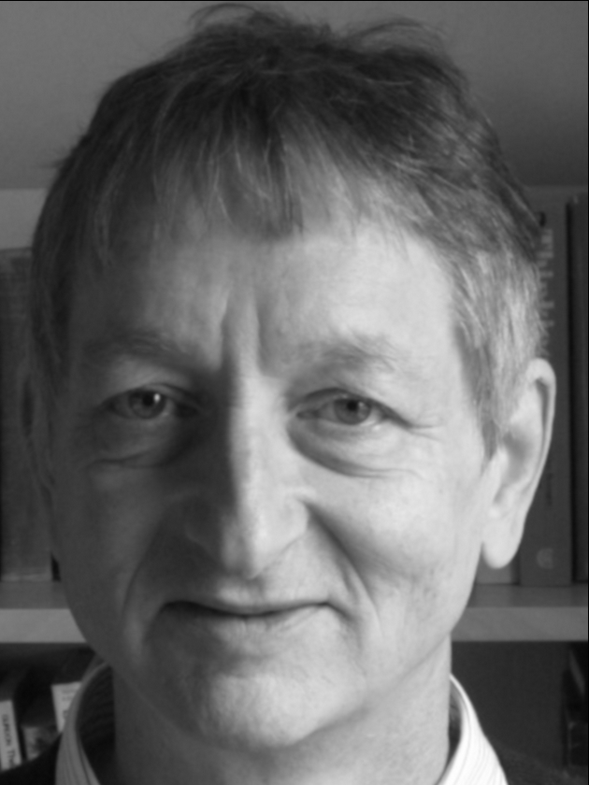
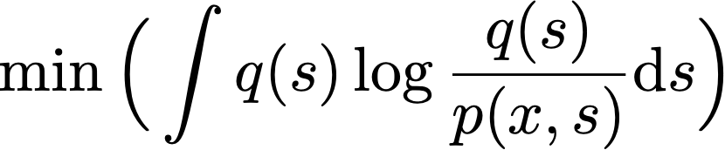
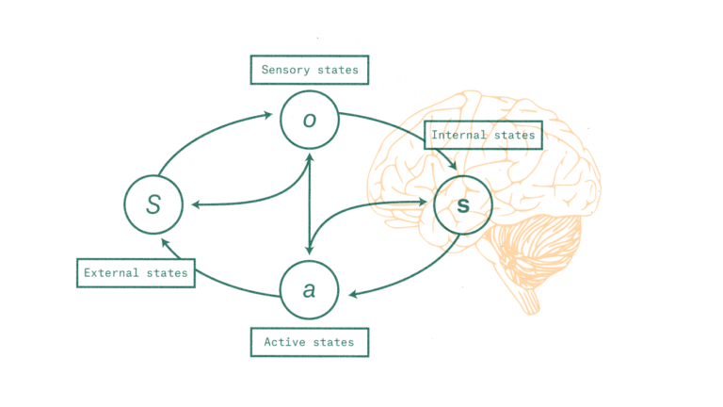
First Principles AI
Signal Processing
Communication
Control Theory
Robotics
Machine Learning
Joseph Fourier
Claude Shannon
Rudolf Kalman
Richard Bellman
Geoffrey Hinton
First Principles AI
Situated Free energy miniminization in a generative model is the only ongoing process

Slide 15
Source: gartner.com, 17-aug 2023
Generative AI
no real-time
learning
hallucination
resource-
hungry
Not
explainable
powerful user-friendly toolbox
First-Principles AI
very large
data sets
lots of computing
power
powerful user-friendly toolbox
real-time
learning
corrected
hallucination
0 engineers
low power
explainable

Slide 16
  End

