Slide 1

Active Inference and the Free Energy Principle
Bert de Vries
Eindhoven University of Technology
Nov 2026

Slide 2

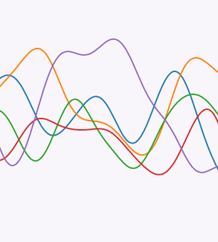
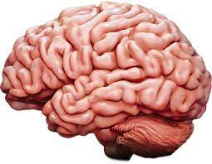

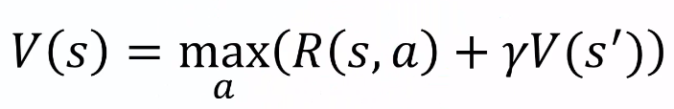
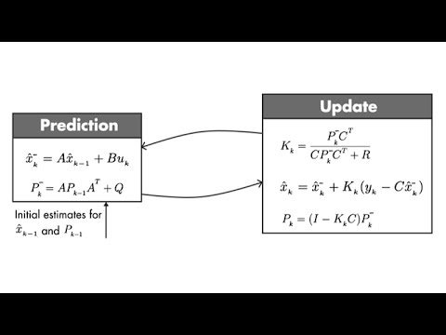
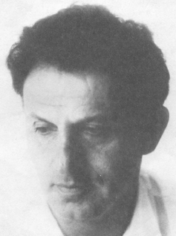
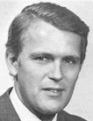
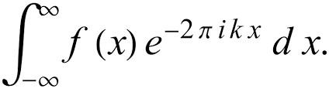
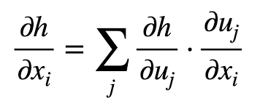
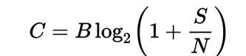
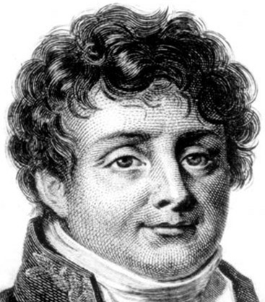
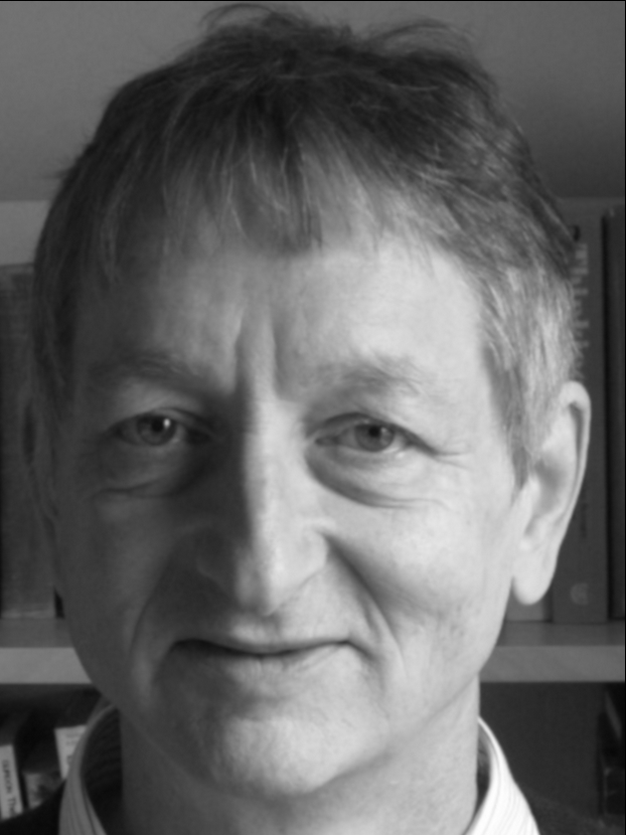
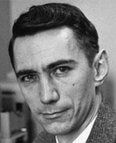
Simulated
Physics
Physics
?
Robotics
Control Theory
Signal Processing
Machine Learning
Communication
Richard Bellman
Rudolf Kalman
Joseph Fourier
Geoffrey Hinton
Claude Shannon

Slide 3
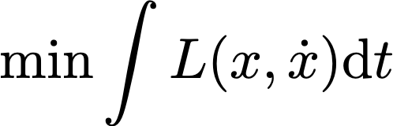
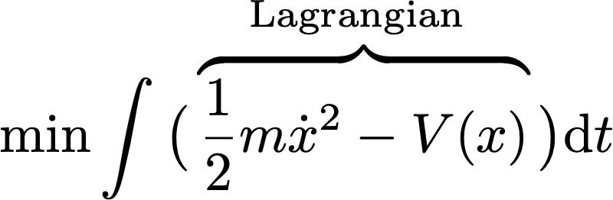
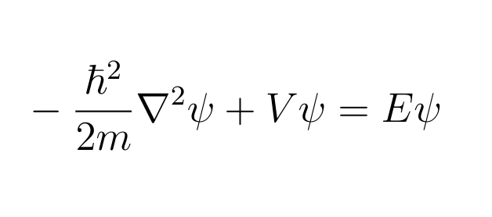
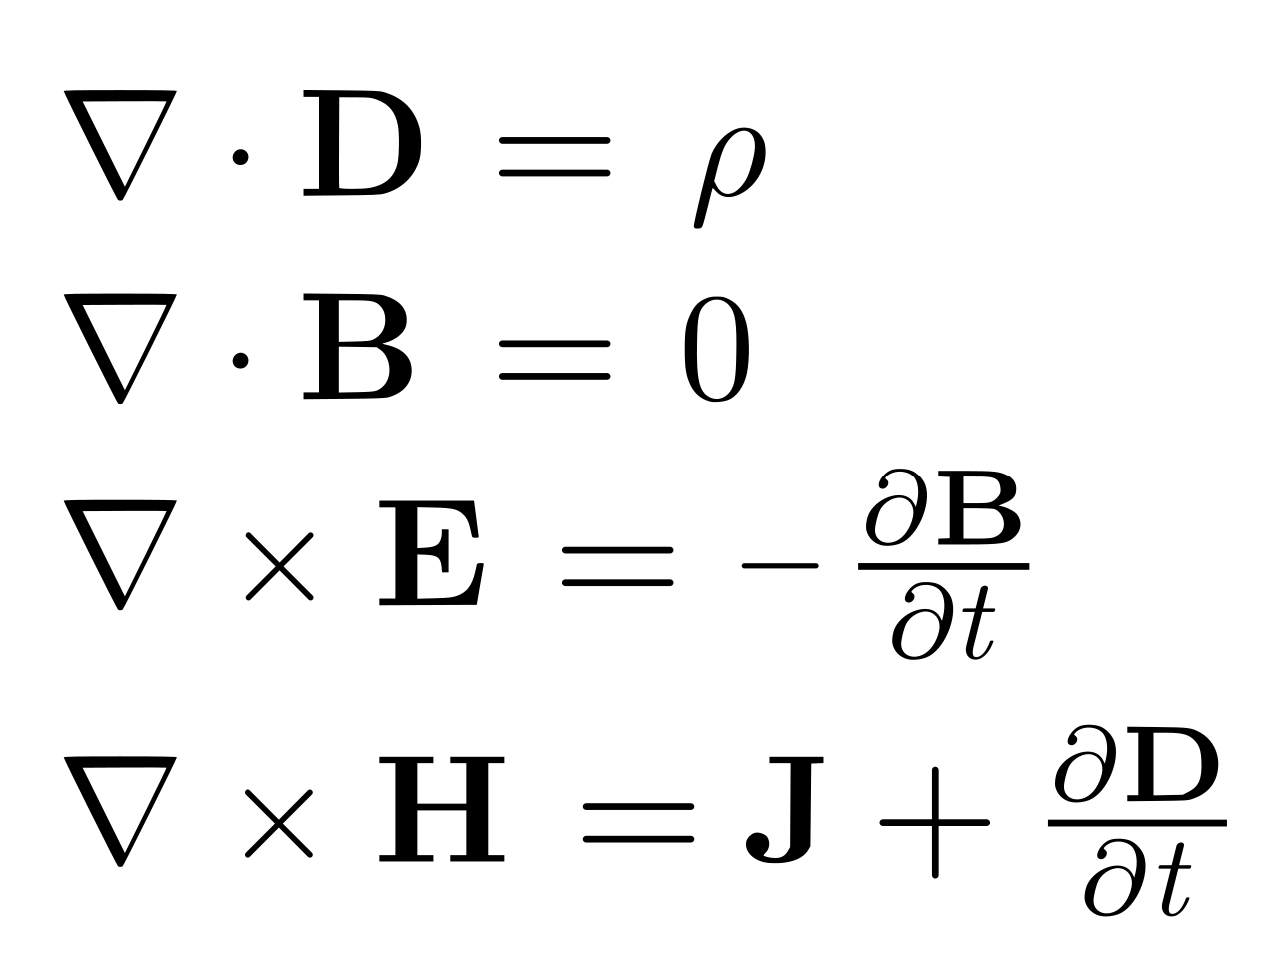
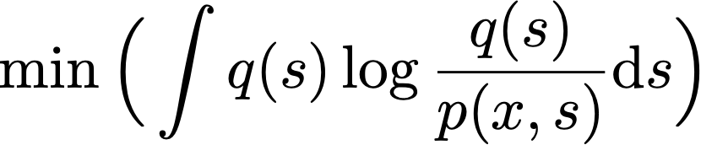
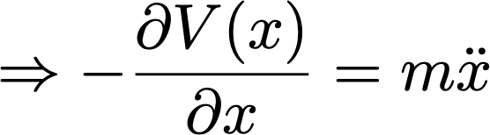
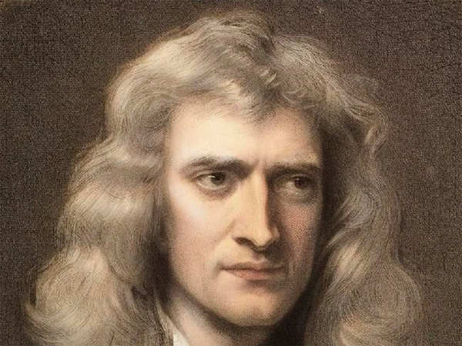
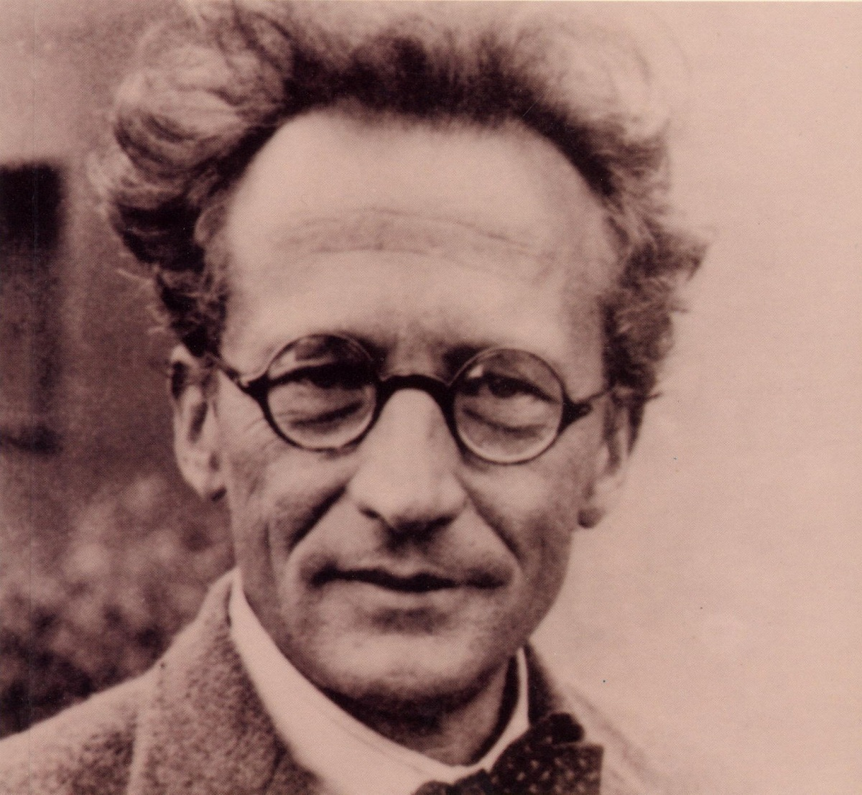
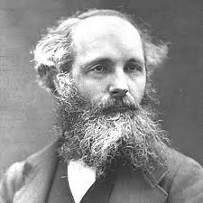
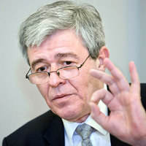



The Principle of Least Action
“In nature, energy differences of any kind are neutralized as fast a possible”
$$t_{0}$$
$$t_{1}$$
$$m$$
Free Energy Principle
Movement of
big things
(classical mechanics)
Movement of
small things
(quantum mechanics)
Movement of
electromagnetic fields
(electrodynamics)
Movement of
beliefs in brains
(Bayesian mechanics)
Isaac Newton
Erwin Schrodinger
James C. Maxwell
Karl Friston
Notes:
Maxwell:” L.D. Landau & E.M. Lifshitz, The Classical Theory of Fields, Vol. 2 of Course of Theoretical Physics
➤ Chapter 1–3 give an elegant derivation using field Lagrangians.
L.D. Landau & E.M. Lifshitz, Quantum Mechanics: Non-Relativistic Theory, Vol. 3
➤ Rigorous derivation of Schrödinger equation from variational principles.
Parr & Friston (2019), Generalised Free Energy and Active Inference:
“The accuracy term… acts like a potential energy in that it pulls beliefs towards states that are compatible with sensory data.” (DOI:10.1007/s00422-019-00805-w)

Slide 4

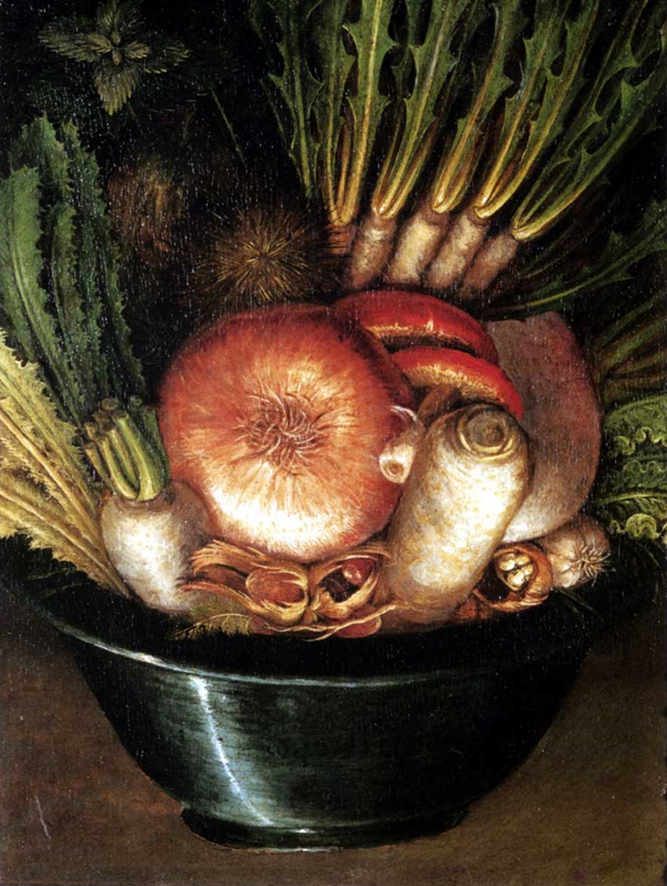
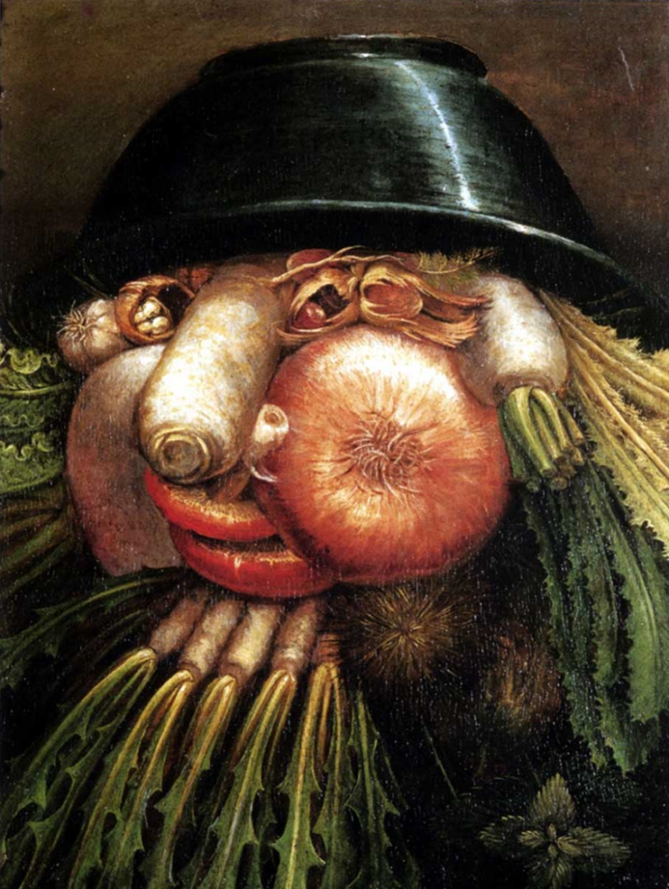

The Brain is a Generative Model for its Sensorium
The brain is a hierarchical probabilistic generative model
All processing is (variational) Bayesian inference
“abstract”
prediction
correction
prediction
correction
“concrete”
prediction
correction
sensor
observation
The Gardener Giuseppe Arcimboldo ~1590

Slide 5
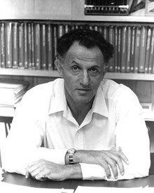
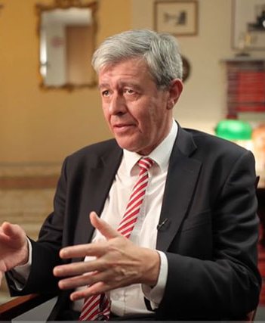
The Mechanism of Control
Richard Bellman (~1960)
Karl Friston (~2005)
“Control minimizes a cost function of state of the world”
“(In biotic systems,) control is a side-effect of optimizing beliefs about the state of the world”

Slide 6

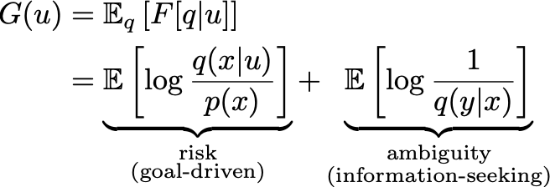
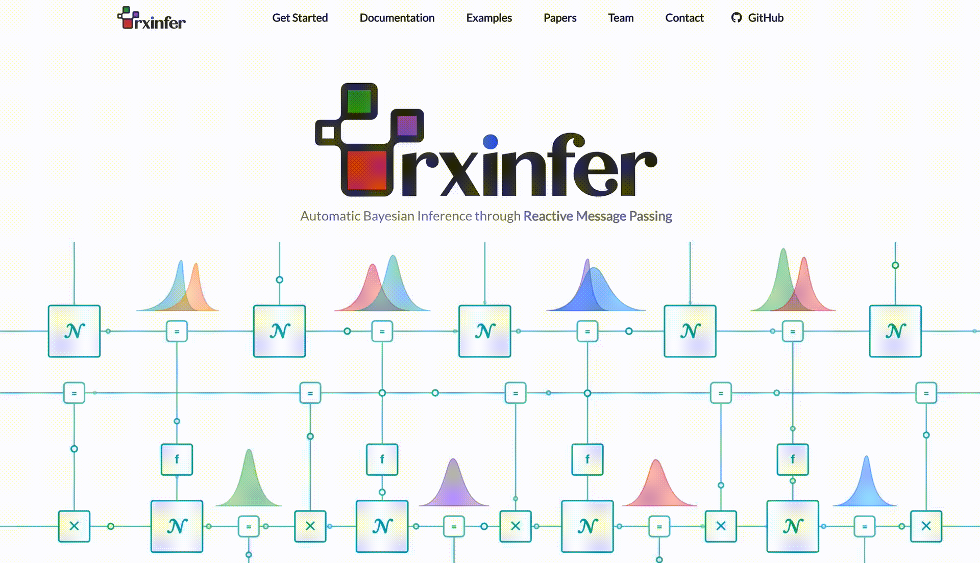
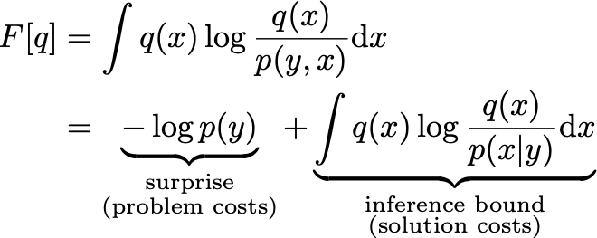
(Synthetic) Active Inference
Physics
Simulated
Physics
prediction
correction
prediction
correction
sensor
sensor
observation
observation

Slide 7

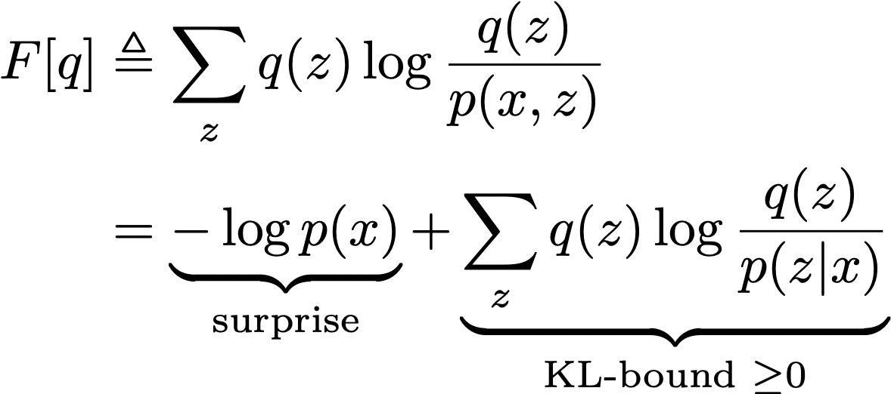
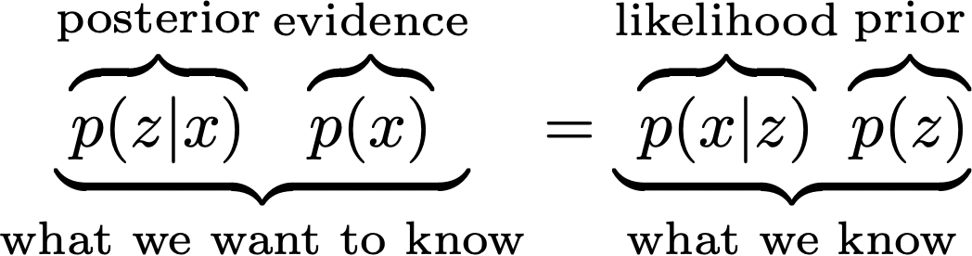
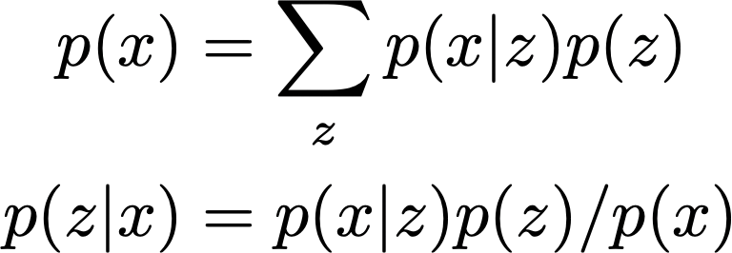
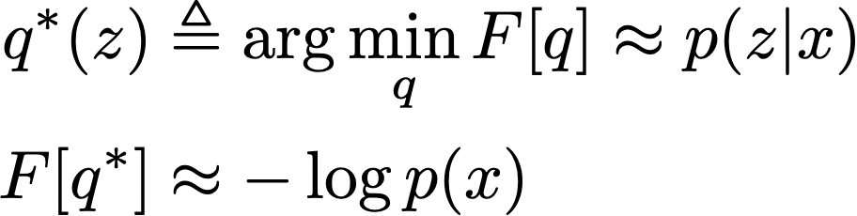
Intermezzo: Bayesian Inference vs Variational Inference
model
Variational Free Energy
Bayesian inference
Executing Bayes rule
Executing Variational Inference

Slide 8


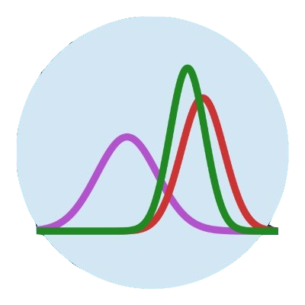






Software for Automated Free Energy Minimization?
Desiderata
Existing PPLs
Pyro / NumPyro
Model scope
Low-power
Turing
RxInfer
User-friendly
Adaptivity
PyMC3
ForneyLab
Performance
Real-time
Notes:
So we in BIASlab do want to build such a software with such nice characteristics. It is always about tradeoffs, we do something better in one particular domain, and other libraries might be better in a different domain. But we are really focusing on this particular properties.

Slide 9


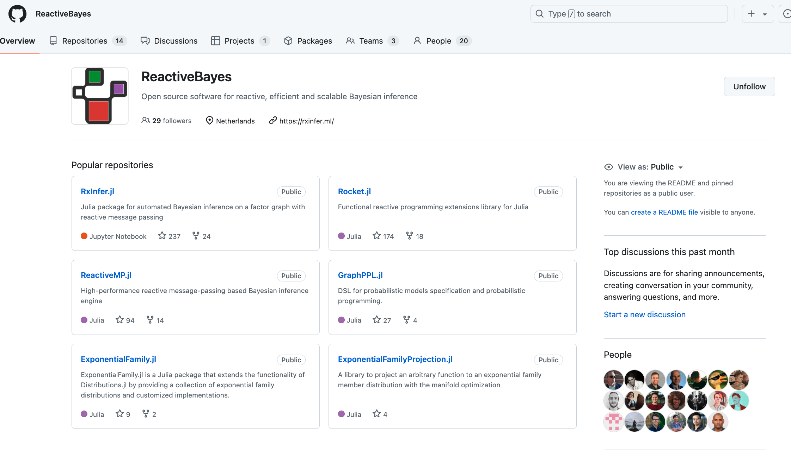
RxInfer: A Software Toolbox for Scalable, Real-time, Automated Free Energy Minimization
rxinfer.com
Notes:
Parallel Distributed Processing

Slide 10
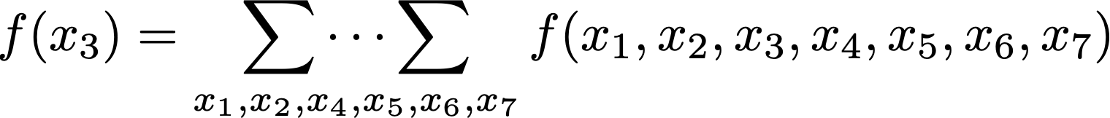
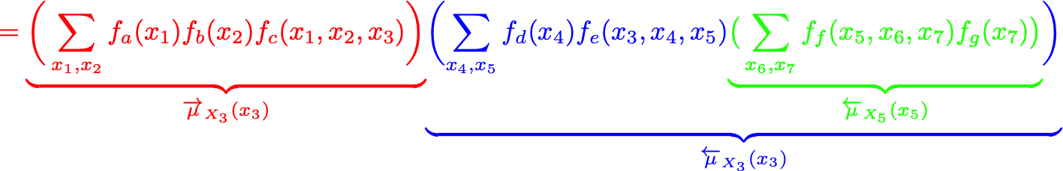






















Message Passing for Scalability
$$f\left(x_{1},x_{2},x_{3},x_{4},x_{5},x_{6},x_{7}\right)=f_{a}\left(x_{1}\right)∙f_{b}(x_{2})∙f_{c}(x_{1},x_{2},x_{3})∙f_{d}(x_{4})∙f_{e}(x_{3},x_{4},x_{5})∙f_{f}(x_{5},x_{6},x_{7})∙f_{g}(x_{7})$$
$$f_{b}$$
$$f_{d}$$
$$x_{2}$$
$$f_{b}(x_{2})$$
$$x_{4}$$
$$f_{d}(x_{4})$$
$$f_{a}(x_{1})$$
$$x_{3}$$
$${\overset{⃖}{μ}}_{X_{3}}(x_{3})$$
$${\overset{⃖}{μ}}_{X_{5}}(x_{5})$$
$$1$$
$$f_{a}$$
$$f_{c}$$
$$f_{e}$$
$$f_{f}$$
$$x_{1}$$
$$x_{5}$$
$$x_{6}$$
$${\vec{μ}}_{X_{3}}(x_{3})$$
$$x_{7}$$
$$f_{g}(x_{7})$$
$$f_{g}$$
If each variable has 10 possible values, then inference complexity drops from ${O(10}^{6})$ to ${O(10}^{2})$ # additions.

Slide 11
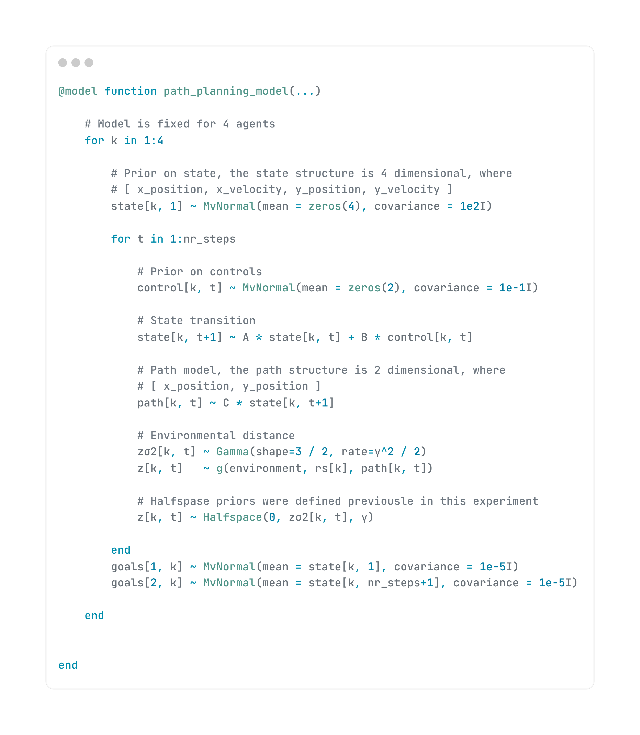
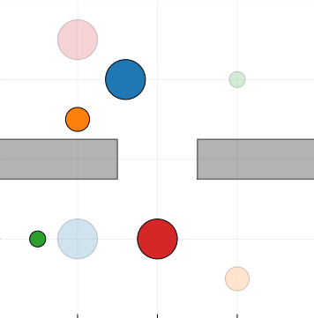
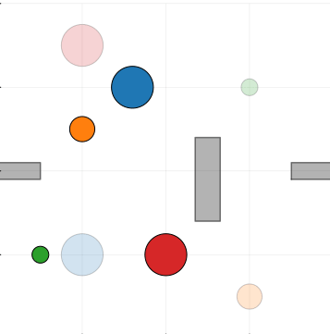
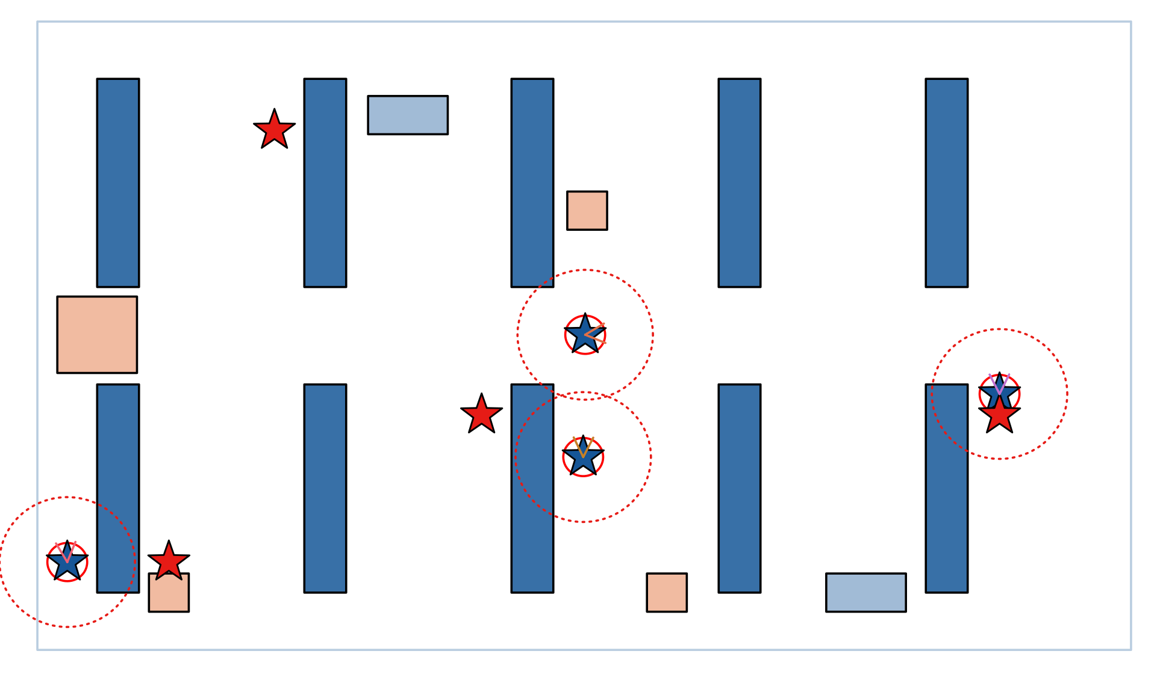
Multi-agent Planning
generative
model
goal
priors
15 lines of code!
~
Notes:
Strong effort, limited effort

Slide 12
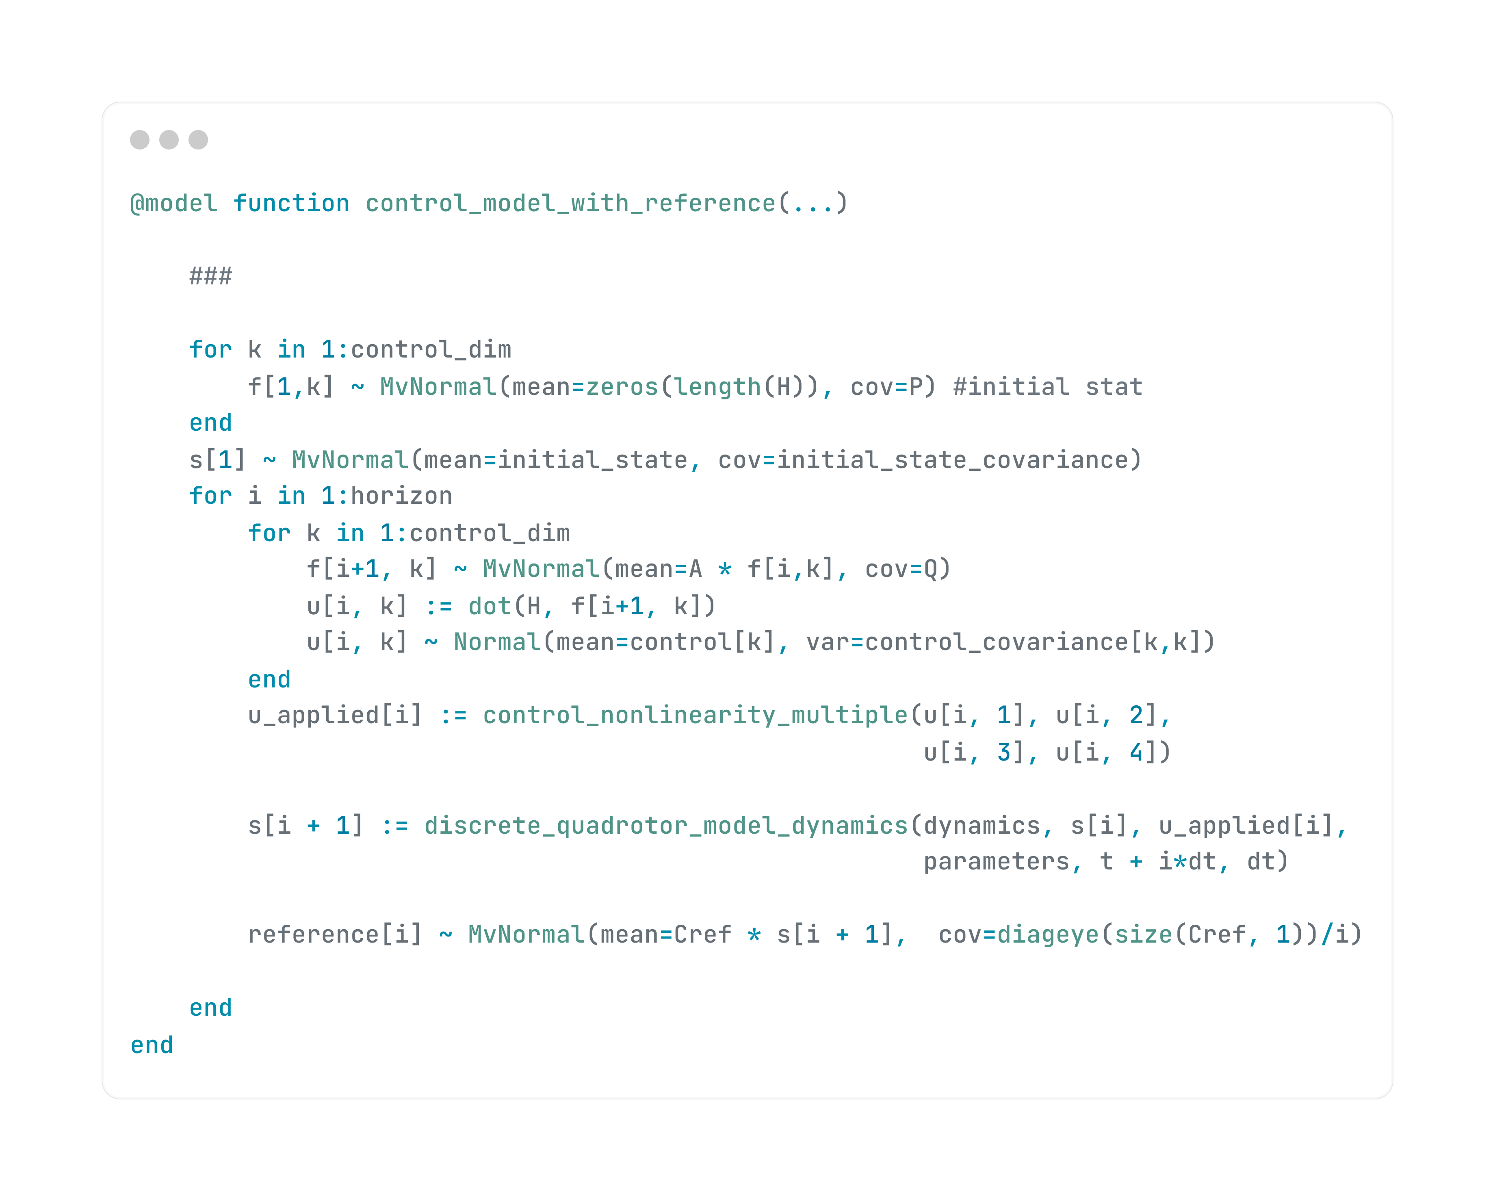
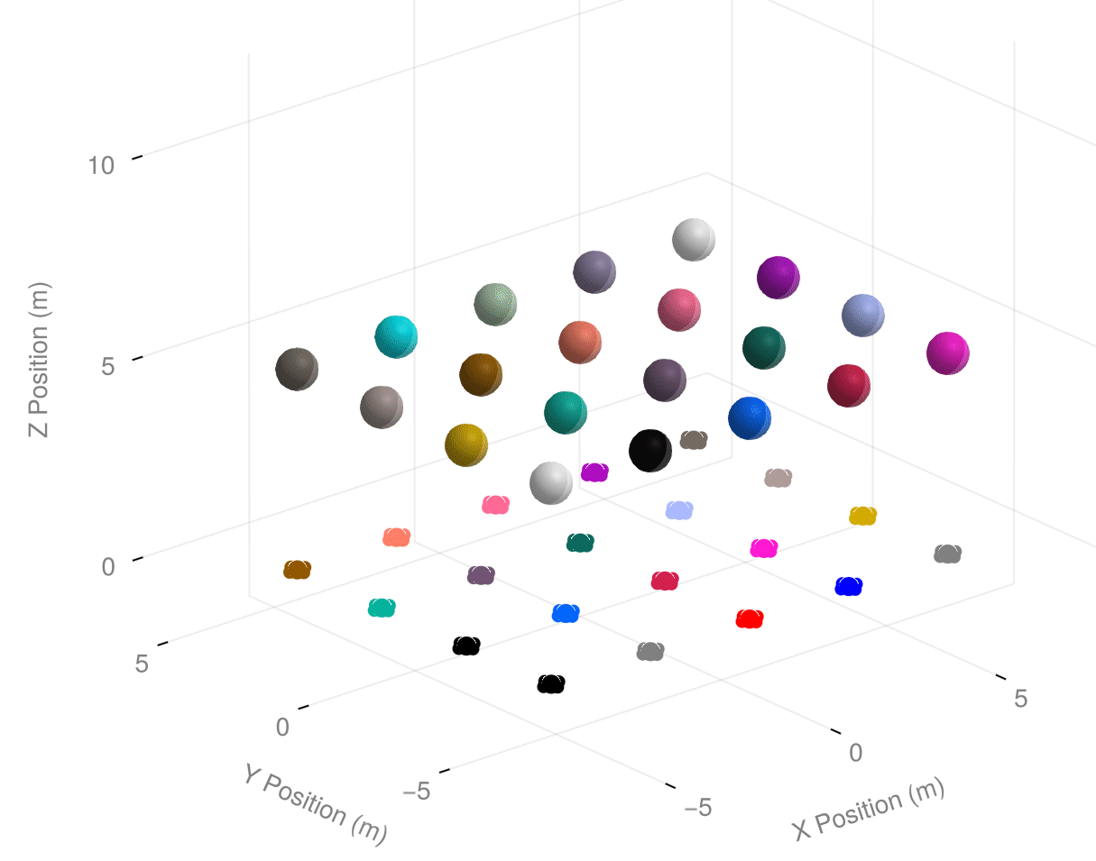
Dynamic Obstacle Avoidance in Drone Swarms
generative
model
goal
priors
10 lines of code!
~
Notes:
Strong effort, limited effort

Slide 13
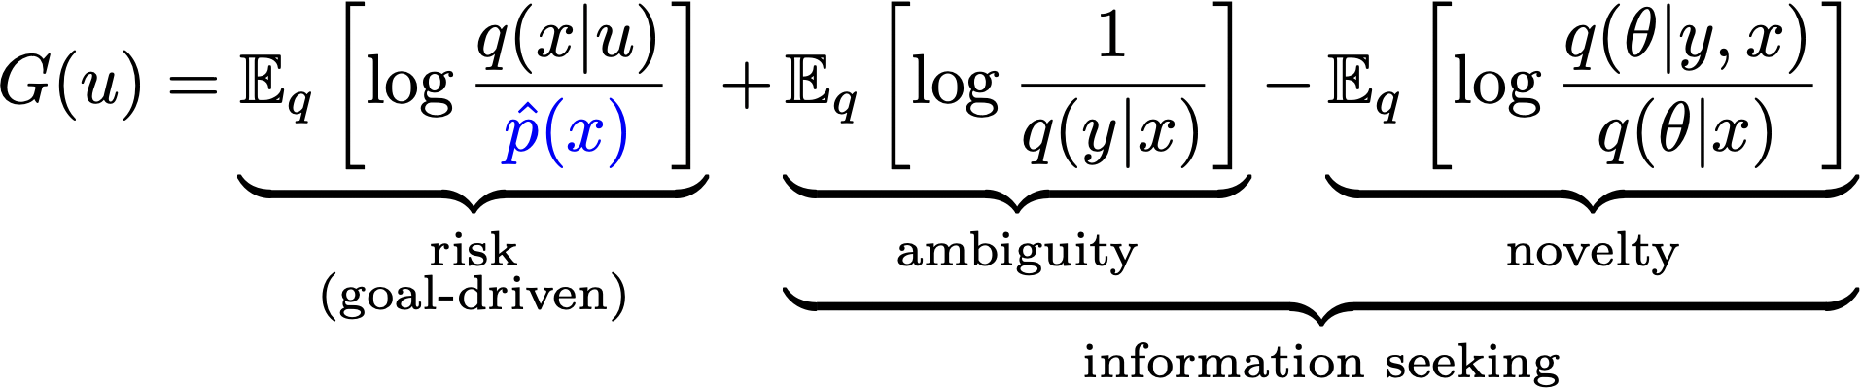









Active Inference-based Planning by Message Passing?
$$x_{τ}^{+}$$
$$q\left(u_{T}\right)=σ\left(−G\left(u_{T}\right)\right)?$$
$$x_{τ}^{+}$$
$$q\left(u_{t+1}\right)=σ\left(−G\left(u_{t+1}\right)\right)?$$
$$q\left(u_{T}\right)= ?$$
$$q\left(u_{t+1}\right)= ?$$
$$u_{1}$$
$$u_{t}$$
$$u_{t+1}$$
$$u_{T}$$
$$x_{T}$$
$$x_{0}$$
=
$$x_{t−1}$$
=
$$x_{t}$$
=
$$x_{T−1}$$
=
$$\hat{p}\left(x_{0}\right|x_{τ}^{+})$$
$$p\left(x_{t+1}\right|x_{t},u_{t+1})$$
$$\hat{p}\left(x_{T}\right|x_{τ}^{+})$$
$$p\left(y_{1}\right|x_{1})$$
$$y_{1}$$
$$y_{t}$$
$$y_{t+1}$$
$$y_{T}$$
$$t_{}$$
“If FE minimization is the only process, then planning should minimize Expected FE (EFE)”
Challenge: Under which generative model does MP lead to EFE-based planning?

Slide 14
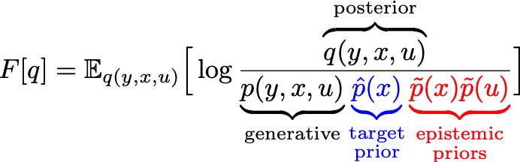

EFE-based Planning by Message Passing
Define VFE functional
$$\tilde{p}(u_{t+1})$$
$$\tilde{p}(u_{T})$$
$$x_{τ}^{+}$$
$$x_{τ}^{+}$$
$$q\left(u_{t+1}\right)=σ\left(−G\left(u_{t+1}\right)\right) ?$$
$$u_{1}$$
$$u_{t}$$
$$u_{t+1}$$
$$u_{T}$$
$$x_{T}$$
$$x_{0}$$
=
$$x_{t−1}$$
=
$$x_{t}$$
=
$$x_{T−1}$$
=
$$\hat{p}\left(x_{0}\right|x_{τ}^{+})$$
$$p\left(x_{t+1}\right|x_{t},u_{t+1})$$
$$\hat{p}\left(x_{T}\right|x_{τ}^{+})$$
$$p\left(y_{1}\right|x_{1})$$
$$y_{1}$$
$$y_{t}$$
$$\tilde{p}(x_{t+1})$$
$$\tilde{p}(x_{T})$$
$$t_{}$$

Slide 15
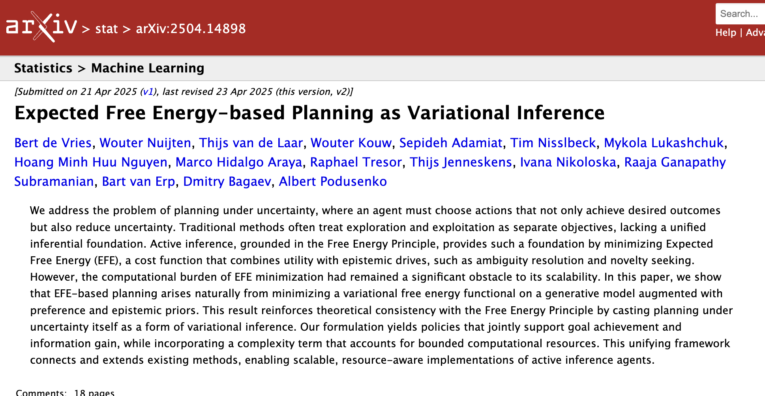
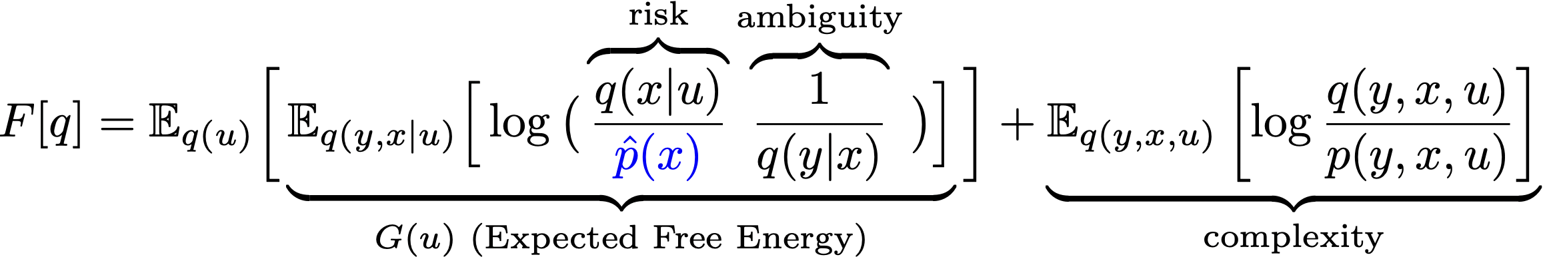
EFE-based Planning as Inference: The Expected Free Energy Theorem
$$\tilde{p}(u_{t+1})$$
$$\tilde{p}(u_{T})$$
$$x_{τ}^{+}$$
$$x_{τ}^{+}$$
$$u_{1}$$
$$u_{t}$$
$$u_{t+1}$$
$$u_{T}$$
$$x_{T}$$
$$x_{0}$$
=
$$x_{t−1}$$
$$x_{t}$$
=
$$x_{T−1}$$
=
=
$$\hat{p}\left(x_{0}\right|x_{τ}^{+})$$
$$p\left(x_{t+1}\right|x_{t},u_{t+1})$$
$$\hat{p}\left(x_{T}\right|x_{τ}^{+})$$
$$p\left(y_{1}\right|x_{1})$$
$$y_{1}$$
$$y_{t}$$
$$\tilde{p}(x_{t+1})$$
$$\tilde{p}(x_{T})$$
If we choose
$$t_{}$$
$\tilde{p}\left(x\right)=σ\left(−H\left[q\left(y | x\right)\right]\right)$ and $\tilde{p}\left(u\right)=σ\left(H\left[q\left(x | u\right)\right]\right)$
then …
In other words, selecting policies by minimizing Expected Free Energy (EFE) emerges naturally from standard variational free energy minimization when applied to a rollout of the generative model into the future, where the inference process is guided by both target priors and epistemic priors.

Slide 16
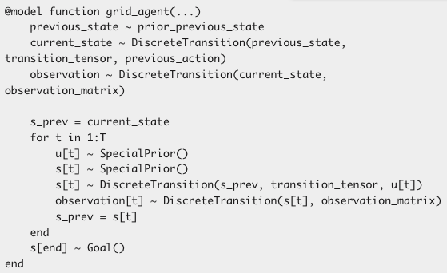
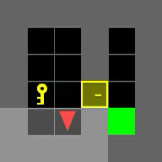
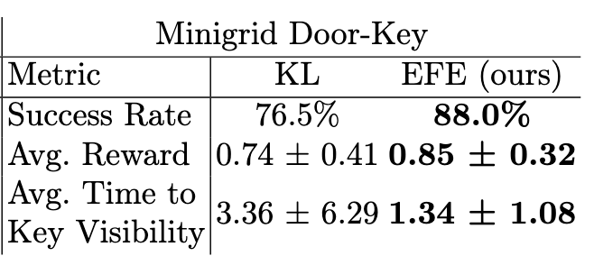
Solving Mini-grid Door-Key Problem
~10 lines of code!
setup
epistemic
priors
generative
model
goal
prior
Notes:
Strong effort, limited effort

Slide 17
Why Active Inference Agents (rather than RL, MPC, …)?
People say (I’ve heard …)
  Principled. Derived from foundational physics / information theory.
  EFE-based planning balances goal-driven vs information-seeking behavior, without need for tuning parameters.
  AIF requires no reward function.
  AIF is explainable and trustworthy, due to separation of assumptions from a Bayes-optimal reasoning process. (application to medical AI!!)
Yes, plus …
  Robustness by RMP realization! RMP-AIF is a reactive, fully-distributed (in both time and space) process, which is robust to fluctuating computational resources (both in energy, data, and time).
    Keeps working on power dips, missing and poor observations, hard interrupt at decision time, …
    Planning as (interruptible!) Inference
  Easy to code! <1 page for generative model.
  Potential for Scaling: Real-time inference in large models with ultra-low computational load.

Slide 18
Conclusions / Recapitulation
The Free Energy Principle offers a principled foundation for adaptive, self-organizing agents.
Active Inference (AIF) unifies perception, learning, and control as variational Bayesian inference.
Personalized control emerges naturally in AIF agents through Expected Free Energy minimization.
Local message passing on a factor graph enables efficient, real-time inference on low-power devices.
AIF provides a promising alternative to RL/MPC in dynamic, uncertain environments.
Tooling maturity remains limited; advancing practical AIF frameworks is a key future objective.
RxInfer aims to provide a path toward deployable, embedded Bayesian intelligence.

Slide 19
  Questions?

