Slide 1
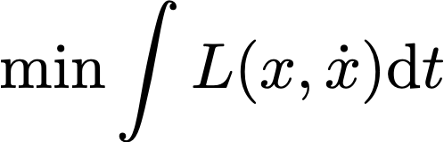
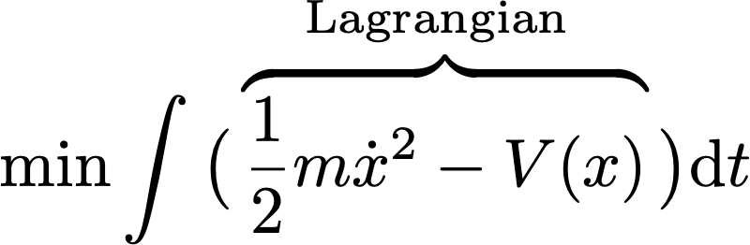
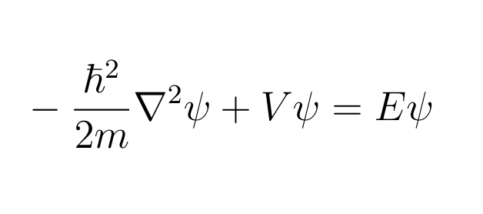
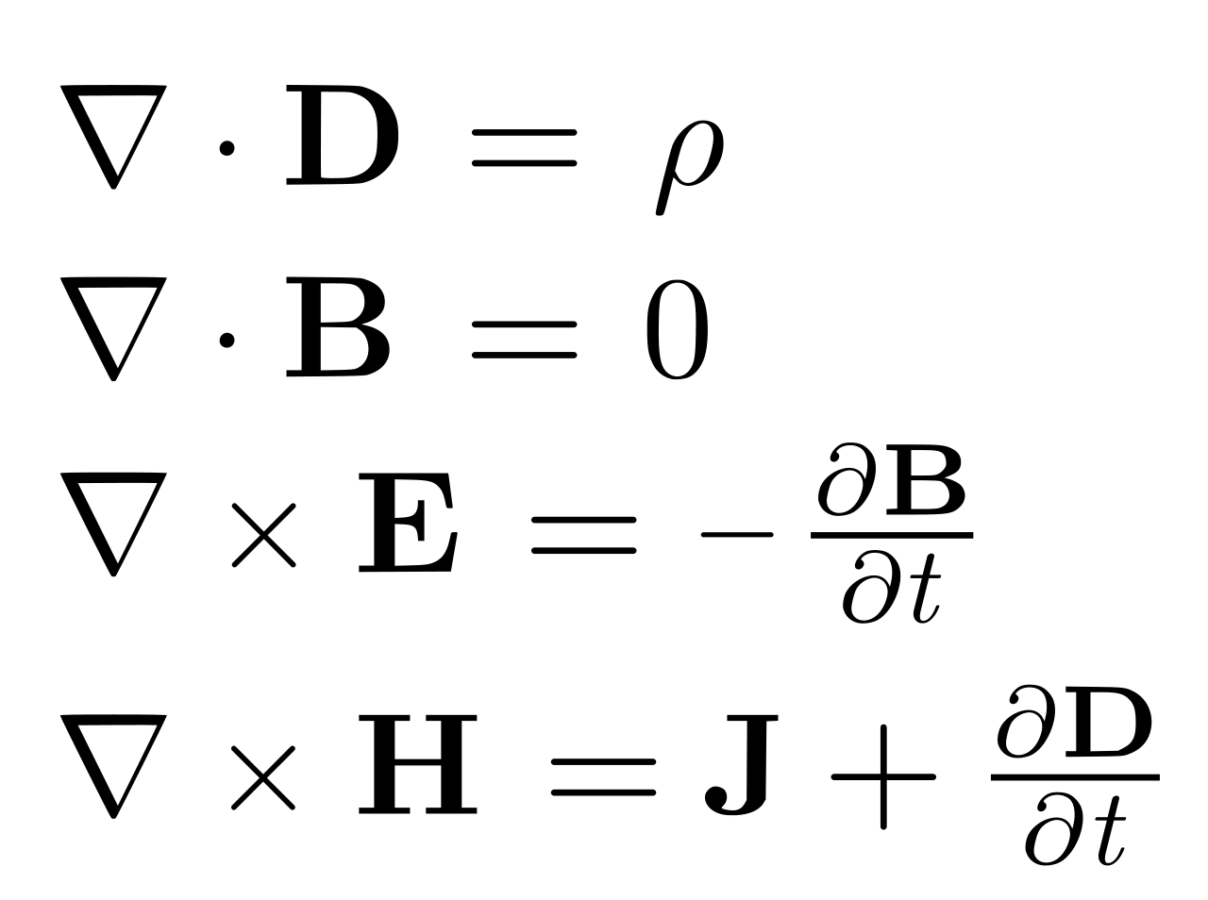
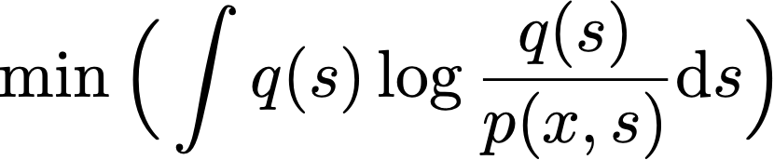
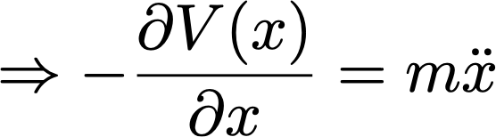
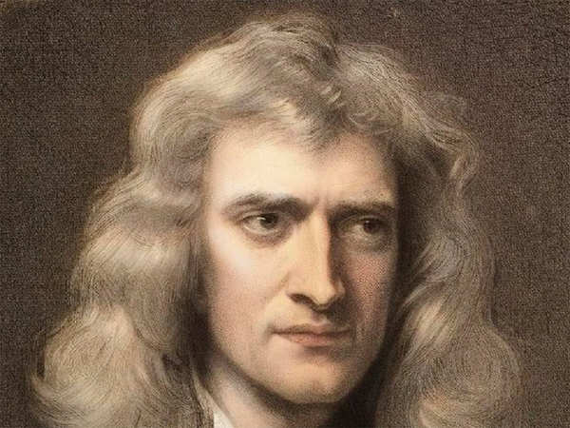
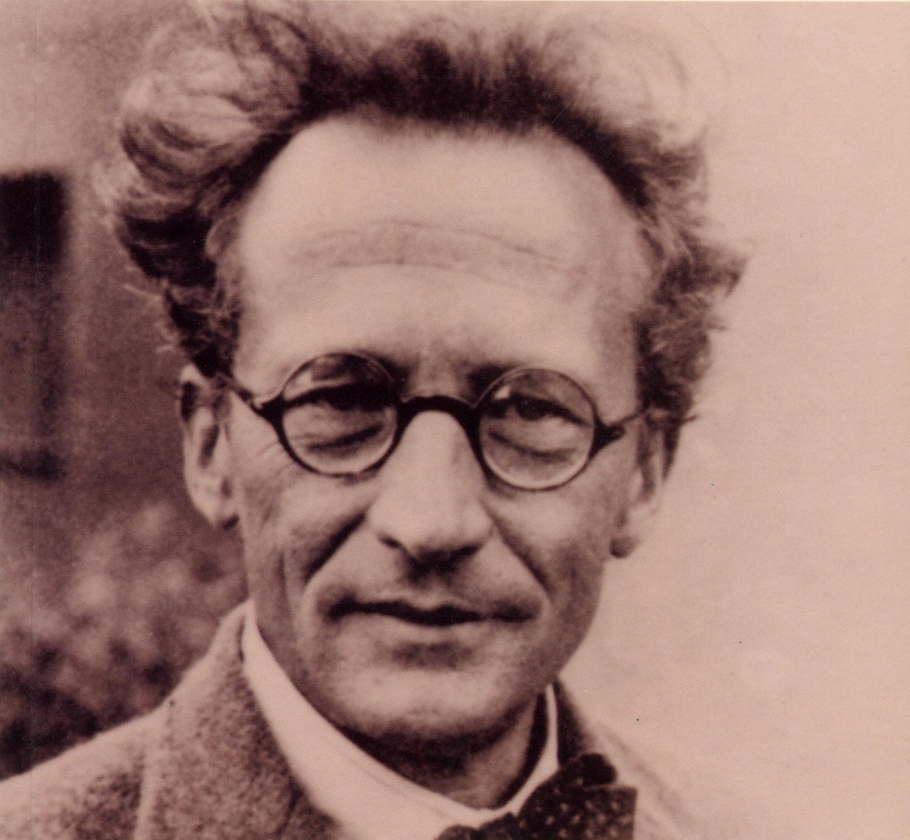
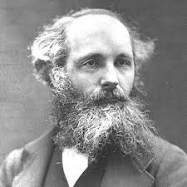
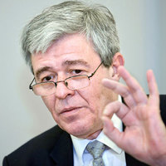



$$t_{0}$$
$$t_{1}$$
$$m$$
The Free Energy Principle
Movement of
big things
(classical mechanics)
Movement of
small things
(quantum mechanics)
Movement of
electromagnetic fields
(electrodynamics)
Movement of
beliefs/thoughts
(Bayesian mechanics)
Isaac Newton
Erwin Schrodinger
James C. Maxwell
Karl Friston

Slide 2
data
posterior
learning
prior
model
applications
trial
design
actions

Slide 3
data
posterior
learning
prior
model
applications
trial
design
actions
posterior

Slide 4














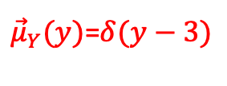
$${\vec{μ}}_{X_{1}}(x_{1})$$
$$f_{a}$$
$$x_{1}$$
$$x_{1}$$
$$x_{2}$$
$$x_{1}$$
$$x_{2}$$
$$f_{a}$$
$$f_{b}$$
$$f_{a}$$
$$f_{b}$$
$$≡$$
$$y$$
$$y$$
${\vec{μ}}_{Y}(y)$=$δ(y−3)$
plus observation $y=3$
$$δ(y−3)$$

Slide 5






















$$f_{b}$$
$$f_{d}$$
$${\vec{μ}}_{X_{2}}(x_{2})$$
$${\vec{μ}}_{X_{4}}(x_{4})$$
$$x_{2}$$
$$x_{4}$$
$${\overset{⃖}{μ}}_{X_{3}}(x_{3})$$
$${\overset{⃖}{μ}}_{X_{5}}(x_{5})$$
$$1$$
$${\vec{μ}}_{X_{1}}(x_{1})$$
$$x_{3}$$
$$f_{a}$$
$$f_{c}$$
$$f_{e}$$
$$f_{f}$$
$$x_{1}$$
$$x_{5}$$
$$x_{6}$$
$${\vec{μ}}_{X_{3}}(x_{3})$$
$$x_{7}$$
$${\overset{⃖}{μ}}_{X_{7}}(x_{7})$$
$$f_{g}$$

Slide 6









$$x_{2}^{′′}$$
$$f_{a}$$
$$=$$
$$f_{c}$$
$$x_{1}$$
$$x_{2}$$
$$x_{4}$$
$$x_{2}^{′}$$
$$f_{b}$$
$$x_{3}$$

Slide 7
Machine learning
Trial design /
Decision-making
supervised learning
unsupervised learning
Other stuff
Reinforcement
learning
classification
regression
clustering
compression
Active inference

Slide 8

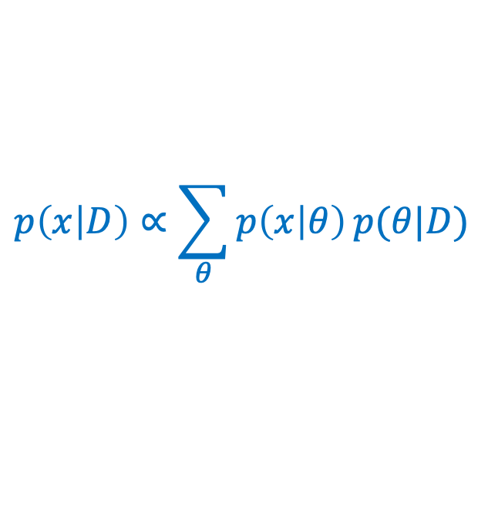


data
learning
posterior
$$p\left(D | θ\right)$$
$$p\left(θ | D\right)∝p\left(D | θ\right)p(θ)$$
prior
model
applications
$$p(θ)$$
$$p\left(x | D\right)∝\sum_{θ}{p\left(x | θ\right)}p(θ|D)$$
trial
design
(for prediction)
actions

Slide 9





$$q(u)$$
actions
actuators
agent
$$q(y,x,u,θ)$$
goals
VFEM
$$\hat{p}(x)$$
$$p(y,x,u,θ)$$
sensors
$$y$$
observations

Slide 10

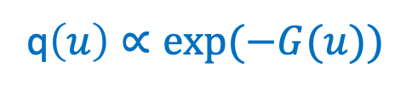
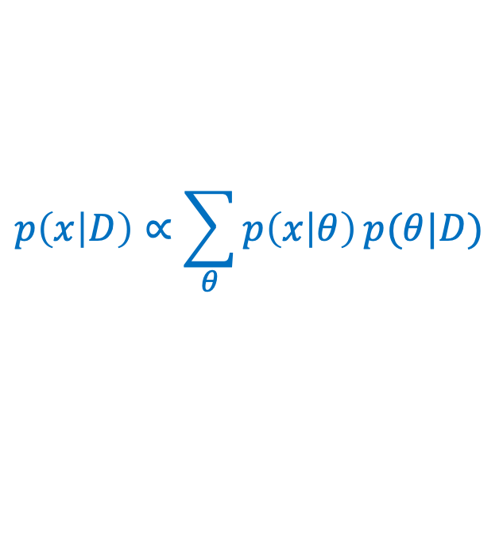


data
learning
posterior
$$p\left(D | θ\right)$$
$$q\left(θ | D\right)∝p\left(D | θ\right)p(θ)$$
prior
model
applications
$$p(θ)$$
$$p\left(x | D\right)∝\sum_{θ}{p\left(x | θ\right)}p(θ|D)$$
trial
design
(for prediction)
q$\left(u\right)∝exp⁡(−G(u))$
actions

Slide 11
machine learning
data
posterior
learning
prior
model
applications
e.g., algorithms for
classification, regression, prediction, etc.
trial
design
actions
scientific inquiry loop
engineering

Slide 12
data
posterior
learning
prior
model
trial
design
actions
agent

Slide 13
observations
sensors
model
goals
prior on
future
observations
actuators
actions
agent

Slide 14
“sensory” data
machine
learning
posterior
goals
prior
model
prior on
future
sensations
trial
design
actions
agent

Slide 15
General framework
Specific example
“sensory” data
data
posterior
machine
learning
posterior
learning
“reward” data
prior
prior
model
model
trial
design
trial
design
actions
actions
agent
agent

Slide 16
compressed
(encoded)
original
decoded

