Slide 1
MSc Thesis Projects @ BIASlab
Q3 2022-2023 and onwards
Wouter Nuijten 13-01-2023

Slide 2
Who are you?
MSc student in Dept. of Electrical Engineering
Passed/enrolled in Bayesian Machine Learning & Information Processing course
Happy with the course contents

Slide 3

Who are we?
BIASlab
Research lab pushing the frontier in these methods
Apply Bayesian Machine Learning/Active Inference to new problems.

Slide 4
AIF for SpotMicro Locomotion
Develop intelligent agent controlling a quadrupedal robot
Agent will learn to walk by interacting with environment
(Theoretically) AIF should learn faster than Deep Reinforcement Learning

Slide 5
Drift Control in TwinScan Lithography
@ ASML
Lithography systems need sub-nanometer accuracy, the systems drift
Human experts intervene when the system needs correction
Develop a drift controller using Machine Learning
Develop a machine specific controller algorithm to minimize drift

Slide 6
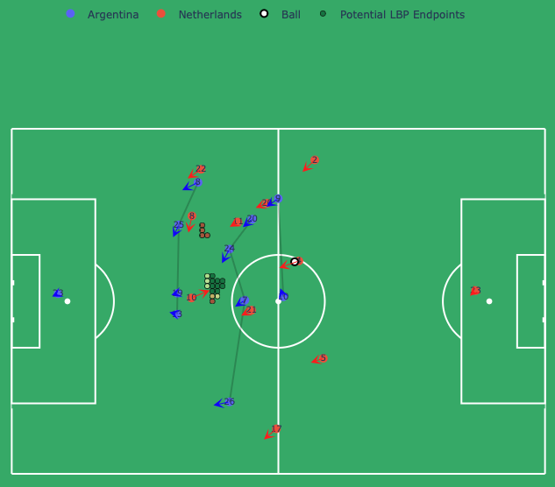
Winning the World Cup in 2026
w KNVB
Cast tactical decisions/player choices as Bayesian inference problem
Work with coaches of Dutch national team in order to improve field play
Simulate player decisions and improve tactics

Slide 7
Improve your tennis skills
w TopTennis040
Develop an Active Inference agent that controls a tennis cannon
Link different sources of data together to simulate a real opponent
Return the “perfect” practice shot to the player
Learns weak points of player and plays this

Slide 8
Predict health condition
@ Philips
Analyze smart watch data of post-surgical patients (heart rate, breath rate)
Predict post-operative complications
Use Active Inference to learn personalized health monitoring algorithms

Slide 9
Other projects
master.ele.tue.nl for an overview of all available projects
Own inspiration? Great! Let us know
Discuss possible projects? Let me (w.w.l.nuijten@tue.nl) or Bert (bert.de.vries@tue.nl) know

