Slide 1
Oxidation and Reduction Reactions

Slide 2
Oxidation (Read only)
Original definition:
When substances combined with oxygen.
Ex:
All combustion (burning) reactions
CH₄(g) + 2O₂(g) CO₂(g) + 2H₂O(l)
All “rusting” reactions
4Fe(s) + 3O₂(g) 2Fe₂O₃(s)

Slide 3
Reduction (Read Only)
Original Definition:
Reaction where a substance “gave up” oxygen.
Called “reductions” because they produced
products that were “reduced” in mass because
gas escaped.
Ex:
2Fe₂O₃(l) + 3C(s) 4Fe(l) + 3CO₂(g)

Slide 4
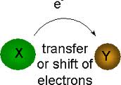
Oxidation/Reduction
Deals with movement of ELECTRONS
during a chemical reaction.
(Oxygen doesn’t have to be present)

Slide 5
Electron Transfer Reactions
Oxidation: LOSS of one or more electrons.
Reduction: GAIN of one or more electrons

Slide 6
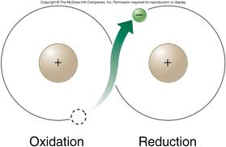
Electron Transfer Reactions
Oxidation & reduction always occur together.
Electrons travel from what is oxidized towards
what is reduced.
One atom loses e-, the other gains e-

Slide 7
Review
Oxidation – a species is oxidized when it loses one or more electrons, and it is called a reducing agent
Reduction – a species is reduced when it gains one or more electrons, and it is called an oxidizing agent
Oxidation and reduction always occur together, never in isolation. If something gains electrons, something else had to lose them.

Slide 8
Oxidation Number
The charge the atom would have in a molecule (or an
ionic compound) if electrons were completely transferred.
Free elements (uncombined state) have an oxidation number of ______.
Na, Be, K, Pb, H₂, O₂, P₄ = 0
In monatomic ions, the oxidation number is equal to 1.
Li⁺, Li = +1; Fe³⁺, Fe = +3; O²⁻, O = -2
The oxidation number of oxygen is usually -2 In H₂O₂ and O₂²⁻ it is -1

Slide 9
Oxidation Number
The oxidation number of hydrogen is +1 except when it is bonded to metals in binary compounds. In these cases, its oxidation number is -1. (LiAlH₄)
Group IA metals are +1, IIA metals are +2 and fluorine is always -1.
6. The sum of the oxidation numbers of all the atoms in a molecule or ion is equal to 0 or the charge on the ion.

Slide 10
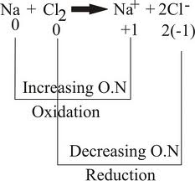
Redox Reactions:
ALWAYS involve changes in charge
A competition for electrons between atoms!

Slide 11
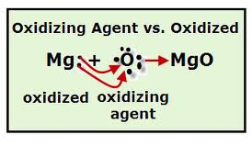
Oxidizing/Reducing Agents
Oxidizing Agent:
substance reduced
Gains electrons
Reducing Agent:
substance oxidized
Loses electrons
The “Agent” is the “opposite”

Slide 12
Identify What is Changing in Charge
What is oxidized and reduced?
What are the oxidizing and reducing agents?
3Br₂ + 2AlI₃ 2AlBr₃ + 3I₂
0 +3 -1 +3 -1 0
3Br₂ + 2AlI₃ 2AlBr₃ + 3I₂
Br₂ is reduced and is the oxidizing agent
I⁻¹ is oxidized and is the reducing agent

Slide 13
0 +2 +2 0
Mg + CuSO₄ MgSO₄ + Cu
Mg oxidized (reducing agent)
Cu⁺² reduced (oxidizing agent)
0 0 +1 -1
2K + Br₂ 2KBr
K oxidized (reducing agent)
Br₂ reduced (oxidizing agent)
0 +1 +2 0
Cu + 2AgNO₃ Cu(NO₃)₂ + 2Ag
Cu oxidized (reducing agent)
Ag⁺¹ reduced (oxidizing agent)

Slide 14

Look for Changes in Charge!
Are elements entering and leaving compounds?
Synthesis:
Ex: 2H2 + O2 2H2O
Decomposition:
Ex: 2KClO3 2KCl + 3O2

Slide 15
Synthesis: YES
₀ ₀ ₊₁ ₋₂
Ex: 2H₂ + O₂ 2H₂O
Decomposition: YES
₊₁ ₊₅ ₋₂ ₊₁ ₋₁ ₀
Ex: 2KClO₃ 2KCl + 3O₂

Slide 16
Combustion: YES
-4 +1 0 +4 -2 +1 -2
CH₄ + 2O₂ CO₂ + 2H₂0
Single Replacement: YES
0 +2 -1 +2 -1 0
Zn + CuCl₂ ZnCl₂ + Cu

Slide 17
Writing Half Reactions
Redox Reactions are composed of two parts
or half reactions.
Half Reactions Show:
Element being oxidized or reduced.
Change in charge
# of electrons being lost or gained

Slide 18
Writing Half Reactions
0 0 +1 -1
2Na + F₂ 2NaF
Oxidation: Na Na⁺¹ + 1e-
or2Na 2Na⁺¹ + 2e-
Note: e- are “lost” (on the right of arrow)
Reduction: F + 1e- F⁻¹
or F₂ + 2e- 2F⁻¹
Note: e- are “gained” (on the left of arrow)

Slide 19
₀ ₊₂ ₋₁ ₊₂ ₋₁ ₀
Zn + CuCl₂ ZnCl₂ + Cu
Ox: Zn Zn⁺² + 2e-
Red: Cu⁺² + 2e- Cu

Slide 20
Oxidation Number Method (Balancing in Acid Solution)
Find ox #’s and use brackets to connect elements
changing in charge.
Balance atoms changing in charge
Find total e- involved in each change
If necessary balance e- by multiplication
Balance all other atoms except H and O
Balance oxygen by adding H₂O to side deficient
Balance hydrogen by adding H⁺¹ to side deficient
Check for balance with respect to atoms and charge

Slide 21
Half Reaction Method (Ion/Electron Method) (In acid solution
Separate equation into two “basic” half reactions
Balance all atoms except H and O
Balance oxygen by adding H₂O
Balance hydrogen by adding H⁺¹
Balance charge by adding electrons to more positive side
If necessary balance e- by multiplication
Add together half reactions and simplify
Check for balance of atoms and charge

Slide 22
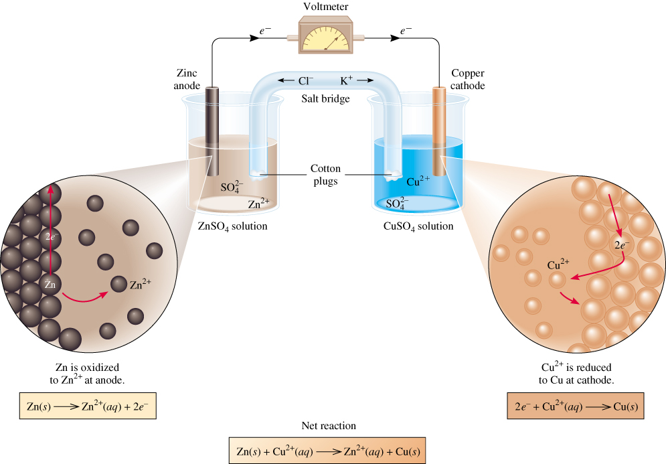
Balance the oxidation of Fe²⁺ to Fe³⁺ by Cr₂O₇²⁻ in acid solution

Slide 23
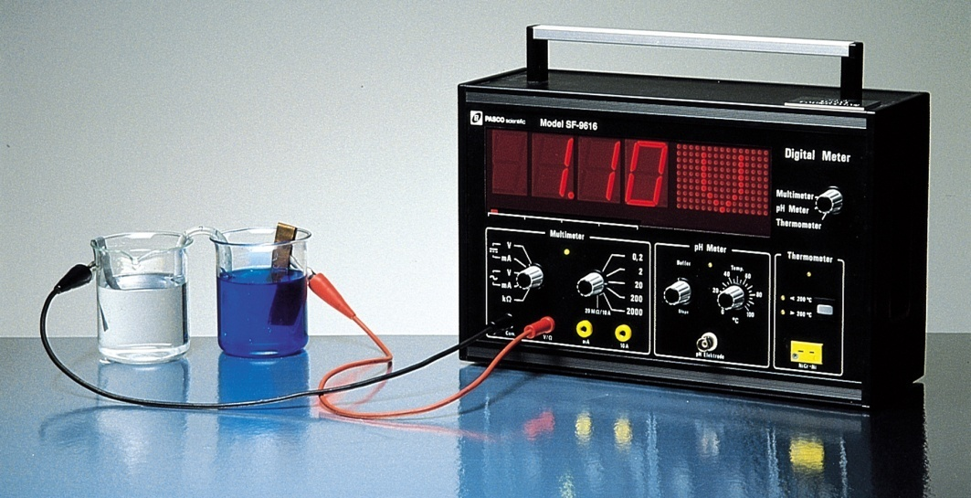
Electrochemical Cells
The difference in electrical potential between the anode and cathode is called:
____________________
____________________
____________________
Cell Diagram
Zn (s) + Cu²⁺ (aq) Cu (s) + Zn²⁺ (aq)
[Cu²⁺] = 1 M & [Zn²⁺] = 1 M
Zn (s) | Zn²⁺ (1 M) || Cu²⁺ (1 M) | Cu (s)
anode
cathode

Slide 24
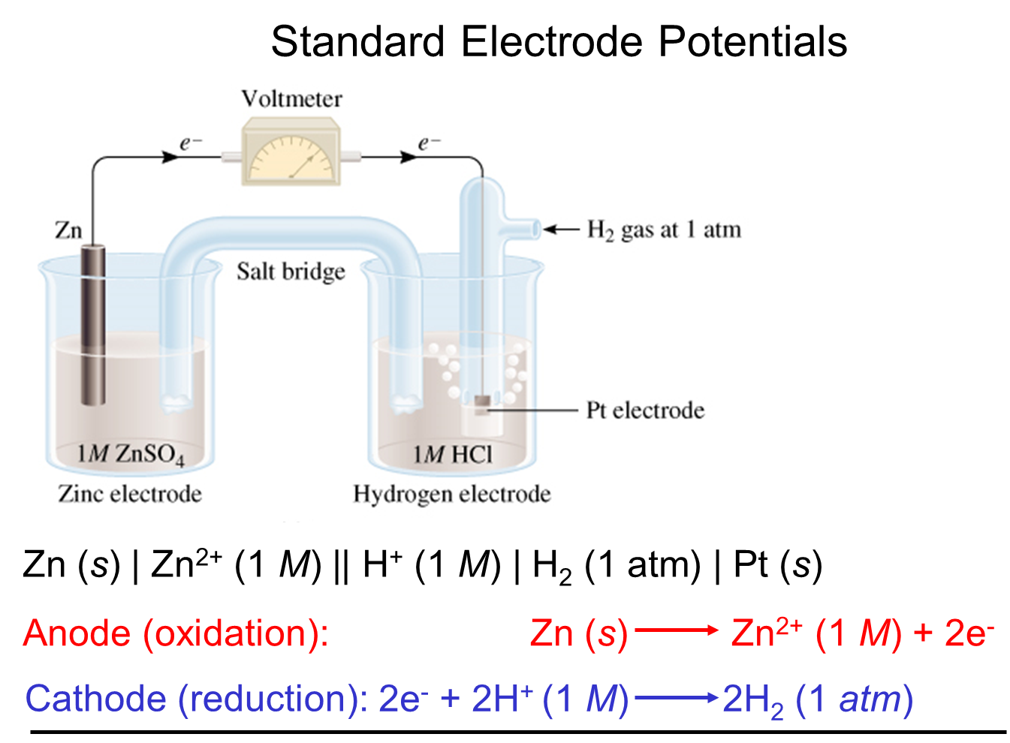

Slide 25
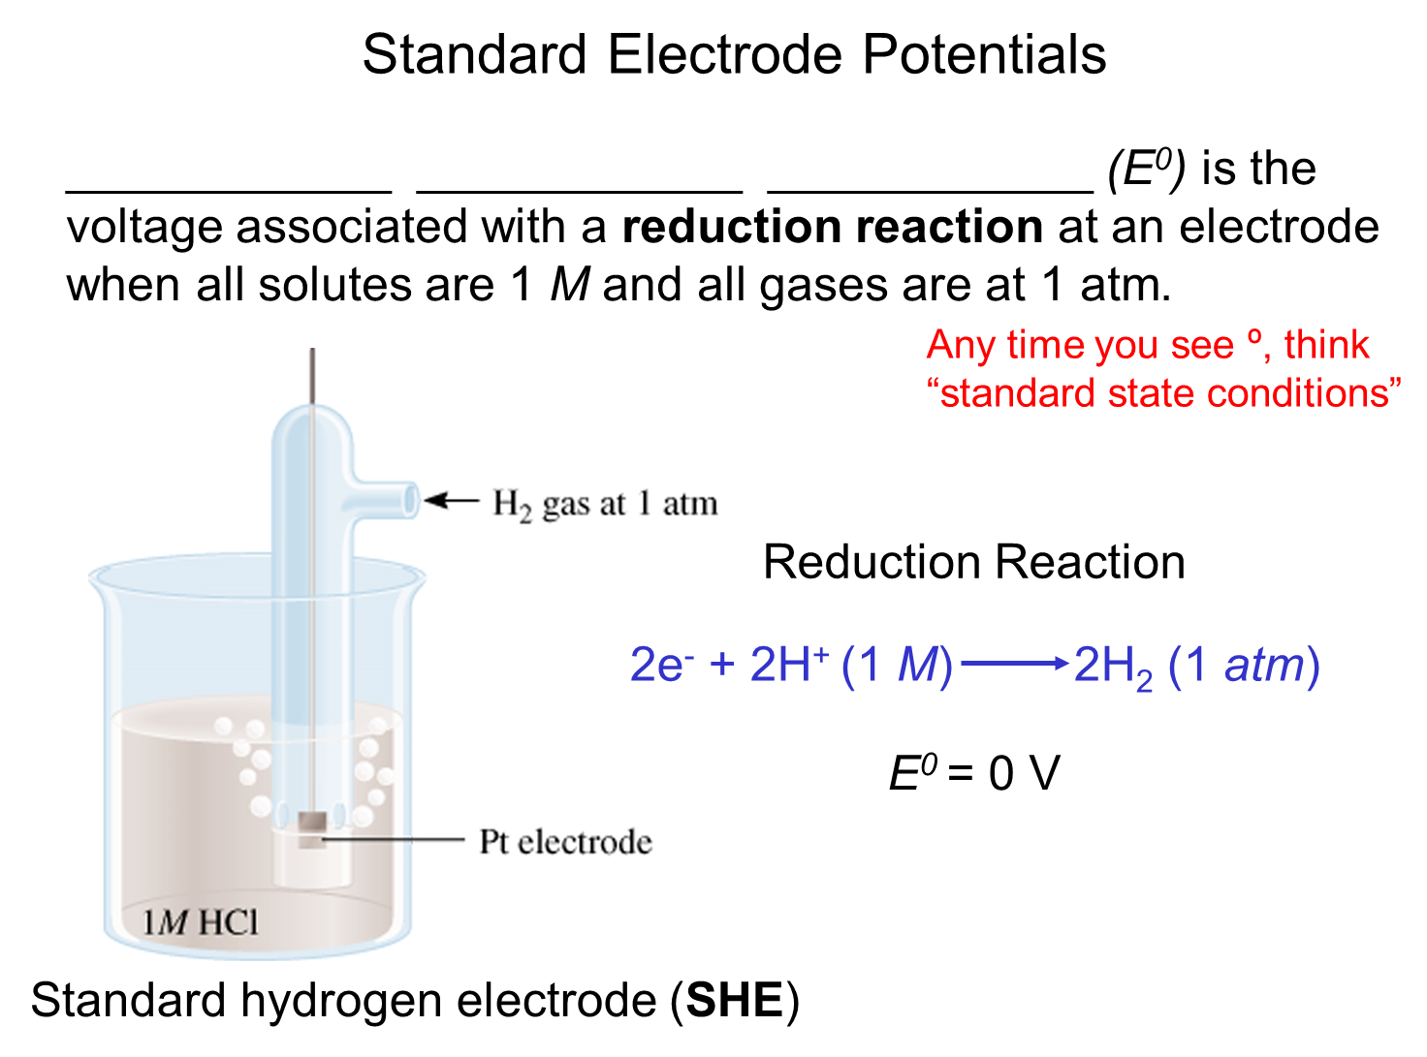

Slide 26
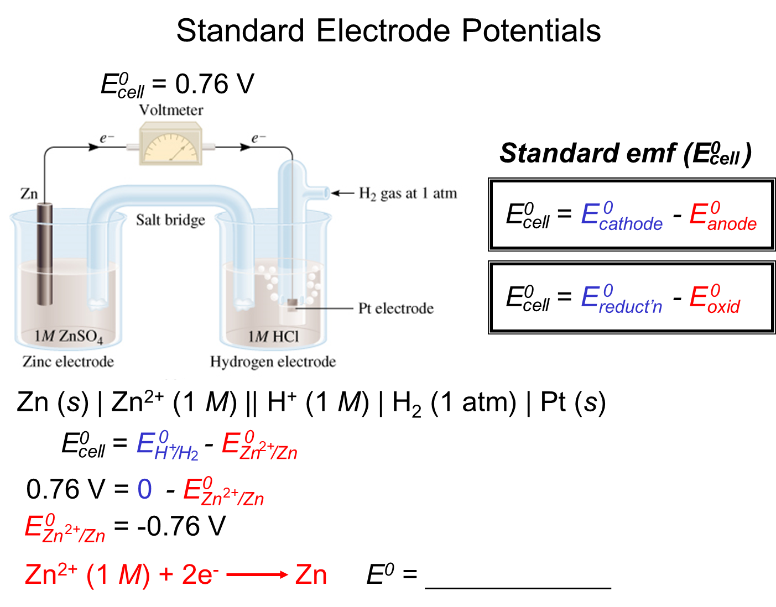

Slide 27
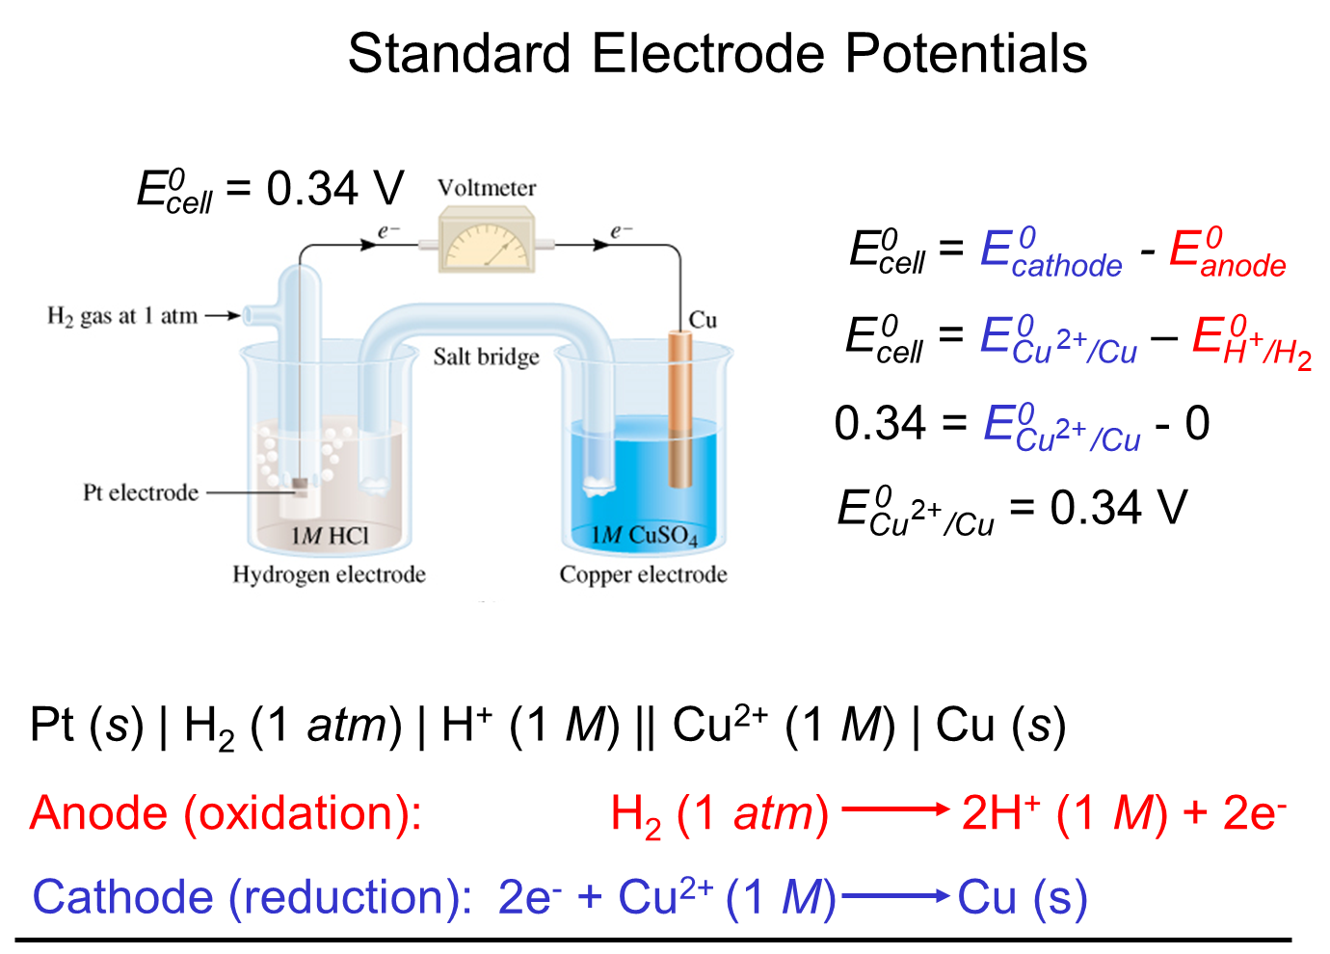

Slide 28
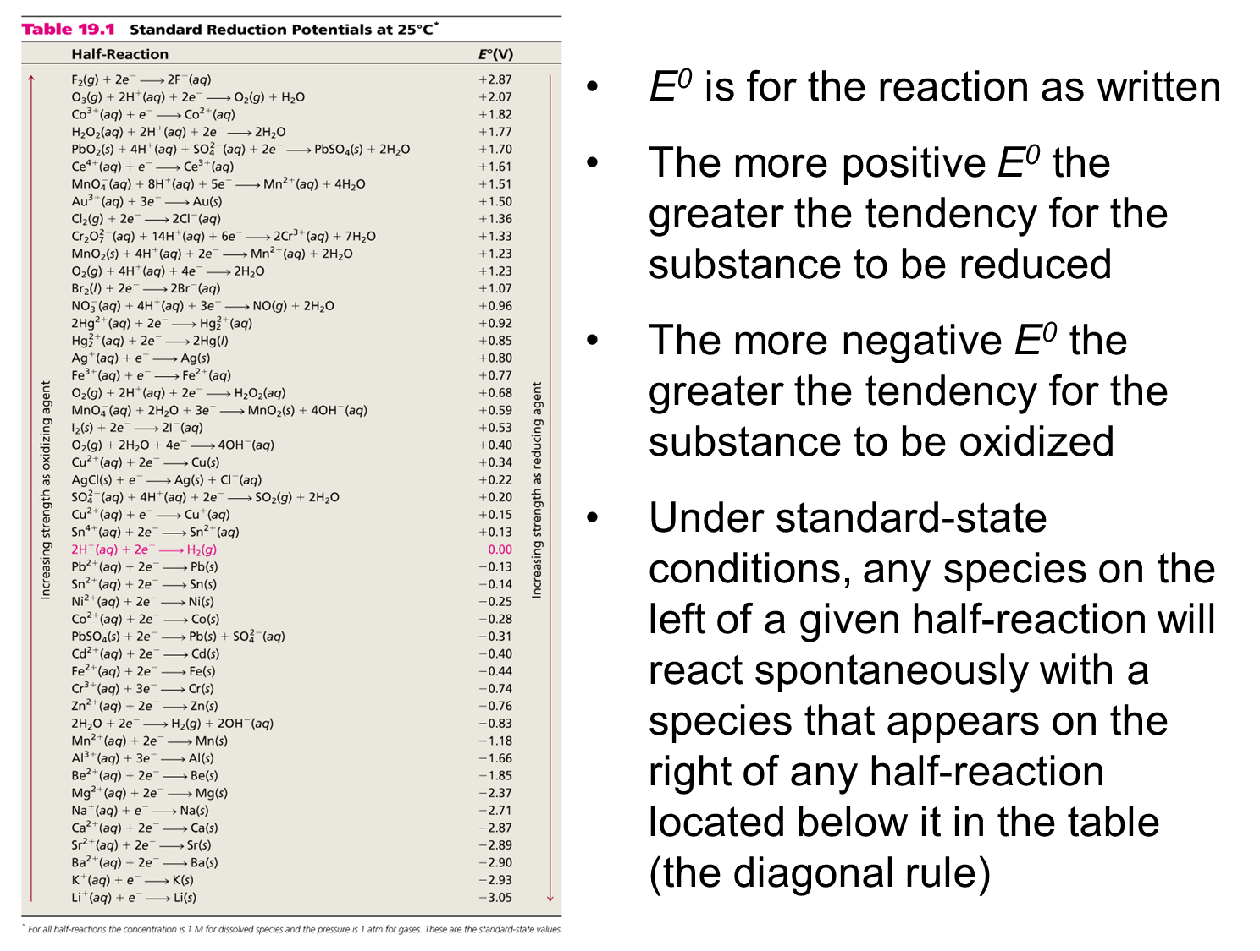

Slide 29
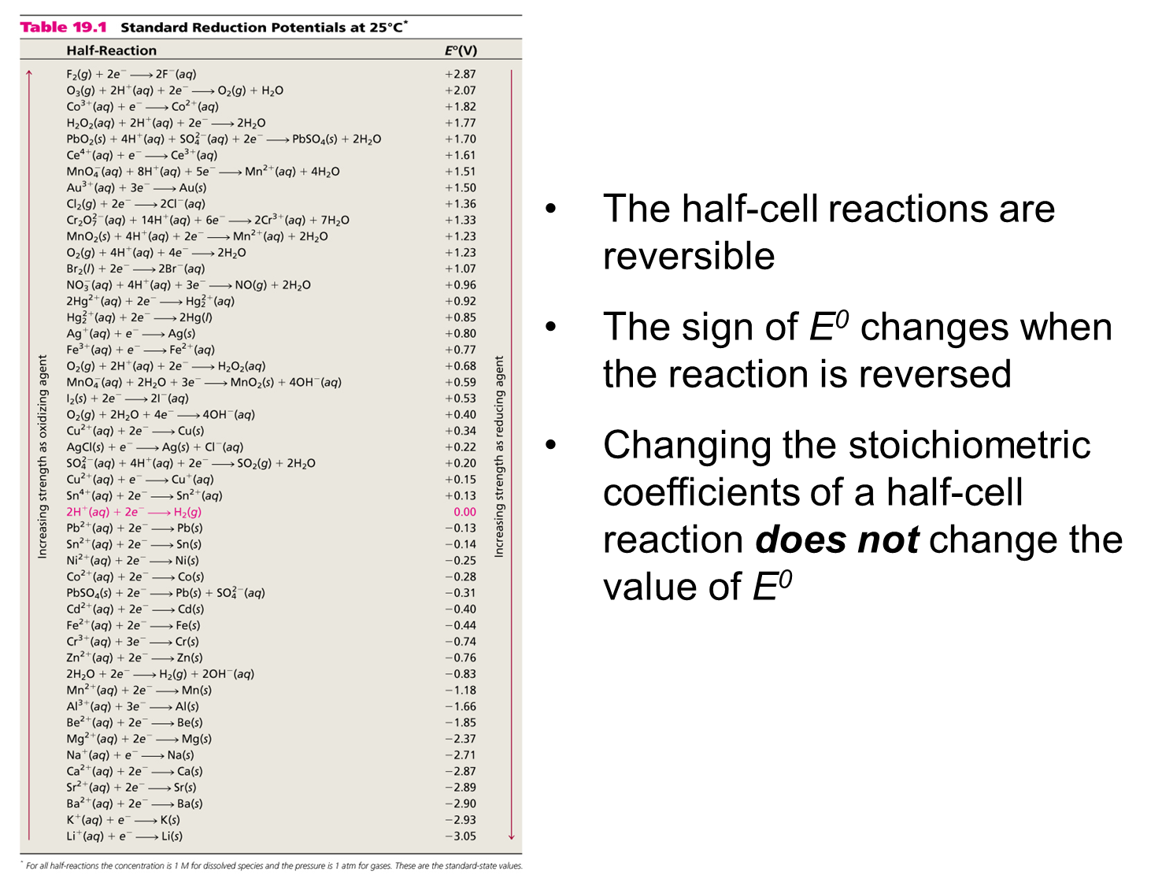

Slide 30
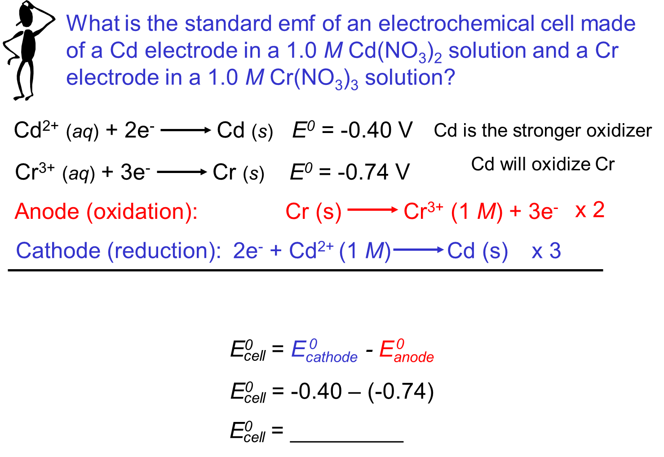

Slide 31
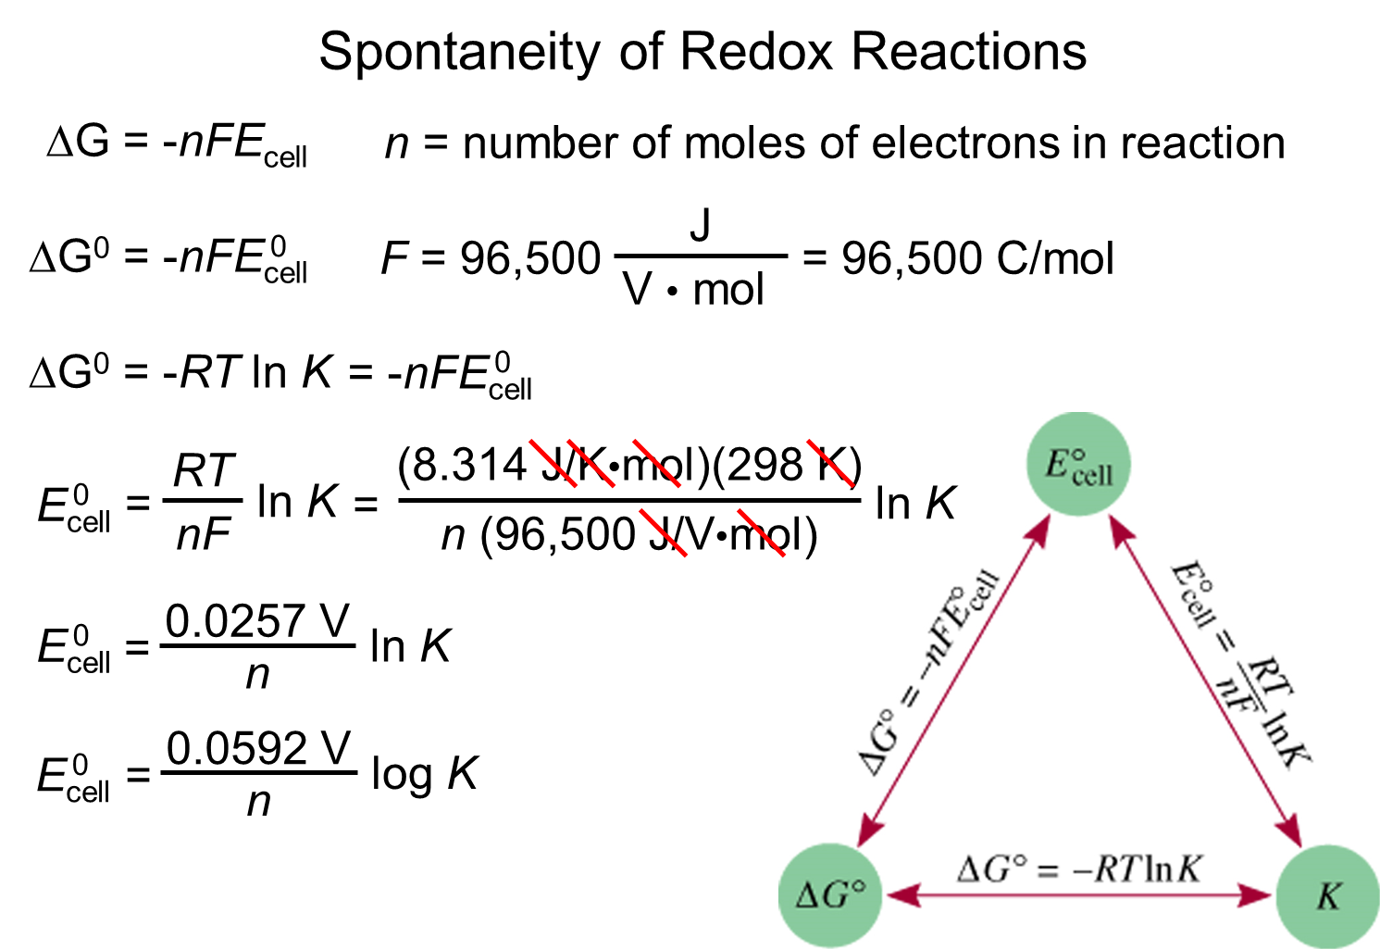

Slide 32
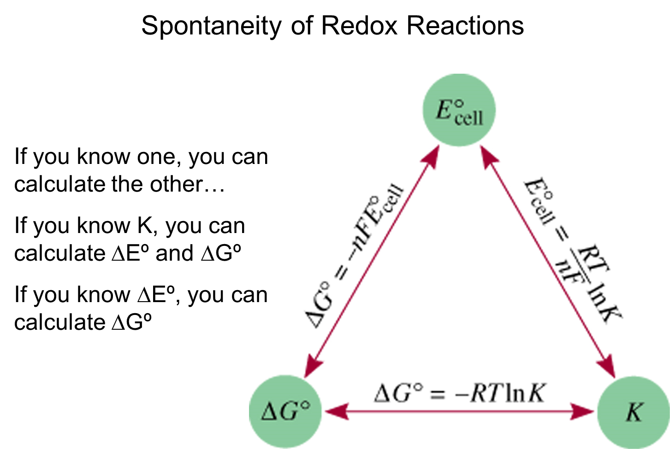

Slide 33
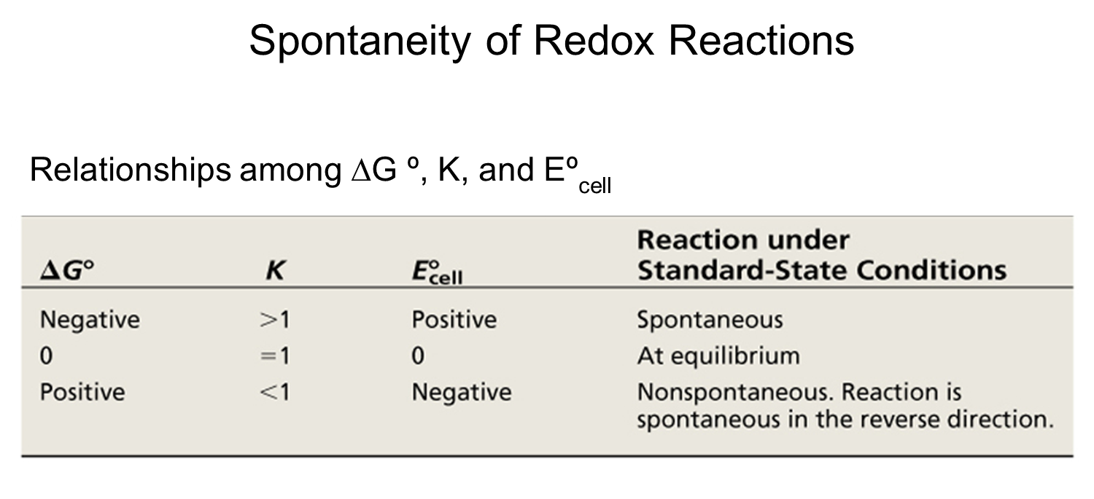

Slide 34
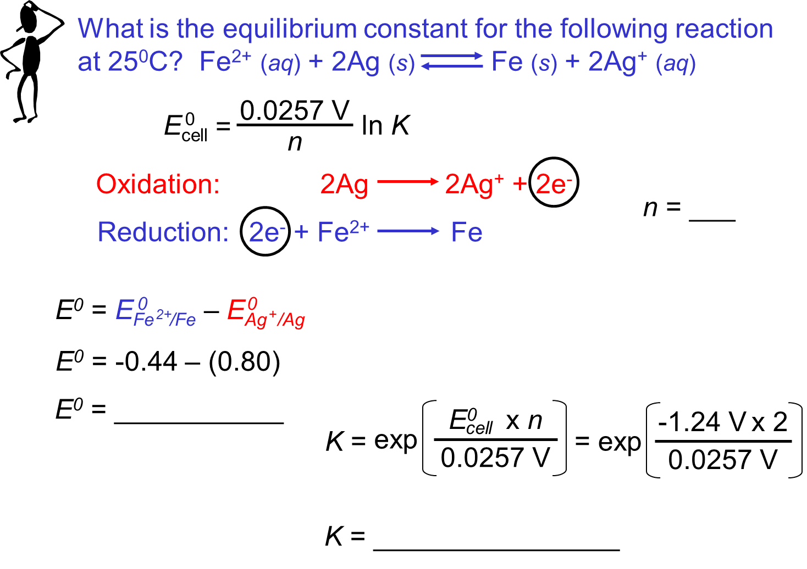

Slide 35
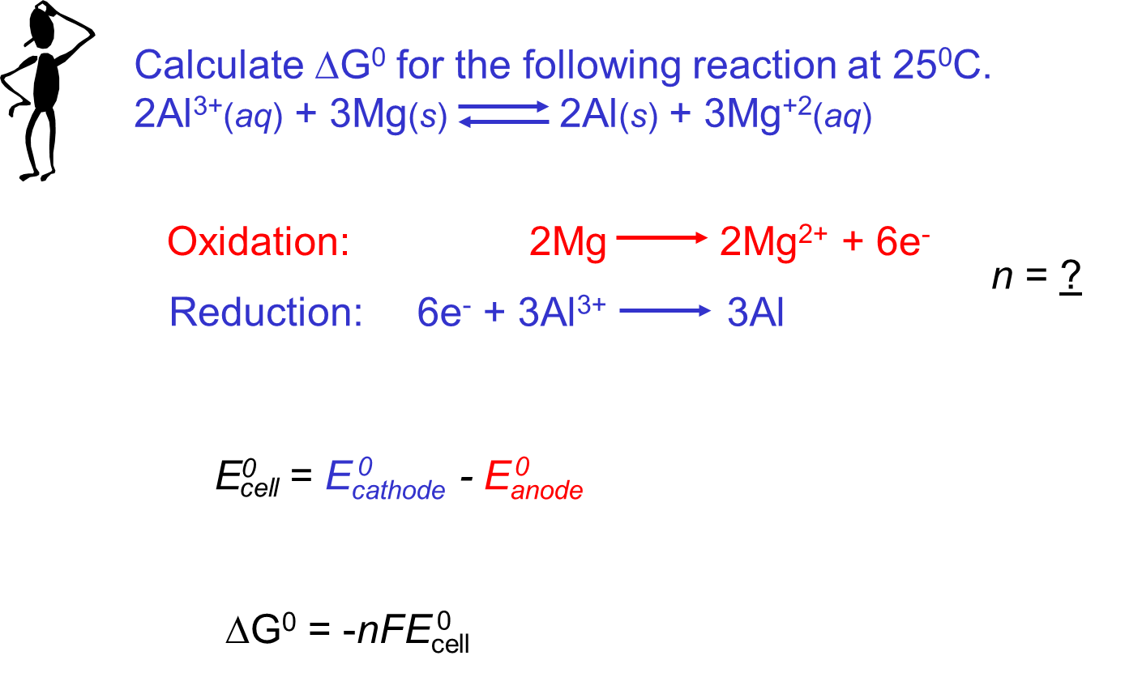

Slide 36
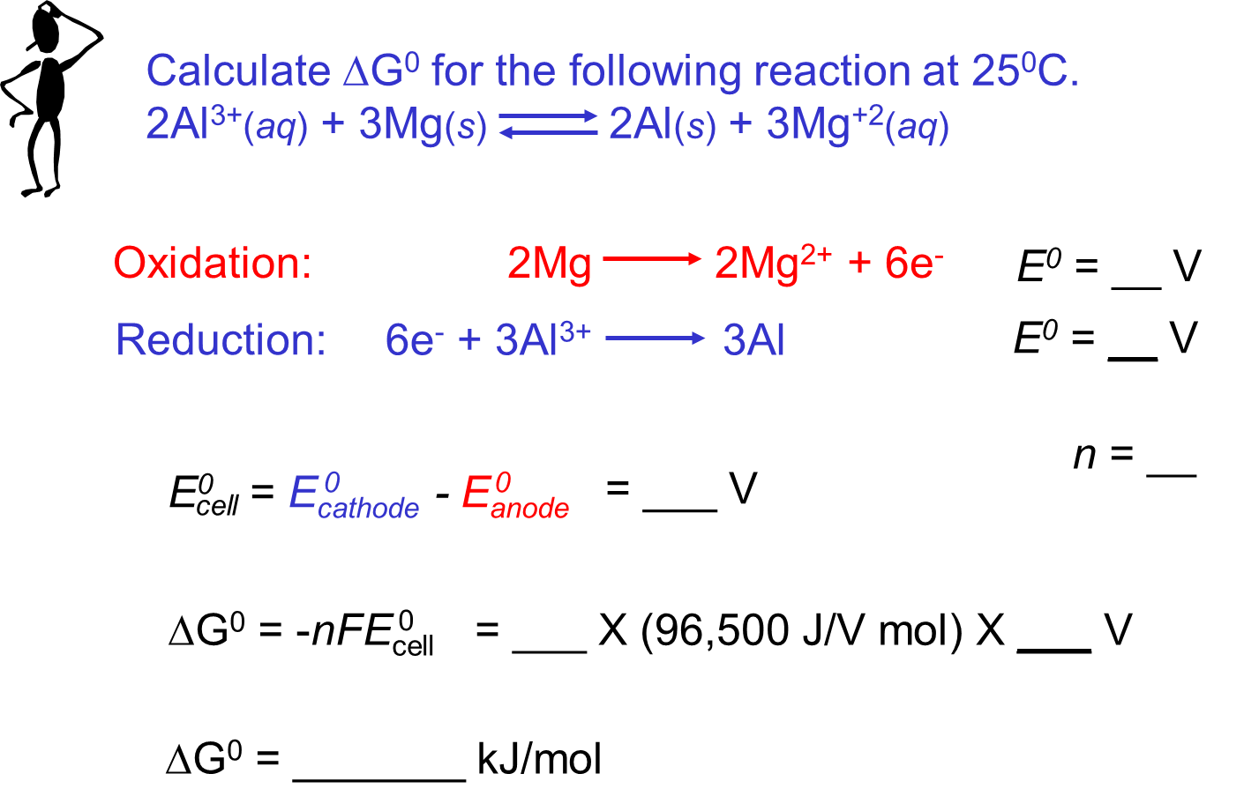

Slide 37
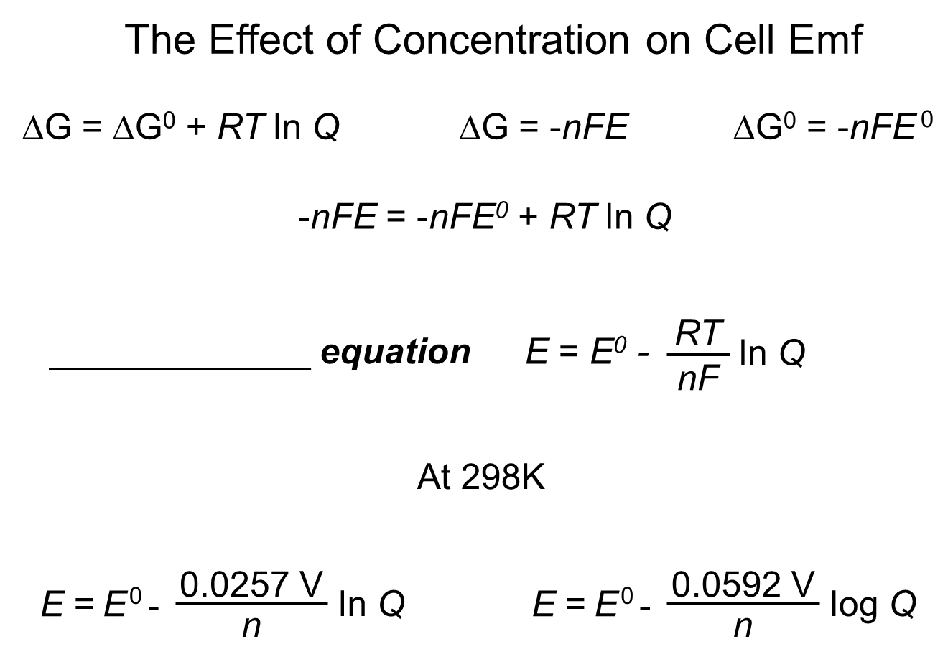

Slide 38
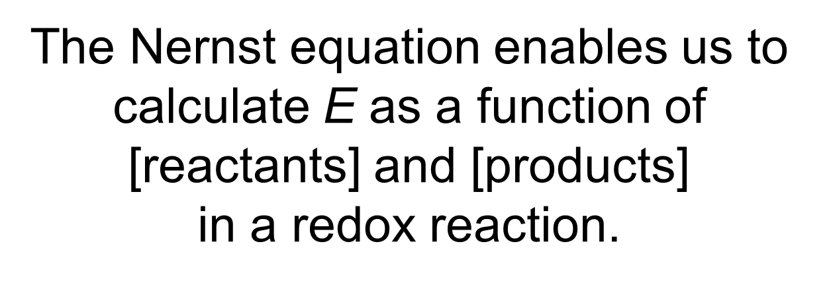

Slide 39
