Slide 1




1

Slide 2


Linux system administrators, cloud administrators, and network administrators interested in centrally managing Ansible projects and playbook execution at scale with Ansible Tower.

Slide 3

Ansible Knowledge, familiar with Ansible playbooks, and roles
RHCSA in RHEL or equivalent Linux system administration skills recommended

Slide 4

Introduction to Ansible Tower
Overview of Ansible
Introduction to Ansible Tower
Ansible Tower Features
Ansible Tower Setup

Slide 5
Installing Ansible Tower
Installation Steps of Ansible
Overview of Ansible Setup, AD-Hoc Commands and running Playbook
Installation of Ansible Tower
Orientation to the Ansible Tower Web Interface

Slide 6
Ansible Tower Web Interface
Overview of Tower Dashboard
Resources like Templates, Credentials, Projects & Inventories etc
Practice Lab Session - Running a job to update a content in a file
Practice Lab Session - Running a job to restart a service

Slide 7
Creating Users and Teams for Role-Based Access Control
Overview of RBAC
Creating & Managing Ansible Tower Users
User Types, Organization Role
Lab Session 1 - Creating and Managing Ansible Tower Users
Lab Session 2 - Delegating permissions to a normal user to execute a job template
Lab Session 3 - Delegating permissions to a normal user to access, edit or update a inventory
Lab Session 4 - Delegating permissions to a normal user to run a AD-Hoc Commands
Managing Users with Teams
Practice Lab Session

Slide 8
Creating & Managing Inventories & Credentials
Creating a Static Inventory
Practice Lab Session
Creating Machine Credentials for Access to Inventory Hosts
Credential Types
Practice Lab Session

Slide 9
GitHub
Overview of GitHub
Install and Configure Git
Create a GitHub Account
Creating a local Git Repository
Push the files from local Git Repository to remote GitHub Repository
Pull the from GitHub Repo to Local repo
Managing Ansible Projects using Git
Practice Lab Session

Slide 10
Dynamic Inventory
Overview of Dynamic Inventories
Configuring a Dynamic Inventory for AWS EC2 Environment
Creating AWS Credentials on Tower
Practice Lab : Sync to update Inventory for newly added EC2 hosts or decommissioned servers
Last Lecture

Slide 11

Introduction about Ansible
Ansible is a radically simple IT automation platform that makes your applications and systems easier to deploy.
It support configuration management with examples as below.
    Configuration of servers
    Application deployment
    Continuous testing of already install application
    Provisioning
    Automation of tasks

Slide 12

What is Ansible?
Ansible is an open source configuration management and orchestration utility (planning or coordination of the elements of a situation to produce a desired effect).
It can automate and standardize the configuration of remote hosts and virtual machines. Its orchestration functionality allows Ansible to coordinate the launch and graceful shutdown of multitiered applications. Because of this, Ansible can perform rolling updates of multiple systems in a way that results in zero downtime.
Instead of writing custom, individualized scripts, system administrators create high-level plays in Ansible. A play performs a series of tasks on the host, or group of hosts, specified in the play. A file that contains one or more plays is called a playbook.

Slide 13

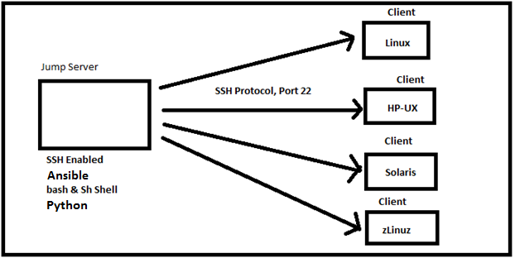


Slide 14
Introduction
Ansible Tower is Ansible at a more enterprise level. It is a web-based solution for managing your organization with a very easy user interface that provides a dashboard with all of the state summaries of all the hosts, allows quick deployments, and monitors all configurations.
The tower allows you to share the SSH credentials without exposing them, logs all the jobs, manage inventories graphically and syncs them with a wide variety of cloud providers.
Tower can keep a history of the times that job has run, the successes/failures, logs, what servers you have run it against, and the status of those servers. Because it stores all this information, it makes auditing a breeze.
In my opinion, the benefits to using Ansible Tower are: simplifying the use of Ansible, auditing, and security.

Slide 15
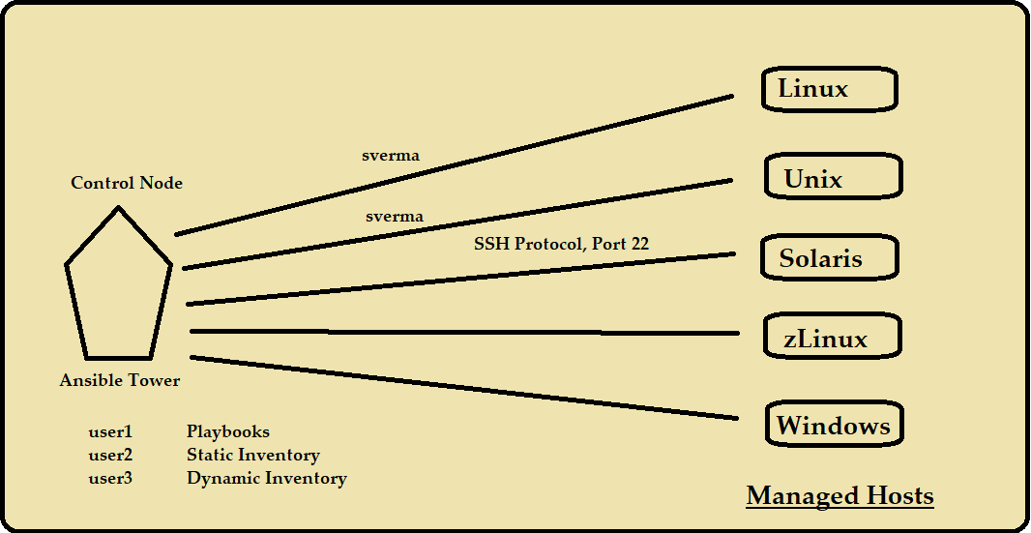

Slide 16
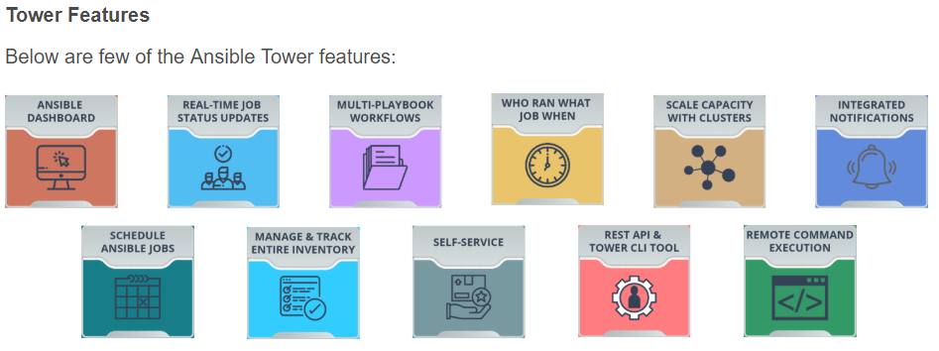
Introduction
Some of the important features of Ansible Tower are listed below.

Slide 17
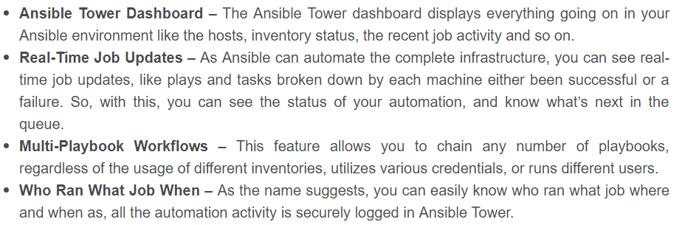
Introduction
Some of the important features of Ansible Tower are listed below.

Slide 18
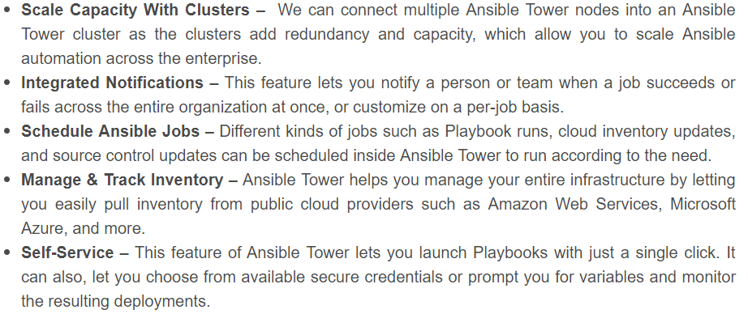
Introduction
Some of the important features of Ansible Tower are listed below.

Slide 19
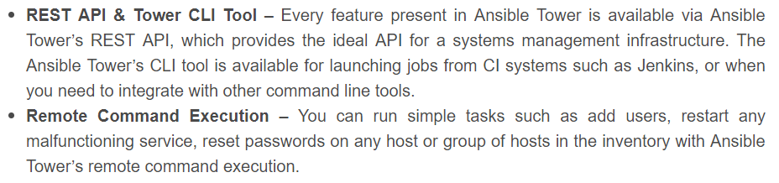
Introduction
Some of the important features of Ansible Tower are listed below.

Slide 20
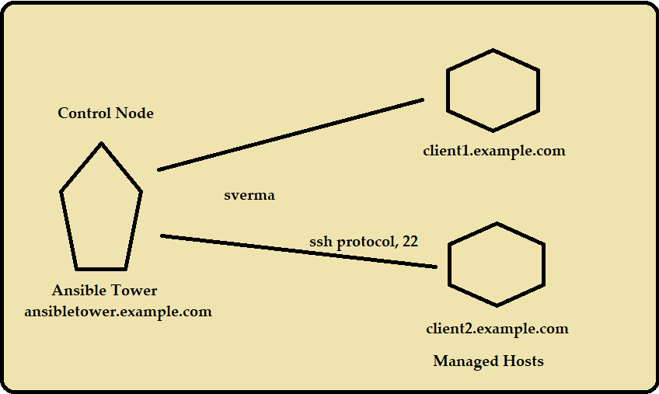

Slide 21
Note: Ansible Tower must be installed on RHEL 7, CentOS 7, or Ubuntu 16.04 LTS, and requires Ansible Core 2.6.X or later.
https://www.ansible.com/products/tower/trial
https://releases.ansible.com/ansible-tower/setup/

Slide 22
ROLE-BASED ACCESS CONTROLS
Different people using an Ansible Tower installation need to have different levels of access. Some may simply need to run existing job templates against a preconfigured inventory of machines.
Others need to be able to modify particular inventories, job templates, and playbooks. Still others may need access to change anything in the Tower installation.
The Tower interface has a built-in administrative user, admin, that has superuser access to the entire Tower configuration.
The permissions Users have to make changes to Tower objects are managed through Role-Based Access Controls (RBAC). Users are assigned roles that grant permissions which define precisely who can see, change, or delete an object in Tower.

Slide 23
ORGANIZATIONS
An Ansible Tower Organization is a logical collection of Teams, Projects, and Inventories. Since all Users must be assigned to an Organization, a brief discussion of Organizations is necessary before looking at User configuration.

Slide 24
USER TYPES
By default, an admin User account is created by the Tower installer which has full control of the Tower installation.
Tower Users can be created as one of three user types.
System Administrator
System Auditor
Normal User

Slide 25
ORGANIZATION ROLES
Newly created Users inherit specific roles from their Organization, based on their user type.
Additional roles can be assigned to a User after it is created in order to grant permissions to view, use, or change additional Tower objects.
Admin
Auditor
Member
Read

Slide 26
Practice Lab Session

Slide 27
Managing Users with Teams

Slide 28
Creating And Managing Inventories

Slide 30
Creating Machine Credentials for Access to Inventory Hosts
CREDENTIALS
Credentials are Ansible Tower objects that are used to authenticate to remote systems for various purposes. They may provide secrets such as passwords, SSH keys, or other supporting information needed to successfully access or use a remote resource.
Credential passwords and keys are encrypted before they are saved to the Tower database and can not be retrieved in clear text from the Tower user interface.
Users and Teams can be assigned privileges to use Credentials, but the secrets are not exposed to them.

Slide 31
Creating Machine Credentials for Access to Inventory Hosts
CREDENTIAL TYPES
Ansible Tower has a number of different types of Credentials that it can manage:
• Machine credentials are used to authenticate playbook logins and privilege escalation for
inventory hosts
Network credentials are used when Ansible network modules are used to manage networking equipment
Source Control (or SCM) credentials are used by Projects to clone and update Ansible project materials from a remote version control system such as Git, Subversion, or Mercurial
Inventory credentials are used to update dynamic inventory information from one of Ansible Tower's built-in dynamic inventory sources.

Slide 32
GitHub
To understand GitHub, you must first have an understanding of Git. Git is an open-source version control system that was started by Linus Trovalds—the same person who created Linux. Git is similar to other version control systems—Subversion, CVS, and Mercurial to name a few.
The “Hub” in GitHub
We’ve established that Git is a version control system, similar but better than the many alternatives available. So, what makes GitHub so special? Git is a command-line tool, but the center around which all things involving Git revolve is the hub—GitHub.com—where developers store their projects and network with like minded people.

Slide 33
DYNAMIC INVENTORIES
When Ansible runs a playbook, it uses an inventory to help determine against which hosts the plays should be run. Both Ansible and Ansible Tower make it easy to set up a static inventory of hosts which are explicitly specified in the inventory by the administrator.
However, these static lists require manual administration in order to keep them up to date. This can be inconvenient or challenging, especially when an organization wants to run the playbooks against hosts which are dynamically created in a virtualization or cloud computing environment.
In that scenario, it is useful to use a dynamic inventory. Dynamic inventories are scripts that, when run, dynamically determine which hosts and host groups should be in the inventory based on information from some external source.

Slide 34
DYNAMIC INVENTORIES
By default, Ansible Tower comes with built-in dynamic inventory support for a number of external inventory sources (or cloud inventory sources), including:
Amazon EC2
Google Compute Engine
Microsoft Azure Resource Manager
VMware vCenter
Red Hat Satellite 6
Red Hat CloudForms
OpenStack

Slide 35
Last Lecture

