Slide 1
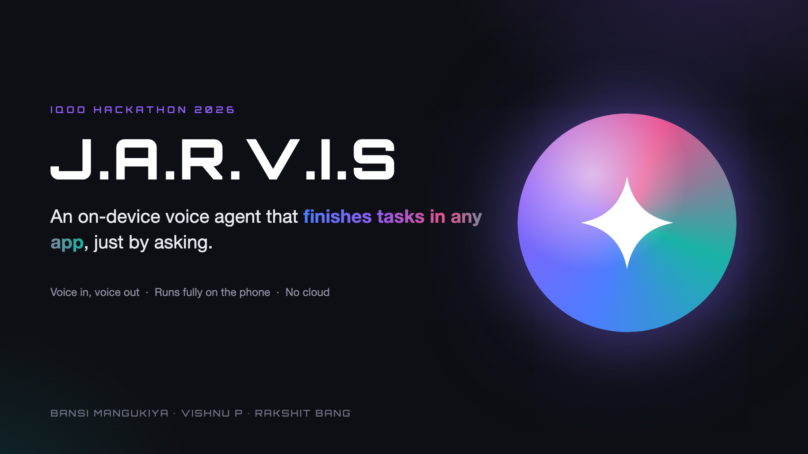
Notes:
Hi, we're team J.A.R.V.I.S. We built a voice agent that finishes real tasks inside any Android app, and it runs entirely on the phone.

Slide 2
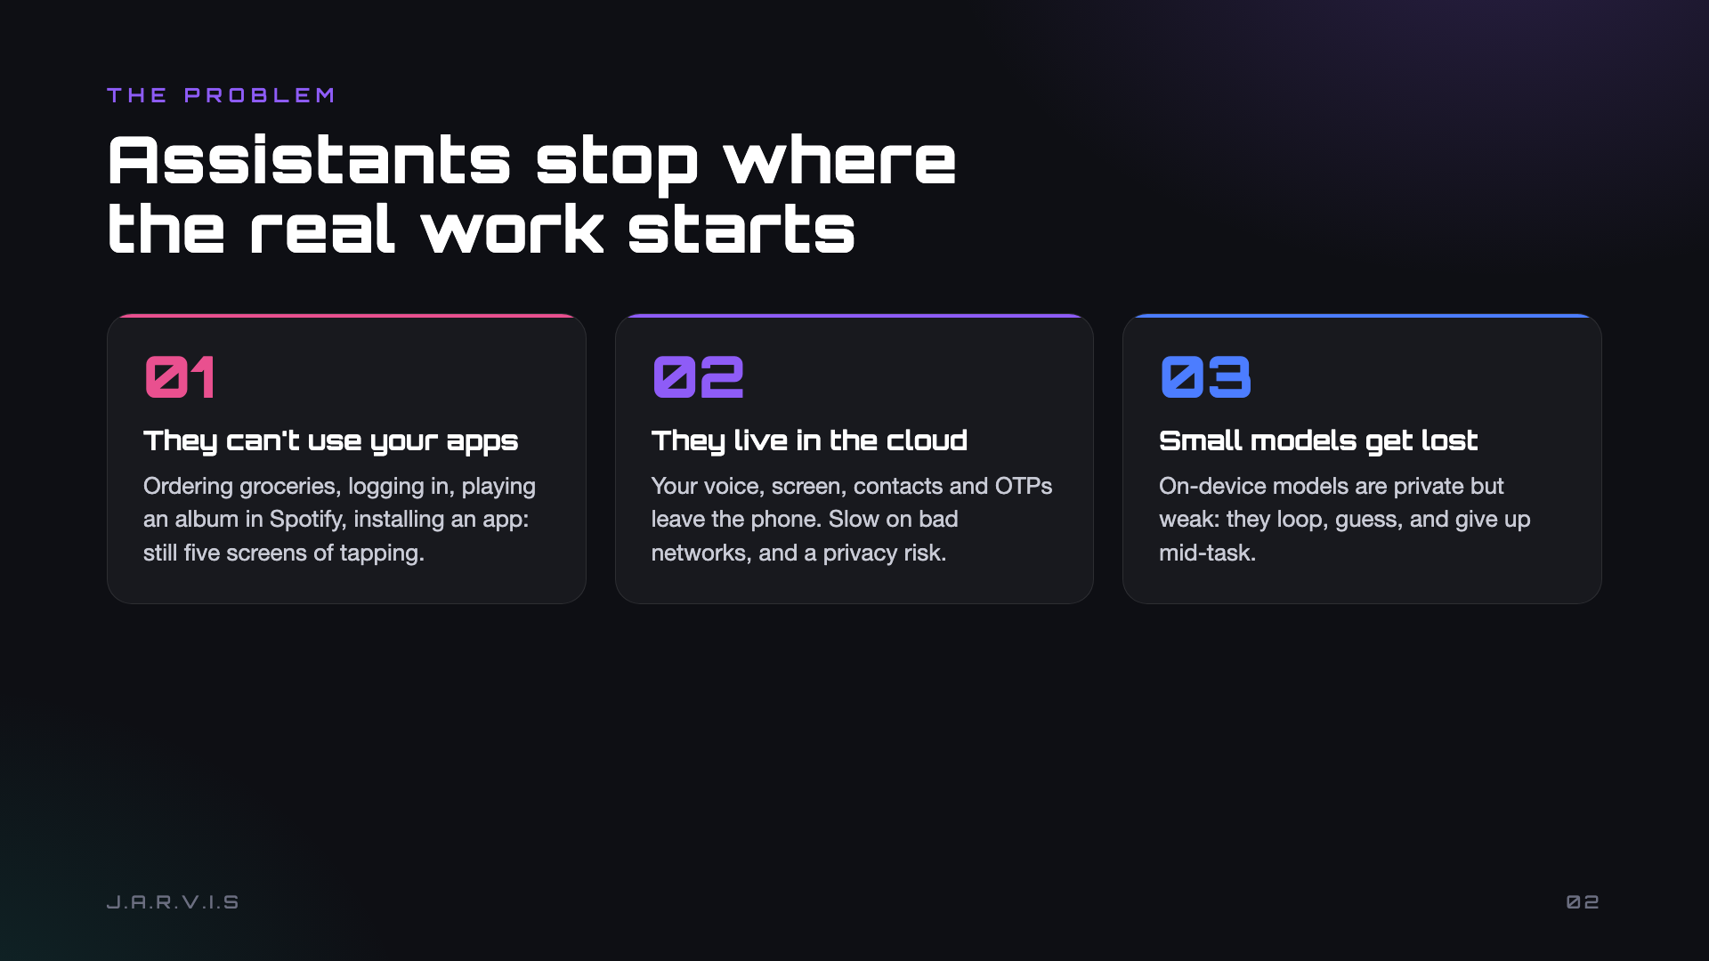
Notes:
Today's assistants answer questions but stop at their own features. Anything inside another app is still manual. The ones that go further send your data to the cloud. And small on-device models tend to loop or give up.

Slide 3
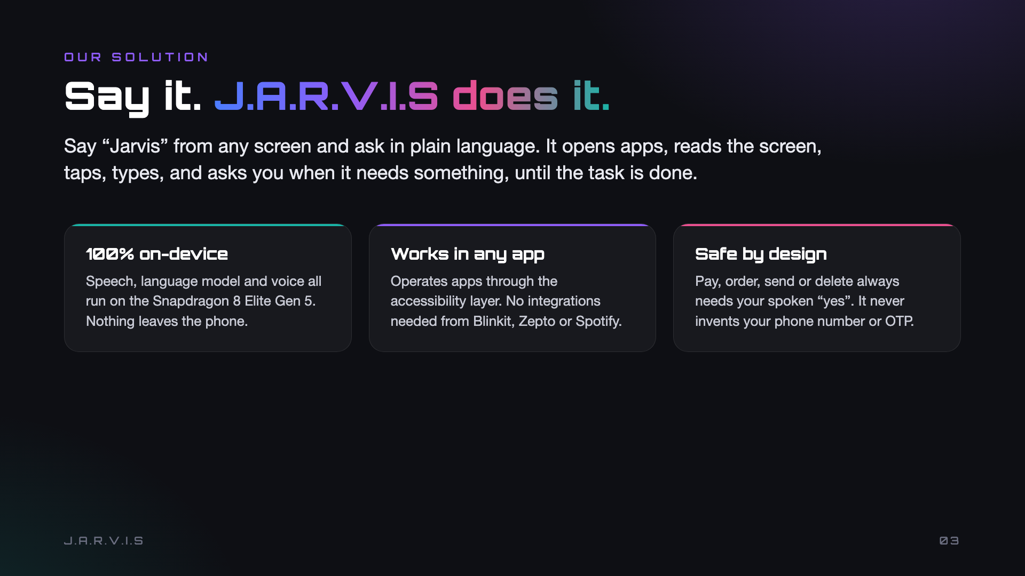
Notes:
You say Jarvis from any screen and ask in plain language. It operates apps like you would. Speech, the LLM and TTS all run on the Snapdragon 8 Elite Gen 5. Anything consequential needs your spoken yes.

Slide 4
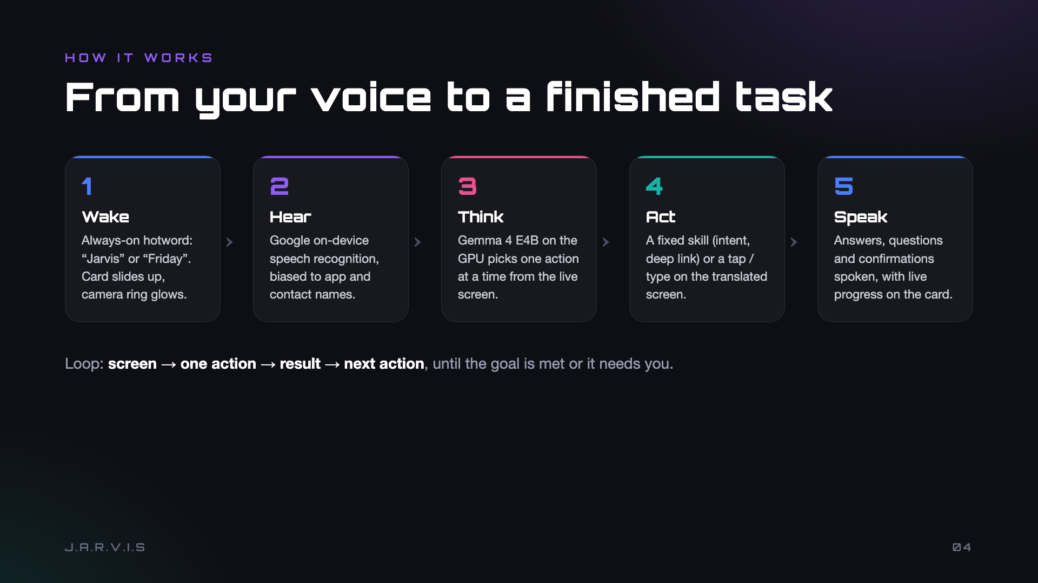
Notes:
Five stages: wake word, on-device speech recognition, Gemma 4 E4B picking one action at a time, a fixed skill or a screen action, and a spoken reply. It loops until the goal is met or it needs you.

Slide 5
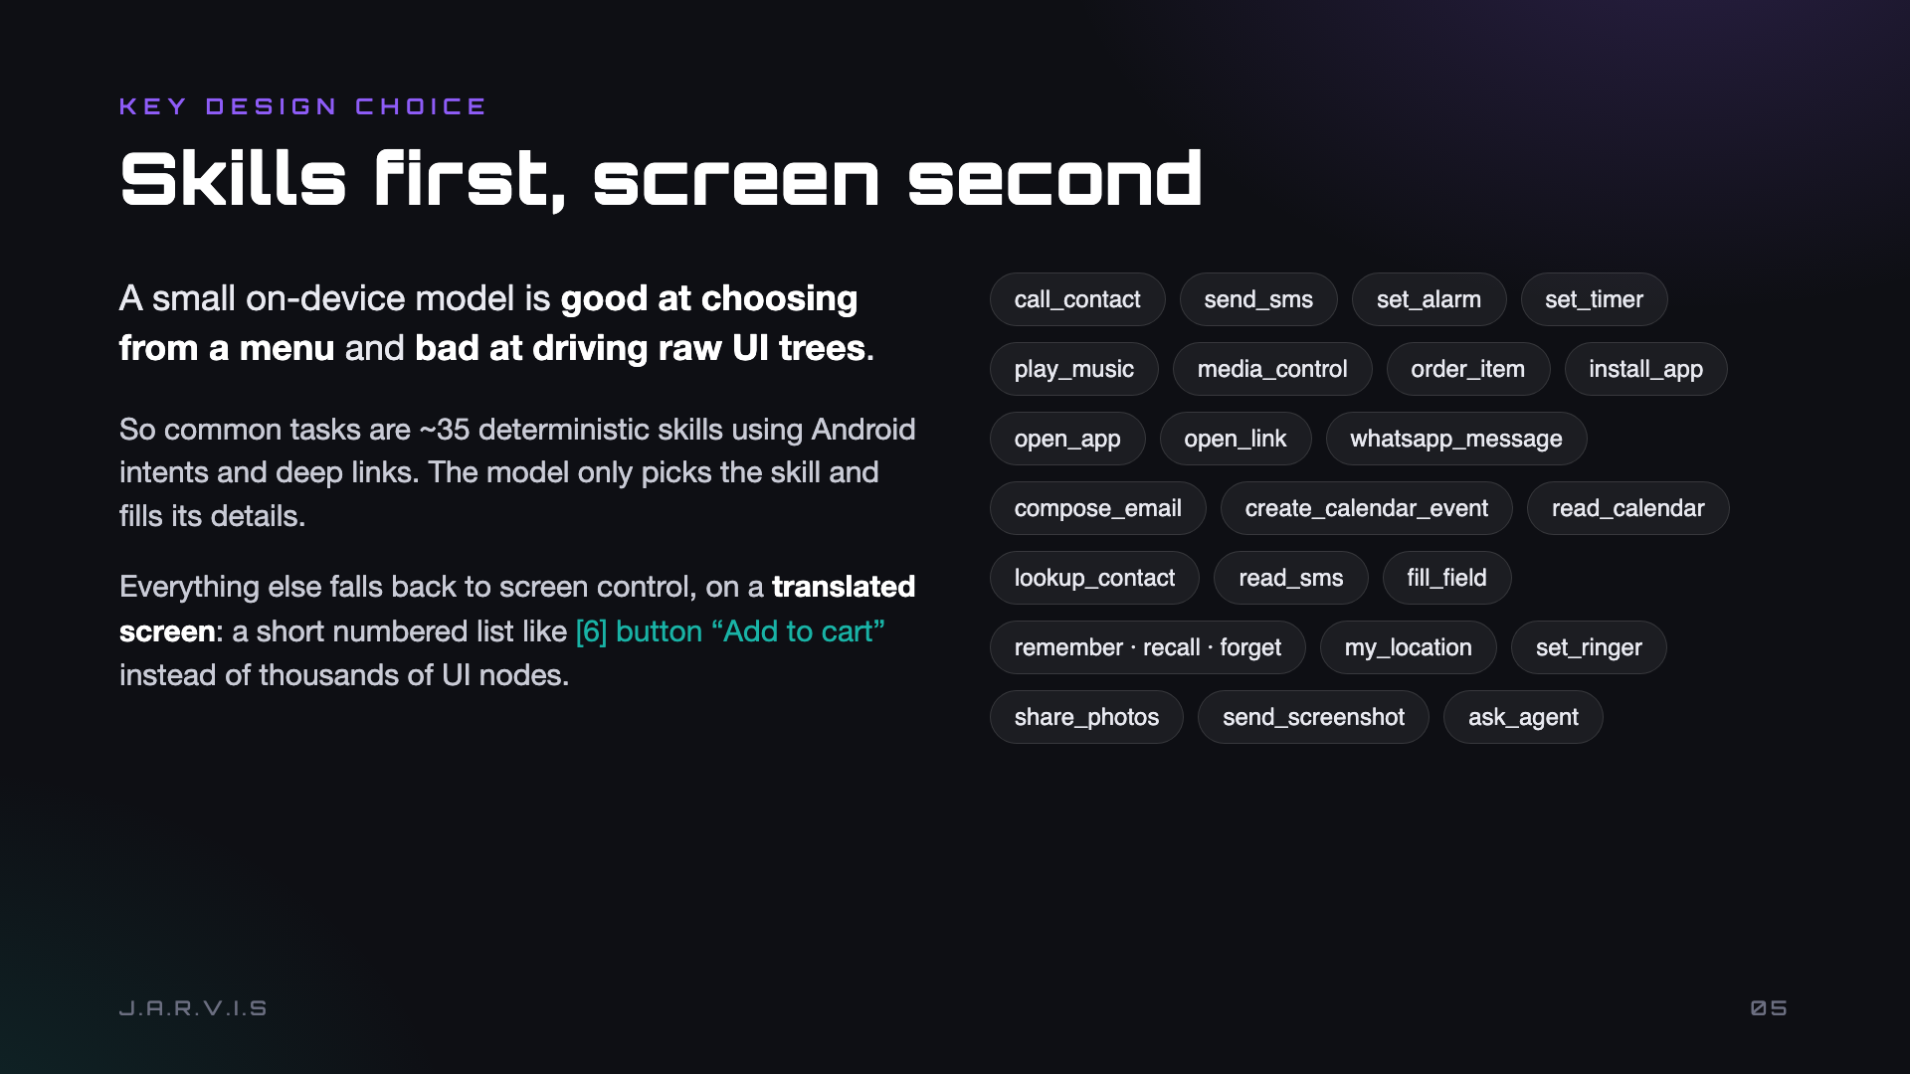
Notes:
Our key design choice: skills first. The small model is good at choosing from a menu, so about 35 common tasks are deterministic skills via intents and deep links. Everything else uses a translated screen, a short numbered list of meaningful elements.

Slide 6
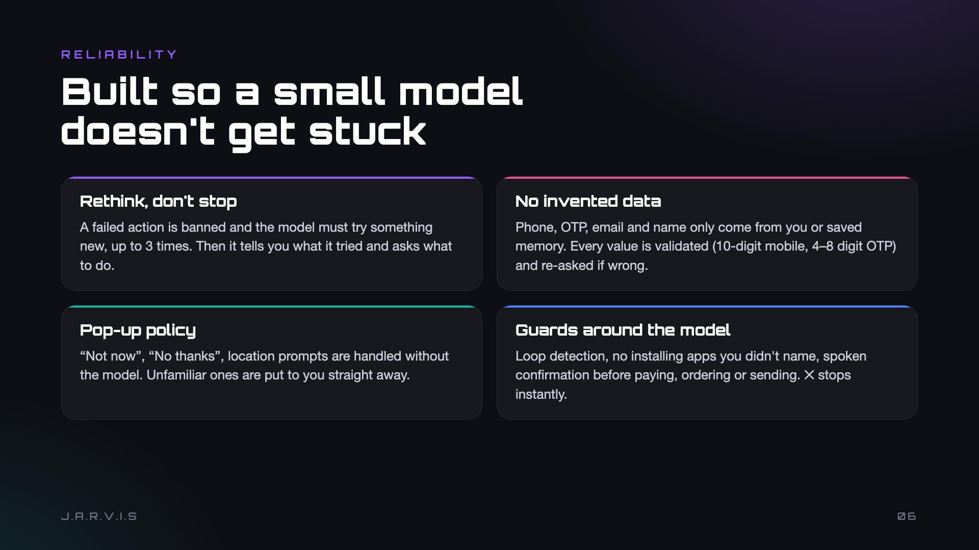
Notes:
Around the model we added guards: rethink up to 3 times instead of stopping, then ask the user. Personal data is never invented and is validated. Pop-ups get a default policy. Loops, unasked installs and payments are guarded.

Slide 7
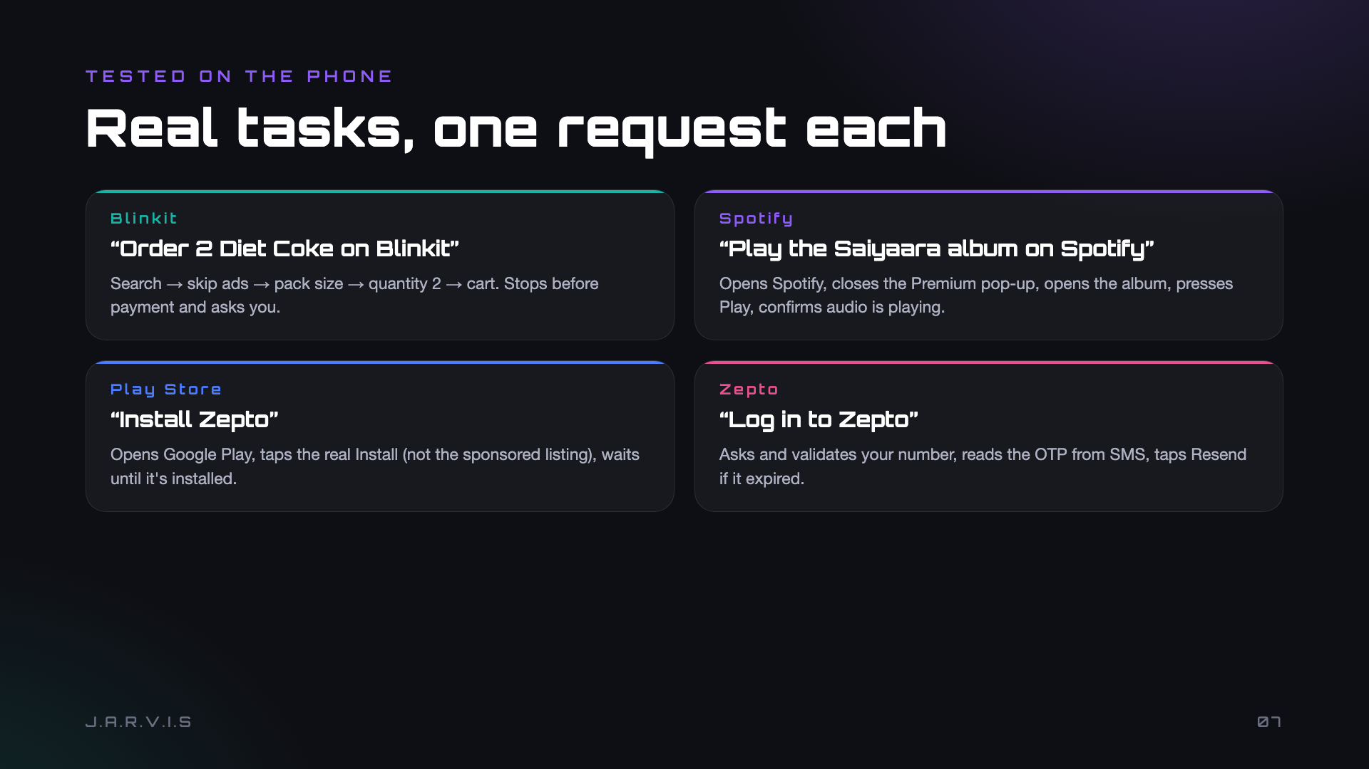
Notes:
These all ran on the phone in one request each: Blinkit order stopping before payment, Spotify album with the Premium pop-up, Play Store install avoiding the sponsored result, Zepto login with OTP from SMS.

Slide 8
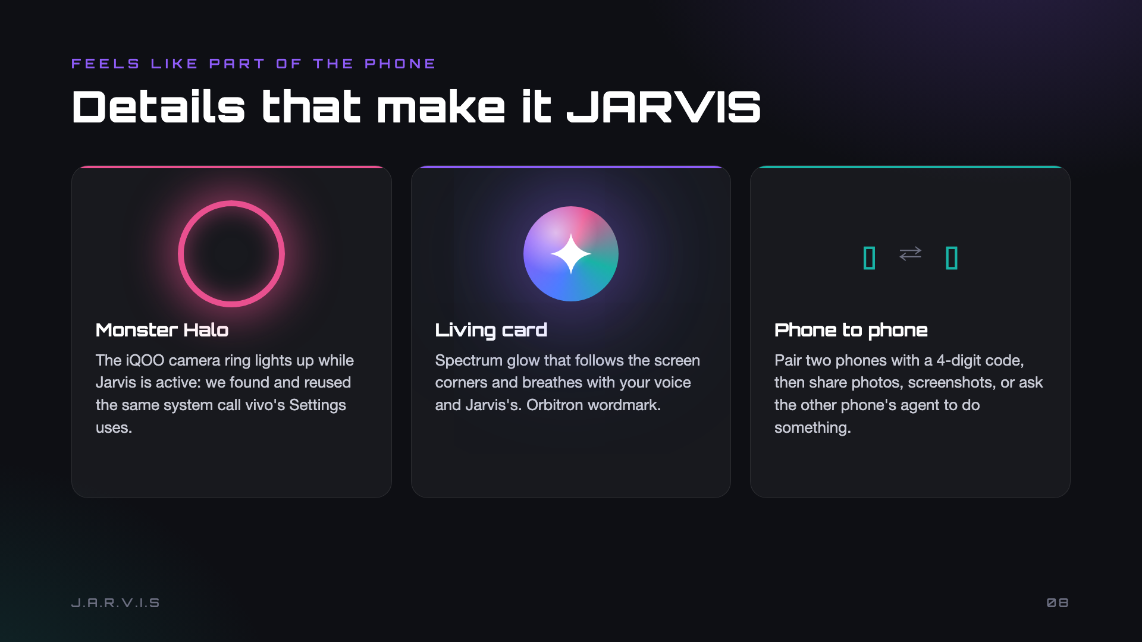
Notes:
Polish: the iQOO camera ring lights while Jarvis is active, using vivo's own system call. The card has a live spectrum glow. And two phones can pair and ask each other's agents to act.

Slide 9
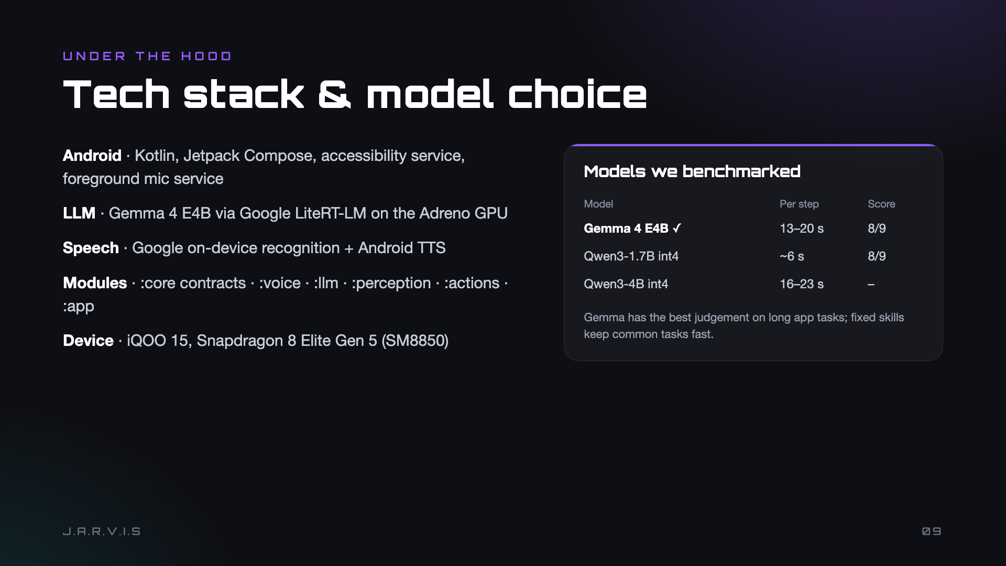
Notes:
Kotlin and Compose with an accessibility service. Gemma 4 E4B on LiteRT-LM on the GPU. We benchmarked Qwen models too: Gemma judged long app tasks best; fixed skills keep common tasks fast.

Slide 10
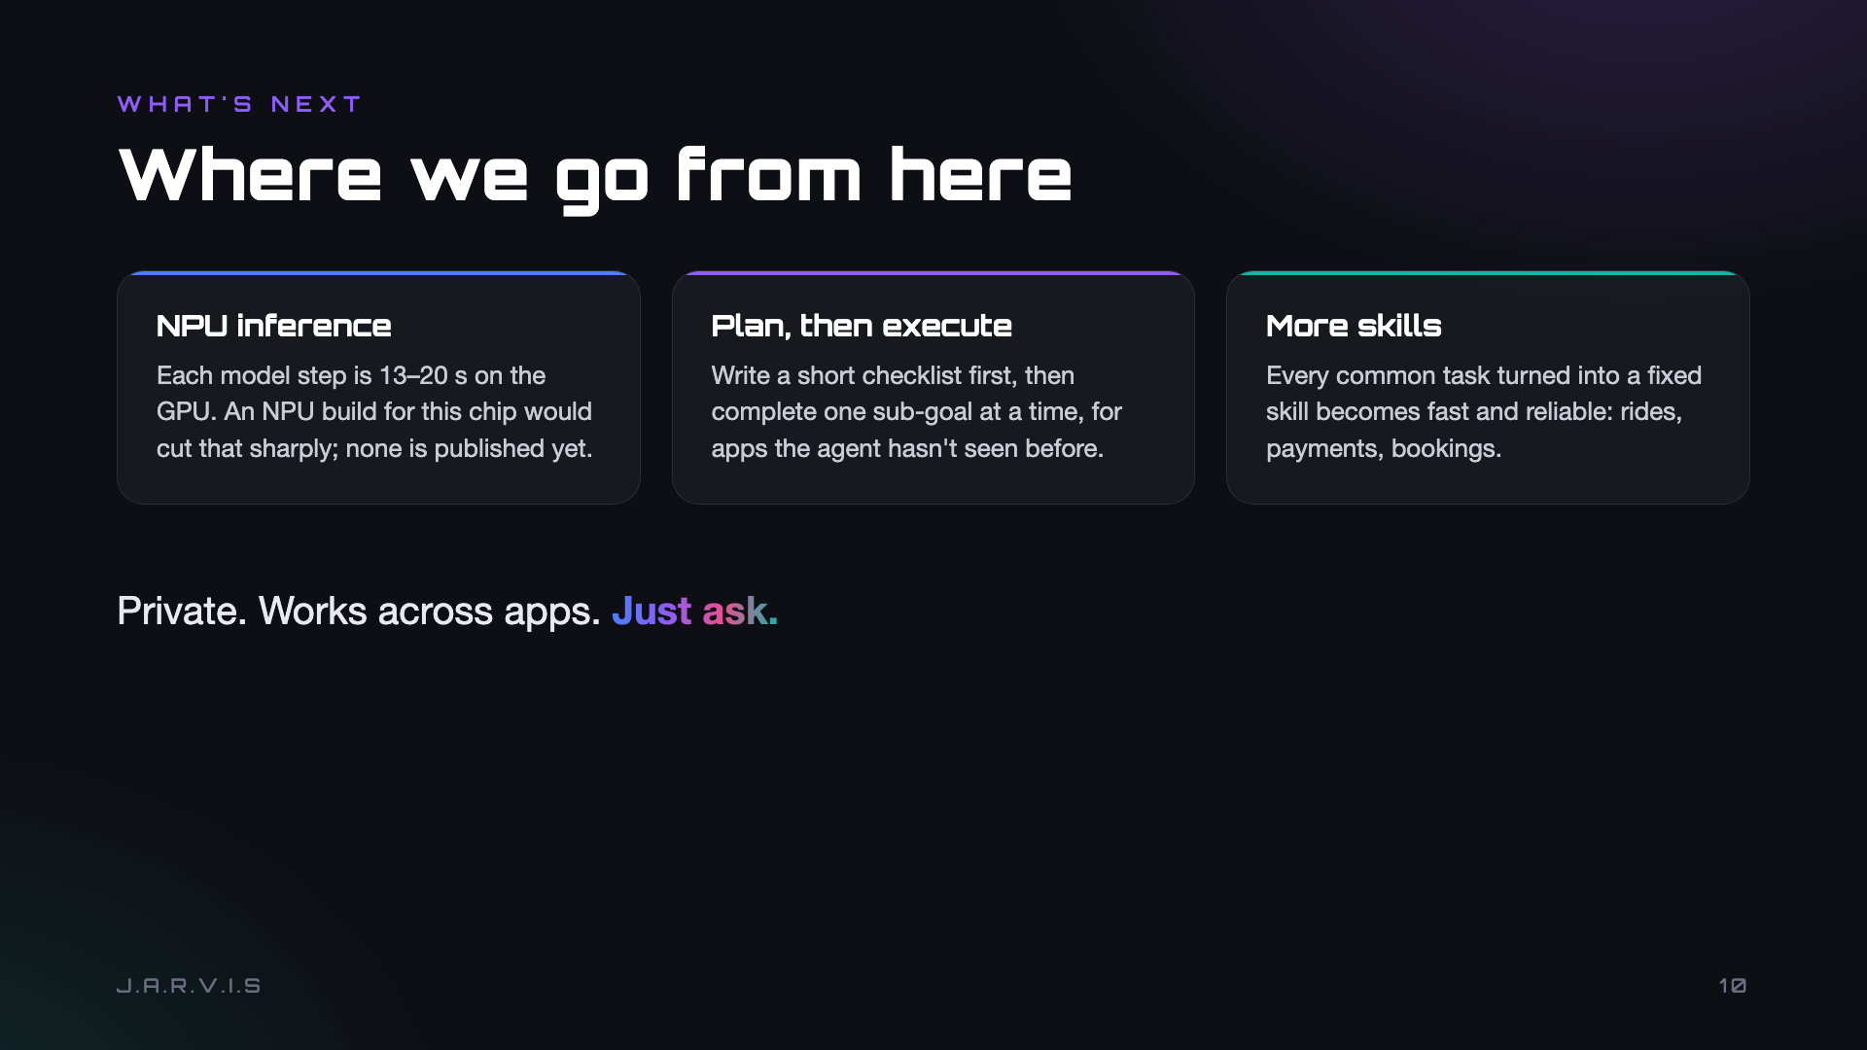
Notes:
Next: NPU inference once a build for this chip exists, plan-then-execute for unfamiliar apps, and more skills. Private, works across apps, just ask. Thank you.

