Slide 1
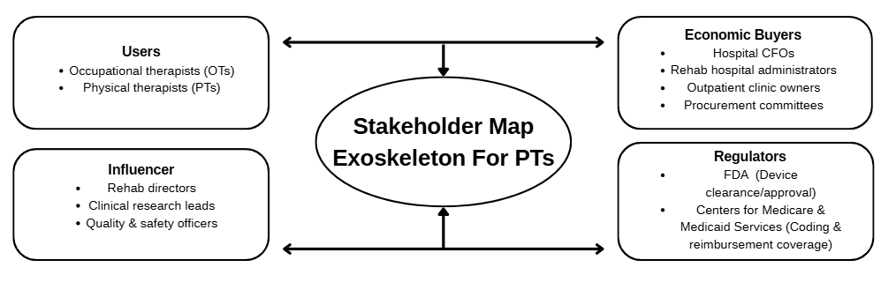
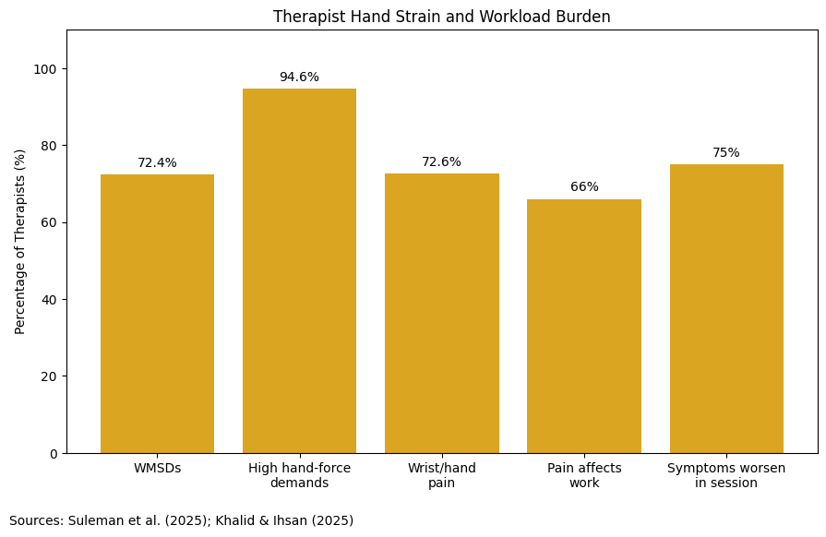
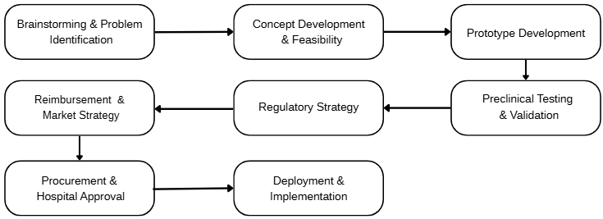



Reducing Therapist Hand Strain Through Wearable Soft Robotic Assistance
IMPACT Program | Vanderbilt University | Spring 2026
Brianna Moering| Cynthia Huang |Rbani Elrayah
PROBLEM STATEMENT
Physical Therapists experience repetitive hand and grip strain during therapy sessions, which can lead to fatigue, reduced hand performance, and difficulty maintaining consistent patient care.
OVERVIEW
CORE PROBLEM SPACE
Overview
Physical therapists rely heavily on their hands to perform manual therapy techniques often requiring repetitive motions and sustained grip force. Over time this repeated use can lead to hand strain and fatigue making it difficult to maintain consistent high-quality care. Persistent hand strain may also increase the risk of injury and professional burnout. This project focuses on identifying the causes of hand strain in physical therapists and exploring potential solutions to reduce physical stress during treatment.
Physical therapists experience repeated hand and wrist strain because rehabilitation sessions require frequent assisted gripping, finger extension, and guided movement exercises. Recent studies show that 72.4% of physical therapy professionals report work-related musculoskeletal disorders, and 94.6% report excessive hand-force demands during treatment tasks (Suleman et al., 2025). While current rehabilitation technologies improve patient recovery, most are designed primarily for the patient and do not reduce the repetitive physical effort required from therapists. This creates both a clinical and economic challenge, including:
therapist fatigue can reduce daily patient capacity and increase clinic staffing costs. This creates a clear opportunity for wearable rehabilitation support systems that improve therapist endurance while maintaining strong patient outcomes.
STAKEHOLDERS & ECOSYSTEM
72.6% reported wrist/hand pain linked to repetitive manual therapy tasks (Khalid & Ihsan, 2025).
CONCLUSION
TECH INTERVENTIONS
Reducing therapist hand strain is a critical opportunity to improve rehabilitation care. By integrating soft robotics, wearable sensing, and adaptive AI, this solution supports therapist endurance while preserving high-quality patient outcomes. This creates a scalable path toward safer clinicians, more consistent therapy, and stronger rehabilitation efficiency.
Soft robotic assistive glove → reduces repeated manual finger force
Force-sensing wearable system → measures therapist strain and applied force
AI-guided adaptive assistance → adjusts support based on fatigue and recovery stage
Notes:
500

