Slide 1
Generics
by B. Molutov

Slide 2
Introduction
We have already used a generic class ArrayList and generic interface Comparable. Generics let you parametrize types.
With this capability, we can define a class or a method with generic types that the compiler can replace with concrete types.
For Java defines a generic ArrayList class for storing the elements of a generic type. From this generic class, you can create an ArrayList object for holding strings and an ArrayList object for holding numbers. Here, strings and numbers are concrete types that replace the generic type.

Slide 3
Introduction
The key benefit of generics is to enable errors to be detected at compile time rather than at runtime. A generic class or method permits you to specify allowable types of objects that the class or method can work with.
If you attempt to use an incompatible object, the compiler will detect that error.

Slide 4
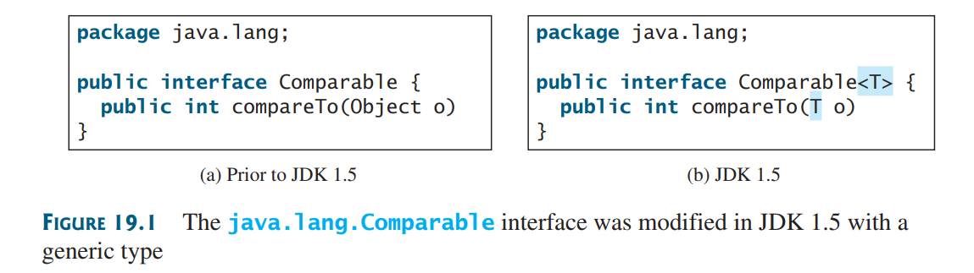
Motivations and Benefits
Java has allowed us to define generic classes, interfaces, and methods since JDK 1.5. Several interfaces and classes in the Java API were modified using generics. For example, prior to JDK 1.5 the java.lang.Comparable interface was defined as shown in Figure 19.1a, but since JDK 1.5 it is modified as shown in Figure 19.1b.

Slide 5
Motivations and Benefits
<T> represents a formal generic type, which can be replaced later with an actual concrete type. Replacing a generic type is called a generic instantiation. By convention, a single capital letter such as E or T is used to denote a formal generic type.

Slide 6
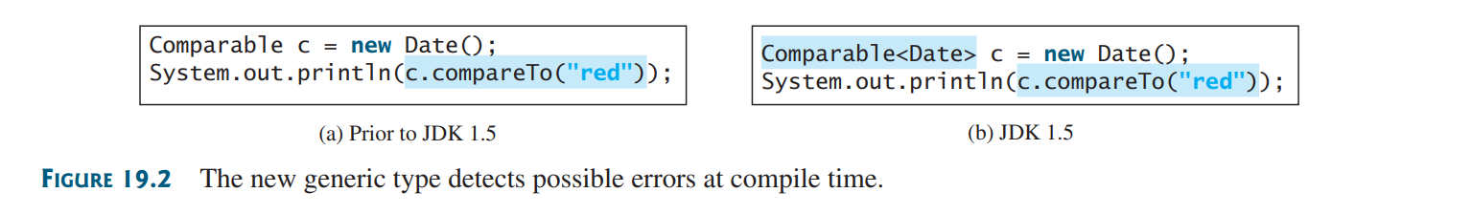
Motivations and Benefits
To see the benefits of using generics, let us examine the code in Figure 19.2. The statement in Figure 19.2a declares that c is a reference variable whose type is Comparable and invokes the compareTo method to compare a Date object with a string. The code compiles fine, but it has a runtime error because as string cannot be compared with a date.
The statement in Figure 19.2b declares that c is a reference variable whose type is Comparable<Date> and invokes the compareTo method to compare a Date object with a string. This code generates a compile error, because the argument passes to the compareTo method must be of the Date type. Since the errors can be detected at compile time rather than at runtime, the generic type makes the program more reliable.

Slide 7
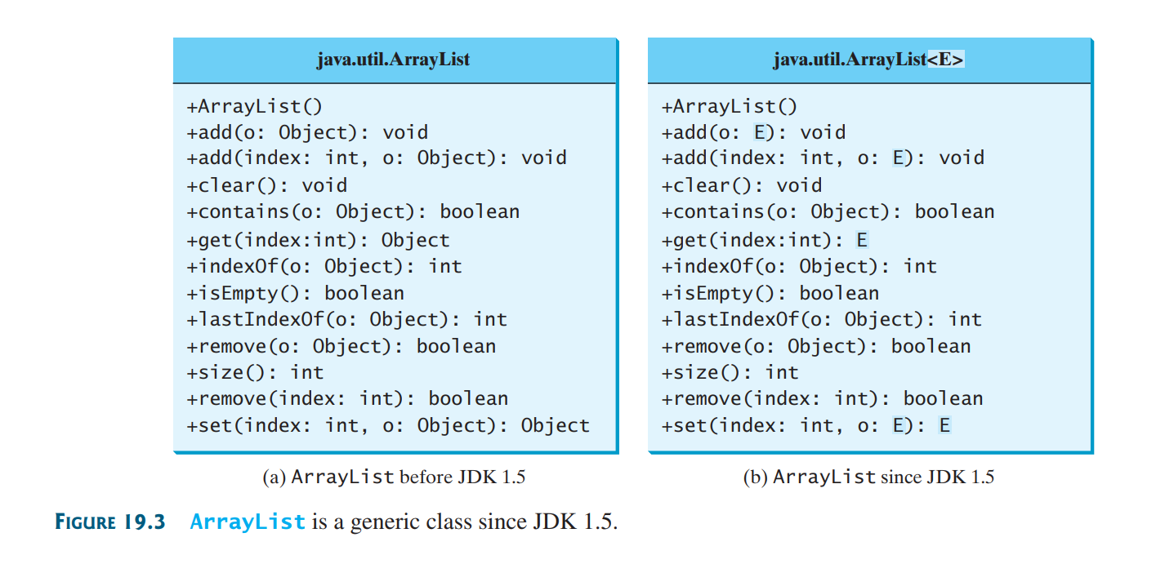
ArrayList

Slide 8
Defining Generic Classes and Interfaces
Key point: A generic type can be defined for a class or interface. A concrete type must be specified when using the class to create and object or using the class or interface to declare a reference variable.

Slide 9
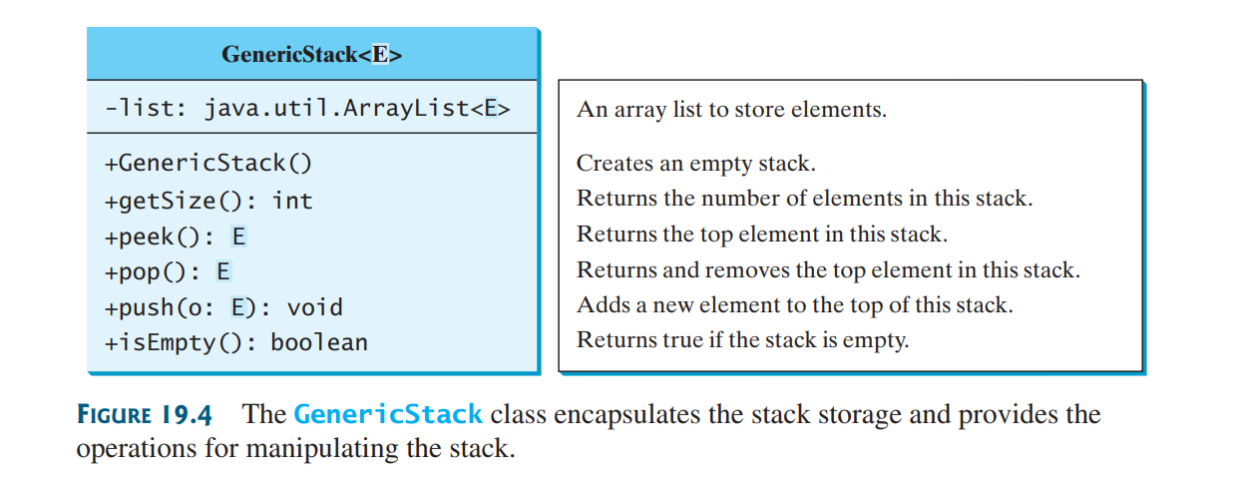
Generic Stack

Slide 10
Generic Stack
# see implementation using generics in “GenericStack.java”
# also see “TestGenericStack.java” to test the stack

Slide 11
Benefits of using generic types
In the previous example, instead of using a generic type, you could simply make the type element Object, which can accommodate any object type. However, using generic types can improve software reliability and readability, because certain errors can be detected at compile time rather than at runtime. For example, because stack1 is declared GenericStack<String>, only strings can be added to the stack. It would be a compile error if you attempted to add an integer to stack1.

Slide 12
Multiple generic parameters
Occasionally, a generic class may have more than one parameter. In this case, place the parameters together inside the brackets, separated by commas – for example, <E1, E2, E3>

Slide 13
Inheritance with generics
You can define or an interface as a subtype of a generic class or interface. For example, the java.lang.String class is defined to implement the Comparable interface in the Java API as follows:

Slide 14
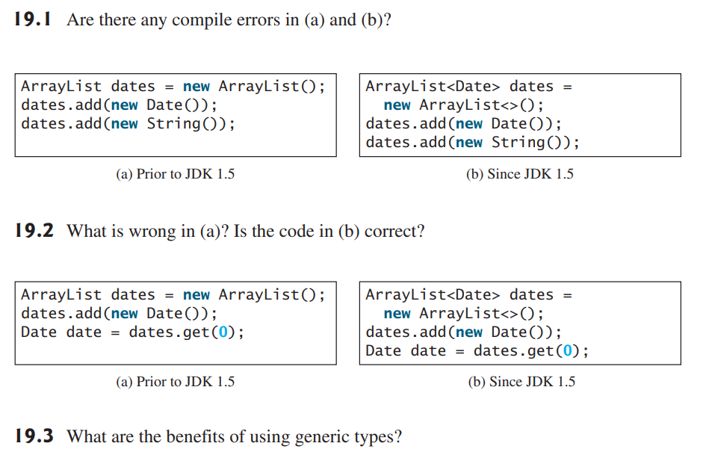
Check point

Slide 15
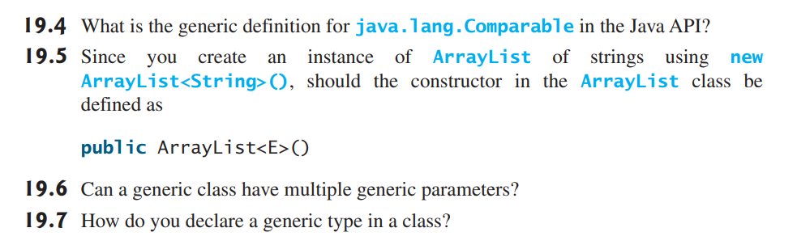
Check point

Slide 16

Generic Methods
Key point: a generic type can be defined for a static method.
# see code example “GenericMethodDemo.java”
To declare a generic method, you place the generic type <E> immediately after the keyword static in the method header. For example:

Slide 17
Generic Methods
A generic type can be specified as a subtype of another type. Such a generic type is called bounded.
# see code example “BoundedTypeDemo.java”
Note: An unbounded generic type <E> is the same as <E extends Object>.
Note: To define a generic type for a class, place it after the class name, such as GenericStack<E>. To define a generic type for a method, place the generic type before the method return type, such as <E> void max(E o1, E o2).

Slide 18
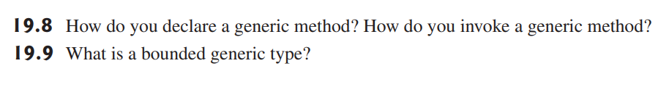
Check point

Slide 19
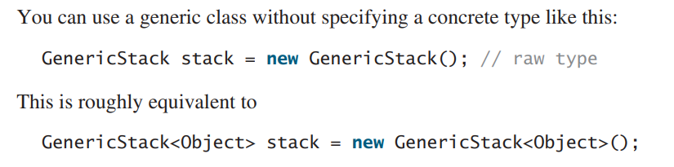
Raw Type and Backward Compatibility
Key point: a generic class or interface used without specifying a concrete type, called a raw type, enables backward compatibility with earlier versions of Java.

Slide 20
Using raw type
A generic class such as GenericStack and ArrayList used without a type parameter is called a raw type. Using raw types allows for backward compatibility with earlier versions of Java. For example, a generic type has been used in java.lang.Comparable since JDK 1.5, but a lot of code still uses the raw type Comparable.
# see code example “Max.java” for demo of above content
Comparable o1 and Comparable o2 are raw type declarations. Be careful: raw types are unsafe.

Slide 21
Using raw type
For example, you might invoke the max method using
This would cause a runtime error, because you cannot compare a string with an integer object. The Java compiler will also display a warning message

Slide 22
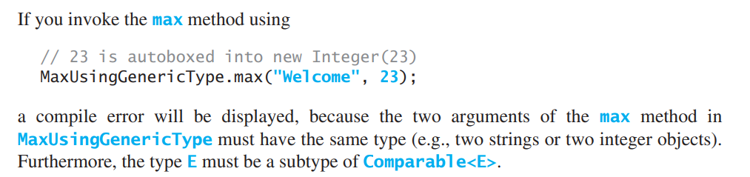
Using generic type for above purposes
A better way to write the max method is to use a generic type
# see code example “MaxUsingGenericType.java”

Slide 23
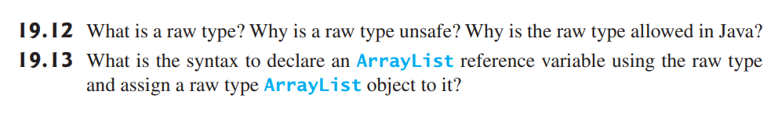
Check point

Slide 24
Wildcard Generic Types
Key point: you can use unbounded wildcards, bounded wildcards, or lower-bound wildcards to specify a range for a generic type.
Firstly, run this program to see the result and analyze it, “WildCardNeedDemo.java”
We will face an compile error. The fact is that Integer is a subtype of Number, but GenericStack<Integer> is not a subtype of GenericStack<Number>.
To circumvent this problem, use wildcard generic types. A wildcard generic type has three forms: ? And ? extends T, as well as ? super T, where T is a generic type.

Slide 25
Wildcard Generic Types
? Called an unbounded wildcard, is the same as ? Extends Object
? extends T called a bounded wildcard, represents T or a subtype of T.
? super T, called a lower-bound wildcard, denotes T or a supertype of T.

Slide 26
Wildcard Generic Type
# see demonstration, code example “AnyWildCardDemo.java”
# see code example “SuperWildCardDemo.java”

Slide 27
Check point

