Slide 1
Introduction
by B. Molutov

Slide 2
What is programming?
Programming means to create or develop software, which is also called a program.
Software contains the instructions that tell a computerized device – what to do.
Software developers create software with the help of powerful tools called programming languages.

Slide 3
Machine language
It is computer’s native language, which differs among different types of computers.
It is a set of built-in primitive instructions.
These instructions are in binary form.
For example, to add two numbers, you might have to write an instruction in binary code, like this: 1101101010011010

Slide 4
Assembly language
It was created in the early days of computing as an alternative to machine language. Assembly language uses a short descriptive word, know as a mnemonic, to represent each of the machine-language instructions.
For example, the mnemonic add typically means to add numbers and sub means to subtract numbers. To add the numbers 2 and 3 and get the result, you might write an instruction in assembly code like this: add 2, 3, result

Slide 5
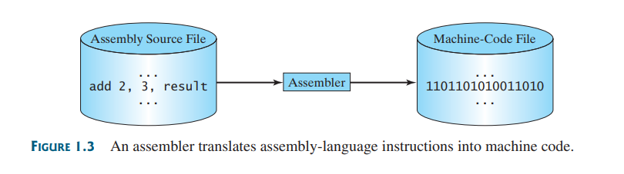
Assembly language
Because the computer cannot execute assembly language, another program – called and assembler – is used to translate assembly language programs into machine code

Slide 6
Assembly language
Writing code in assembly language is easier than in machine language, how it is still tedious to write code in assembly language.
Writing in assembly requires that you know how the CPU works.
Assembly language is referred to as a low-level language, because assembly language is close in nature to machine language and is machine dependent.

Slide 7
High-level languages
A new generation of programming languages known as high-level languages emerged in 1950s.
They are platform independent, which means that you can write a program in a high-level language and run it in different types of machines.
High-level languages are English-like and easy to learn and use.
There are many high-level programming languages, and each was designed for a specific purpose.

Slide 8
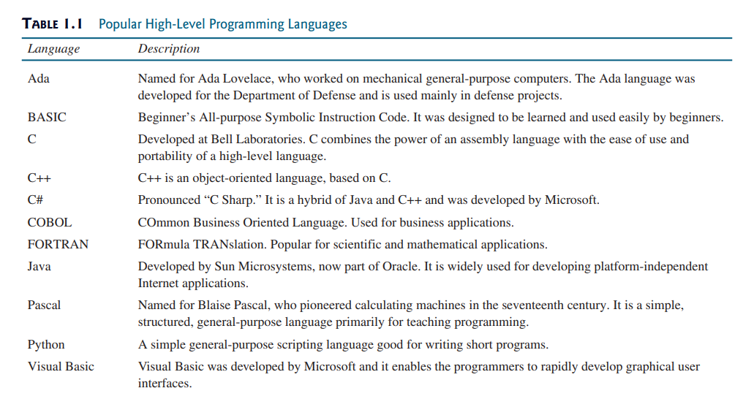

Slide 9
High-level languages
A program written in a high-level language is called a source program or source code.
A source program must be translated into machine code for execution.
The translation can be done using another programming tool called an interpreter or a compiler.

Slide 10
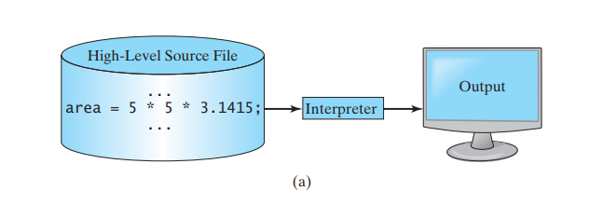
Interpreter
An interpreter read one statement from the source code, translates it to the machine code or virtual machine code, and then executes it.

Slide 11
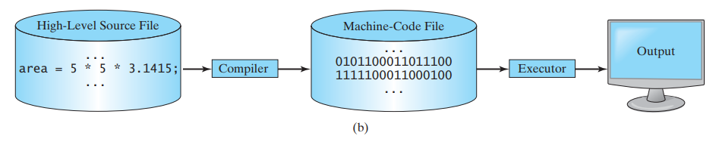
Compiler
A compiler translates the entire source code into a machine-code file, and machine-code file is then executed.

Slide 12
Java, the World Wide Web, and Beyond
Java is powerful and versatile programming language for developing software running on mobile devices, desktop computers, and servers.
Java was developed by a team led by James Gosling at Sun Microsystems. Sun Microsystems was purchased by Oracle in 2010.
Originally called Oak, Java was designed in 1991 for use in embedded chips in consumer electronic appliances.
In 1995, renamed Java, it was redesigned for developing Web applications.

Slide 13
As stated by its designed Java is
Simple
Object oriented
Interpreted
Robust
Secure
Architecture neutral
High performance
Multithreaded

Slide 14
Java
Is used to develop robust mission-critical applications.
Is used to develop server applications, software for desktop computers and mobile devices.
It was used to develop the code to communicate with and control the robotic rover on Mars.
Many commercial Websites are developed using Java on the backend.

Slide 15
Java is a versatile programming language
Apps for desktop computers
Server apps
Small handheld devices apps
Android apps

Slide 16
The Java language Specification, API, JDK, and IDE
Java syntax is defined in the Java language specification, and the Java library is defined in the Java API.
The JDK is the software for developing and running Java programs.
An IDE is and integrated development environment for rapidly developing programs.

Slide 17
Java language specification
It is a technical definition of the Java programming language’s syntax and semantics.
Link: https://docs.oracle.com/javase/specs/

Slide 18
The application program interface (API)
Also know as library
It contains predefined classes and interfaces for developing Java programs. The API is still expanding.
Link: https://docs.oracle.com/javase/8/docs/api/index.html

Slide 19
Java is a full-fledged and powerful language that can be used in many ways. It comes in three editions:
Java Standard Edition (Java SE) to develop client-side applications. The applications can run standalone or as applets running from a Web browser.
Java Enterprise Edition (Java EE) to develop server-side applications, such as Java servlets, Java Server Pages (JSP), and Java Server Faces (JSF).
Java Micro Edition (Java ME) to develop applications for mobile devices, such as cell phones.

Slide 20
Java SE
It is the foundation upon which all other Java technology is based.
The latest LTS (long term support) version will be used.

Slide 21
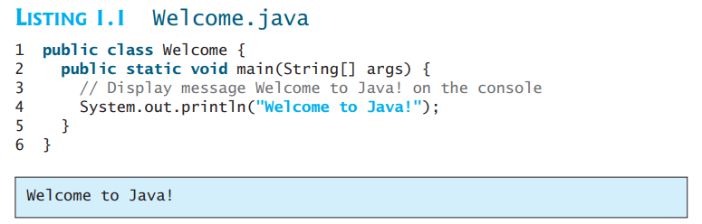
A simple Java program
# see code example Welcome.java in examples folder

Slide 22
Line 1 defines a class. Every Java program must have at least one class. Each class has a name. By convention, class name start with an uppercase letter. In this example, the class name is Welcome.
Line 2 defines main method. The program is executed from the main method. A class may contain several methods. The main method is the entry point where the program begins execution.
The main method in this program contains the System.out.println statement. This statement displays the string Welcome to Java! on the console.
Every statement in Java ends with a semicolon (;), knows as the statement terminator.
Reserved words, or keywords, have a specific meaning to the compiler and cannot be used for other purposes in the program. For example, when the compiler sees the word class, it understands that the word after class is the name for the class. Other reserved words in this program are public, static, and void.
Line 3 is a comment that documents what the program is and how it is constructed. Comments help programmers to communicate and understand the program. They are not statements and thus are ignored by the compiler. In Java, comments are preceded by two slashes (//) on a line, called a line comment, or enclosed between /* and */ on one or several lines, called a block comment or paragraph comment.

Slide 23

Types of comments

Slide 24
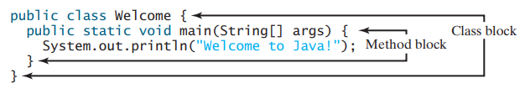
Blocks
A pair of curly braces in a program forms a block that groups the program’s components. In java, each block begins with an opening brace { and ends with a closing brace }. Every class has a class block that groups the data and methods of the class. Similarly, every method has a method block that groups the statements in the method. Blocks can be nested, meaning that one block can be placed within another, as shown in the following code.

Slide 25
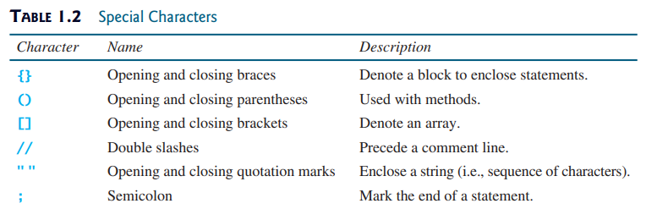
Like any programming language, Java has its own syntax, and you need to write code that conforms to the syntax rules. If your program violates a rule – for example, if the semicolon is missing, a brace is missing, a quotation mark is missing, or a word is misspelled – the Java compiler will report syntax errors.

Slide 26
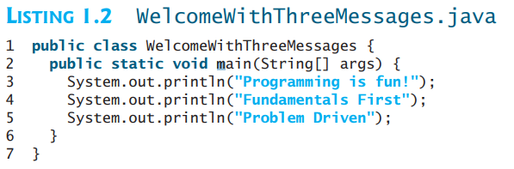
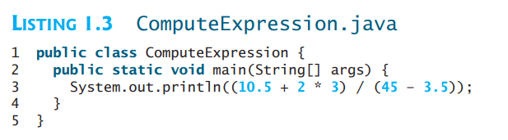
Show output of these programs (run them):

Slide 27
Creating, Compiling, and Executing a Java Program
You save a Java program in a .java file and compile it into a .class file. The .class file is executed by the Java Virtual Machine.
If your program has compile errors, you have to modify the program to fix them, and then recompile it.
If your program has runtime errors or does not produce the correct result, you have to modify the program, recompile it, and execute it again.
You can use any text editor or IDE to create and edit a Java source-code file.

Slide 28
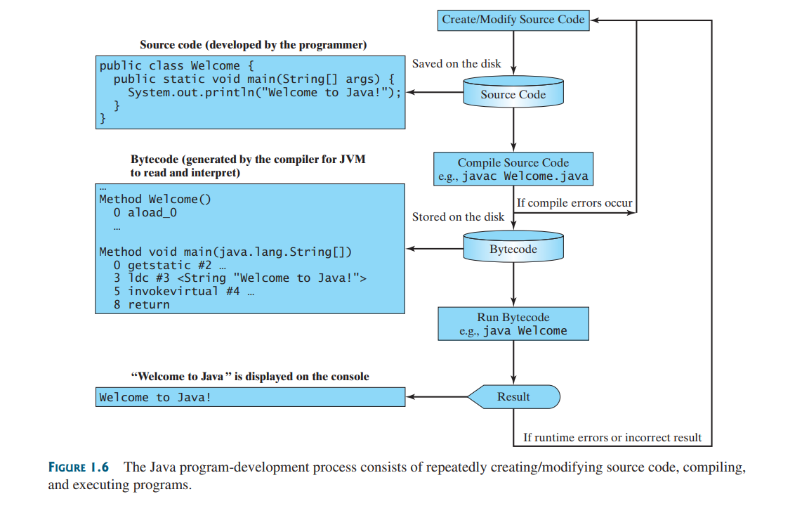

Slide 29
Java Virtual Machine
Java bytecode is a low-level language.
The bytecode is similar to machine instructions but is architecture neutral and can run on any platform that has a Java Virtual Machine (JVM).
Rather than physical machine, the virtual machine is a program that interprets Java bytecode.
This is one of Java’s primary advantages: Java bytecode can run on a variety of hardware platforms and operating systems.

Slide 30
Executing Java program
To execute Java program is to run the program’s bytecode.
You can execute the bytecode on any platform with a JVM, which is an interpreter. It translates the individual instructions in the bytecode into the target machine language code one at a time rather than the whole program as a single unit.
Each step is executed immediately after it is translated.

Slide 31
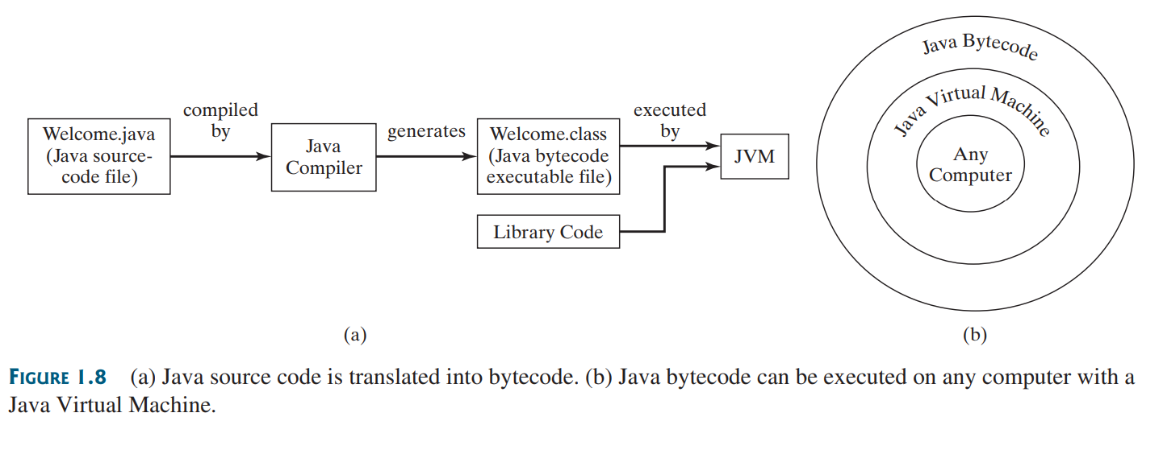

Slide 32
Homework
Read chapter 1.9
Read chapter 1.10
Book: “Introduction to Java programming” Y. Daniel Liang

Slide 33
How to install Java on your computer (on Windows OS)?
You can install JDK here: https://www.oracle.com/java/technologies/downloads/
Choose the version you need and download it, then run executable installer.
Add path to Java compiler into system environment variables.
Optional: add JAVA_HOME variable
Open command prompt and type: java –version
Open command prompt and type: echo %JAVA_HOME%

