Slide 1
Predicting fake messages and tamper identification

Slide 2
Abstract
With the steady growth of so many internets based cheap Social media, media channels and networks, people doesn’t bother on spreading fake news.
But a fake message or news can have very unusual and negative impact on the society.
This is an idea to predict whether a media can potentially be fake or not.

Slide 3
Introduction
In 2013 The World Economic Forum warned that fake news would be one of the biggest threats faced by society.
One of the major fake news that revolves around politics. And keeping that even in mind it can polarize any political event.
The biggest factor behind the success of fake news stories is their high level of social engagement.
In this era a system is necessary which could potentially verify the truth of the source and predict the percentage for being this fake.

Slide 4
Problem Definition
The main problem right now is that we do not monitor all the spreading points and check the validity.
Also it is very easy to tamper with the source media.
There is no software where we could get the truth of the message on whether that had been in original format or been tampered with.
This demo is going to deal with all these points.

Slide 5
Solution Details - media creation
Find hash from image using hashing technology
Use invisible watermark technology to embed the hash into image using advanced image processing method
Get GPS, Timestamp from device
Register all the required data into blockchain consortium

Slide 6
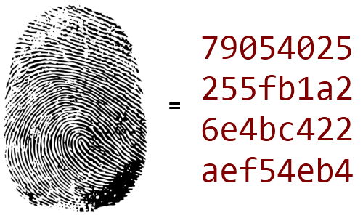
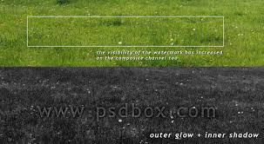


1) Capture and generate image hash
2) Invisible watermark technology
Media Creation
3) Register in Blockchain with Timestamp and GPS data

Slide 7
Solution Details - validation
Reverse engineering using advanced AIML method to get the hash from media
Check same data is present in blockchain or not
Calculate fake percentage using NLP and AIML based algorithm

Slide 8


2) Search hash in blockchain
1) Extract Hash from invisible watermark
Yes
Validation Time
No

Slide 9
Solution Benefits
Blockchain data is immutable, hence it will not be possible to tamper existing truth of a media aka hash, GPS, TimeStamp, Description which can signify the percentage of being fake.
It can refrain from further forwarding if the fake prediction percentage is very high.
This solution could be scaled very easily.
The market demand is high and potential customers are social and medial channels.

Slide 10
Implementation Next Steps
Web – UI design
Off-chain database could also be setup for media storage.
Hash collision could be prevented by additional authentication modules.
Cloud enablement

Slide 11
Solution Assumption
This solution assumes that any news/ message is associated with a media.
The news/message is being tracked from source of the media creation apps.
This solution assumes that the first news is not fake.

Slide 12
Conclusion
This solution could track down any tampering at any time and hence could monitor the end to end journey of a media and the story of the media.

Slide 13
References
https://www.kingsleynapley.co.uk/insights/blogs/criminal-law-blog/the-impact-of-fake-news-society
https://encrypted-tbn0.gstatic.com/images?q=tbn:ANd9GcRHV5oZssu86lCTM9QU3XV9BLfdZCIx2seK30AFdgv1J8dnucET5w
https://pdfs.semanticscholar.org/4d5e/cd46bb1e7b1a36fdd42640e201ee0e17d49b.pdf
https://petapixel.com/2017/12/22/imatag-uses-invisible-watermarks-protect-photos/

Slide 14
Thank you
Bhaskar Mondal
Tech Lead
DBS-IP

