Slide 1
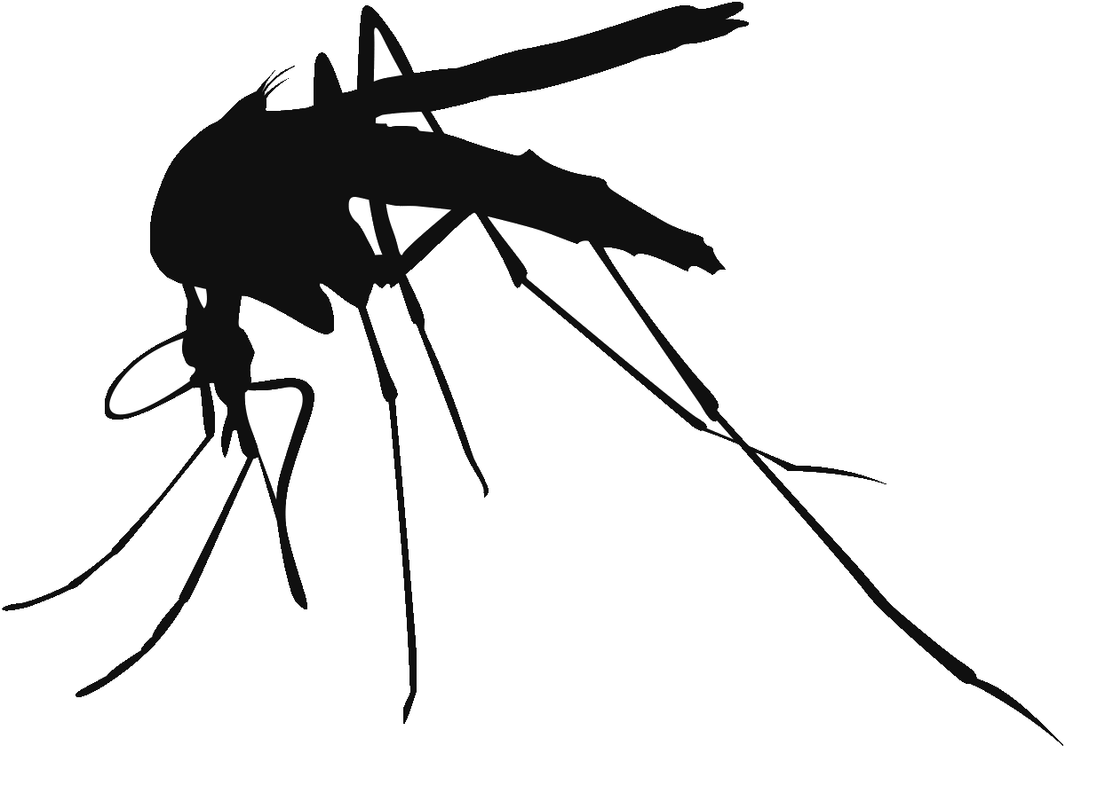
Zika Project
International Health Analysis and Policy
Dr. Ahmed N. Shaaban & Dr. Dareng Gyang

Slide 2
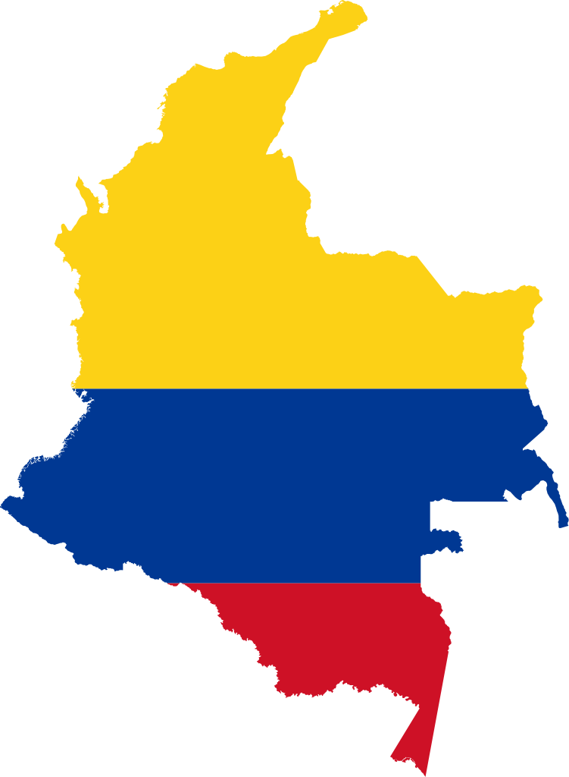
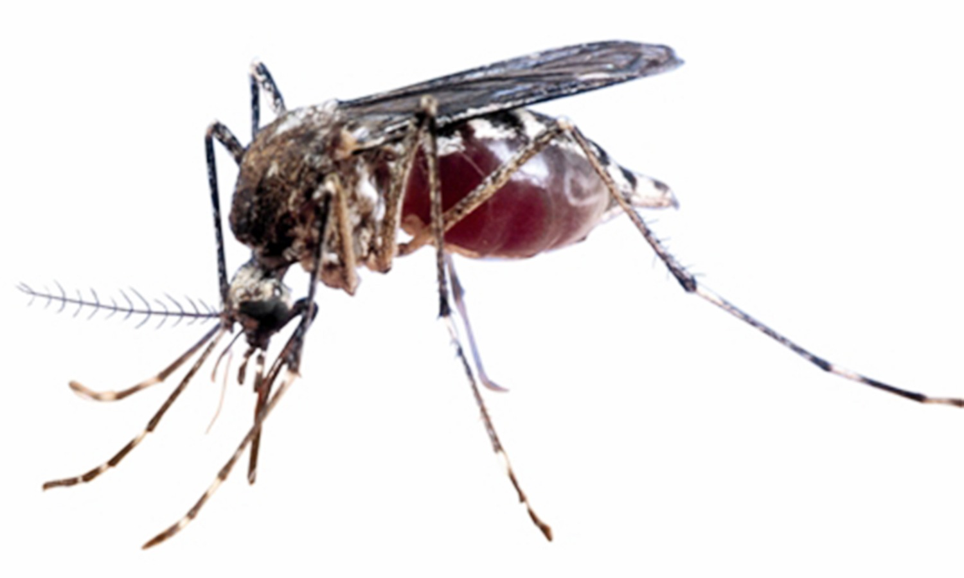
Background
Colombia
• 42,706 reported cases
• 600,000 expected in 2016

Slide 3
Objectives
To Create Mobile Application for accurate diagnosis.
To create a system that allowed for easier and rapid delivery of patient reports attached to location and condition information.
Tool for education and awareness.

Slide 4

Design Process
Where?
Stakeholders
Public Policy
Funding

Slide 5
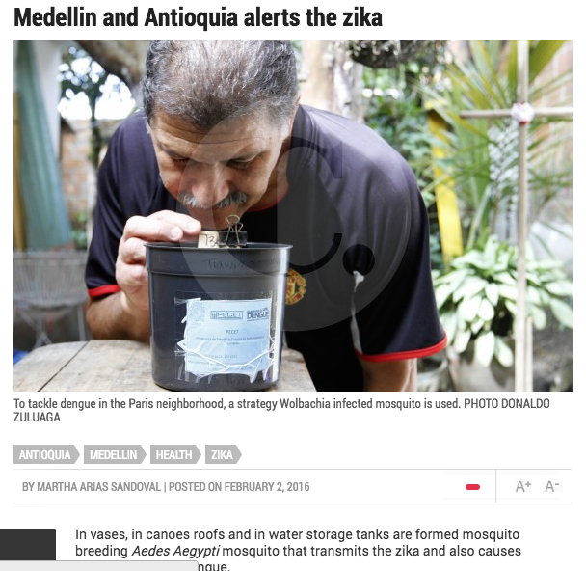
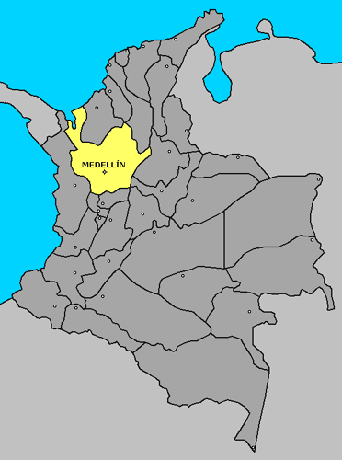
Where?
Medellin City Slums
Medellin has the highest number of cases

Slide 6
Stakeholders
Colombian Government
MoH/ Hospital/ Clinics & Clinicians/ CHW
Patients/ Community Members
USAID/NGOs/ Grand Challenges Canada/
Funders
ZIKA
Mobile companies
Private companies
WHO / CDC
Universities/ Researchers/ (PECET) / Sana/CAMTech
Media / IT Support

Slide 7
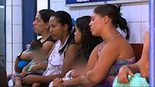
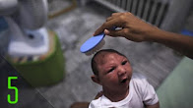
Public Policy Objective
FOR AS MANY TO BE EDUCATED !!!! - To enlighten all Stakeholders involved
To communicate and educate people about the risk associated with zika virus dx a to promote:
Use of all protective and preventive behaviours
Reduce anxiety ( presentation of dx is scary)
Address stigma
Dispel all rumours
Displace all cultural Misperception of Zika dx
Informed Policy to prevent and eradicate Zika

Slide 8

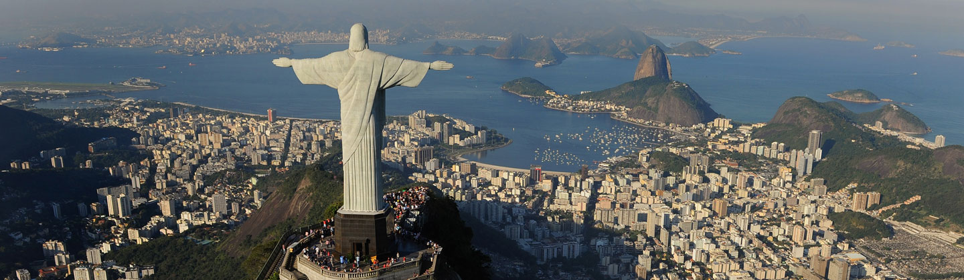


Public Policy
Brazil - World Cup 2014 Brazil - Olympics 2016
Big worry for W.H.O !!!

Slide 9
Funding Sources
CAMTech and Grand Challenges Canada (GCC)
Starting point
Awards of up to $25,000
These awards will accelerate the development and commercialization of innovations addressing the Zika public health crisis.
USAID
Sustainability
To Bring all stakeholders involved

Slide 10
CONCLUSION
Creating technology through mobile application and use GIS will in tracking Zika disease, diagnosing and treating infected patients.
Innovative way to inform the policy makers about the magnitude of Zika to control the epidemic.
A successful model that can be scaled used to tackle other Arbovirus infection.

Slide 11
Thank You

