Slide 1


Quantum CAPITAL LLC
ENERGY Fund Prospectus
“Driving capital markets through algorithmic design”

Slide 2

COMPANY BACKGROUND
Quantum Capital Management LLC is new private fund management company in fundamental commodity strategies with a specialization in the oil and energy complex. Quantum Capital is led by a team of data scientists. The investment strategy targets absolute returns with an asymmetric upside, via detailed supply and demand forecasting, fundamental, macro economic and physical market information combined with various technical market indicators to generate fair values, forecasts and trading signals for energy and commodities.

Slide 3
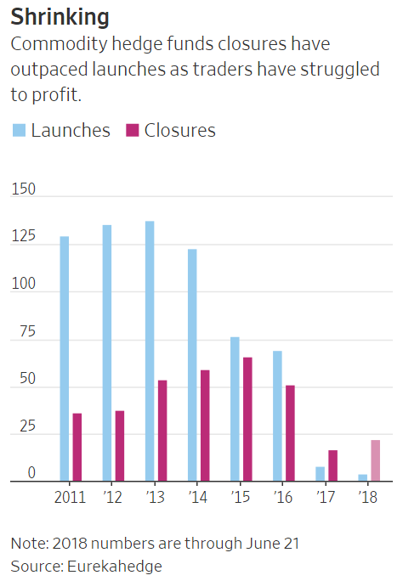


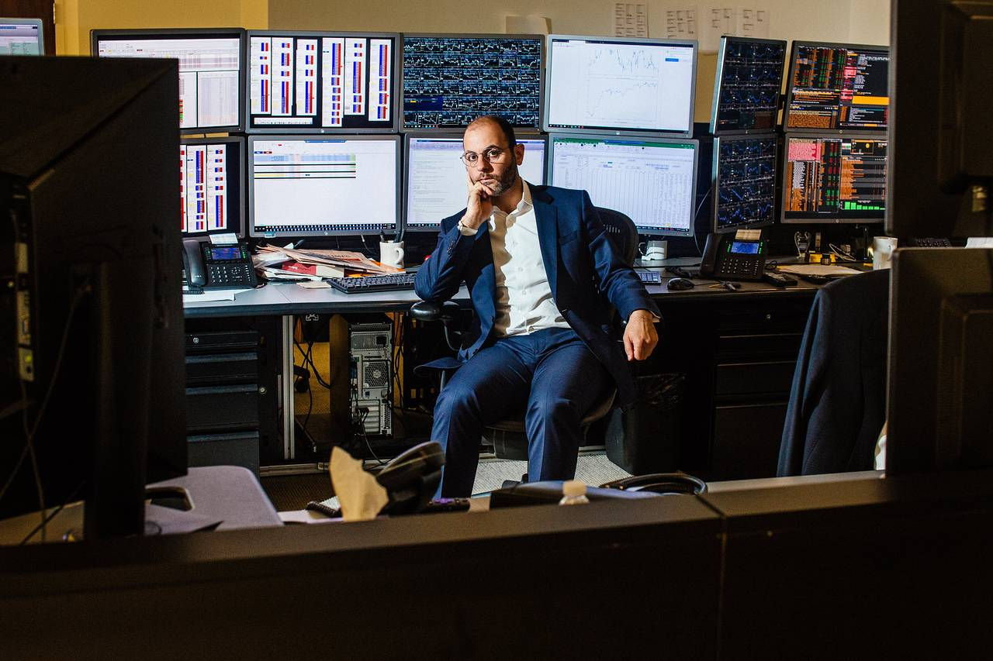
OPPORTUNITY – proprietary commodity trading space is shrinking…
In 2017, closures of commodities hedge funds outnumbered launches for the first time in data going back to 2000, according to data provider Eurekahedge—a trend that has continued into this year.
The reason? Investors who were burned by the severe two-year market rout that started in 2014 aren’t rushing back, fund managers and traders say, despite prices of commodities, including oil, copper, lumber and cotton, all rebounding to multiyear highs.
However, commodity futures offer tremendous upside if one can manage volatility.

Slide 4


However - Commodities Traders are increasingly adopting algorithms
According to estimates, about 15 percent to 20 percent of all futures trading occurs in commodities futures contracts. Within commodities, there are various sub-types, including metals; agricultural products, such as sugar, soybean futures and grains; and energy. Automated trading is being applied to the most highly volatile commodities, and active subsets of that tend to be energy futures contracts and specifically crude oil products.
The Reason
One of the reasons commodities are attracting new players and new strategies is that the markets are not as mature as equities. There is greater opportunity in commodities for electronic strategies to take advantage of market inefficiencies. Also, with more and more institutional money flowing into commodities, both through exchange-traded funds (ETFs) and listed futures and options, managers are looking for new ways to generate alpha in commodities.
The opportunity
According to a recent survey, hedge funds implementing algorithms that support the trading decision and the risk management all in one integrated process that is supported by algorithmic decision making are highly sought by investors. While the overall hedge fund industry has performed poorly since the 2008 – 2009 financial crisis, the bright spot in the industry are quant based funds.

Slide 5
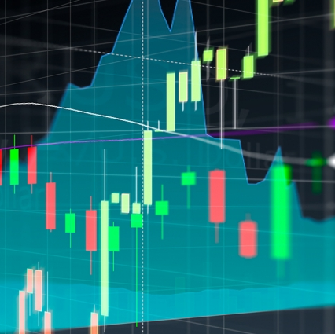
Initial goal: raising capital
We need to establish a solid track record to be able to solicit additional funding via a marketing campaign.
Potential investors in our new fund, will be funds of funds, endowments, pensions, family offices and high-net-worth individuals.
Our commercial ask of you is to green light the project; we need an initial injection of capital to seed two portfolios(A + B) and build out an analytic and machine learning infrastructure.

Slide 6
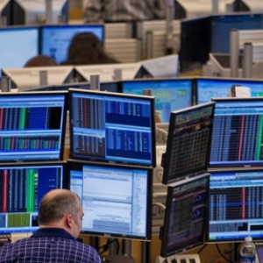
Three characteristics of our strategy.
Story: Identify key signals in scenarios that correlate strongly with the probability that the market has continuously mispriced futures prices in these situations, creating opportunities to earn market returns but with significantly less risk.
Process:
Download, track and store activity in an energy sector
Apply various data munging and feature extraction techniques
Fit various algorithms and machine learning techniques on the data sets.
Back test strategy and forecast result
Returns: Working in a team of 4 using two portfolio strategies with $20 million in capital, we would like to averaged 11% annual returns, always in a relatively narrow band from 8% to 15% in any given year.

Slide 7
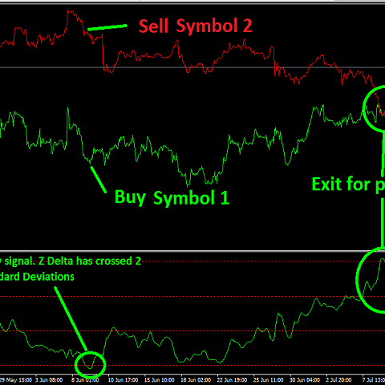
Portfolio a ($10 M )
Data containing all continuous energy futures contracts, global index data, the open, high, low, and closing costs of certain crude oil, natural gas, heating oil, and gasoline suppliers and the United States Energy Information Administration.
All available energy futures contracts will be used to produce a statistical arbitrage strategy.

Slide 8

Portfolio B ($10 M)
Gasoline specific strategy using proprietary stitching of futures contracts and feature extraction.
Additional data from global indexes and Department of Energy will be weaved into the data set.
Long/Short Trading Strategy will be developed based on price forecast conclusions based on machine learning algorithms.
Back testing framework will feature artificial intelligence.

Slide 9
Proposed Methodology
The ultimate goal for the initial project is to develop two profitable trading strategies. The models developed using machine learning techniques will be the foundation for the strategies.
Data Collection
Create data warehouse server and load global index data
Python code to download Department of Energy Data
Data Analysis & Understanding
Analyze future contract curves
Analyze correlations
Data Preparation
Outlier Detection
Fill missing values
Python code to download future contracts
Fit additional feature sets such as Bollinger and Exponential Moving Averages.
This will be a bespoke proprietary data set and wil be owned by Quantum Capital Management
Standardization and Normalization for Linear and Nueral Network analysis
Analyze for contango and backwardation - potential feature development
Data Collection
Create data warehouse server and load global index data
Python code to download Department of Energy Data
Data Analysis & Understanding
Analyze future contract curves
Analyze correlations
Data Preparation
Outlier Detection
Fill missing values
Python code to download future contracts
Fit additional feature sets such as Bollinger and Exponential Moving Averages.
This will be a bespoke proprietary data set and will be owned by Quantum Capital Management
Standardization and Normalization for Linear and Nueral Network analysis
Analyze for contango and backwardation - potential feature development
Initial data set was over 4,000 attributes, for the purpose of this project we will be significantly pruning.
Output to csv files for further processing
Modeling
Neural Network(specifically LSTM) – price activity
Evaluation
Standard model fit parameters
Visualization
Dashboard Development
Random Forest for classification of signal direction
Logistic Regression for signal direction
Linear Regression for price activity
Build backtesting framework for real world signal and pattern evaluation
Mobile Application Development

Slide 10

Trade Modeling Process Flow
We will need $22 million in cap ex funds for this project to deliver the initial phase of this project.
Statistical Summary
Neural Network
ROC Tables
Time Series
Outer Detection
Lift Table
Dashboard
Development
Random Forests
Normalization
Confusion Matrix
Pattern Matching
Mobile Application Development
Logistic Regression
R-Squared
Date Type Handling
Missing Value Imputation
Linear Regression
MSE
Data Collection
Data Analysis & Understanding
Data Preparation
Modeling
Evaluation
Visualization
This will be an iterative process.

Slide 11
Project deliverables ( $22 Million cap ex spend)
Week 1​-​2 | Project Definition and Scope
Week 3 | Project Goals
Week 4-6 | Initial Findings
Week 7-9 | Final Recommendations and Executive Summary
Week 10 | Presentation to Project Stakeholders

Slide 12
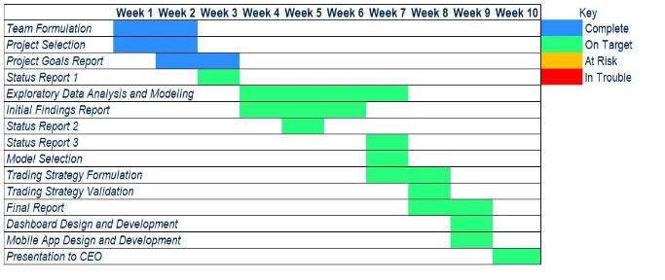
Project timeline
The project will be broken down into 10 weeks. All deliverables are due by the end of each week, except
for the Final Report, which will be delivered earlier in Week 9 on Tuesday, November 19, 2019.
The first key deliverable is the Goals Report, due at the end of Week 3. Next, there are three status reports that
will be delivered at the end of Weeks 3, 5, and 7. The Initial Findings Report will be turned in at the end
of Week 6, and the Final Report, Dashboard, and Mobile Application will be completed on or before the
end of Week 9. At the end of Week 10 the team will deliver a presentation to the CEO. Any changes to
the schedule will require a change request, signed by the project sponsors (CEO).

Slide 13
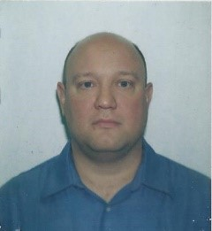
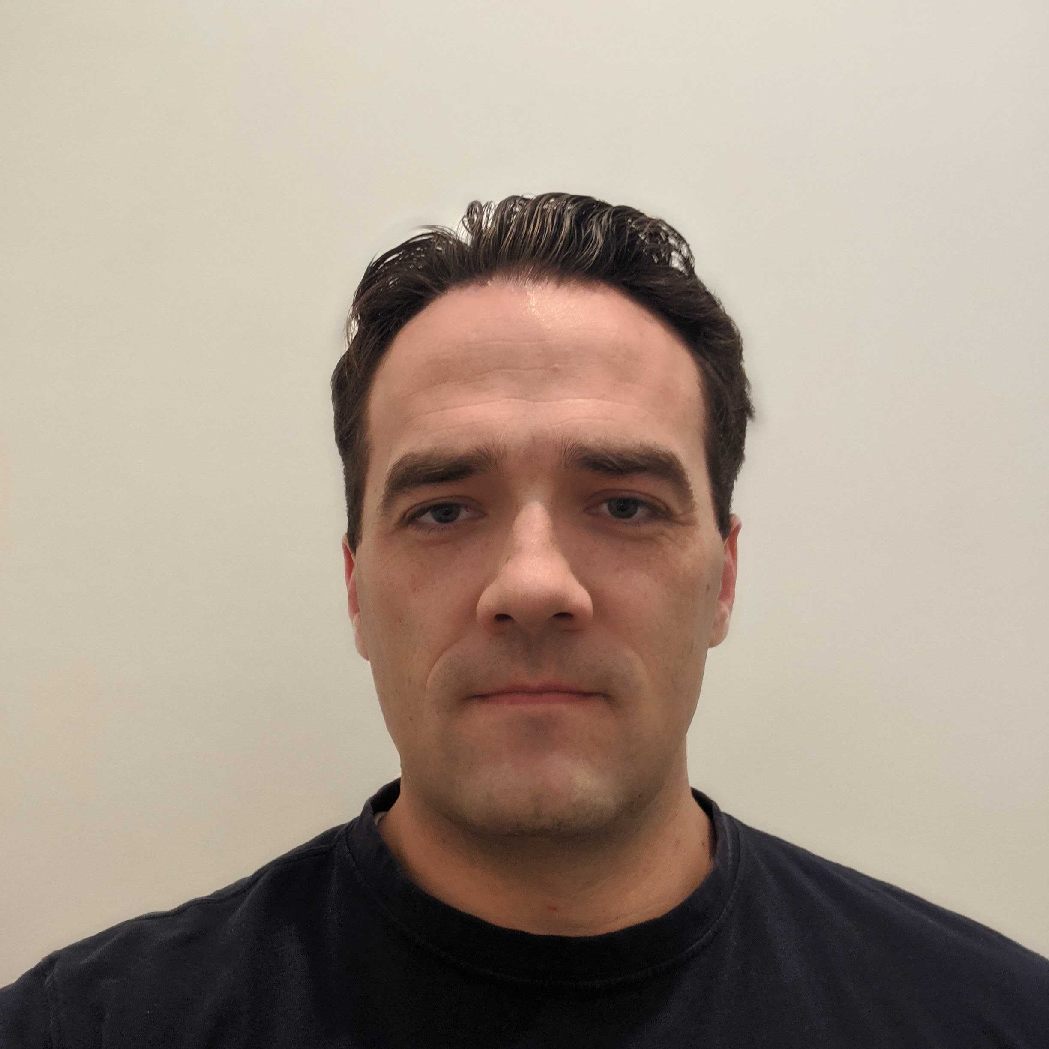
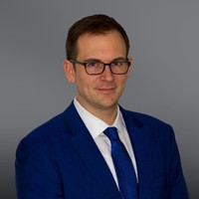

team
Andrius Markvaldas
Joshua Wood
Brandon Moretz
Tate Bollick
has over 20 years of information technology and data management experience on a variety of different platforms. He defined enterprise data strategies, as well as, built and managed world-class data capabilities for proprietary trading firms.
Flew for Southwest Airlines as captain of a Boeing 737 before turning to finance. His attention to detail, situational awareness and self-confidence rounds out the team dynamics.
Has close to two decades of experience in the financial services industry. Most recently heading the development efforts of a proprietary in-house order management, research and risk analytics systems for a hedge with $20B in assets under management. Before that he spent time in the anti-money laundering space for some of the world’s largest financial institutions
For over 10 years, Tate has held a variety of roles within finance and technology. He has spent the last six years in program and project management for medium and large scale financial institutions. During that time he has worked on number of different projects for front, middle, and back office functions. He received his MBA in 2014, and has lived in Charlotte, NC since then.

Slide 14
Thank you!
Feel free to contact any one of us…..

