Slide 1
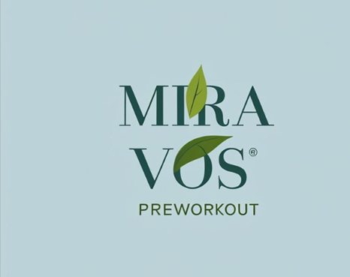

Slide 2
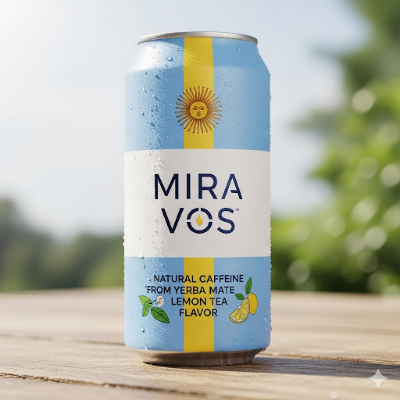
• A description of your product/service
Mira Vos Drink Company manufactures high-quality exercise supplement powders and drinks with a real science-based focus on health and wellness. Our flagship drink “Mira Vos” is made with caffeine from Yerba Matte tea leaves from the heart of Argentina. Our products are made to support health-conscious people with the motivation to start new habits and the energy to maintain them.

Slide 3
• The pain it solves
Low trust industry – 3rd party tested
Busy shelves filled with unknown brands and little differentiation
Products that are marketed to mostly power lifters and male audiences. With ingredients that don’t align to the Mira Vos buyers needs.
Mira Vos sells the ritual of preworkout drinking to a customer segment that hasn’t been engaged previously. The pain is getting yourself up to go to the gym every day. MiraVos extends the preworkout ritual solution to a new segment

Slide 4
• Market trends over the next 3-5 years
Mira Vos will be a part of the exercise supplement industry. The exercise supplement industry currently consists of 19.58b in revenue with a CAGR of 5.9 into 2030. 35.1% of that market is US-based with 88% in powder and 12% in ready-to-drink. The growing market is associated with a growing understanding of the importance of exercise for men and women. A trend towards simpler eating and increased focus on processed ingredients creates an opening for a pre-workout supplement drink with simple and natural ingredients.

Slide 5
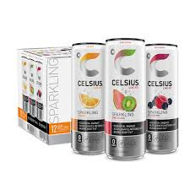
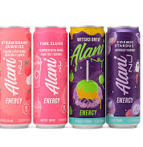
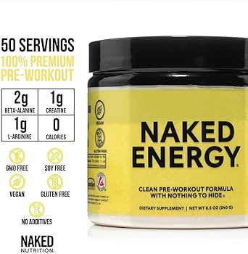

Product positioning - comparison to existing (or potential) products/services and why existing solutions do not solve the pain you have identified
Alani – Targets the same consumer segment with high end marketing
Celsius – competes for the shelf space MiraVos would like to occupy with Pepsi backing.
Naked Energy – focuses on defeating the low trust reputation of this sector and competes for a similar customer segment.
None of these solves the pain point in the same way MiraVos can.
Notes:
The closest competitors to the Mira Vos model are: Celcius, Alani Nu, and Naked Energy. Each of these are competitors in the clean energy preworkout space. Each of these is differentiated in ways similar to the Mira Vos model. Celcius is sold in different locations (i.e. Costco shelves). Alani is marketed heavily in social media and targeted towards women. Naked Energy focuses on third party testing and natural ingredients. None of these approaches the problem in the same way as Mira Vos. None of these includes the same ingredient mix and marketing story Mira Vos can tell.

Slide 6
• Annual revenue projects for the next 3 years
I have a projected COGS.
Need to determine projected sales. (Might be a guess?) This one is a little tricky I think!

Slide 7
• Key success factors (up to 3)
Strong initial product launch to grab loyal market share is key to avoid being crushed by a big business.
Consumer ed and marketing are key and could be expensive. Most buyers don’t know why Yerba makes this product such a good fit.
Repeat buy and product flavor? If marketing is expensive profits begin at second purchase. This makes it crucial to understand why customers buy again.

