Slide 1

Icedelights – Investment Decision
Brian Morman – Innovation and Entrepreneurship – EMBA 60

Slide 2
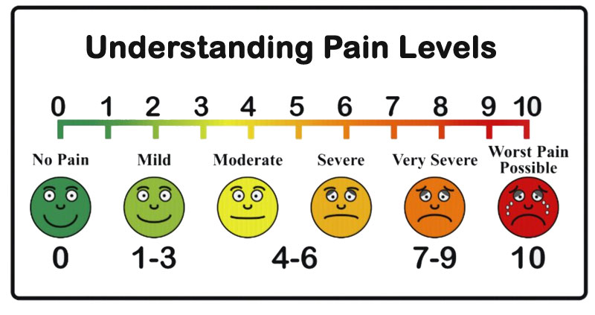
The Pain
Ice cream is not good?
Most ice cream stores have to manufacture elsewhere and freeze their product to transport it.
Icedelights product offering makes for higher quality product because it can be manufactured on site.

Slide 3
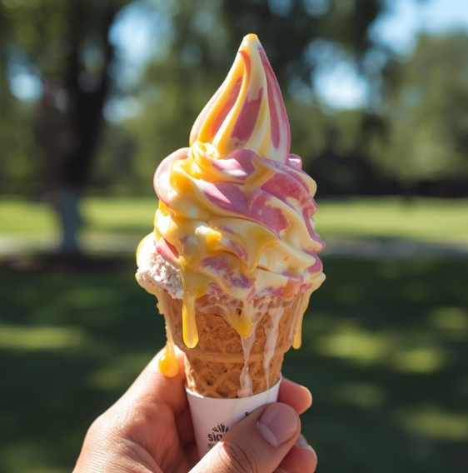
Opportunity in Florida
Per the case study, inconclusive.
Best location population growth ~4% yoy. This business will need to take market share to grow. Management claimed store growth is ~10% yoy.
Store COGS predict a 32% margin. This is reasonable for the industry. But poor for angel investment.

Slide 4


3 Factors for success
The product – Icedelights differentiator is its product. The product is not controlled by the management team in any way.
The Real Estate – Icedelights has a track record of choosing good locations. But, they have no experience in this new market directly. Can we trust that learnings from Oregon and California will transfer to Florida?
The Team – The Icedelights management team are smart and likely to succeed but this is effectively their first business venture.

Slide 5

The Founders
Paul Rodgers – IPO, test equipment, corporate finance, and theater production.
Mark Daniels – consulting, M&A, office products, high tech industries, and international business
Eric Garfield – University of Florida, consulting experience, international audit and finance, and accounting.
Notably, this team has no experience running a food service business…

Slide 6

Take the Deal?

