Slide 1
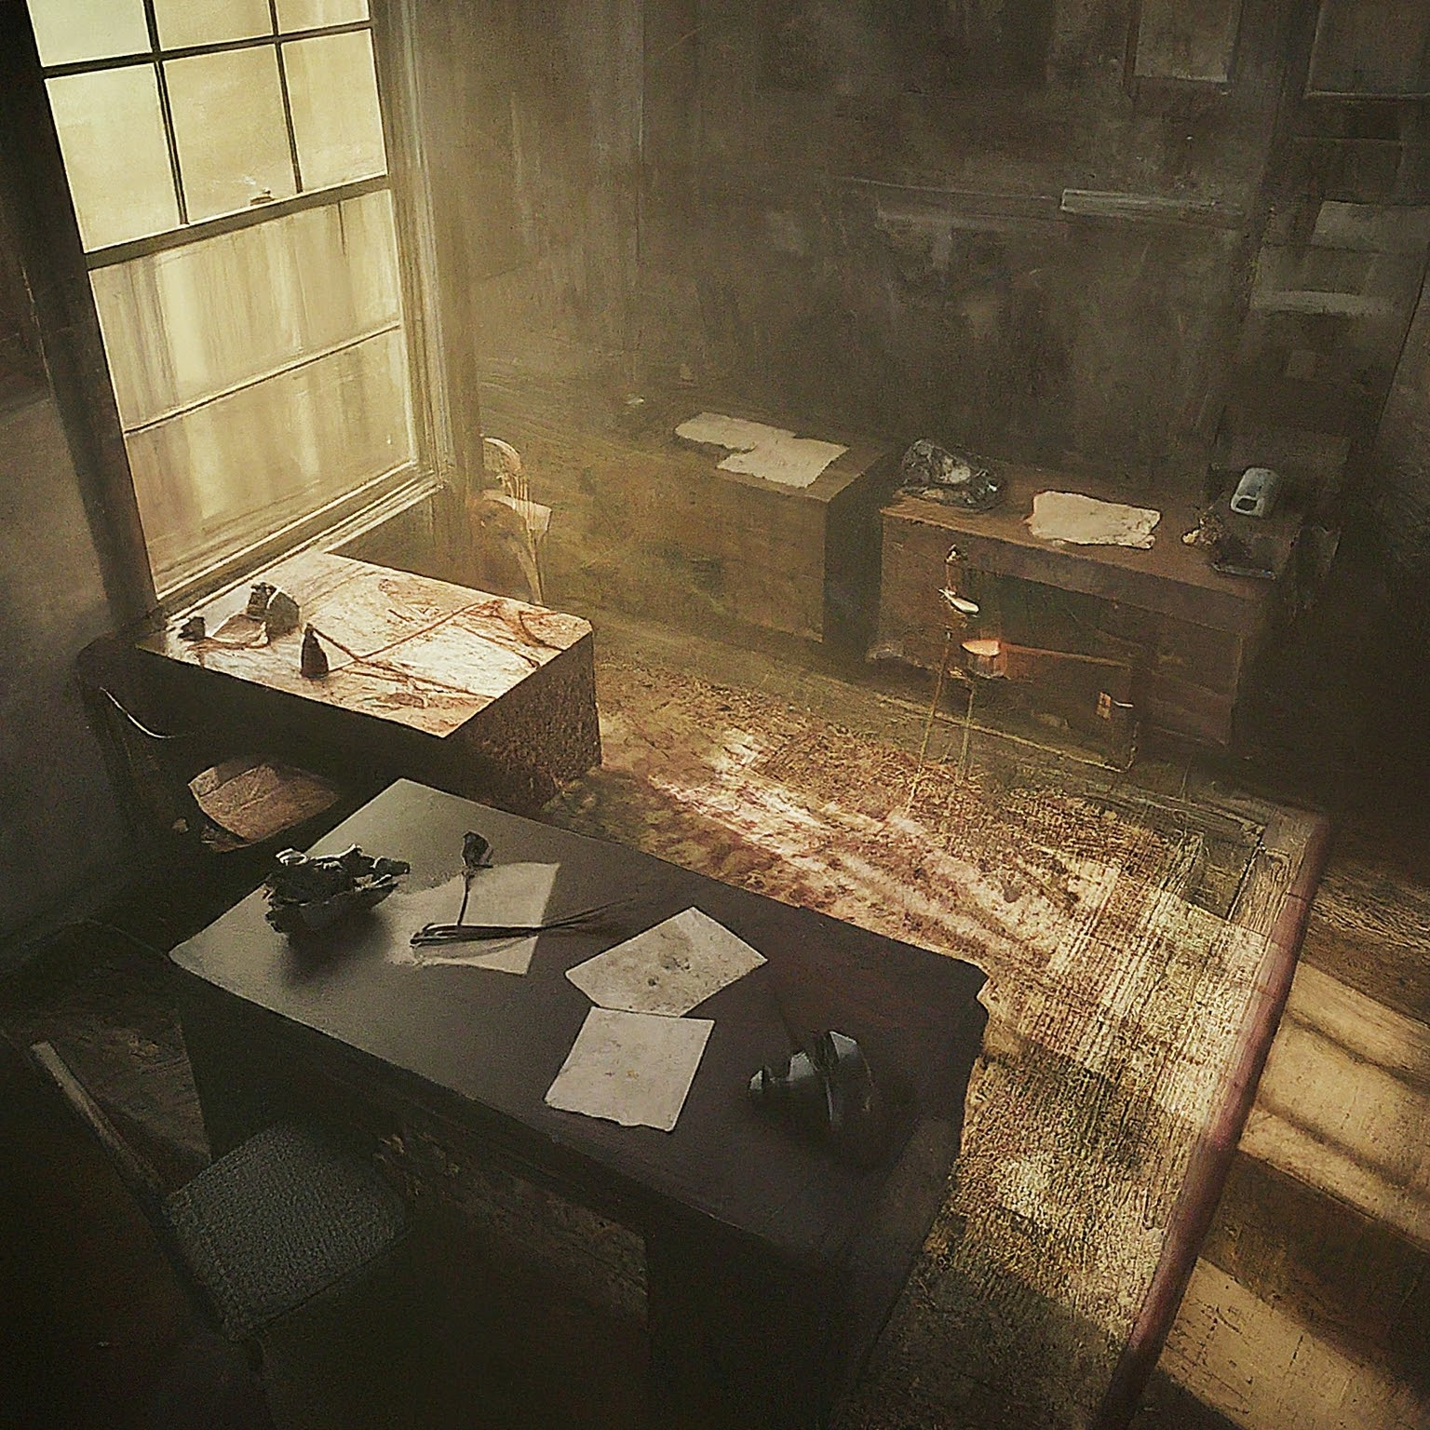

The Crew’s office
Conrad Knott enters the office.
Ask for crew help to investigate his new property.
He had one renter and they ran out. The Macario family.
Ill pay $20 a day.
Boston Globe offices for newspaper
Central Library for general research
Hall of Records – house info

Slide 2
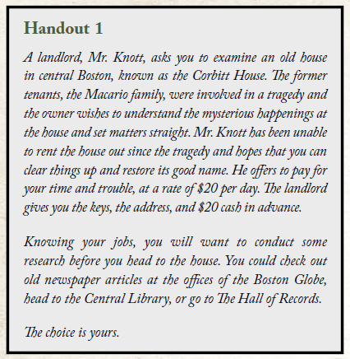
Handout 1

Slide 3
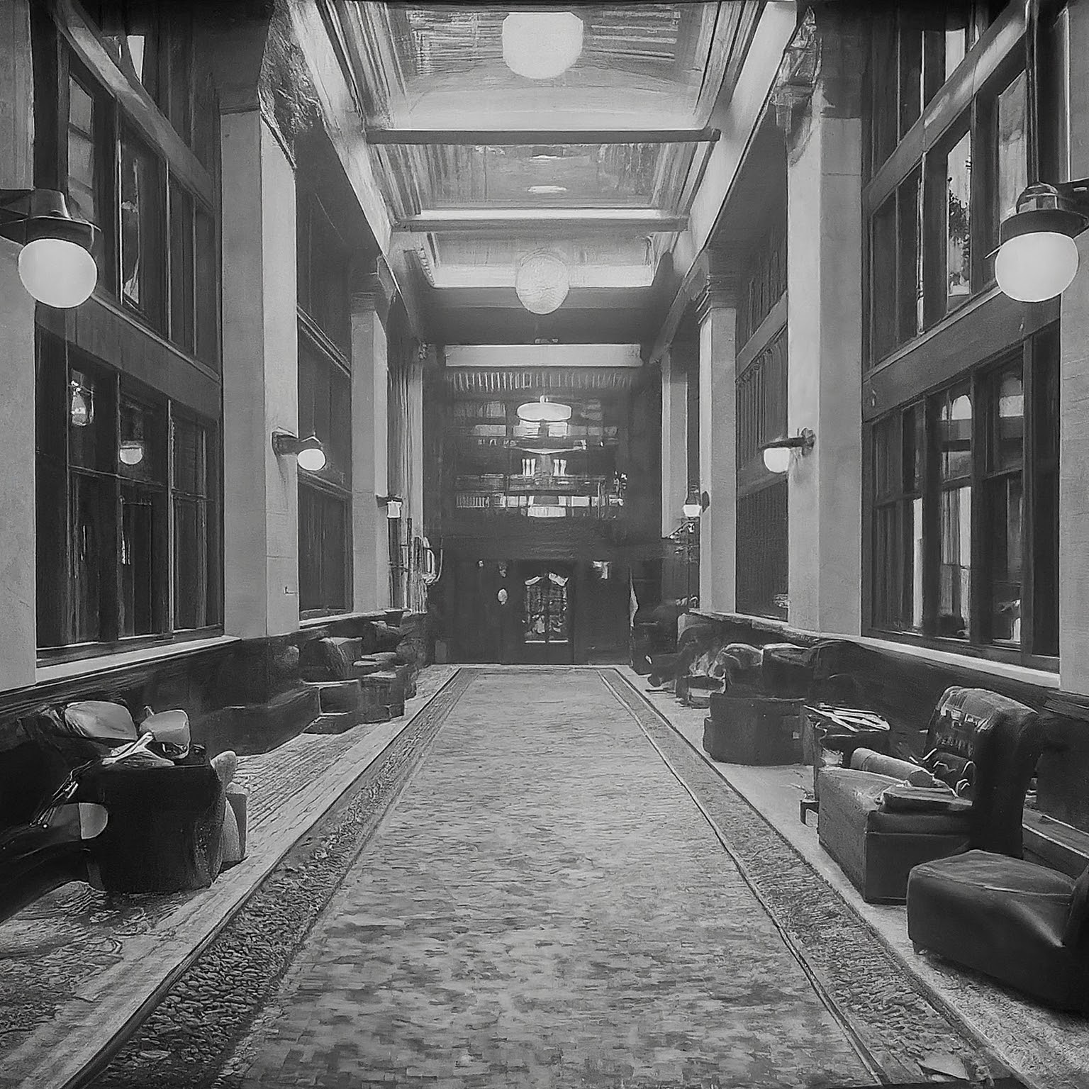


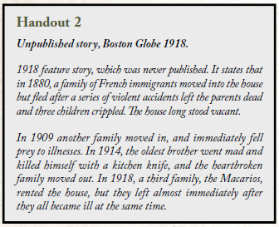
Boston Globe
Ruth Blake secretary – reference the morgue may
Mention they have nothing older than 1878 fire
Arty Wilmott editor – power tripping editor

Slide 4
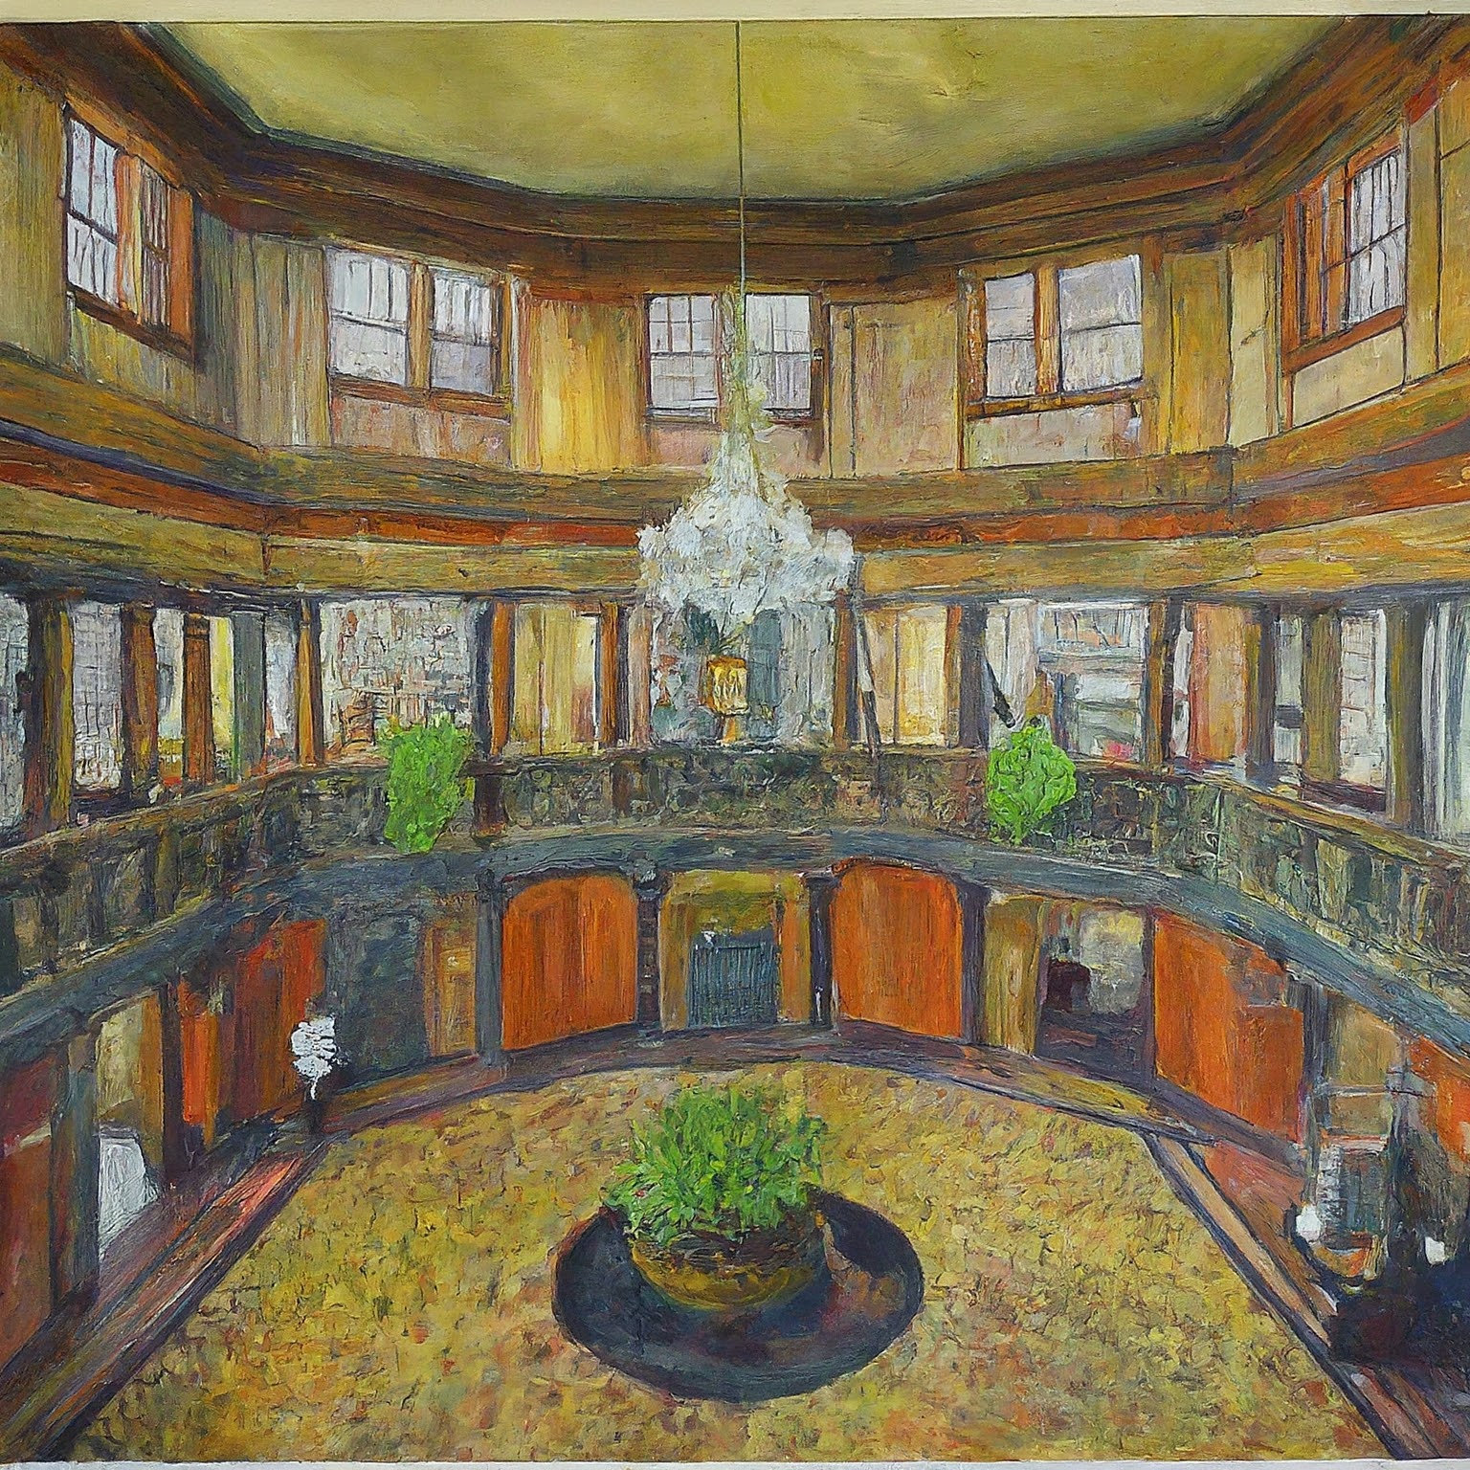
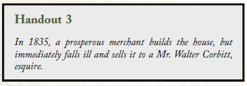
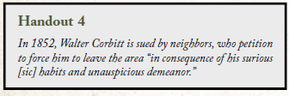
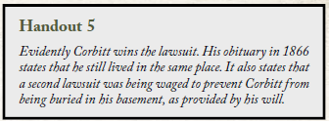

Central Library

Slide 5

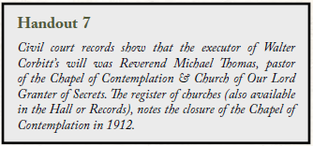
Hall of Records

Slide 6
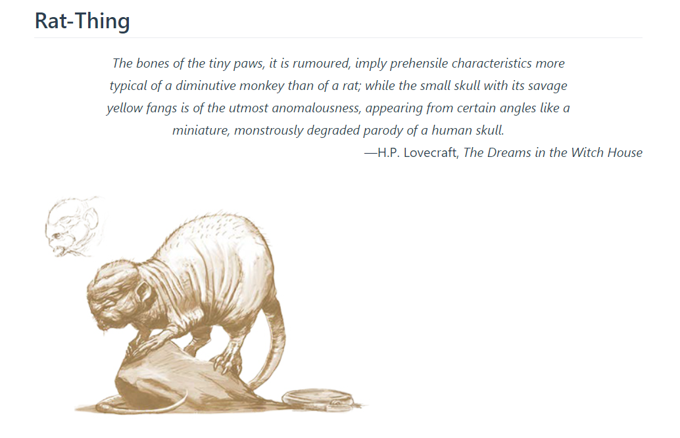
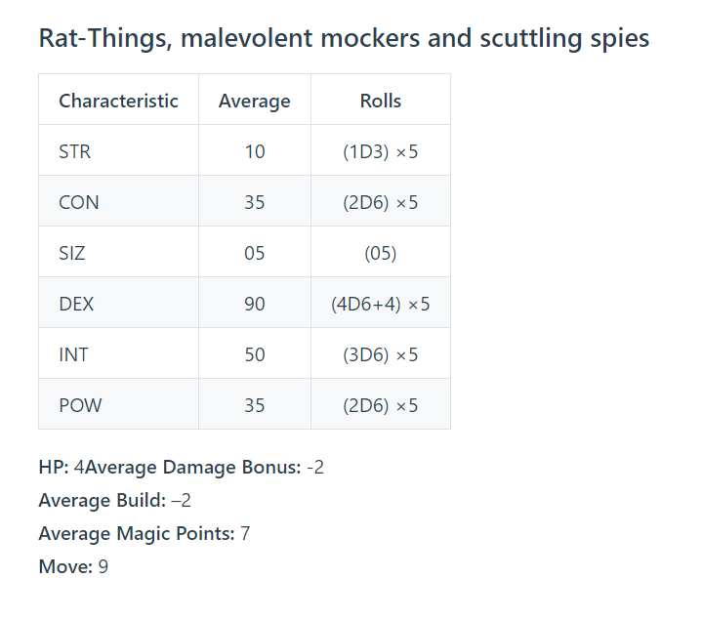
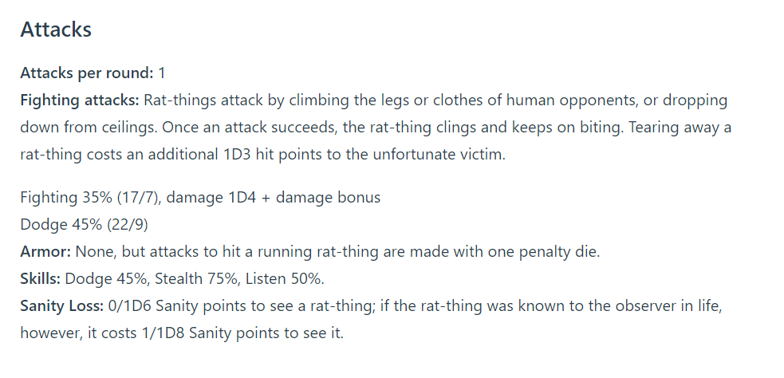

Slide 7

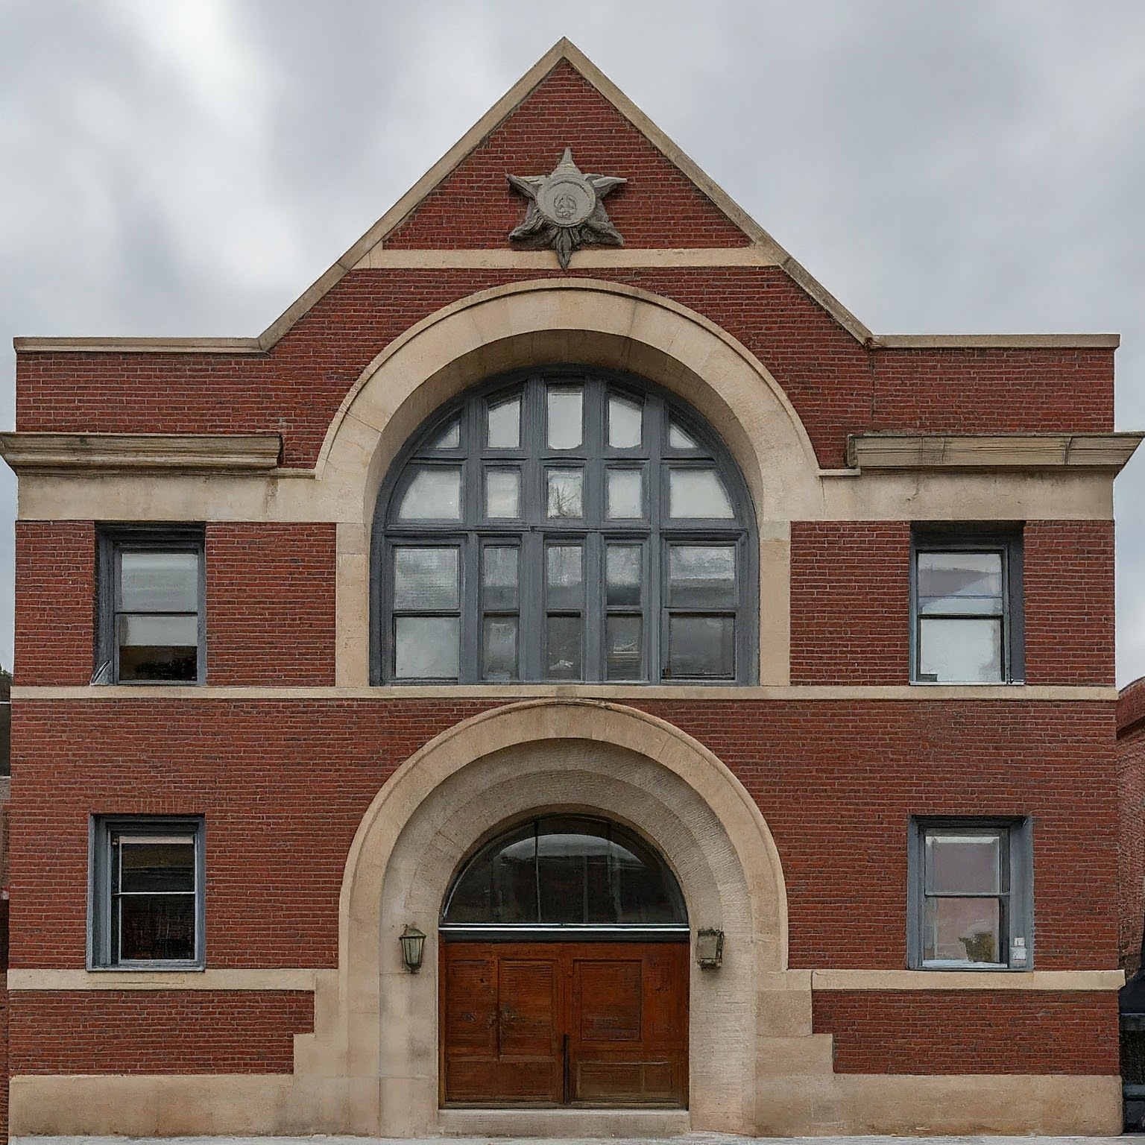
Central Police Station and Higher Courts

Slide 8
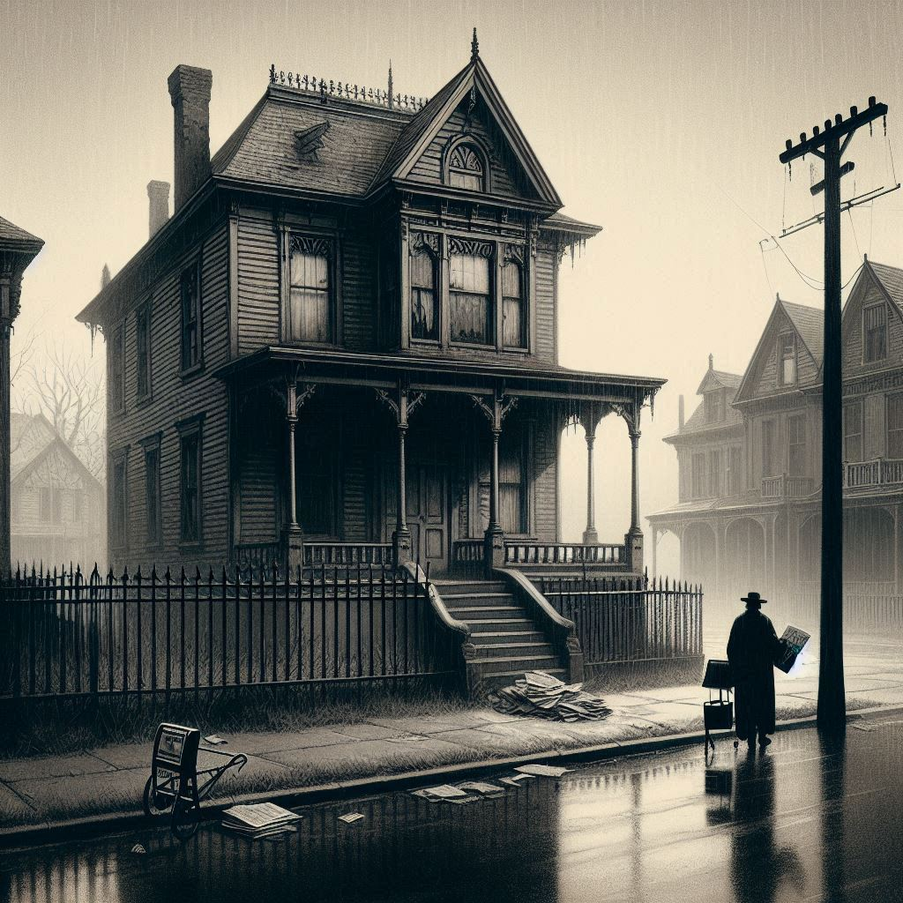

The Neighborhood
Mr Don Dooley wants a bribe roll credit or try other stuff. If they bribe well go heavy on lies.
- Macario family moved in a few years back
Dad had a serious accident and went mad – a haunting with burning eyes
A month later the lady went mad too
Both are in Roxbury sanitorium
Kids were taken to live in baltimore

Slide 9
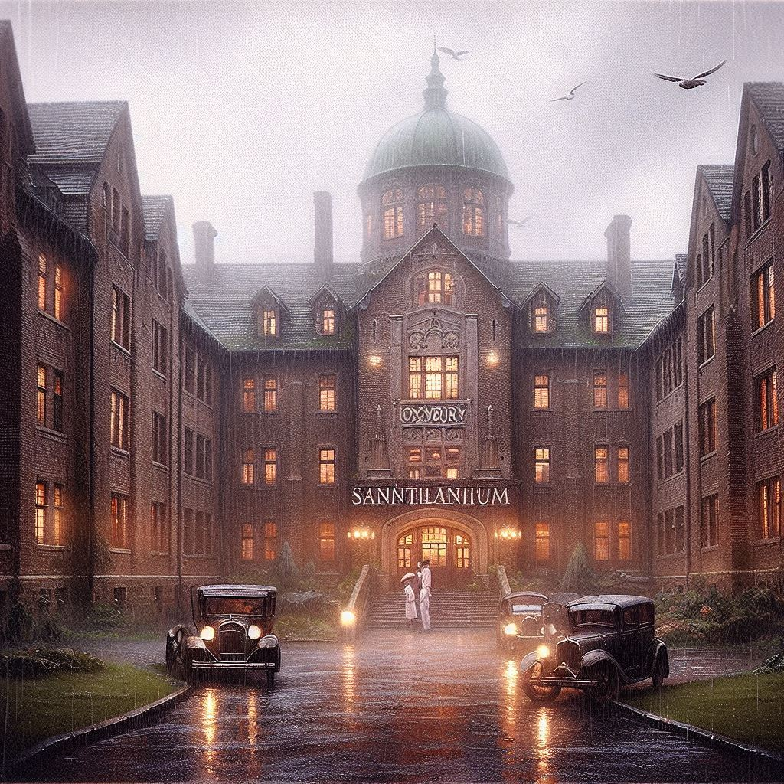


Roxbury Sanitarium
Vittorio is crazy holding bible – throws it open “By his own weapon is the devil bested”
Gabriela is kind – presence leans over her throws things and hated husband
Kids complain of nightmares of a man with burning eyes

Slide 10
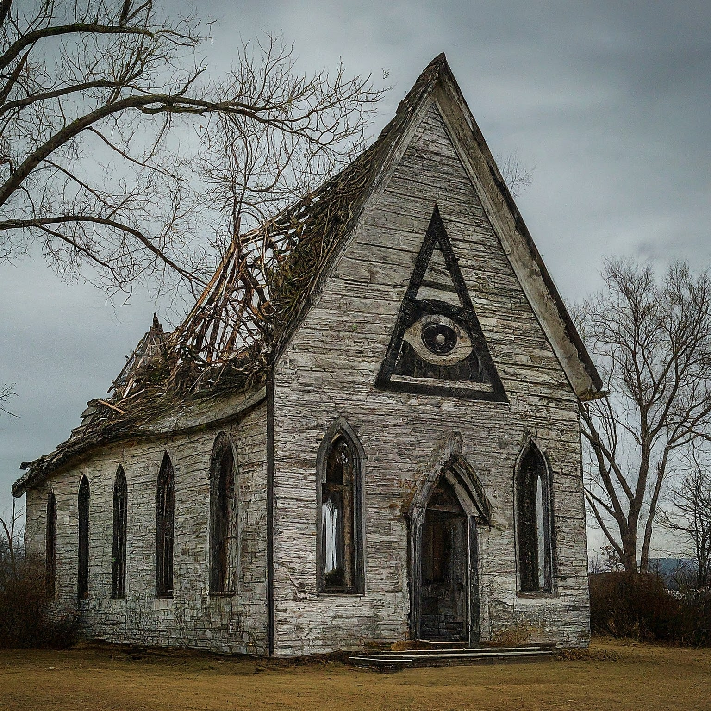


Chapel of Contemplation
Make a spot hidden find journal of cult activities The musty old journal falls to pieces as you turn the
pages, but the name Walter Corbitt catches your eye.
An entry records that Walter Corbitt was buried in
the basement of his house, “In accordance with his
wishes and with the wishes of that one who waits
in the dark”.
Alongside the journal is an enormous volume,
handwritten in Latin, but so rotten and worm-eaten
that whole sections no longer can be understood.”
The tome is a copy of the Liber Ivonis. A cursory look at the
book will show that it is in Latin and deals with matters of an
occult nature. An initial reading of this book (requiring either
a Read Latin skill of 50% or more, or a successful Read Latin
roll) will take a minimum of three hours. If an investigator
takes the time to do this then have that investigator gain 2%
Cthulhu Mythos knowledge (and reduce Maximum Sanity
by the same amount, from 99 to 97).
When nearing the building feel burning headaches setting in.
Floorboards feel week. Luck roll – failures make a jump roll to not fall 10ft. Falling is 1d6 damage.

Slide 11
Corbitt place
Front door is locked windows are nailed shut and coal shoot is boarded up

Slide 12
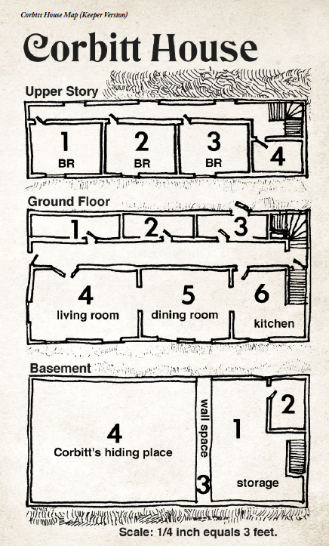
My map

Slide 13
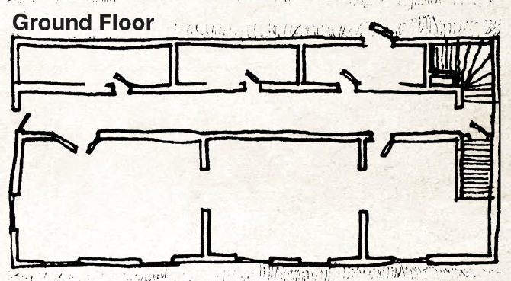
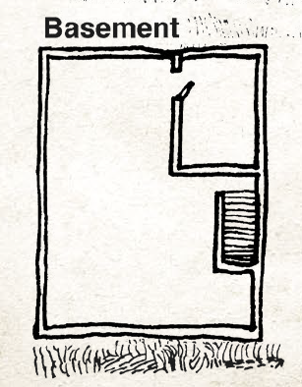
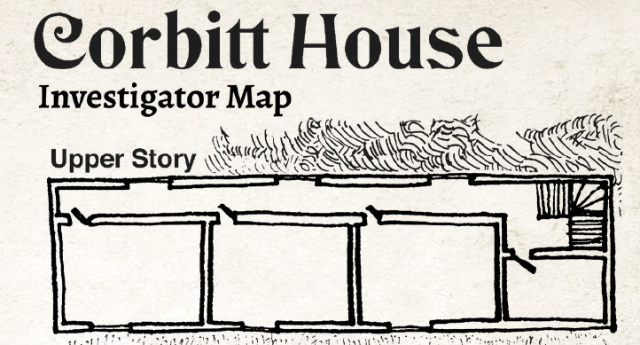

Slide 14
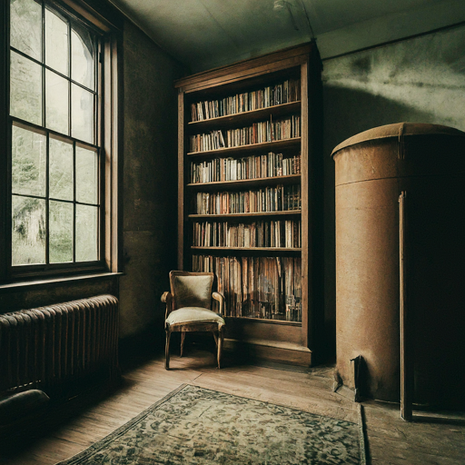
Ground floor – room 1
The room is filled with boxes and junk, such as rusted water
tanks and old bicycles. At the right end of the room is a
cupboard, boarded shut.
If the cupboard is wrenched open, three bound books are
found within—the diaries of a certain W. Corbitt, a former
inhabitant of the house, as the address on the flyleaf of
volume one testifies.
The Corbitt Diaries are in English, though sometimes
strangely phrased. The three volumes take a total of two days
to read, adding +4 to Cthulhu Mythos skill and losing 1D4
Sanity points.
The diaries describe Corbitt’s various occult experiments,
including the summoning of some unearthly spirit and other
magic, and clearly describe a spell entitled “Call Forth the
Opener of Ways” (an alternative title for the spell Summon
/ Bind Dimensional Shambler). No other spells exist in the
diaries. The spell takes
Roll corbitts magic and a sudden stench

Slide 15
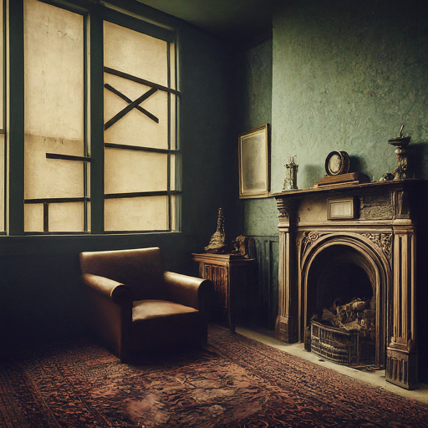
Ground floor room 2
A wood burning fireplace shows someone has been in here

Slide 16
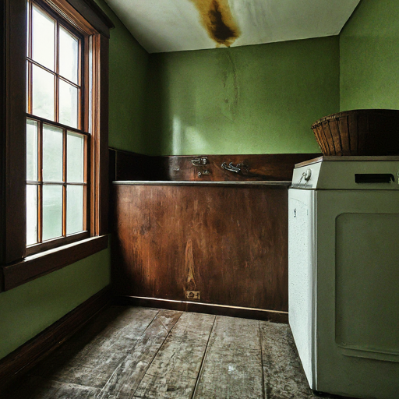
Room 3 mud room
Blood drips from the ceiling play on drowning fear as room shuts behind. Make a roll to escape or risk drowning.

Slide 17
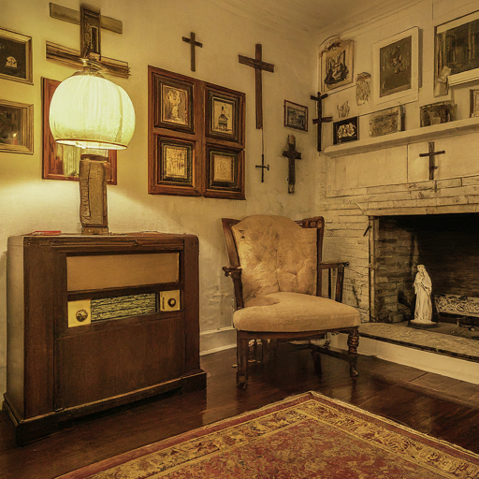
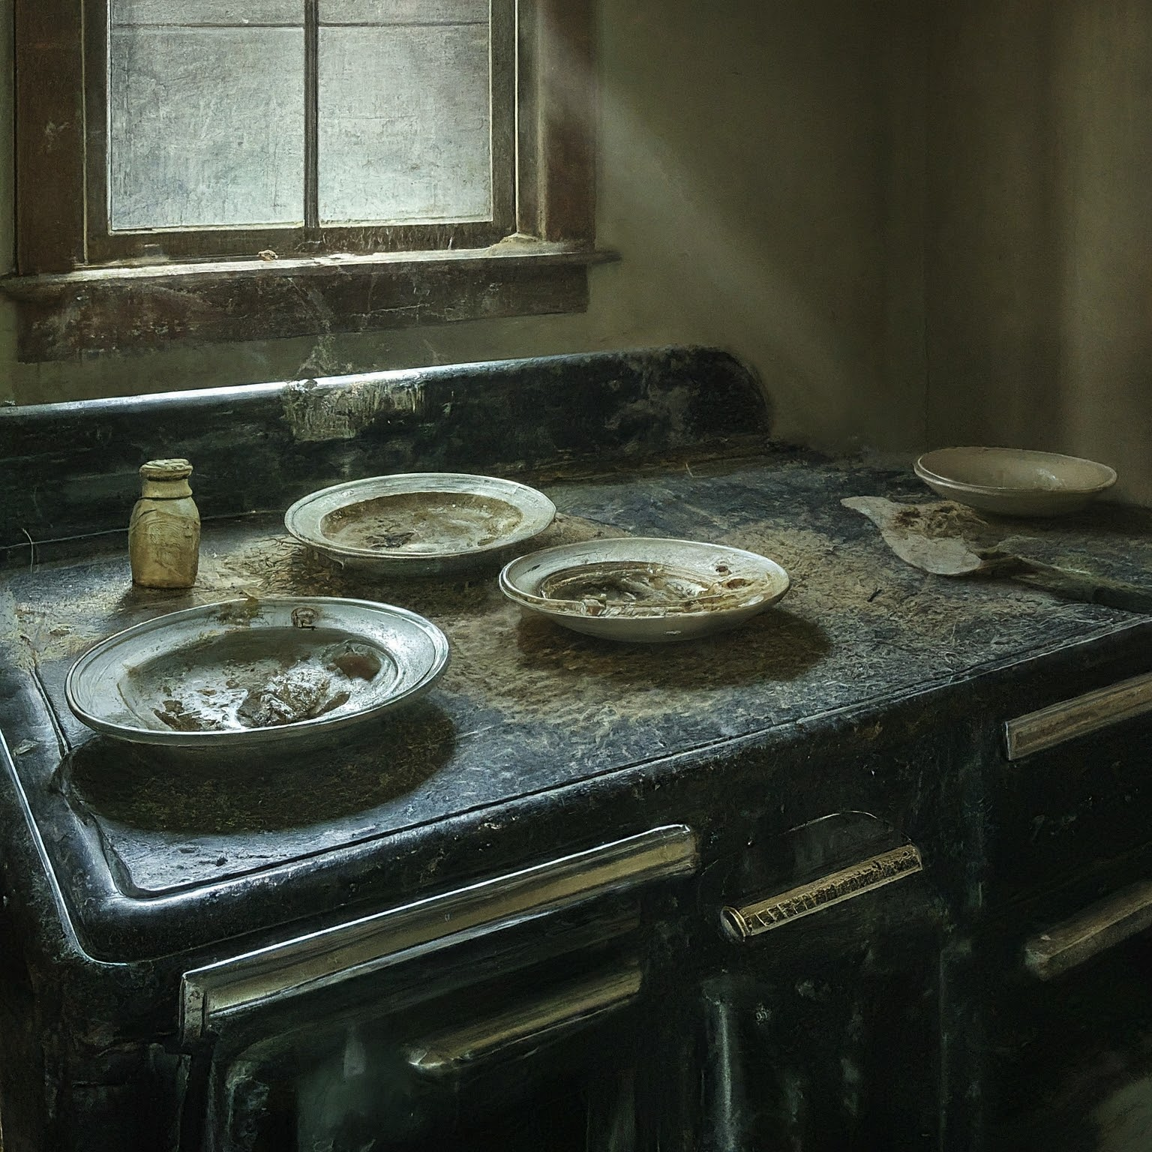
Room 4 and 5
This room contains conventional furnishings: a radio, couch,
stuffed chairs, and shelves laden with gewgaws. You cannot
help but notice the unusual quantities of crosses, images of
the Virgin and other Catholic artifacts.
Room 5 dining room three places are set and unused rice soup is rotten in the tureen

Slide 18
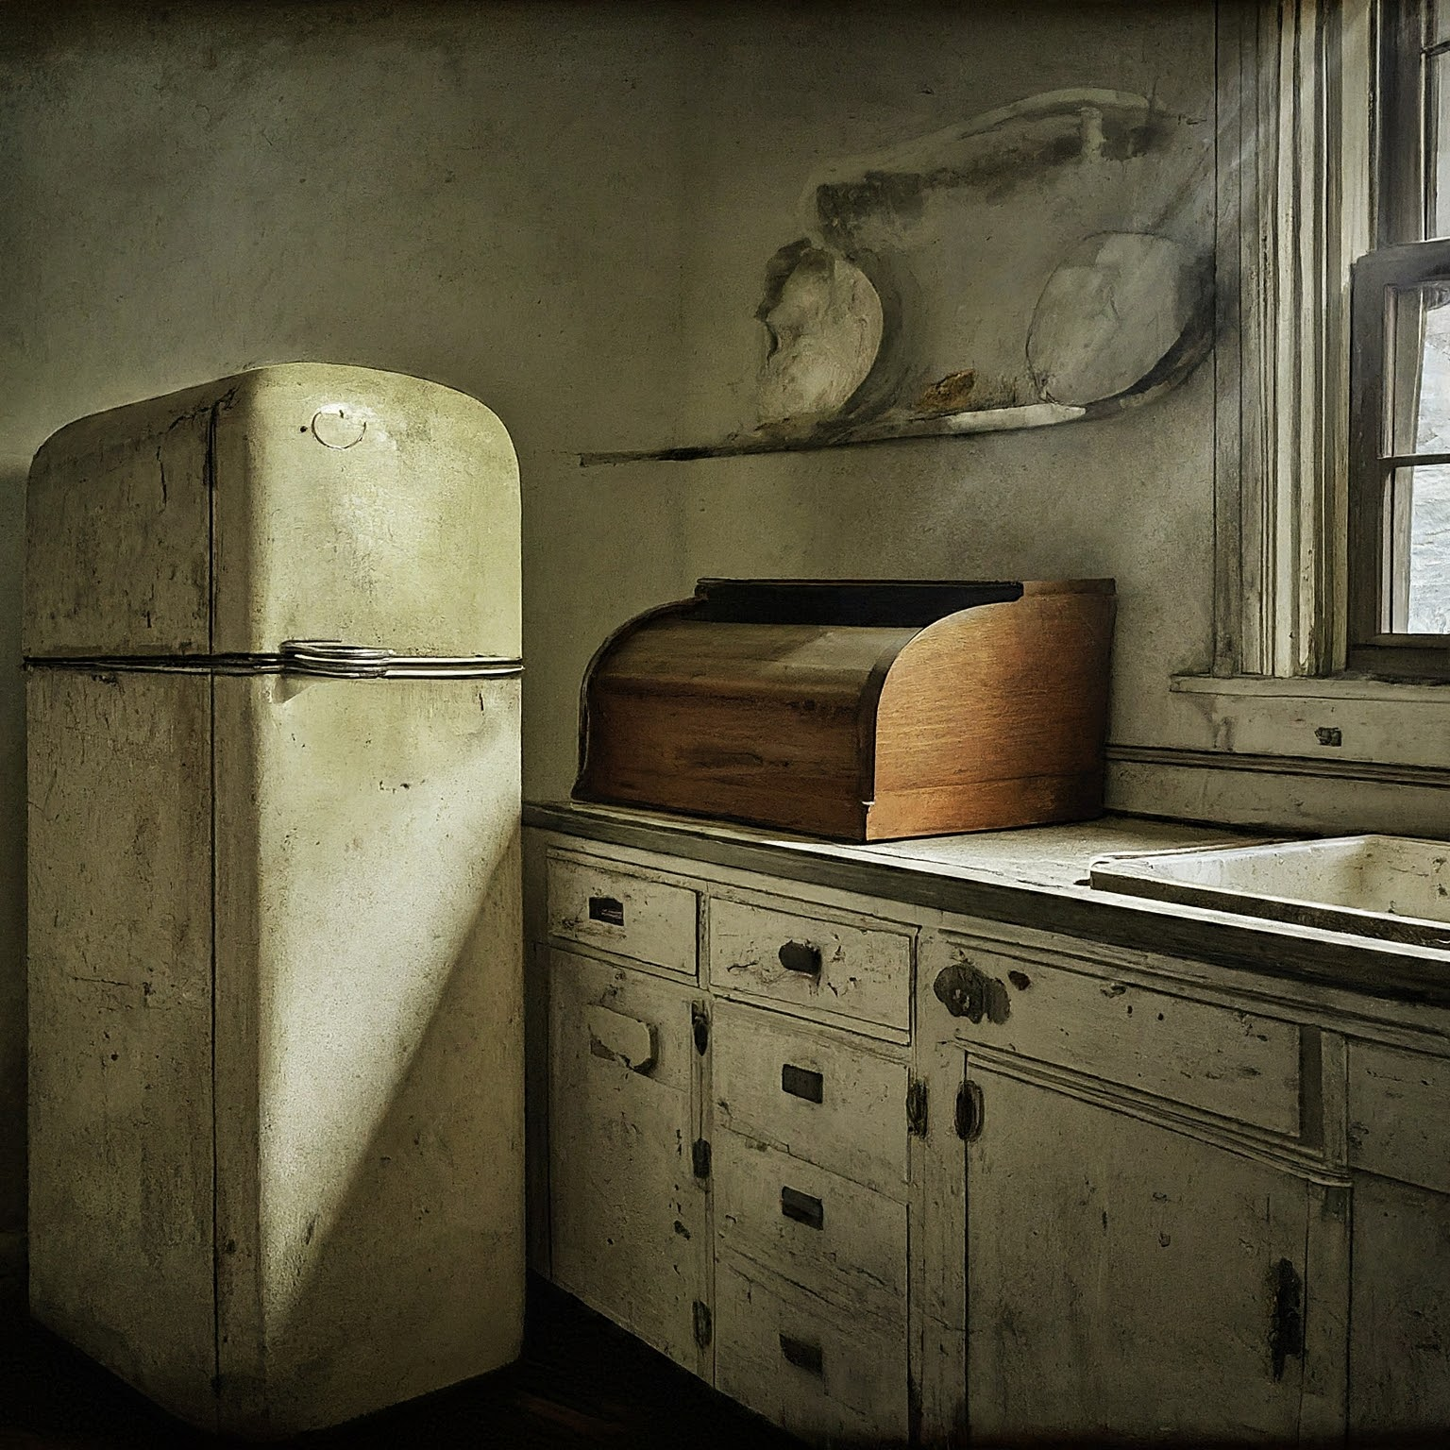
Room 6 kitchen
A conventional kitchen, with icebox, wood-fed stove and
oven, plus a meager larder. Some of the foodstuffs may be
edible—there is canned soup and meat, rice kernels, several
pastas, and a few bottles of homemade wine. The produce
which has not spoiled has been eaten by rats, judging by the
spoor left behind.
A small locked box in the corner contains bread. Its not sliced but if Tim sees it it will be D3 sanity check.
There is also a small fuse box in the corner
Opening fridge will find blood drained rats.

Slide 19
Basement Storage
Tell the players that in this smallish room are scattered
tools, pipe, a trash can lid, lumber, nails, screws, and so
forth. If an investigator searches through the mess, ask the
player to make a Spot Hidden roll. Treat this as an Obscure
Clue (don’t give the clue out if the player fails the roll). The
player might Push the roll by taking time to conduct a more
thorough search. You can foreshadow the consequence of
failure by pointing out the many sharp things among the
mess and the risk of injury
Corbitt has turned off the electricity to the basement at the
fuse box upstairs in the kitchen—if the investigators turn it
back on, Corbitt can switch it off again when it best suits him.
The stairs are perilous; all the more so because Corbitt
can make them move. One at a time, ask each investigator
descending the stairs to make a DEX or Climb roll. Treat
this as a Combined roll: the players should roll dice once and
compare the result with their DEX and Climb skills. Rolling
equal to or below one of these values counts as a success.
Anyone failing the DEX / Climb roll should be told
that the stairs are too dangerous and that to go further risks
injury. They now have a choice: remain upstairs or Push the
roll and risk falling. Failing the Pushed roll will result in the
loss of 1D6 hit points as the investigator slips and crashes to
the basement floor.

Slide 20
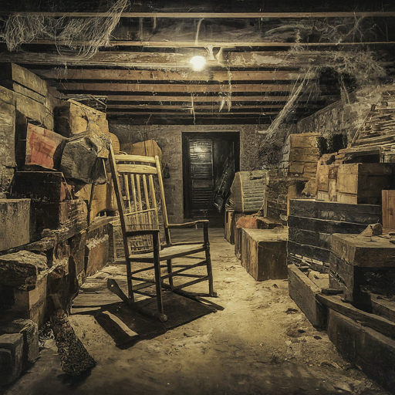
Basement storage 2
With a successful Spot Hidden roll, the investigator finds
Corbitt’s knife (see The Floating Knife) and may pick it up.
Once picked up, the knife will try to wrest itself free from the
investigator’s grasp and attack the investigator (see Having
Hold of the Knife).
If the player fails the Pushed Spot Hidden roll, the
unaware investigator catches a hand on the possessed knife
and it slashes him or her for 1D4+2 hit points of damage.

Slide 21
Floating Knife
Weapon: Floating magical dagger. See The Floating Knife (see
page 23). Spending a Magic point to cause the dagger to attack
for 1 round counts as Corbitt’s combat action for the round.
Fighting 50% (Hard 25%/Extreme10%), damage 1D3 +
damage bonus(1D4) + possible infection (see above).
Dodge 17% (Hard 8%/Extreme 3%).
Skills
Cthulhu Mythos 17%, Intimidate 64%, Listen 60%, Sleight
of hand 30%, Stealth 72%.

Slide 22
Basement storage 2
RAT PACK
STR 35 CON 55 SIZ 35 POW 50 DEX 70
HP: 9
Average Damage Bonus: -1
Average Build: -1
Move: 9
Combat
Attacks per round: 1.
Fighting attacks: Rats attack with teeth and claws.
Overwhelm (fighting maneuver): As a pack they may assault
and overwhelm an individual using the Fighting maneuver
rules, because of their numbers they gain one bonus die on
the attack. Such an attack would involve swarming over the
target, biting, and scratching as they do so.
Fighting 40% (Hard 20/Extreme 8), damage 1D3
Overwhelm (fighting maneuver) damage 2D6
Coal shoot is nailed shut and some boards in here are hollow
Removing these exposes a crawl space that smells. If they crawl right in without care get attached by 10 rats.
A wall says “Chapel of Contemplation”
Slow movers get cast dominate on them.

Slide 23
Corbitts hiding place
Lying motionless and seemingly dead on a pallet in the
centre of the room is a drawn, wooden-looking, wizened
figure of some six-feet. Skinny and naked, with ghastly
wide-flaring, saucer-like eyes and a nose like a knife blade.
Some sort of chain rests around his neck. He has lost all hair
and his shrunken gums make his teeth look very long. From
him comes a sharp, sweet, churning scent, like rotten corn.
The floor is earthen and there is a table in the southwest
corner with some curled papers on it.
Corbitt stands 1D8 sanity roll if loss >5 make intelligence. If failed go insane roll on bouts of madness table.
Fight Corbitt

Slide 24
Corbitt
Corbitt’s Spells
DOMINATE (Corbitt’s variant): Costs Corbitt 1 Magic
point and takes one round to cast.
With his version of the Dominate spell, Corbitt can
mentally cloud the mind of one investigator at a time, as long as
the target is physically in the Corbitt house. The player should
make an opposed POW roll versus Corbitt’s POW of 90.
If Corbitt succeeds, the target is in a daze for 1D6+1
combat rounds. While in this dazed state, the victim is
subject to telepathic commands from Corbitt. These may
take the form of subtle and creepy hallucinations or direct
commands at the Keeper’s discretion. He or she will not
commit suicidal acts, though homicidal, idiotic, or reckless
acts (such as trying to swallow a butcher’s knife) might be
attempted. Waking, the victim will not recall what happened.
FLESH WARD: Corbitt will already have cast this spell
before the investigators get to him, to provide himself with
armor (see Armor above).
• Cost: variable magic points
• Casting Time: 5 rounds
Grants protection against physical attack. Each magic point
spent gives the caster or the chosen target 1D6 points of
armor against non-magical attacks. This protection wears off
as it blocks damage. For example, if a character has 12 points
of Flesh Ward as armor and suffers 8 points of damage, the
character suffers no damage but the Flesh Ward is reduced to 4
points. The spell lasts 24 hours or until the protection is used up.
Once cast, the spell may not be reinforced with further magic
points, nor recast until the old spell’s protection has been used up.
Walter Corbitt, Undead Fiend
STR 90 CON 115 SIZ 55 INT 80
POW 90 DEX 35 APP 05 EDU 80
SAN: 0 (ignore Sanity costs for spells)
HP: 16
Damage bonus: +1D4
Build: 1
Move: 8
Magic points: 18 (if spent, recover 1 per hour)

Slide 25
Combat
Attacks per round: 1
Fighting attacks: When animated, Corbitt is able to make
all regular attacks (kick, punch, etc.). Being wounded by
Corbitt’s clawed fingernails risks serious disease; if he lands
a successful attack upon an investigator, a Luck roll should
be made. If it is failed, the investigator has been raked by
Corbitt’s claws and a day later the victim becomes delirious
and must make a CON roll:
• Failure: Delirium lasts 1D10 days; lose 1D10 CON.
• Success: Delirium lasts 1D6 days; no further CON loss.
• Repeat the procedure until the investigator recovers or dies.
CON lost does not regenerate.
Weapon: Floating magical dagger. See The Floating Knife (see
page 23). Spending a Magic point to cause the dagger to attack
for 1 round counts as Corbitt’s combat action for the round.
Fighting 50% (Hard 25%/Extreme10%), damage 1D3 +
damage bonus(1D4) + possible infection (see above).
Dodge 17% (Hard 8%/Extreme 3%).
Skills
Cthulhu Mythos 17%, Intimidate 64%, Listen 60%, Sleight
of hand 30%, Stealth 72%.

