Slide 1
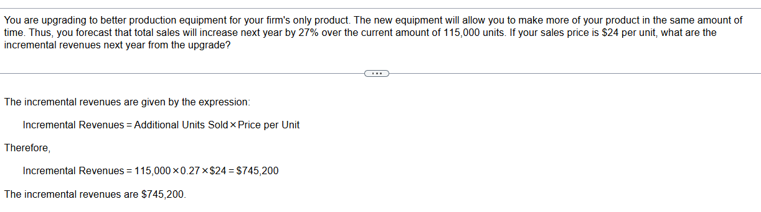

Slide 2
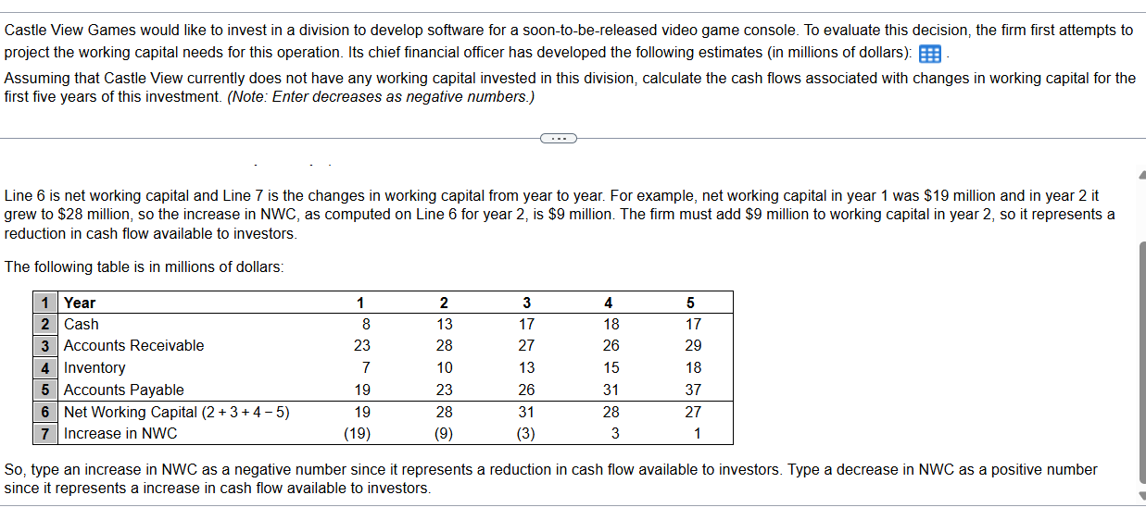
Year 1 2 3 4 5
Cash 7 10 15 16 16
Accounts Receivable 18 26 23 25 23
Inventory 4 9 10 13 16
Accounts Payable 18 19 24 26 32

Slide 3
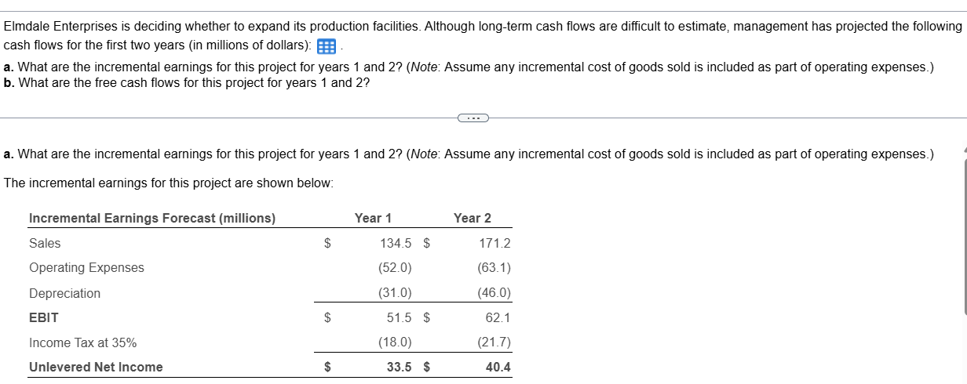
Year 1 2
Revenues 134.5 171.2
Operating Expenses (other than depreciation) 52.0 63.1
Depreciation 31.0 46.0
Increase in Net Working Capital 4.3 9.7
Capital Expenditures 24.8 33.5
Marginal Corporate Tax Rate (%) 35 35

Slide 4
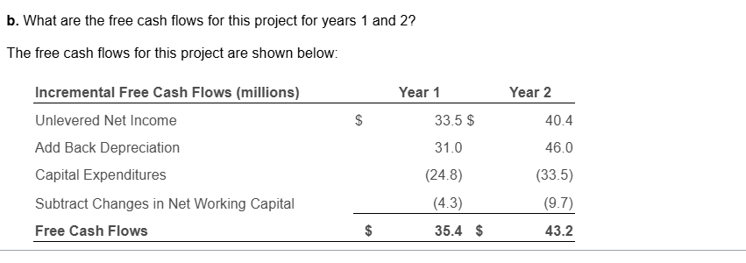

Slide 5
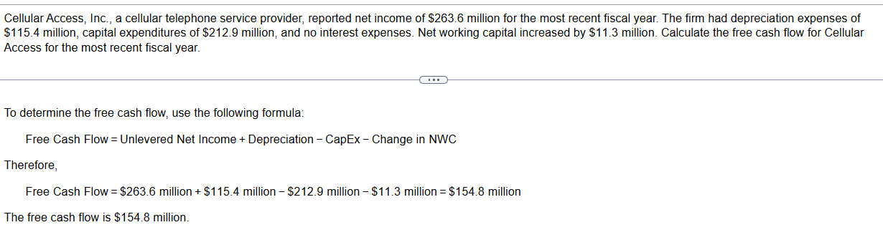

Slide 6
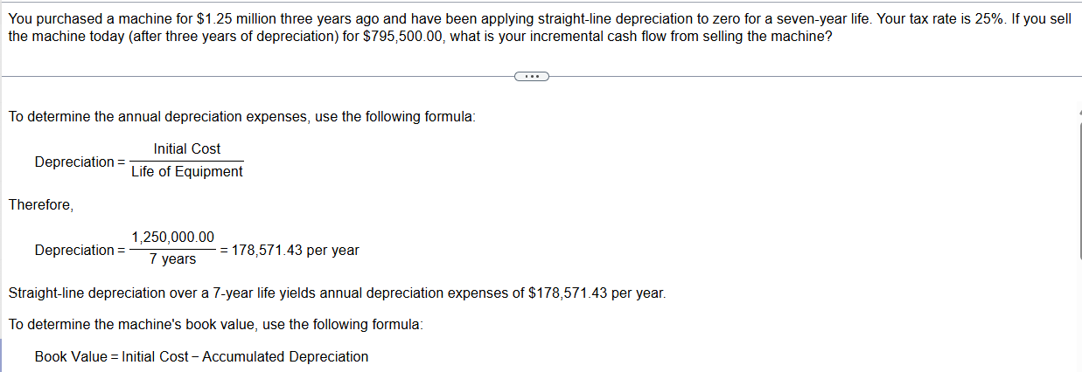

Slide 7
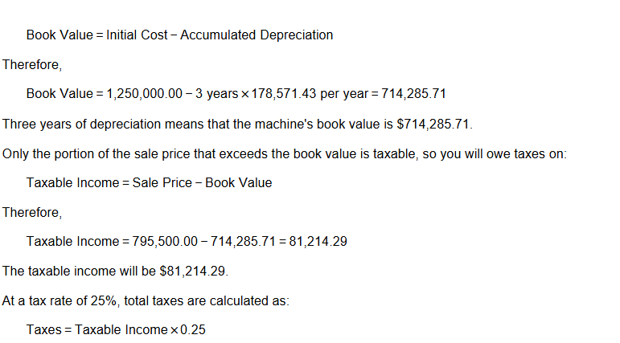

Slide 8
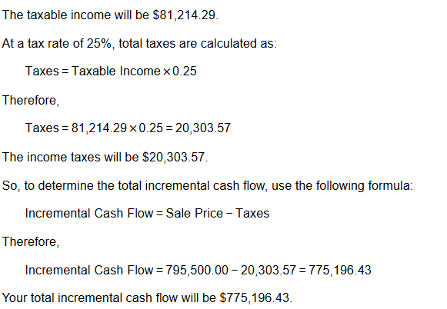

Slide 9
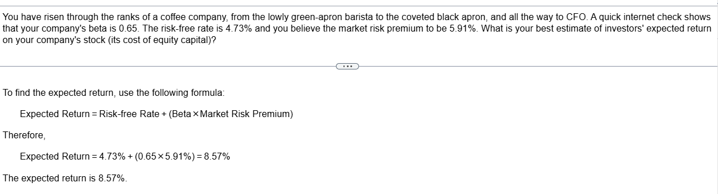

Slide 10
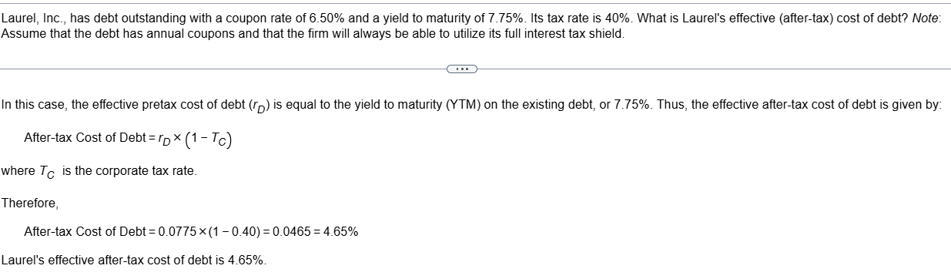

Slide 11
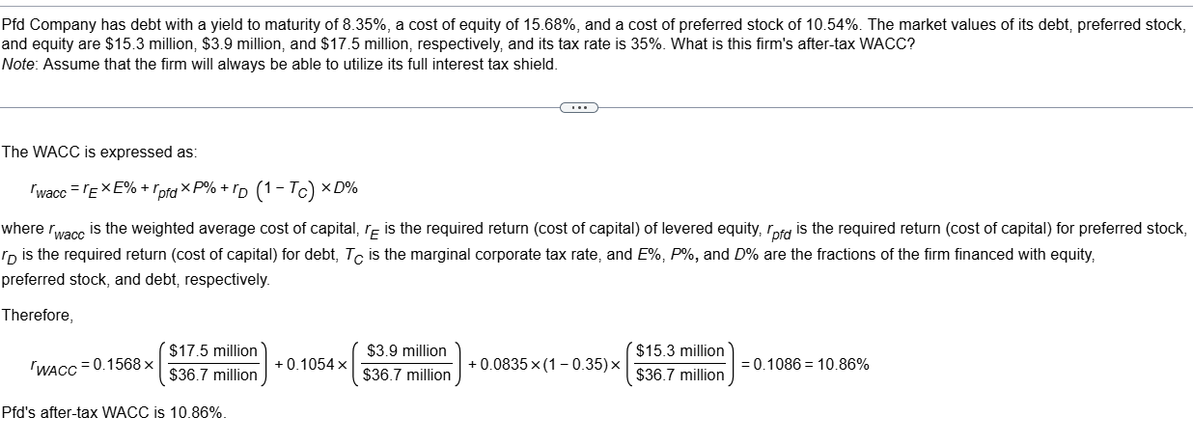

Slide 12
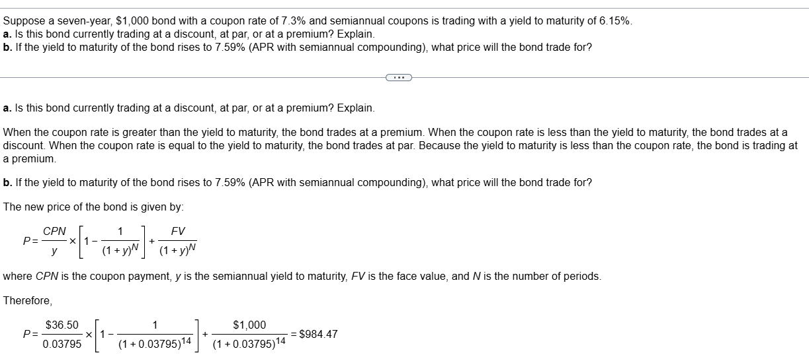

Slide 13
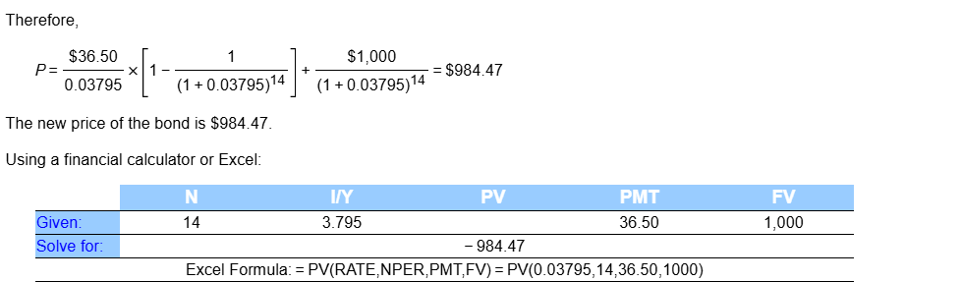

Slide 14
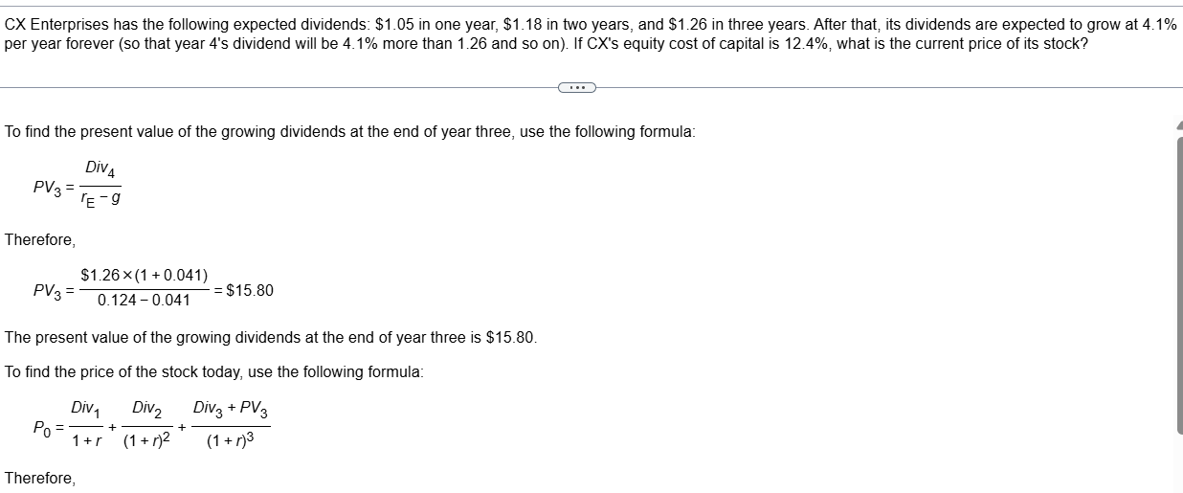

Slide 15
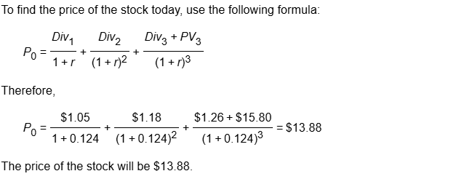

Slide 16
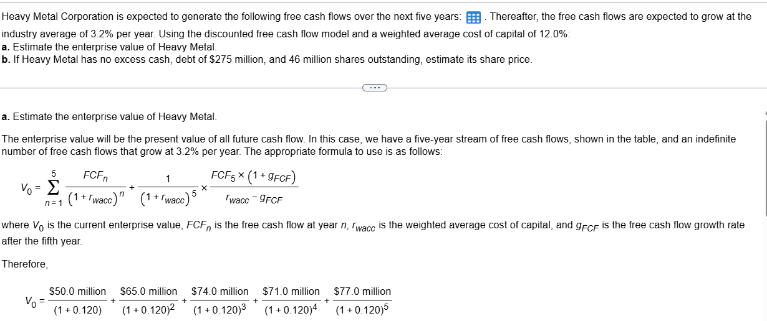

Slide 17
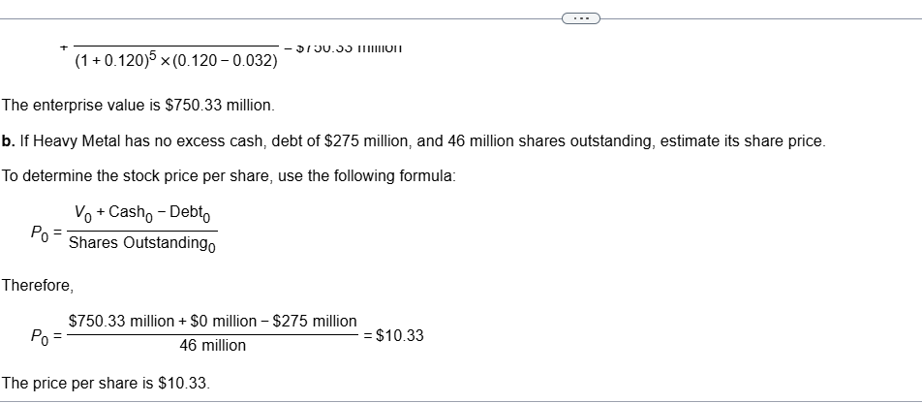
Year 1 2 3 4 5
FCF ($ million) 50.0 65.0 74.0 71.0 77.0

