Slide 1
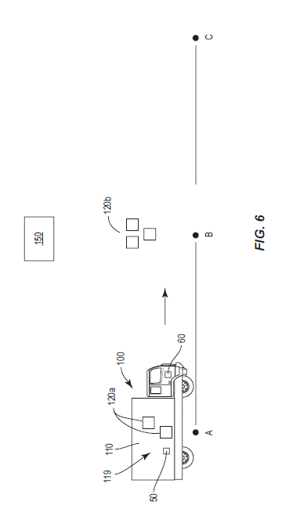





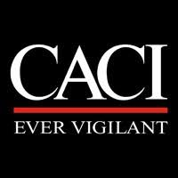

Brian Morman
Program Highlights
1) Boeing Networking – tear down lab,
Phantom Works PM & MQ leadership
2) Executive Coaching
3) DC Residency – April
4) 1st Boeing Patent
“Contour scanning for less
than load trucking applications”
Fall Semester:
Business Analytics and Decisions – High Pass*
Creative thinking – High Pass*
Leadership communication - Pass
Strategic Management - Pass
Values based – Data Driven Leadership - Pass
Financial Accounting – Pass
Team Development and Assessment - Pass
Market and Consumer Focus – Ongoing
Cost accounting - Ongoing
Spring Semester
Negotiations and Conflict Management -
Managerial Economics
Data Driven Decisions
Corporate Finance
Managing Organizations
DC Immersion Courses
6 member project team
Team Dynamic and roles:
CEO / CTO - My Role
Editorial Chief - Chief Administrative Officer CMO - Marketing Director
Chief Commercial Officer - Nurse Administrator Chief Financial Officer - Investment VP Scrum Lead - Data Engineer – Defense Sector
* High Pass signifies top 4 in class

