Slide 1


Slide 2
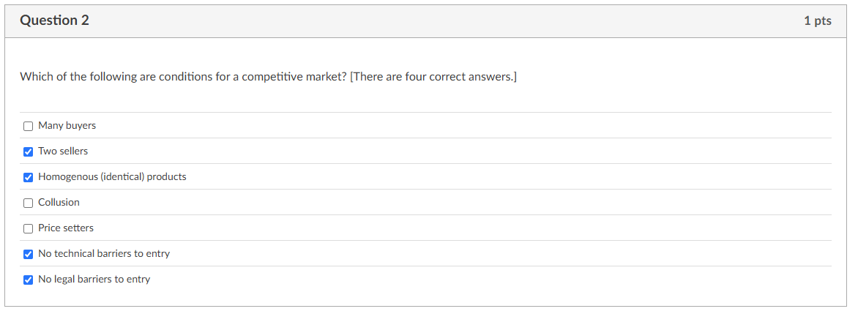
.5 two of four

Slide 3

One right one missing

Slide 4


Slide 5
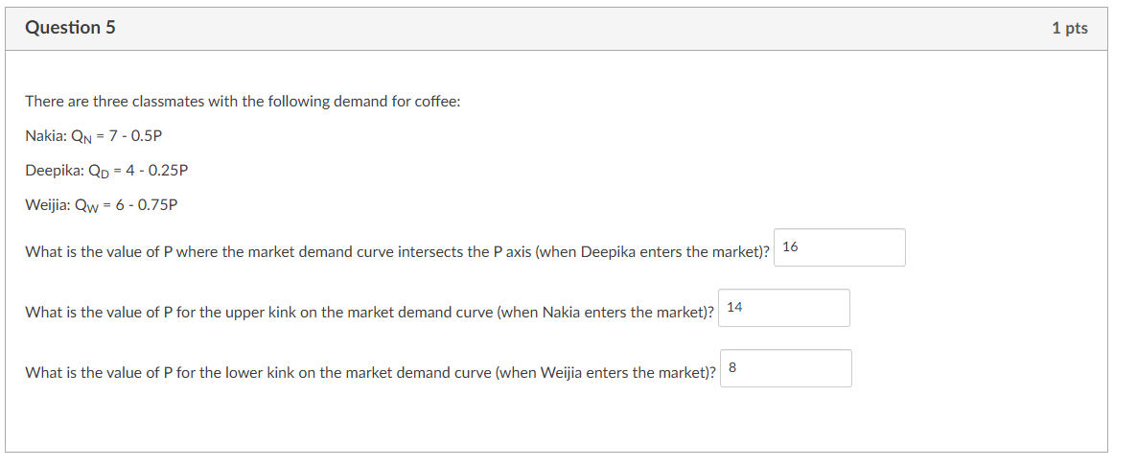

Slide 6


Slide 7
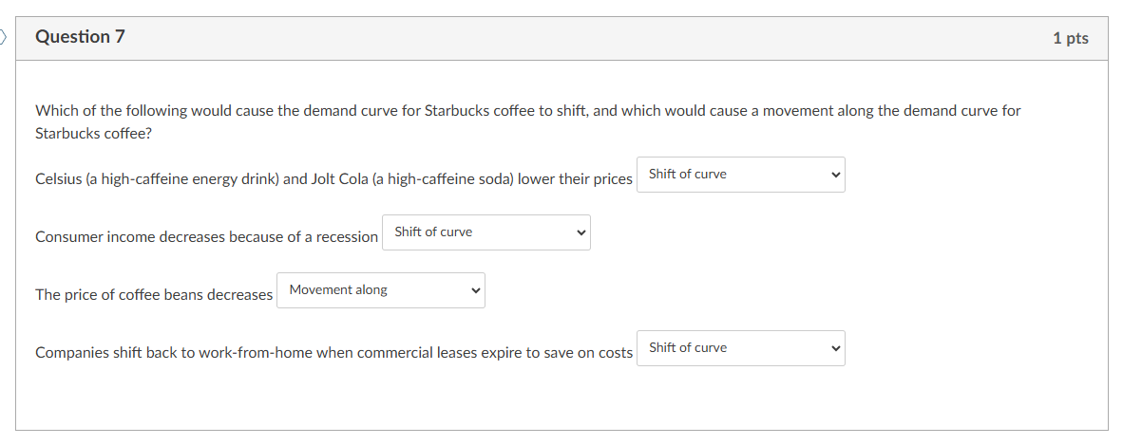

Slide 8


Slide 9

wrong

Slide 10

wrong

Slide 11

wrong

Slide 12


Slide 13


Slide 14


Slide 15
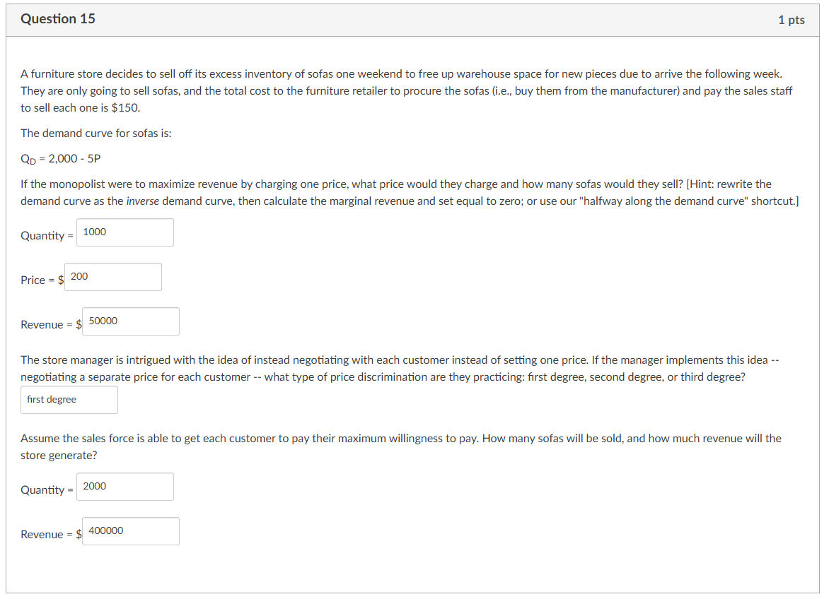
1/2

Slide 16
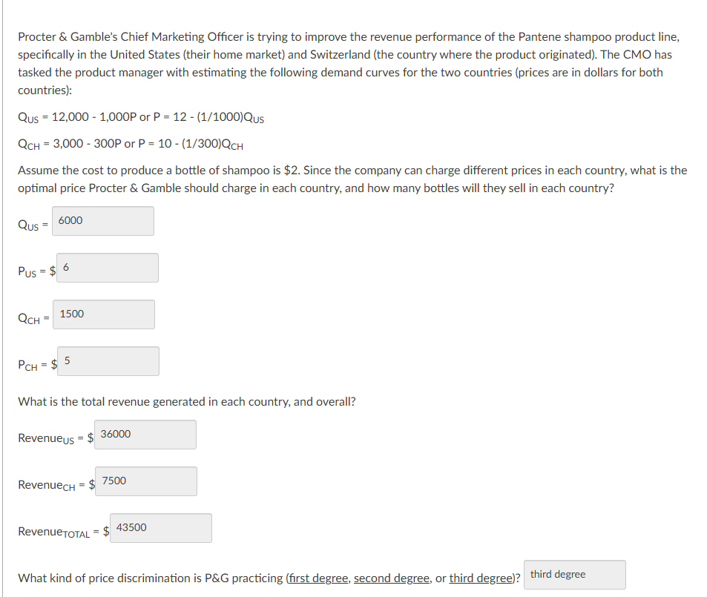
.13 of 1

Slide 17
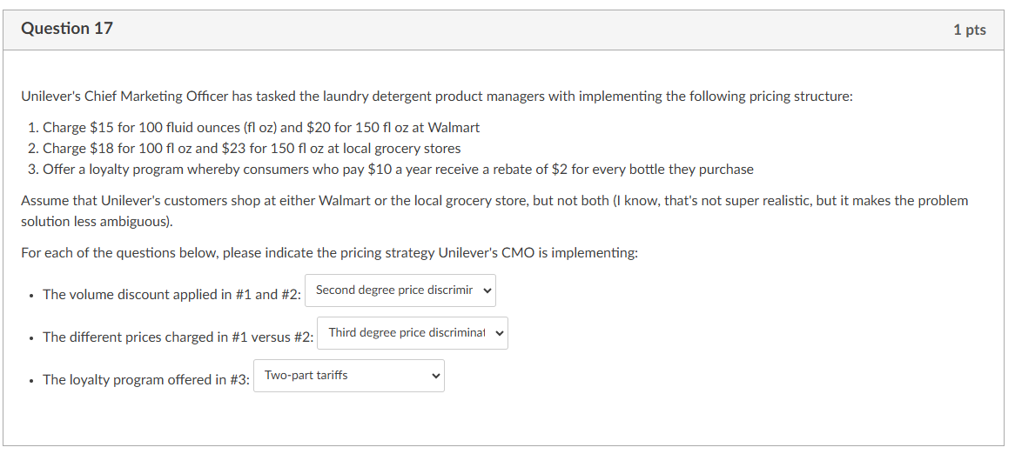

Slide 18
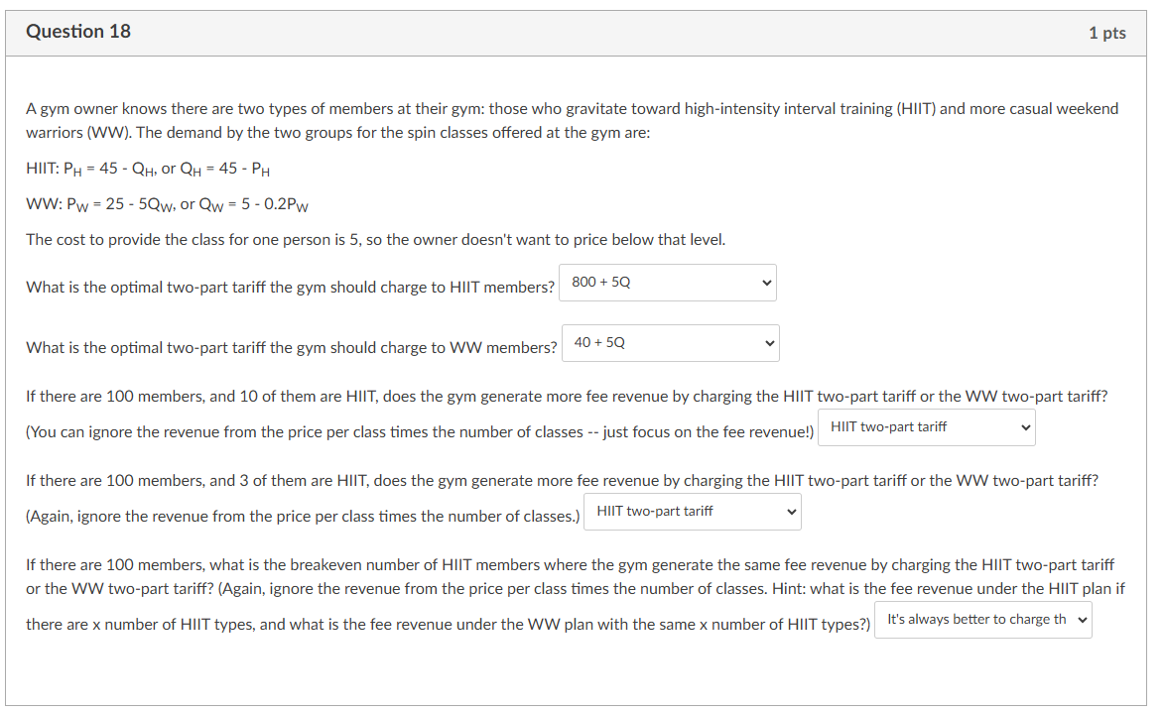
2/3

Slide 19
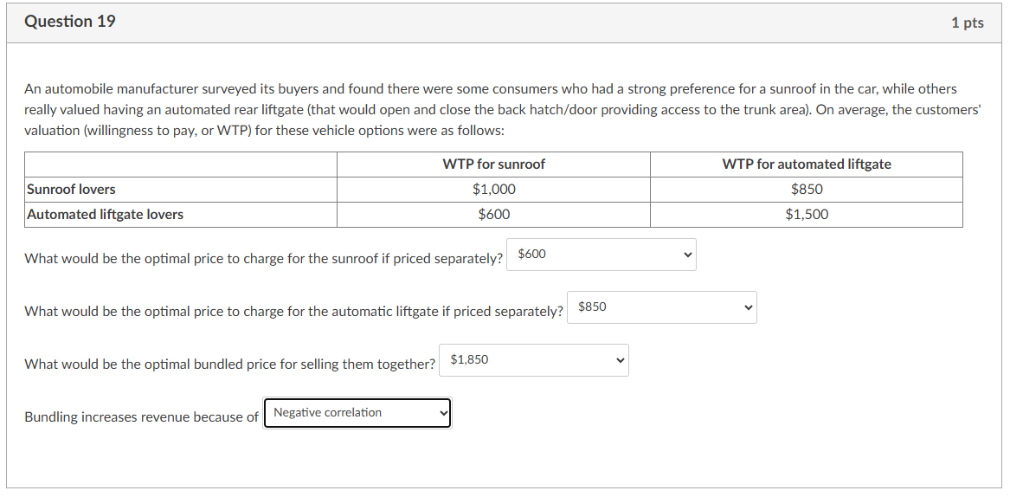

Slide 20
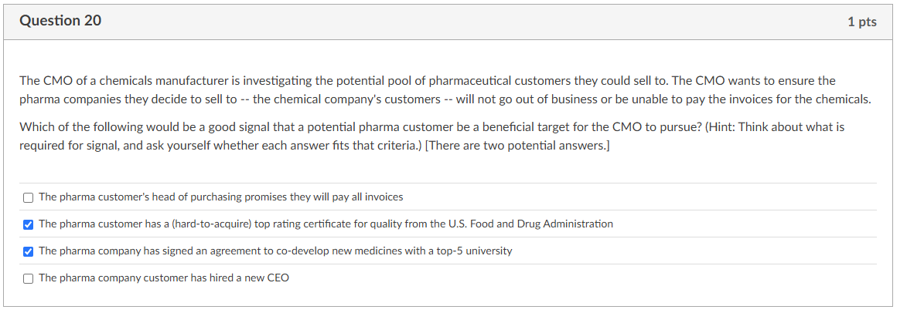

Slide 21
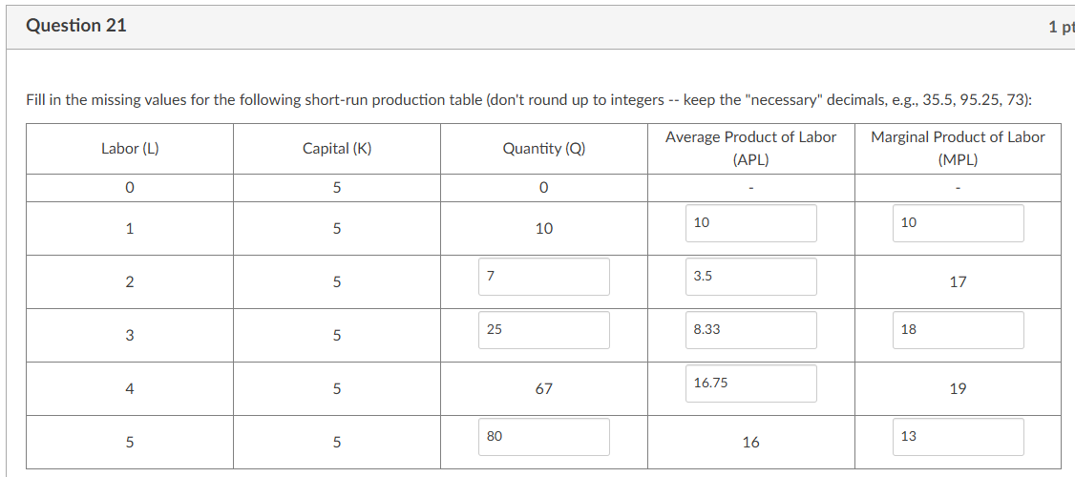
.5

Slide 22
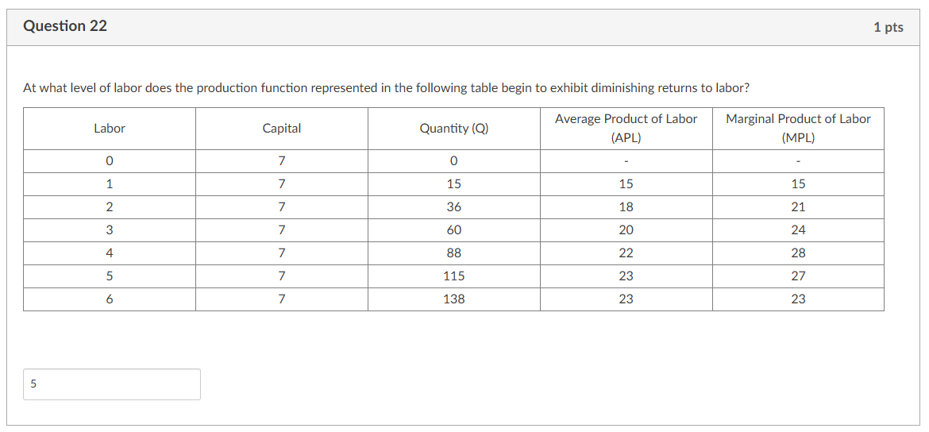

Slide 23
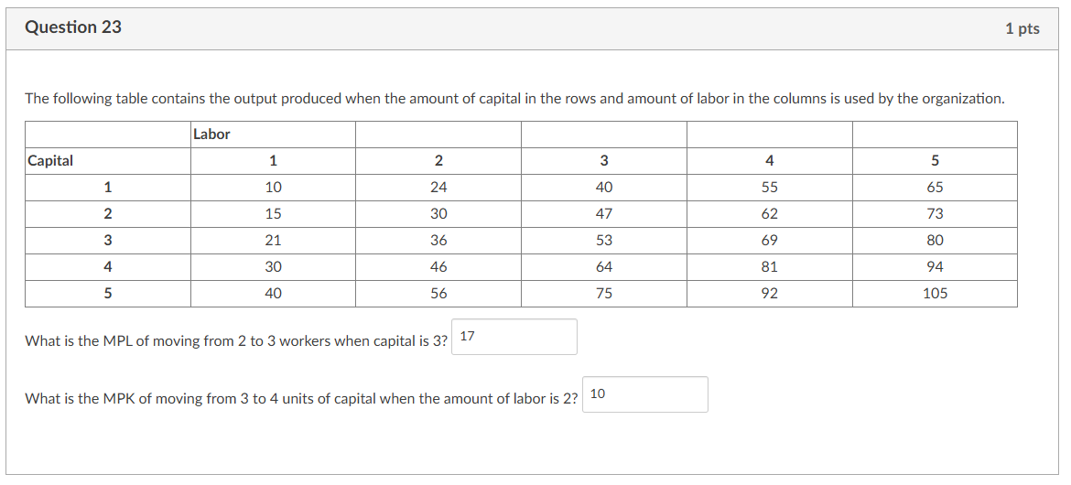

Slide 24
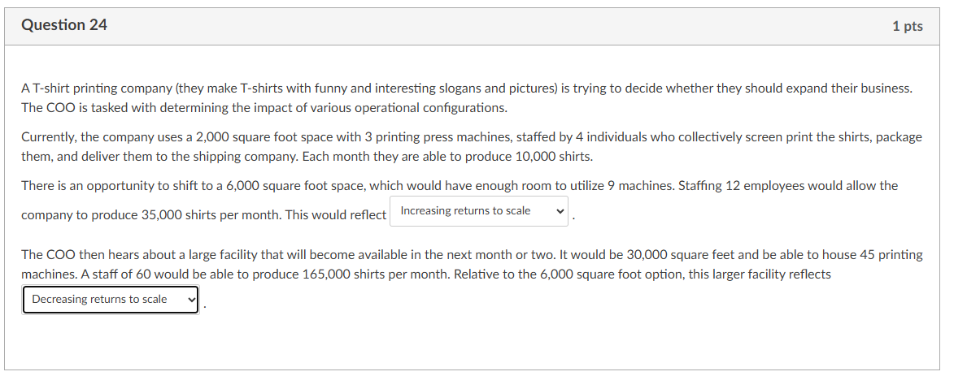

Slide 25

0

