Slide 1
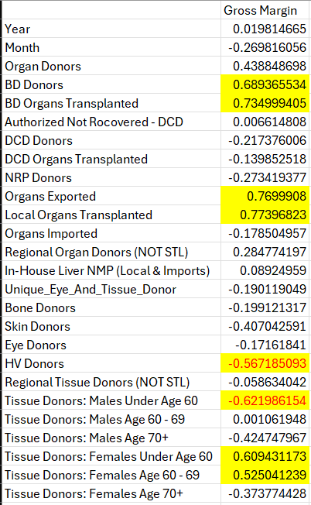
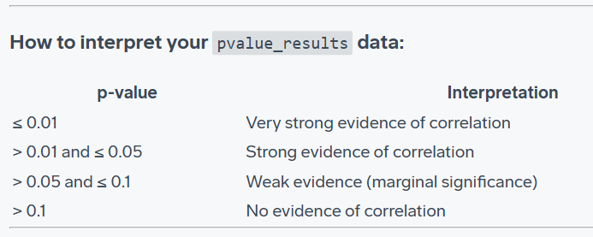
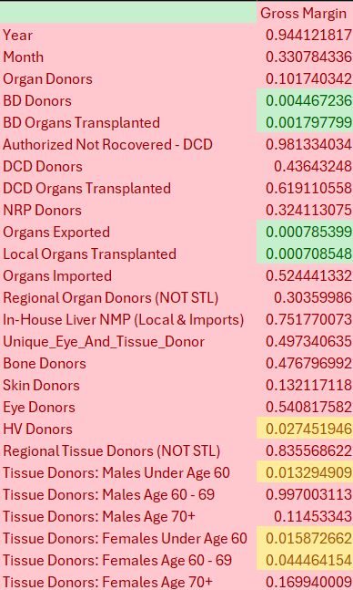
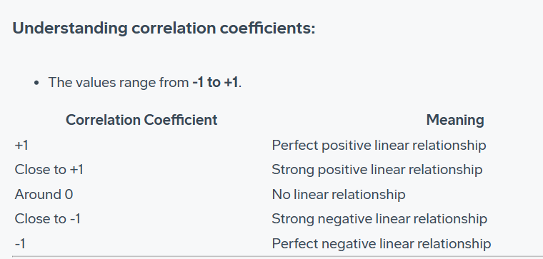
Multivariable Correlation Analysis
P Value Analysis

Slide 2
Chart Meaning:
In the P-Value chart, Green cells have very strong evidence of correlation from our small data set.
Yellow Cells have some evidence of correlation.
In the Correlation Chart, highlighted cells have a good fit to a linear trend. (Red text for a negative correlation).
Takeaways:
No surprise, the most positive correlation to increased gross margin are BD donations.
Somewhat interesting – both local and exported organ donations have very similar positive correlation. This suggests to me the costs of export really aren’t hurting gross margin at this point.
Most interesting – our P value fit is not perfect but this data suggests that HV Donors and Male tissue donors <60 are driving NEGITIVE gross margin while female tissue donors between 60 and 69 are driving POSITIVE Gross margin.
Key Questions: More data would be very useful here to confirm these trends or to deny them. If we had more discrete data to break these up by individual event I could better run the analysis. If that’s not possible we may be able to gather some external research data that might help drive conclusions. I’d love to get your thoughts on the findings so far to see if this could be a good avenue to continue.

