Slide 1

Team Development & Assessment Module 2: Designing & Launching Teams

Slide 2
Three Dimensions of Team Effectiveness
1
2
3
Team members learn and expand their capabilities—both as individuals and as a unit.
Team members feel positively about the experience they had working with one another.
The team delivers results that meet or exceed stakeholders’ expectations.

Slide 3


Our Overarching Framework
Team Learning
Team Processes
Team Effectiveness
Team Design
Team Launch
Cognitive
Socio-emotional
Team Learning

Slide 4

Today’s Objectives
Think critically about the promise and perils of diversity in teams
Learn a model for team design
Learn a model for launching new teams

Slide 5
Our Overarching Framework
Team Learning
Team Processes
Team Effectiveness
Team Design
Team Launch
Cognitive
Socio-emotional
Team Learning

Slide 6


The Promise of Diverse Teams
A team of smart people with diverse perspectives and expertise can tackle highly complex problems more effectively and efficiently than people working alone.

Slide 7
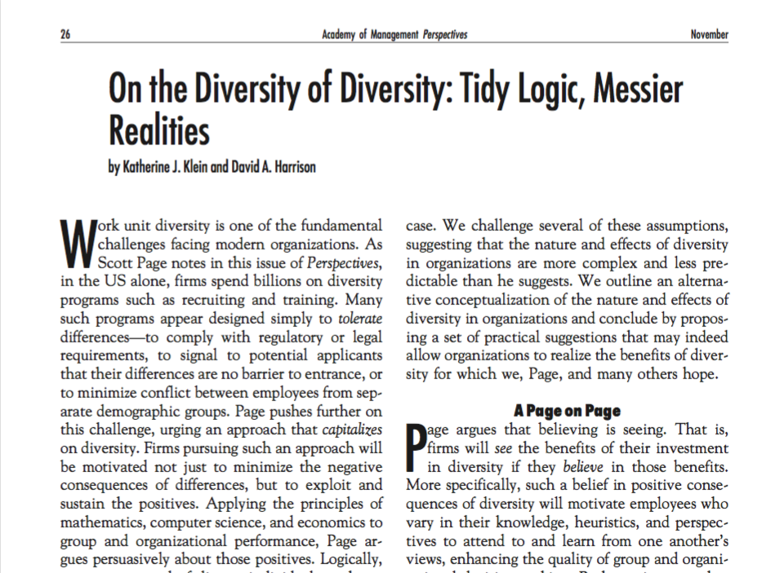
The Reality of Diverse Teams
The results of several meta-analyses show null effects of diversity on team task performance.
A number of individual and interpersonal tendencies create barriers to realizing the benefits of diversity in groups and organizations. Just assembling a diverse group often does not yield benefits. Skillful leadership is needed to overcome these barriers and gain the benefits of diversity.
See endnotes A & B in van Knippenberg et al. (2020)

Slide 8
Dual Pathways of Effects
From van Knippenberg et al. (2020)

Slide 9
Our Overarching Framework
Team Learning
Team Processes
Team Effectiveness
Team Design
Team Launch
Cognitive
Socio-emotional
Team Learning

Slide 10
Checklist for Leading Team Design
Why?
Do I understand this team’s principle objectives and purpose?
Do I know the primary stakeholders for this team’s work?
Can I clearly specify why this team is being put together?
When?
Do I know when key stakeholders expect the team’s ultimate deliverable?
Can I specify critical milestones that can help pace the project?
Have I designed a clear initial timeline for the team’s work?
Who?
Do I understand the skills and perspectives needed for the team to succeed?
Have I identified who has the requisite skills for taskwork and teamwork?
Do prospective members have the time to devote to the team?
Where?
Do I know where team members will collaborate with one another—in person and/or virtually?
Can I identify places where team members can build relationships with each other?
What?
Do I know what role(s) each team member will be asked to play on this team?
Can I articulate the responsibilities and commitments associated with each role?
Am I clear on the role that I will play as project leader?

Slide 11
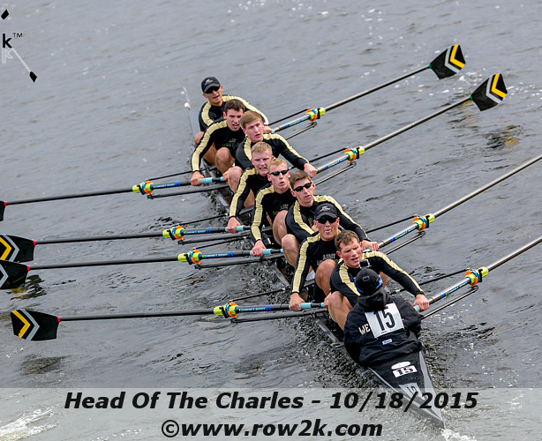
Army Crew Team Case
Fall 2001: Measurement of individual rowing skill and power
Spring Break, 2002: Atlanta Retreat with “seat racing” and selection of Varsity team members
May, 2022: Coach P needs to decide on roster for Nationals

Slide 12
Our Overarching Framework
Team Learning
Team Processes
Team Effectiveness
Team Design
Team Launch
Cognitive
Socio-emotional
Team Learning

Slide 13

Team Launch is a Critical Period
A critical period is a developmental stage when a facet of an organism is particularly sensitive to stimuli and plastic—able to change
Research suggests project-based teams have three relatively discrete critical periods
Team launch
Temporal midpoint
“The Showdown”
Ericksen & Dyer (2004); Gersick (1989); Knight (2015)

Slide 14
Effective Team Launch Kicks off a Virtuous Cycle along Three Dimensions
Effective leaders start the team promptly, rather than delaying the team launch
Invest time early on in recruiting team members
Mobilize the team as quickly as possible with a launch meeting
Time
Effective leaders proactively gather requirements from key stakeholders
Seek out stakeholders’ differing perspectives on the project
Establish clear objectives with the team
Cultivate shared purpose
Task
Effective leaders strategically select team members
Considering the nature of the task, seek out the requisite knowledge, skills, and abilities
Take into account people’s availability and other commitments
Talent
Effective launch produces a surplus of time
Effective launch produces a surplus of knowledge
Effective launch produces a surplus of human capital
Ericksen & Dyer (2004)

Slide 15
Checklist for Leading Team Launch
Four Steps to Develop a Team Charter
Confirm You Have Answered These Questions
1
Discuss the purpose and objectives of the team, including key stakeholders
Agree upon collective goals and the goals of individual team members
Do team members have a shared understanding of the team’s main objectives?
Do team members understand what one another hopes to gain from the experience?
1
2
Discuss and document the team’s strengths and weaknesses
Consider team members’ skills, perspectives, and past work history
2
Do team members have a shared understanding of the team’s resources?
Are team members aware of one another’s strengths and weaknesses?
3
Discuss methods for communication and collaboration
Agree upon team members’ roles and the “rules of engagement”
3
Do team members have a shared understanding of the initial strategy, including critical milestones?
Have team members agreed upon how to communicate and collaborate?
4
Discuss the initial task strategy for the focal project
Agree upon important milestones and the immediate next steps

Slide 16
Next: Leading Decision-Making
Read “What you don’t know about making decisions”
Read “Making dumb groups smarter”
Review your Bauer Leadership Center assessment report. You will use this in time working on your Team Charter

