Slide 1

Team Development & Assessment Module 3: Leading Decision-Making

Slide 2
How would you lead?
Imagine you were charged with leading a team of people high in diversity. Specifically, imagine that team members held very different core values. Which style of leadership do you think would be most beneficial for such a team?
A more directive style of leadership that provides structure to the team’s work. A task-focused leader specifies how work should be done.
Task-Focused Leadership
A more participative style of leadership that focuses principally on relationships among team members and people’s individual needs and perspectives.
Person-Focused Leadership

Slide 3
Results from a study of national service teams
A task-focused style yields the highest performance for highly diverse teams.
Performance
Klein, Knight et al. (2011)

Slide 4
Results from a study of national service teams
Task-focused leadership quells team conflict
Person-focused leadership inflames team conflict
Team Conflict
Klein, Knight et al. (2011)

Slide 5
Results from a study of national service teams
The pattern reverses if team members have similar values
Performance
Klein, Knight et al. (2011)

Slide 6
Results from a study of national service teams
The pattern reverses if team members have similar values
Team Conflict
Klein, Knight et al. (2011)

Slide 7
Of course, though, these styles are not mutually exclusive
Consider how task-focused and person-focused leadership styles can intersect
Directive
Provide specific instructions and closely monitor performance
Coaching
Establish process, routines, and norms; a voice is not a vote
High
Task-Focused
Structuring, Assertive
Empowering
Turn over responsibility for process and decisions
Participative
Share ideas, facilitate joint decision-making among members
Low
Low
Person-Focused
High
Inclusive, Collaborative

Slide 8
The most effective leaders are adaptive, modulating these styles in response to the situation they face
Consider how task-focused and person-focused leadership styles can intersect
Directive
Inexperienced and unfamiliar team, experienced leader, time pressure
Coaching
Experienced members, complex task, varied external stakeholders, politically charged
High
Task-Focused
Structuring, Assertive
Empowering
Experienced team, history of effective collaboration
Participative
Experienced team, low pressure, value of exploratory learning
Low
Low
Person-Focused
High
Inclusive, Collaborative

Slide 9

Today’s Objectives
Apply team launch framework
Learn common pitfalls in team decision-making
Learn an orientation for optimizing team decision-making

Slide 10


Our Overarching Framework
Team Learning
Team Processes
Team Effectiveness
Team Design
Team Launch
Cognitive
Socio-emotional
Team Learning

Slide 11
Checklist for Leading Team Design
Why?
Do I understand this team’s principle objectives and purpose?
Do I know the primary stakeholders for this team’s work?
Can I clearly specify why this team is being put together?
When?
Do I know when key stakeholders expect the team’s ultimate deliverable?
Can I specify critical milestones that can help pace the project?
Have I designed a clear initial timeline for the team’s work?
Who?
Do I understand the skills and perspectives needed for the team to succeed?
Have I identified who has the requisite skills for taskwork and teamwork?
Do prospective members have the time to devote to the team?
Where?
Do I know where team members will collaborate with one another—in person and/or virtually?
Can I identify places where team members can build relationships with each other?
What?
Do I know what role(s) each team member will be asked to play on this team?
Can I articulate the responsibilities and commitments associated with each role?
Am I clear on the role that I will play as project leader?

Slide 12
Checklist for Leading Team Launch
Four Steps to Develop a Team Charter
Confirm You Have Answered These Questions
1
Discuss the purpose and objectives of the team, including key stakeholders
Agree upon collective goals and the goals of individual team members
Do team members have a shared understanding of the team’s main objectives?
Do team members understand what one another hopes to gain from the experience?
1
2
Discuss and document the team’s strengths and weaknesses
Consider team members’ skills, perspectives, and past work history
2
Do team members have a shared understanding of the team’s resources?
Are team members aware of one another’s strengths and weaknesses?
3
Discuss methods for communication and collaboration
Agree upon team members’ roles and the “rules of engagement”
3
Do team members have a shared understanding of the initial strategy, including critical milestones?
Have team members agreed upon how to communicate and collaborate?
4
Discuss the initial task strategy for the focal project
Agree upon important milestones and the immediate next steps

Slide 13
Developing Your Team Charter
What collective goals does your team agree to pursue during your work together?
What does each person in your team hope to achieve in your work together this summer?
How will you know if your team is achieving its goals?
In which areas does your team have deep expertise?
How does cultural and personality diversity present on your team?
Based on your current understanding of the work you’ll face, in which areas does your team lack expertise?
What commitments and responsibilities do team members have?
How will you communicate with each other?
How will you share important resources?
How frequently will you meet as a team?
How responsive do you expect one another to be?
How will you decide who is responsible for what?
What critical milestones do you see throughout your team’s work together?
How will you use critical milestones to obtain feedback on your team’s work?
What project planning approach do you intend to follow?
How will your team ensure it is on track to meet its deadlines?
Developing Shared Goals
Understanding Your Team’s Human Capital
Agreeing on the “Rules of Engagement”
Developing an Initial Task Strategy

Slide 14
Part 1. Developing Shared Goals
What collective goals does your team agree to pursue during your work together?
What does each person in your team hope to achieve in your work together this summer?
How will you know if your team is achieving its goals?
In which areas does your team have deep expertise?
How does cultural and personality diversity present on your team?
Based on your current understanding of the work you’ll face, in which areas does your team lack expertise?
What commitments and responsibilities do team members have?
How will you communicate with each other?
How will you share important resources?
How frequently will you meet as a team?
How responsive do you expect one another to be?
How will you decide who is responsible for what?
What critical milestones do you see throughout your team’s work together?
How will you use critical milestones to obtain feedback on your team’s work?
What project planning approach do you intend to follow?
How will your team ensure it is on track to meet its deadlines?
Developing Shared Goals
Understanding Your Team’s Human Capital
Agreeing on the “Rules of Engagement”
Developing an Initial Task Strategy

Slide 15
Part 2: Understanding Human Capital
What collective goals does your team agree to pursue during your work together?
What does each person in your team hope to achieve in your work together this summer?
How will you know if your team is achieving its goals?
In which areas does your team have deep expertise?
How does cultural and personality diversity present on your team?
Based on your current understanding of the work you’ll face, in which areas does your team lack expertise?
What commitments and responsibilities do team members have?
How will you communicate with each other?
How will you share important resources?
How frequently will you meet as a team?
How responsive do you expect one another to be?
How will you decide who is responsible for what?
What critical milestones do you see throughout your team’s work together?
How will you use critical milestones to obtain feedback on your team’s work?
What project planning approach do you intend to follow?
How will your team ensure it is on track to meet its deadlines?
Developing Shared Goals
Understanding Your Team’s Human Capital
Agreeing on the “Rules of Engagement”
Developing an Initial Task Strategy

Slide 16
Part 3: Agreeing on “Rules of Engagement”
What collective goals does your team agree to pursue during your work together?
What does each person in your team hope to achieve in your work together this summer?
How will you know if your team is achieving its goals?
In which areas does your team have deep expertise?
How does cultural and personality diversity present on your team?
Based on your current understanding of the work you’ll face, in which areas does your team lack expertise?
What commitments and responsibilities do team members have?
How will you communicate with each other?
How will you share important resources?
How frequently will you meet as a team?
How responsive do you expect one another to be?
How will you decide who is responsible for what?
What critical milestones do you see throughout your team’s work together?
How will you use critical milestones to obtain feedback on your team’s work?
What project planning approach do you intend to follow?
How will your team ensure it is on track to meet its deadlines?
Developing Shared Goals
Understanding Your Team’s Human Capital
Agreeing on the “Rules of Engagement”
Developing an Initial Task Strategy

Slide 17
Part 4: Developing an Initial Task Strategy
What collective goals does your team agree to pursue during your work together?
What does each person in your team hope to achieve in your work together this summer?
How will you know if your team is achieving its goals?
In which areas does your team have deep expertise?
How does cultural and personality diversity present on your team?
Based on your current understanding of the work you’ll face, in which areas does your team lack expertise?
What commitments and responsibilities do team members have?
How will you communicate with each other?
How will you share important resources?
How frequently will you meet as a team?
How responsive do you expect one another to be?
How will you decide who is responsible for what?
What critical milestones do you see throughout your team’s work together?
How will you use critical milestones to obtain feedback on your team’s work?
What project planning approach do you intend to follow?
How will your team ensure it is on track to meet its deadlines?
Developing Shared Goals
Understanding Your Team’s Human Capital
Agreeing on the “Rules of Engagement”
Developing an Initial Task Strategy

Slide 18
Our Overarching Framework
Team Learning
Team Processes
Team Effectiveness
Team Design
Team Launch
Cognitive
Socio-emotional
Team Learning

Slide 19
Decision-Making Exercise
You will take on the role of an executive team that is making a personnel decision. There are two parts to this exercise:
On your own: Read about your role, learn about the candidates, select the best candidate
As a group: Reach a single decision of which candidate to hire
Notes:
ONLINE GROUP BREAKOUT GUIDE:
https://docs.google.com/presentation/d/1dWoDwy9HcBbzXFOEq2tYtFV8SJ9Gdt8TutFC205oaJU/edit?usp=sharing

Slide 20
The Challenge of Team Decision-Making
Most complex problems have a “hidden profile” in which necessary information is distributed across different people
The promise of a cross-functional executive team is that smart people with different perspectives and information can best solve complex problems

Slide 21
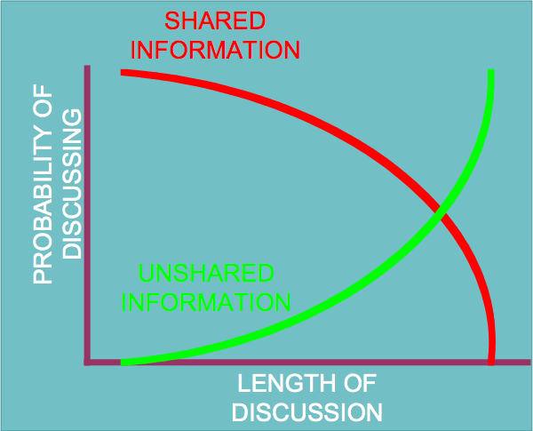
The Challenge of Team Decision-Making
Team members spend significant time focused on shared information—that which everyone holds in common
Without conscious effort it is only after considerable time that group members attend to unshared information

Slide 22
Can You Solve this Puzzle?
I am thinking of a rule describing how three numbers relate to one another
Your challenge is to discover the rule using the following process
Give me a sequence of three numbers
I’ll tell you if they are consistent with the rule or not
You can guess the rule
You tell me how confident you are
Sequence of #s | Consistent with rule? | Guess the rule | How confident? (%)

Slide 23


The emotional dog and its rational tail
We rapidly form judgments and expectations
These are based on experiences, beliefs, values, and norms
We subsequently search for reasons to justify our judgments
This can be effective for simple problems with true right answers that we have experience solving.
It is ineffective for complex problems with many potentially right (and wrong) answers.
A useful book on this topic: Haidt – The Righteous Mind

Slide 24
Two orientations to decision-making
 | Advocacy | Inquiry
Concept of decision making | Solution to be advanced | Problem to be solved
Purpose of discussion | Persuasion & lobbying | Learning, testing, evaluating
Members’ role | Spokesperson for a group | Critical thinker
Usual patterns of behavior | Advance a point of view; Defend a position; Downplay contrary evidence | Consider alternatives; Digest evidence; Discover truth
Minority views | Ignored or Dismissed | Sought-out and Valued
Group Outcome | Winners and Losers | Collective ownership

Slide 25
How to Drive Inquiry (1): Set the Tone
Establish a leader or facilitator to be in charge of the process—not of the outcome
Team members’ role is to supply all information they have
Everyone’s job is to engage in active critical thinking—not advocating a position, but seeking truth
Establish Roles
Everyone must acknowledge that they lack full information into the problem—they have blind spots
Set the tone that all perspectives and goals are valued and important to consider
Expect thorough preparation and transparency
Set Expectations

Slide 26
How to Drive Inquiry (2): Actively Lead the Process
Dedicate time to explicitly consider the problem at hand
What does everyone need for the project to be considered successful?
Leverage diversity of input to re-specify the problem in a superordinate way
Collectively Formulate the Problem
Actively seek out the “hidden profile”
Be mindful of common individual cognitive biases (e.g., confirmation bias)
Be vigilant about common group cognitive biases (e.g., ignoring unshared information)
Move toward solution
Share and Collectively Process Information

Slide 27
Current Understanding of Team Conflict
There are different types of conflict in teams. Some forms of helpful, some are not.
Task conflict: Disagreements about ideas, problems, solutions
Process conflict: Disagreements about how work should be done
Relationship conflict: Emotionally-charged, personal clashes

Slide 28
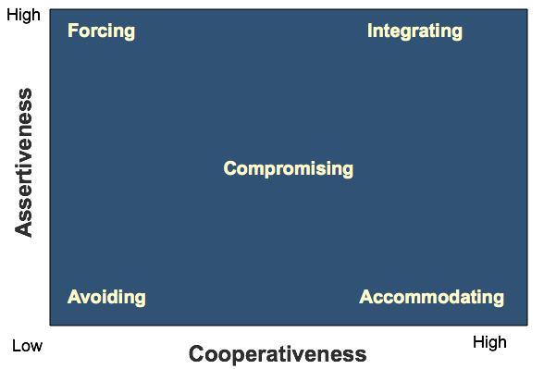
Conflict Management Styles
Teams are cooperative organizational structures
Forcing and avoiding are extremely damaging styles to use in team-based work
For most complex problems, an integrating style is best

Slide 29
Two Key Challenges to Keep on Your Radar in Team Decision-Making
Because teams are assembled to solve complex problems, information is often distributed unevenly across the team. Members must integrate information to succeed in their tasks.
The most effective teams are those that uncover the full pool relevant information that exists across team members and integrate it to derive novel solutions to complex problems.
Information
Goals
Team members almost always have some objectives that are collective (e.g., solving the team’s problems) and some that are individual (e.g., advancing one’s career).
The most effective teams are those that understand and work to discover “win-win” solutions, which enable members to achieve their individual goals without compromising the ability of the team to achieve its own goals.

Slide 30
Evening Team Assignment
Discuss the Trouble at Basecamp case as a team. Before 7 AM on Thursday morning:
Adopt the perspective of Jason Fried at the start of the case
Decide how to handle the charged conversation that emerges in chat form on Basecamp
Provide a detailed account of what you would do, including the text of any communications you would send

Slide 31
Next: Leading the Socioemotional Side
Read “The Five Dysfunctions of a Team”
Read “Too hot to handle: How to manage relationship conflict”
Read “Decision to Trust”
Submit your brief trust reflection

