Slide 1
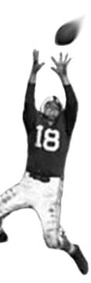
C105 PREDICTION PROBABILITY & PIGSKIN
Fall 2014
Welcome!
© Ben Motz, 2014

Slide 2
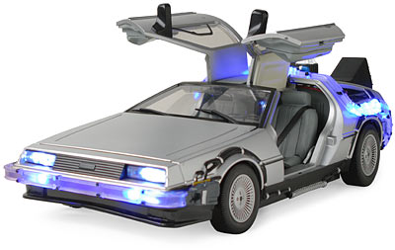
if you could go back in time, what are some things you could do?
Notes:
Open a discussion of all the things you could do if you knew the outcome of events.

Slide 3
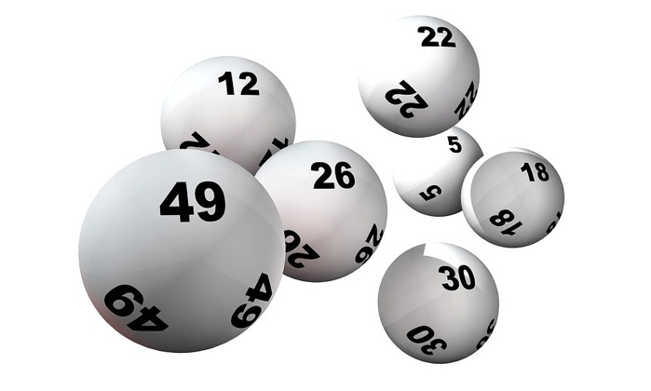
the world is not [entirely] random
but you don’t need to go back in time.
starting point:
things can be predicted
those who predict are powerful
in business, in finance, in politics, in media, in defense, in climatology, in technology, in sports, in everything

Slide 4
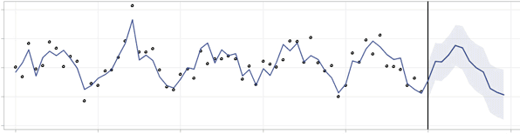
there’s value to understanding how you can use information to make predictions.
what c105 is about

Slide 5
introductions plans icing on the cake grouping-up

Slide 6

ben motz
call me ben
senior lecturer & director of pedagogy
department of psychological and brain sciences
research: cognitive neuroscience and pedagogy in higher education
also worked as a statistical consultant for big companies (toyota, sears, directv, and more)
from los angeles, went to IU for my undergrad
you may have more experience with football than me

Slide 7
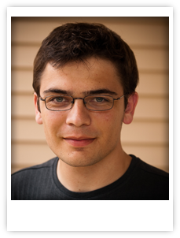
and Josh

Slide 8
c105 plans
playing fantasy football
thinking about fantasy football decisions
you’ll be expected to be in-the-know
analyzing fantasy football decisions
in class / lab
on your own
writing about fantasy football analyses
taking exams about the analyses we discuss

Slide 9
publicity
PEOPLE ACTUALLY READ THE C105 COURSE BLOG
your blog posts will be public
but you may post under a pseudonym

Slide 10
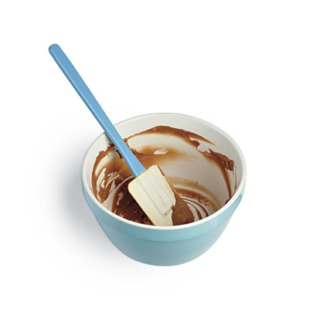
the icing on the cake
extra credit for fantasy football winners:
4% for 1st place
3% for 2nd place
2% for 3rd place

Slide 11
group up
1:00pm Lab (16356)
League Antwaan Randle El (C. Ruchman)
League Pete Stoyanovich (C. Brashear)
League George Taliaferro (C. Morris)
2:30pm Lab (16355)
League Kris Dielman (C. Wisner)
League Trent Green (C. Miller)
League Pete Pihos (C. Smith)

Slide 12
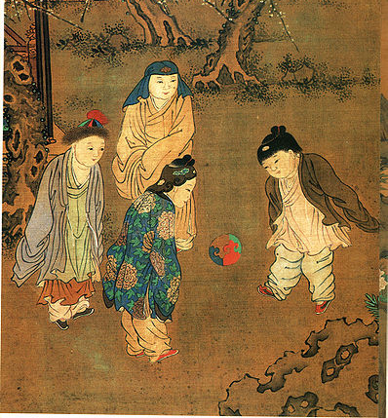
history of football
CUJU: China 500BCE
Military training & aristocratic leisure
kicking ball games (dawn of civilization)
soccer (middle ages)
rugby (1823)
football (mid-1800s)

Slide 13
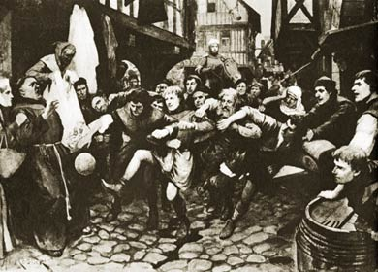
history of football
SOCCER: Medieval England 1500CE "[t]he game at which they had met for common recreation is called by some the foot-ball game. It is one in which young men, in country sport, propel a huge ball not by throwing it into the air but by striking it and rolling it along the ground, and that not with their hands but with their feet... kicking in opposite directions“
kicking ball games (dawn of civilization)
soccer (middle ages)
rugby (1823)
football (mid-1800s)
Notes:
http://vimeo.com/89326438

Slide 14
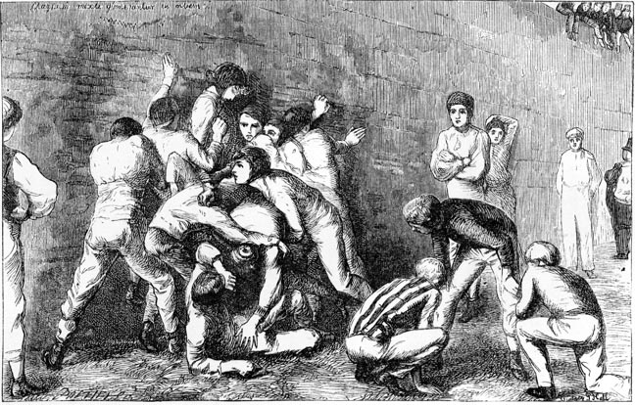
history of football
SOCCER: Eton College 1815 The first “rules” of a soccer game are established at Eton College, England. The game itself, called Bully Football, is itself strange (played against a wall) and violent.
kicking ball games (dawn of civilization)
soccer (middle ages)
rugby (1823)
football (mid-1800s)
Notes:
https://www.youtube.com/watch?v=ougFnM1aVVk

Slide 15
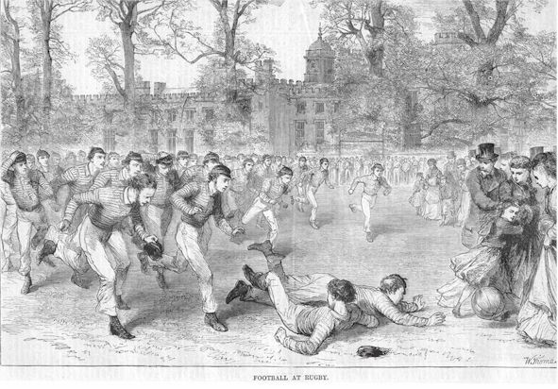
history of football
RUGBY: Rugby School, UK 1823 Infraction of soccer rules by schoolboy at Rugby School, William Webb Ellis, and the ball-carrying play spread to other British prep schools and universities.
kicking ball games (dawn of civilization)
soccer (middle ages)
rugby (1823)
football (mid-1800s)

Slide 16
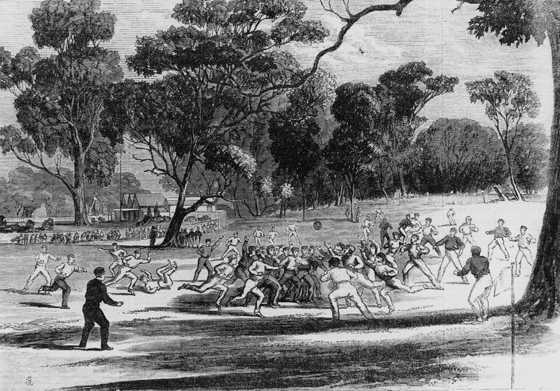
history of football
MOB-STYLE FOOTBALL: American Colleges 1830s Similar to rugby, very simple rules, very violent. Some schools banned the game.
kicking ball games (dawn of civilization)
soccer (middle ages)
rugby (1823)
football (mid-1800s)

Slide 17
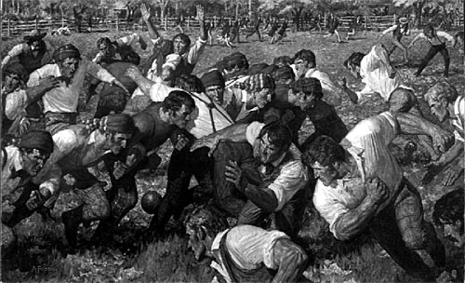
history of football
FIRST GAME OF INTERCOLLEGIATE FOOTBALL Rutgers vs. Princeton 1869 Improvised rules (rugby/soccer), 25 players, kicking ball thru goal.
kicking ball games (dawn of civilization)
soccer (middle ages)
rugby (1823)
football (mid-1800s)

Slide 18
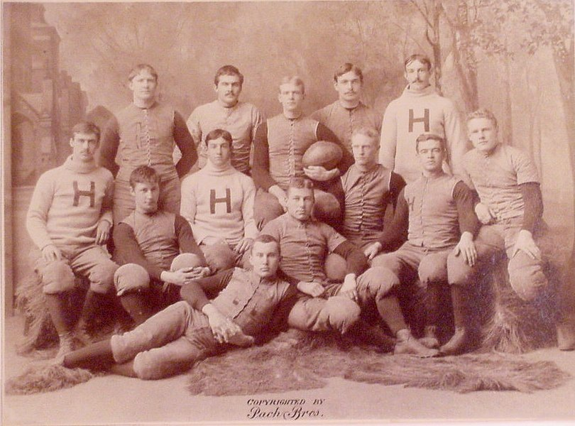
history of football
STANDARDIZATION AND EXPANSION Harvard, McGill, Yale, Princeton 1870-1900 Establishment of a “try” (touchdown) as the primary scoring mechanism, which hadn’t been established yet in rugby.
kicking ball games (dawn of civilization)
soccer (middle ages)
rugby (1823)
football (mid-1800s)

Slide 19
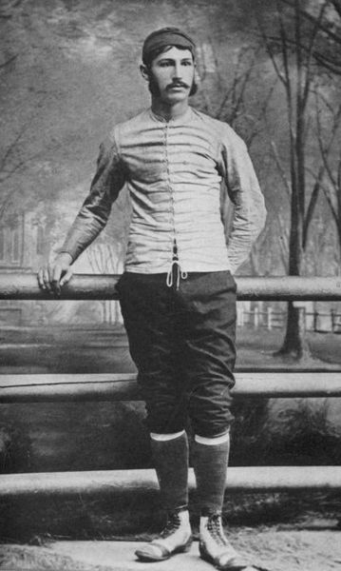
walter camp
father of american football yale university
15 → 11 players (1880)
Intended to improve speed of play, less strength
Line of Scrimmage (1880)
Including snap from center to quarterback
Minimum of five yards within three downs (1882)
Distinguished the game from rugby & soccer
Scoring rules (1883)
4 points for touchdown, 2 for kicks after touchdowns, 2 for safeties, 5 for field goals…
Notes:
Camp's new scrimmage rules revolutionized the game, though not always as intended. Princeton, in particular, used scrimmage play to slow the game, making incremental progress towards the end zone during each down. Rather than increase scoring, which had been Camp's original intent, the rule was exploited to maintain control of the ball for the entire game, resulting in slow, unexciting contests. At the 1882 rules meeting, Camp proposed that a team be required to advance the ball a minimum of five yards within three downs. These down-and-distance rules, combined with the establishment of the line of scrimmage, transformed the game from a variation of rugby or soccer into the distinct sport of American football.

Slide 20
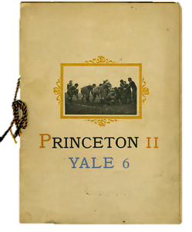
edison’s recording of
November 14, 1903 in New Haven, Conn.

Slide 21
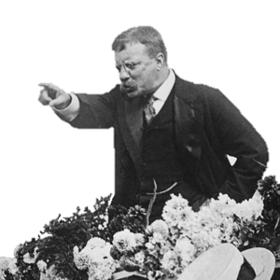
violent, eh?
19 fatalities in 1905 nationwide
President Teddy Roosevelt threatened to outlaw the game if dramatic changes weren’t made.
December 28, 1905, 62 schools met in New York to make football safer.
Formed the Intercollegiate Athletic Association of the United States (later NCAA)
Starting in 1906, established the legal forward pass

Slide 22
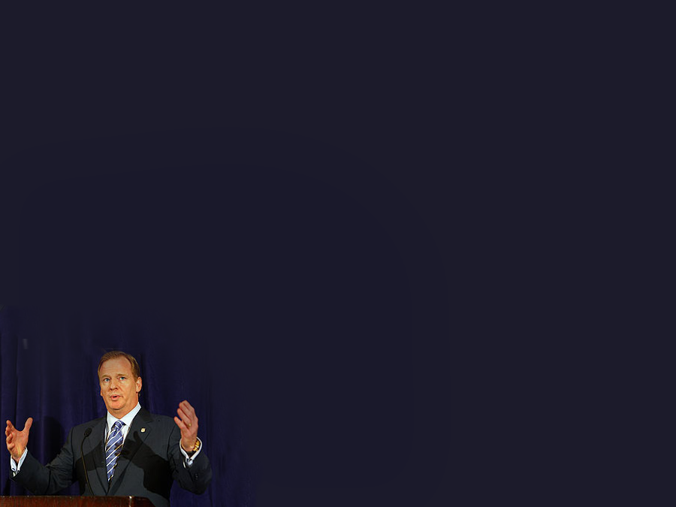
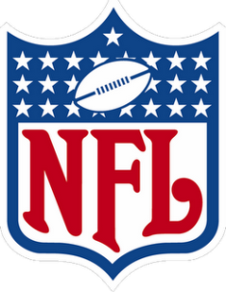
college →
1902: pro baseball clubs assemble football teams
create a “national football league” (not the current one)
1910s: ohio league created, including teams from hammond and muncie indiana
1922: changes name to national football league
1950s: competitor emerges, the american football league
1970: merger of NFL and AFL
normalized player salaries
established single draft

Slide 23
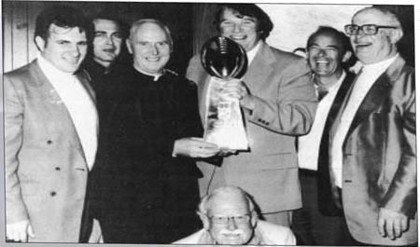
1960s: birth of fantasy football
context: AFL is in bidding war with NFL to acquire players
george “wink” winkenbach had previously invented games for drafting teams of pga and mlb players, with points for the players’ future performance.
Notes:
Legends of Fantasy Football video
On a trip to New York with his buddies, sports writers for the Oakland tribune, they invent the GOPPL, and begin tracking stats and awarding points. Seven years later, Andy Mousalimas brought the game to his Oakland sports bar (called “The King’s X”) where it became wildly popular.

Slide 24
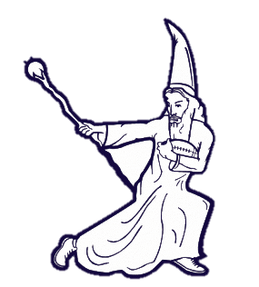
what is fantasy football?
you make a pretend team of 15 real NFL players
each week you pick 9 of your 15 players as being eligible to score points (“starters”)
the remaining 6 are “benched” that week
each week you’re matched-up against another person’s “team”
you earn points based on how your 9 starters perform in real NFL games
whichever team earns the most points that week wins

Slide 25
drafting players
Round 1
Team 1
Team 2
Team 3
Team 4
Team 5
Team 6
Team 7
Team 8
Team 9
Team 10
Round 2
Team 10
Team 9
Team 8
Team 7
Team 6
Team 5
Team 4
Team 3
Team 2
Team 1
Round 3
Team 1
Team 2
Team 3
Team 4
Team 5
Team 6
Team 7
Team 8
Team 9
Team 10
Round 4
Team 10
Team 9
Team 8
Team 7
Team 6
Team 5
Team 4
Team 3
Team 2
Team 1

Slide 26
your team’s roster
What are some reasons you might “start” one player over another?
QB
Jamaal Charles (RB)
Drew Brees (QB)
RB1
C.J. Spiller (RB)
T.Y. Hilton (WR)
RB2
Ben Tate (RB)
WR1
Jimmy Graham (TE)
Julian Edelman (WR)
WR2
Matt Bryant (K)
Jordy Nelson (WR)
TE
Mark Ingram (RB)
KC Chiefs (DST)
W/R
Dwayne Bowe (WR)
K
Eli Manning (QB)
Golden Tate (WR)
DST
Alshon Jeffrey (RB)
Notes:
Bye weeks
Injury
A tough matchup
An easy matchup
…

Slide 27
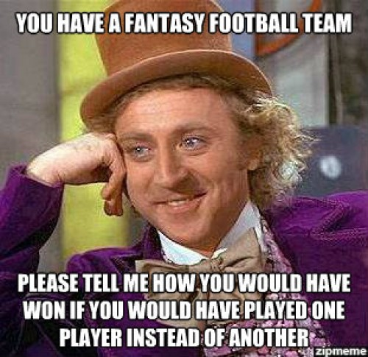

Slide 28
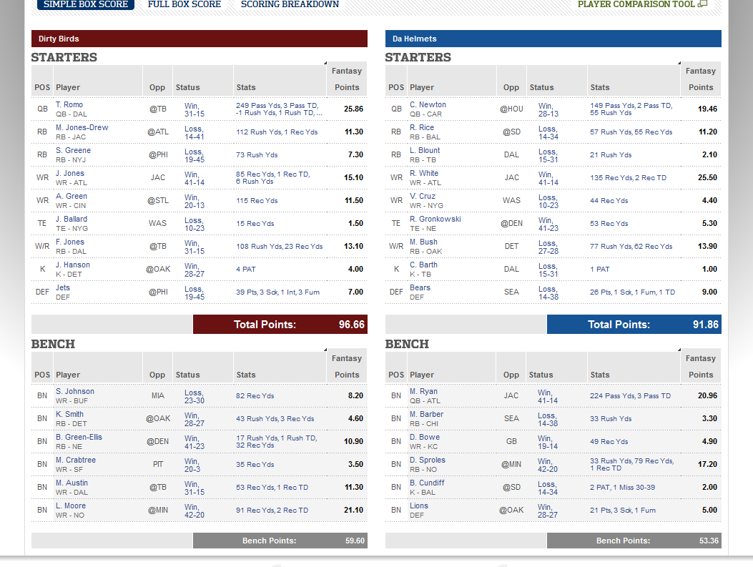

Slide 29
“Everyone knows championships are built during the season… …not the draft”
waivers
trades

Slide 30
value-based drafting
don’t necessarily draft the best player available.
you had the 6th pick, and you took Eddie Lacy
now you have the 15th pick
imagine that the top 14 players are all taken.
the 15th-best-ranked player is Demaryius Thomas
…but you should take him?
why?

Slide 31
To do:
Join your league!!!
Prepare for the draft. Think about strategy.
Readings
Draft Day Manifesto
[Learn about Value Based Drafting]
GET TO LAB EARLY on THURSDAY!

