Slide 1
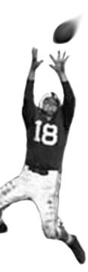
C105 PREDICTION, PROBABILITY & PIGSKIN
day 3: microsoft excel
reading for today: SimpleWorksheetsInExcel
© Ben Motz, 2014

Slide 2
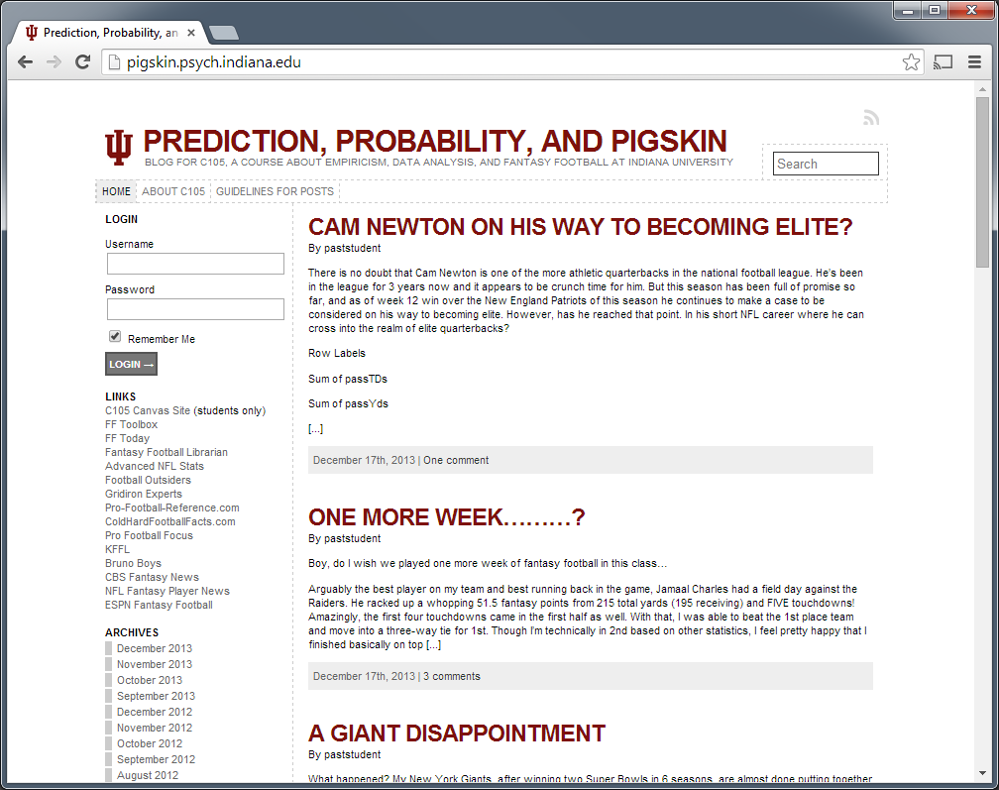

Slide 3
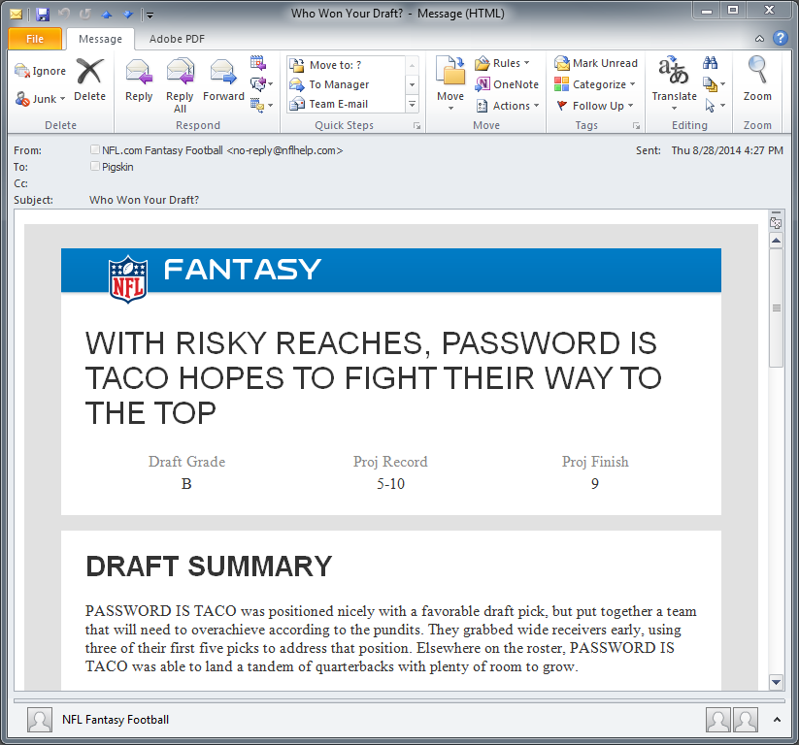
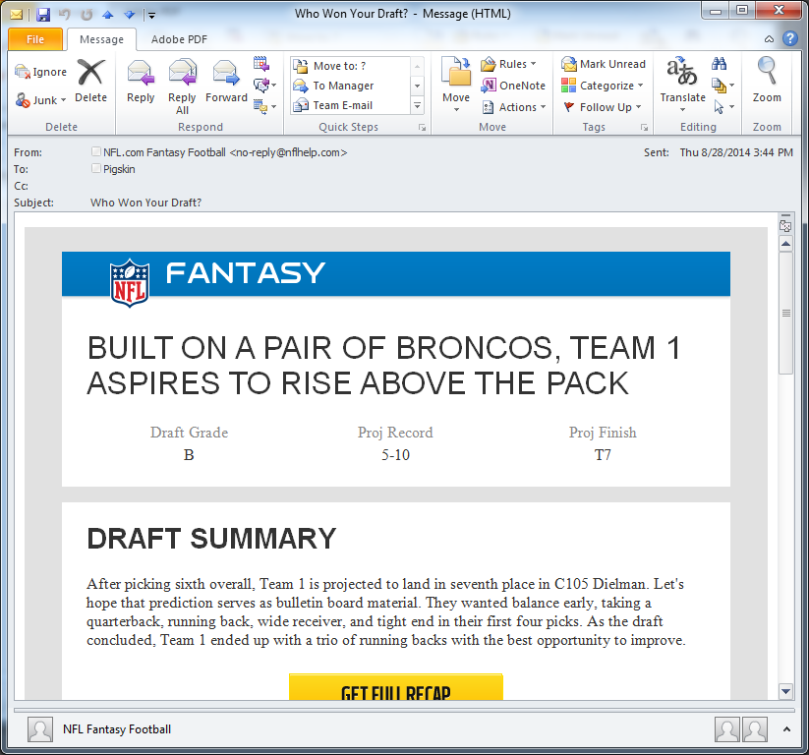
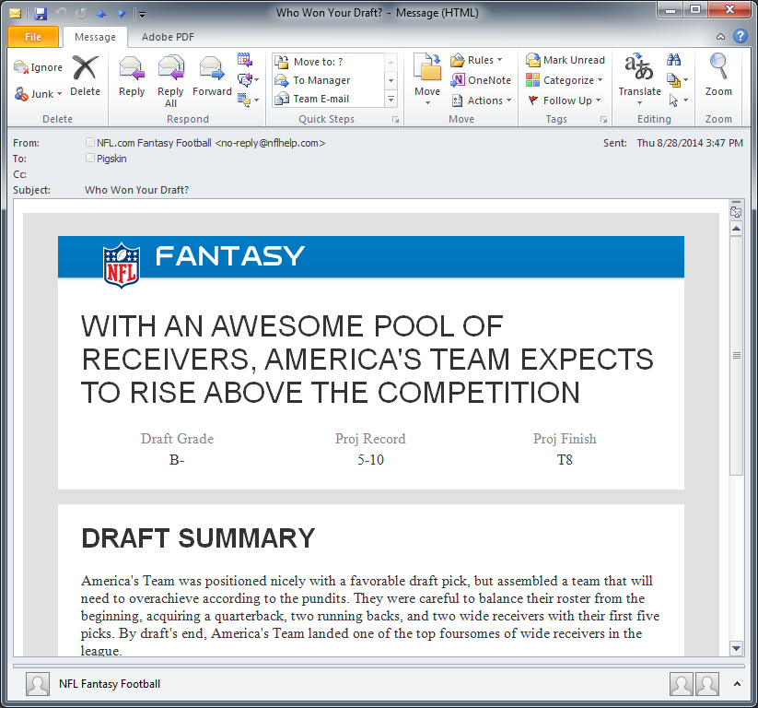
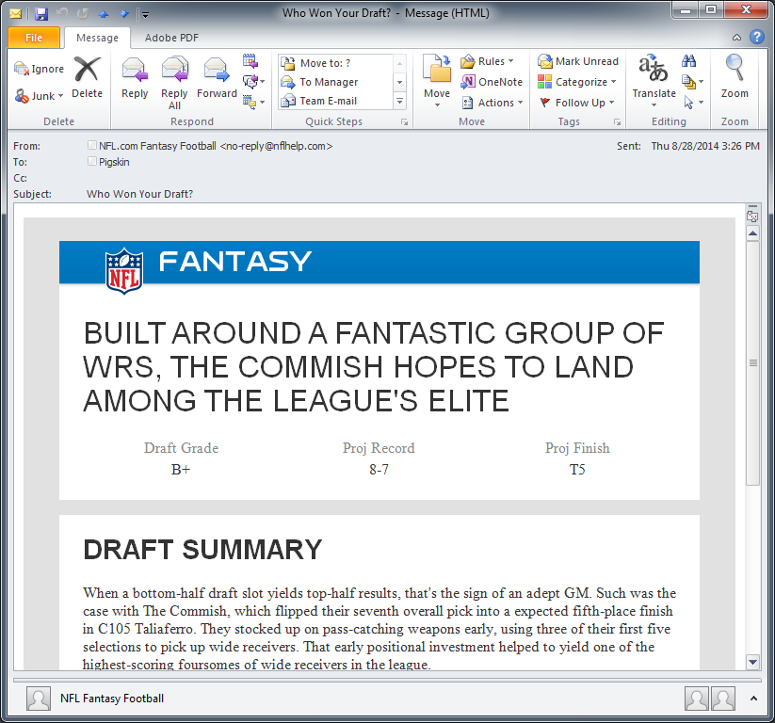
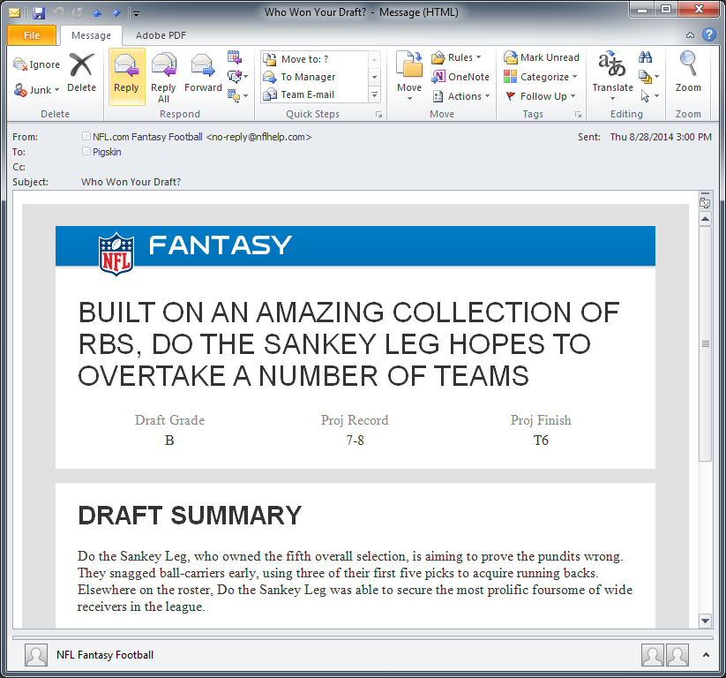
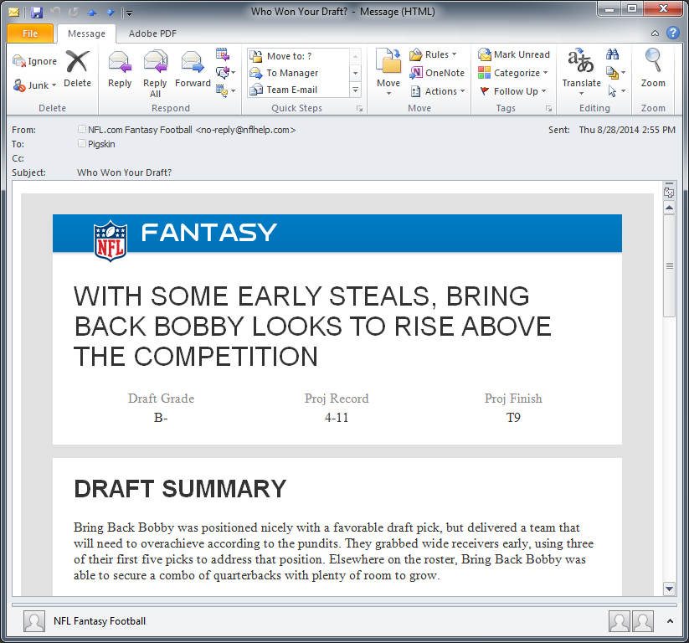
B / 5-10
B / 5-10
B- / 5-10
B+ / 8-7
B / 7-8
B- / 4-11

Slide 4

can you imagine fantasy football before personal computers?
Notes:
How would you keep track of how many points you’d get each week?

Slide 5
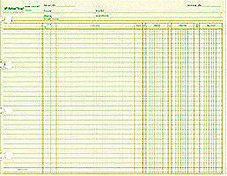
ledger sheet

Slide 6
Microsoft Excel an electronic ledger sheet
good for:
- accessing data
- storing data
- finding data
- doing arithmetic with data
- making graphs with data
it’s good to know Excel.
lots of people use it.
lots of companies use it too.
it’s free to you.

Slide 7
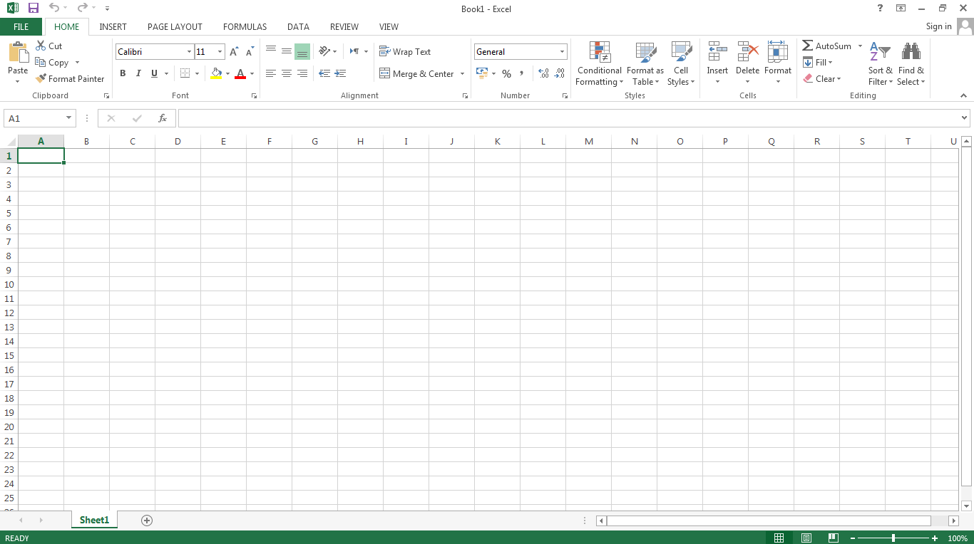
Tabs
Ribbon
Active Cell
Column Headers
Formula Bar
Row numbers
Sheet tabs

Slide 8
 | A | B | C | D
1
2
3
4
5
6
7
8
9
10
11
12
13
14
15
16
17
columns
cell
rows

Slide 9
the four different types of cells
blank
QB
text
235
numbers
=235+B5
formulas

Slide 10
excel primer

