Slide 1

C105 PREDICTION, PROBABILITY & PIGSKIN
day 7: functions, formulas, & statistics
+ introduction to pivottables
© Ben Motz, 2014

Slide 2
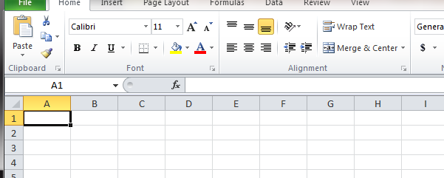
the formula bar

Slide 3
1+1
1+1
formulas always start with an equals sign (=)

Slide 4
=1+1
2
formulas always start with an equals sign (=)

Slide 5
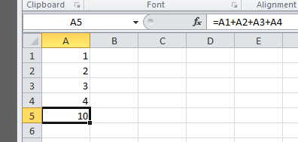
formulas reference other cells
Notes:
Formulas are like miniature computer programs. You’re asking excel to calculate something.

Slide 6
formulas can generate errors
=1/0 | → | #DIV/0!
=1+“TWO” | → | #VALUE!
=1+TWO | → | #NAME!
Notes:
Formulas are like miniature computer programs. You’re asking excel to calculate something.

Slide 7
formulas can contain functions
FUNCTION
INPUT
OUTPUT
sometimes called arguments
IF, AND, OR
SUM, AVERAGE, COUNT, MAX, MIN, ETC.
DATES
STRINGS

Slide 8

the Excel IF function
=if(logical-test, value-if-true, value-if-false)
logical-test is a logical statement, like 3>2
value-if-true is what excel will do if the condition is true
value-if-false is what excel will do if the condition is false
=IF(2+2=5,“weird”,“not-weird”)

Slide 9
logical operators
equality: =
inequality: <>
less than: <
less than or equal to: <=
greater than: >
greater than or equal to: >=
Each of these operators will return a special logical value, either TRUE or FALSE

Slide 10
fun with logical operators
= 2 > 1 TRUE
= 1 <> 1 FALSE
= 3 > 2 > 1 FALSE, because TRUE is not > 1
= “cat” < “dog” TRUE, alphabetical order
= “A” < “B” TRUE, it knows the order of letters
= (1+1) >= (2*1) TRUE
When A1 = 01 Jan 2012 & A2 = 02 Jan 2012 = A1 < A2 TRUE

Slide 11
logical functions
=AND(1=1,1=2,1=3)
=OR(1=1,1=2,1=3)
=NOT(1=2)
Just one “argument”
these can be nested:
=AND(2>1,OR(1=2,NOT(1=2)))
=AND(2>1,OR(1=2,TRUE))
=AND(2>1,TRUE)
=TRUE
A | B | and | or
0 | 0 | 0 | 0
1 | 0 | 0 | 1
0 | 1 | 0 | 1
1 | 1 | 1 | 1

Slide 12
nesting IF statements
fullname | passYds | myFormula
Tom Brady | 149 | Eww
Nick Foles | 331 | Good
Aaron Rodgers | 346 | Good
Drew Brees | 237 | Eww
Phillip Rivers | 284 | Okay
Peyton Manning | 242 | Eww
=IF([@passYds]>300,“Good”,IF([@passYds]>250,“Okay”,“Ew”))
IF statement inside “value-if-false”

Slide 13
practice
Write formulas that will:
return the number “1” if a player had at least 1 passing yard [@passYds], at least 1 rushing yard [@rushYds], and at least 1 reception [@receptions], and “0” otherwise.
returns the percent of fantasy points [@fantasyPoints] that come from rushing touchdowns (6 pts, [@rushTDs]) among RBs [@position]; but only when the RB has had at least 1 rushing touchdown, return “0” otherwise.

Slide 14
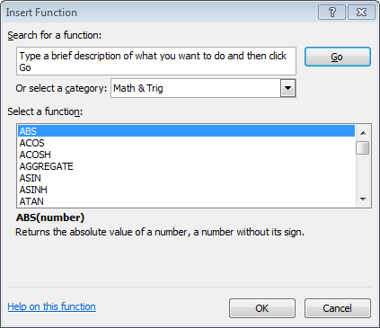

useful common functions
= SUM(number1,number2,…)
= AVERAGE(number1,number2,…)
= COUNT(value1,value2,…)
= COUNT(1,“A”,1) will return 2
= COUNTA(1,“A”,1) will return 3
= MAX(number1,number2,…)
= MAX(0, MIN(A2, 2.875))
… and more

Slide 15
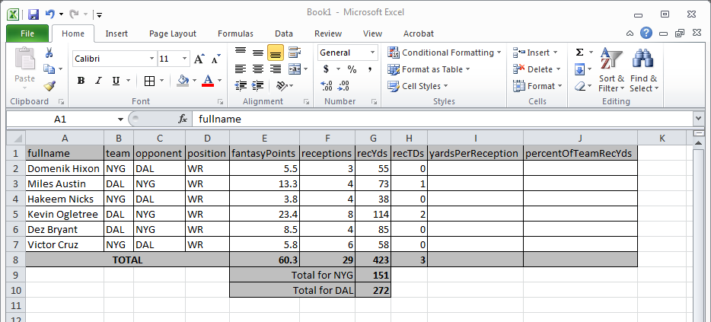
cell references
relative reference: A1
absolute reference: $A$1
what goes here?
what goes here?

Slide 16
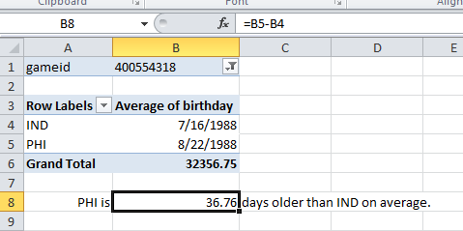

dealing with dates
excel represents date as integers
the number of days since 1900-Jan-0
September 16, 2014 is 41,898.00
you can do math with dates!

Slide 17
dealing with strings
strings can include text, numbers, and symbols
= “Andrew Luck is #1”
you can do stuff with strings
= LEN(A1) → 17
= FIND(“Luck”, A1) → 8
= RIGHT(A1,2) → “#1”
= “And”=LEFT(A1,3) → TRUE
= CONCATENATE(A1,“2”) → “Andrew Luck is #12”

Slide 18

Excel PivotTable
An interactive, dynamic worksheet table
Categorizes
Summarizes
Creates totals, averages, counts…
Turns a big big dataset into a neat table
Keywords:
Interactive: Build your chart by dragging and dropping variables.
Dynamic: Chart automatically recalculates results as you move variables around.

Slide 19
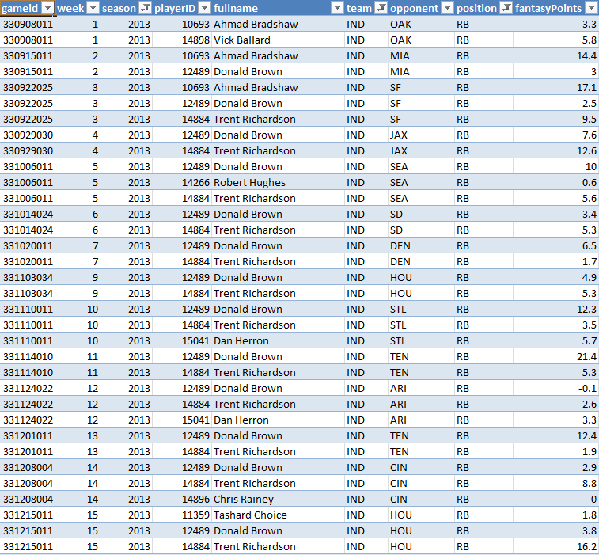
Simple Example: Cross Tabulation
I want to see fantasy points for the 2013 season for each of the Colts running backs…
fullname | Sum of fantasyPoints
Ahmad Bradshaw | 34.8
Donald Brown | 123.1
Tashard Choice | 4.9
Trent Richardson | 94.3
Vick Ballard | 5.8
Grand Total | 262.9
fullname | Count of gameid
Ahmad Bradshaw | 3
Donald Brown | 15
Tashard Choice | 3
Trent Richardson | 14
Vick Ballard | 1
Grand Total | 36
Row Labels | Avg of fantasyPoints
Ahmad Bradshaw | 11.60
Donald Brown | 8.21
Tashard Choice | 1.63
Trent Richardson | 6.74
Vick Ballard | 5.80
Grand Total | 7.30
…

Slide 20
How do you do it… 3 steps
Think about what kind of data belongs in your table, and what kind of data should filtered.
Try to imagine the table that you want to see.
What’s in the columns?
What’s in the rows?
Think about what numbers you want to see in each cell. Averages? Counts?

Slide 21
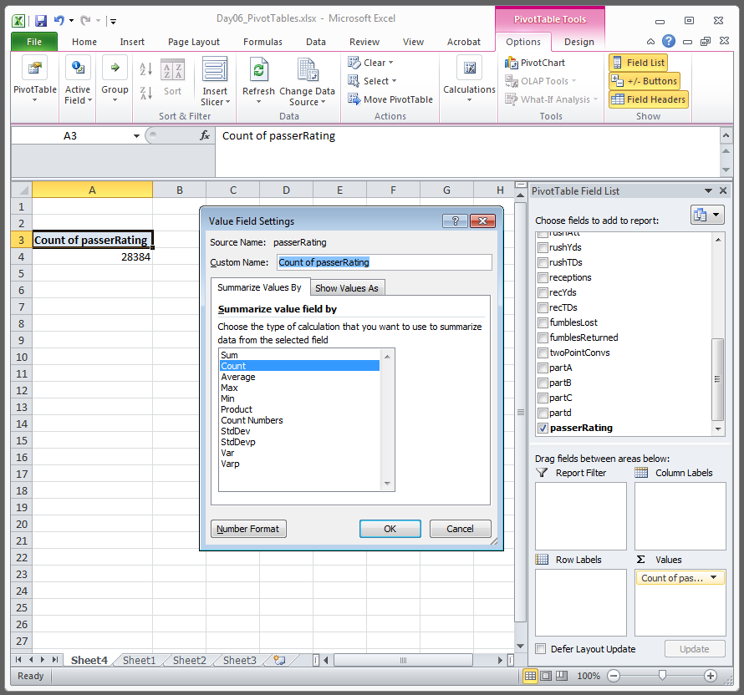
Summarizing Data
Sum
Count
Average
Max
Min
Product
Count Numbers
StdDev
StdDevp
Var *
Varp **
* StdDev squared
** StdDevp squared
Notes:
The standard deviation of the population divides the sum of squared deviations by the number of observations.
The standard deviation (of a sample) divides the sum of squared deviations by the number of observations (MINUS ONE). (Bessel’s correction)

Slide 22
Count = 5014
Sum = 59329.32
11.83
8.47
8.47
-6.94
49.32
for QBs

