Slide 1
a video of this class is available at: https://vimeo.com/107593995

Slide 2

C105 PREDICTION, PROBABILITY & PIGSKIN
day 9: more functions and pivottables
© Ben Motz, 2014

Slide 3
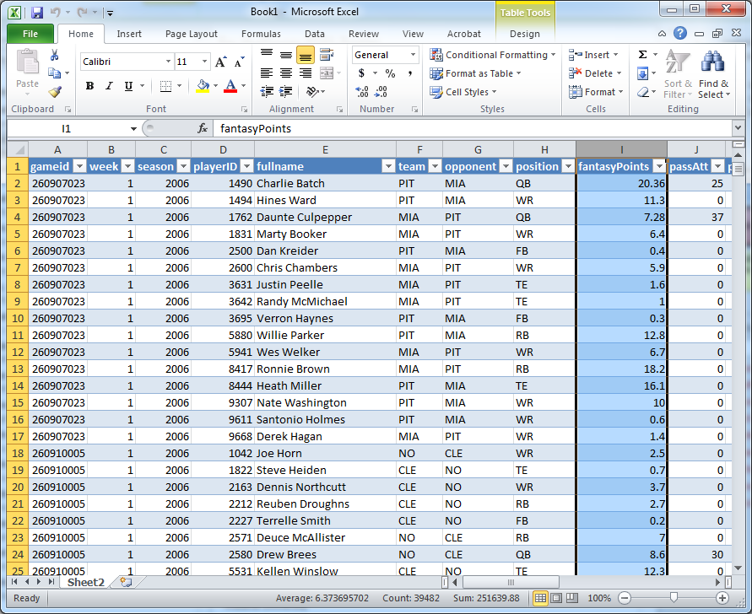
pivottables. wtf.
you want to find out the average number of fantasy points for all players. easy.
6.37 fantasy points

Slide 4
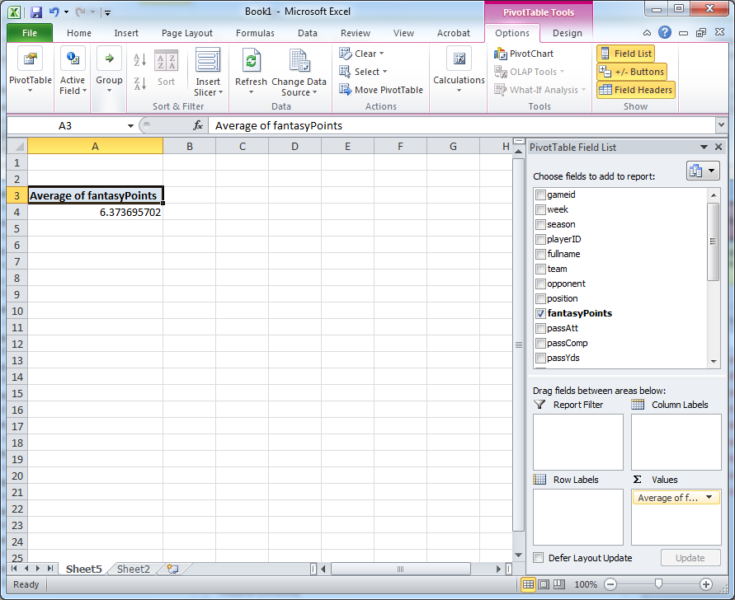
pivottables. wtf.
you could also do it in a pivottable. easy.
6.37 fantasy points

Slide 5
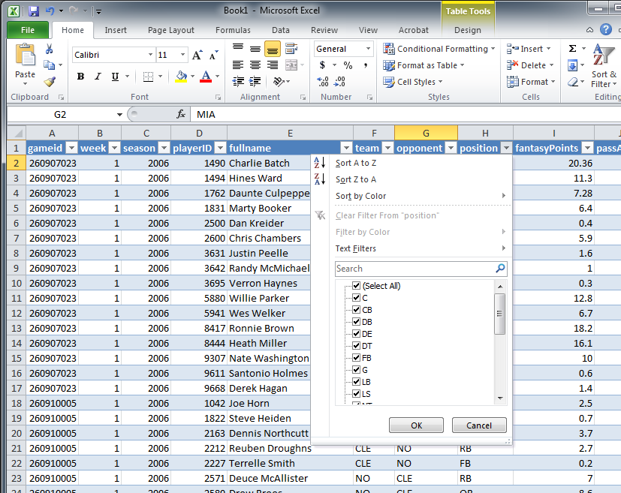
pivottables. wtf.
but what if you wanted to find out the average number of fantasy points for each of the different positions? not so easy in the raw data table.

Slide 6
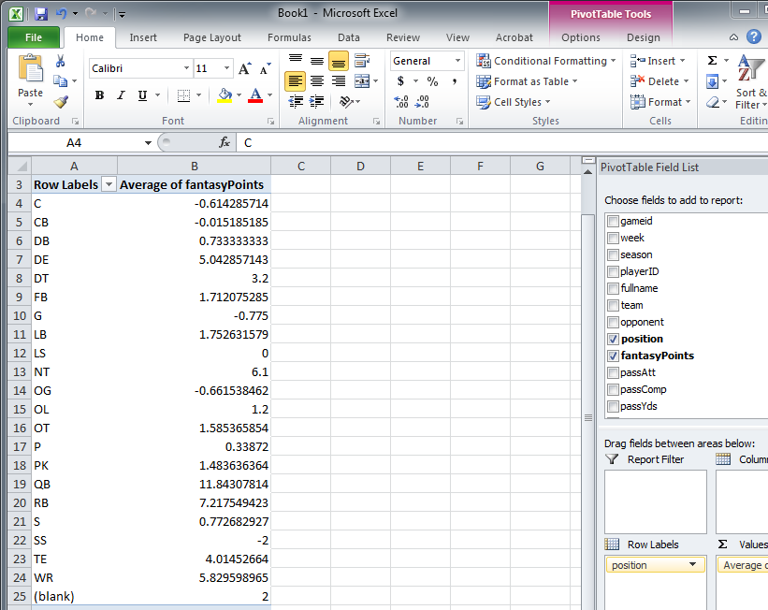
pivottables. wtf.
but what if you wanted to find out the average number of fantasy points for each of the different positions? easy in a pivottable.

Slide 7
today: pivottable review
Six challenges (of increasing difficulty):
Which opponent surrenders the most fantasy points per offensive position in 2014?
Is there a relationship between sacks and interceptions?
Who gets more total yards on offense: running backs or receivers?
Since 2006, which team has hosted MNF most often?
Among the kickers who’ve played in at least 25 games since 2006, who are the top 5 kickers in terms of total field goal conversion rate?
What WR (who has played in all 3 games of 2014, earning at least 20 cumulative fantasy points) has the lowest standard deviation of fantasy points?

