Slide 1

C105 PREDICTION, PROBABILITY & PIGSKIN
day 11: vlookup
© Ben Motz, 2014

Slide 2
the problem:
Do WRs perform better when RBs perform worse?
Does Jordy Nelson get more points without Eddie Lacy?
Do Kaepernick’s scramble plays help the 49ers win?
systematically combining information across rows.
To answer these questions, you’d need to categorize some rows (e.g., WR’s points)
on the basis of values in another row
(e.g., RB’s points)

Slide 3
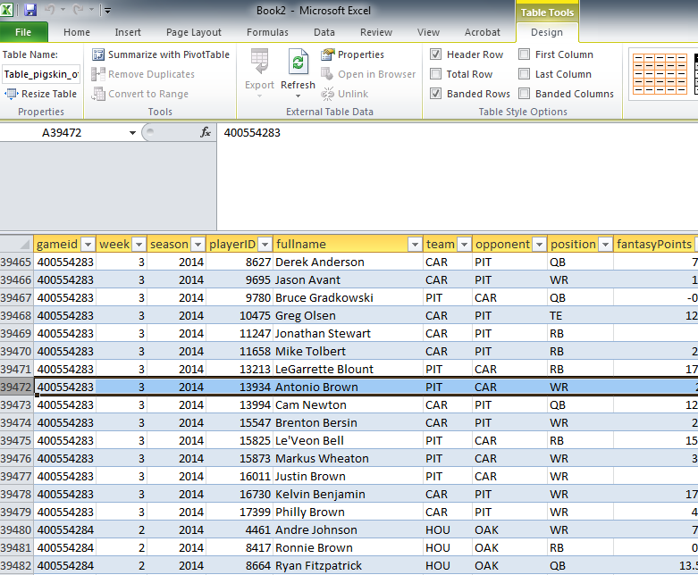
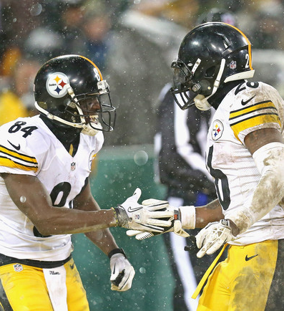
rb vs. wr
there isn’t a column on brown’s row to tell you about bell in that game.

Slide 4
VLOOKUP
=VLOOKUP(lookup_value, table_array, col_index_num, [range_lookup])
a value to find in a table
a table to look for the value
when you find the value in the table, what column should be returned.
whether it should be allowed to find an approximate match to the lookup value

Slide 5
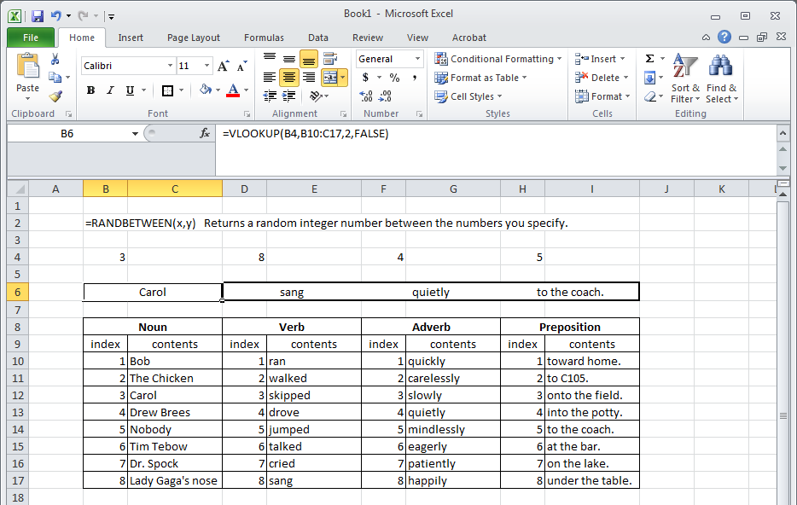
madlibs: random sentence generator

Slide 6
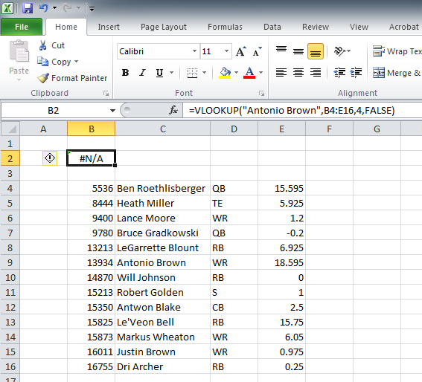
vlookup caveat:
index needs to be in first column
Excel only looks for the lookup_value in the first column of the table_array that you’re searching thru.
#N/A error if it can’t find it.

Slide 7
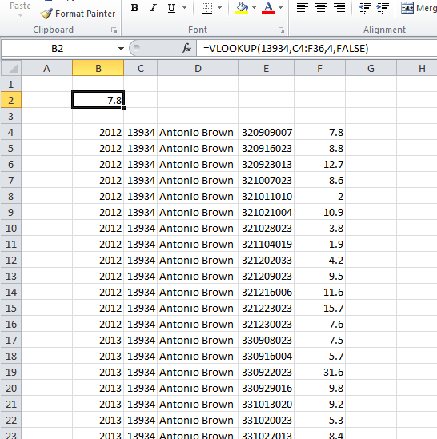
vlookup caveat:
only returns the first index
Excel only returns the first “match” that it finds of the lookup_value in the table_array.

Slide 8
vlookup demo
when RBs perform better than or worse than average, what is the effect on the team’s WR fantasy points?

Slide 9
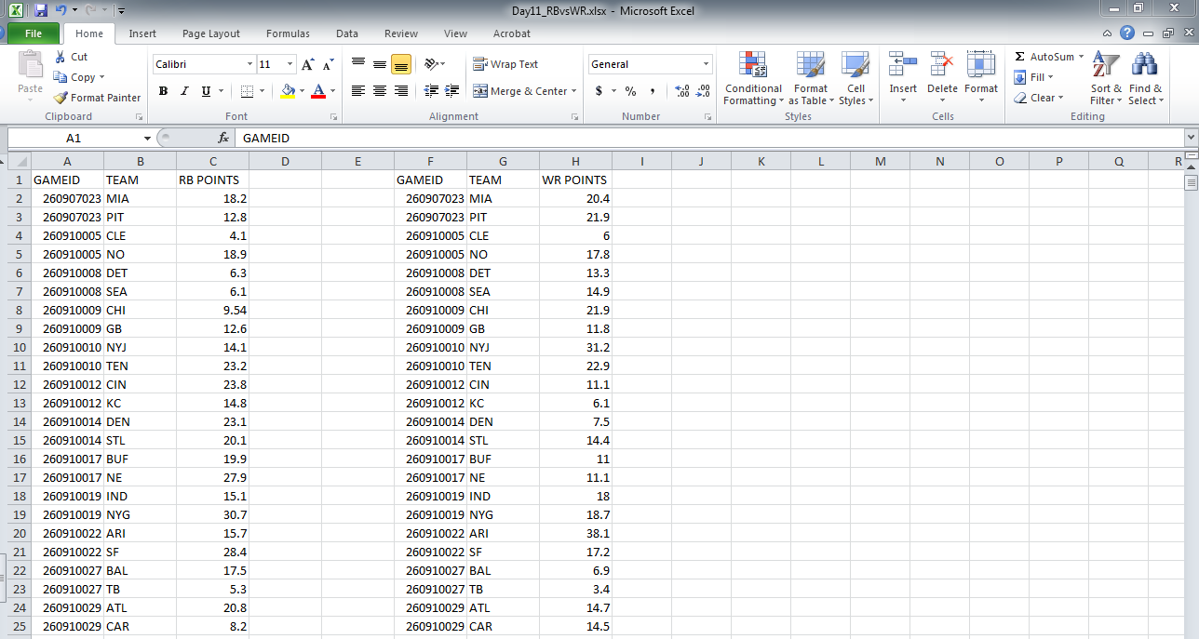
rb vs. wr
average = 17.7
average = 20.4
=VLOOKUP(lookup_value, table_array, col_index_num, [range_lookup])

Slide 10

vlookup and ms query
with VLOOKUP you can combine information across rows.
what if you want to combine information from two different tables (e.g., offense and games)
you could use VLOOKUP and match on gameid
but there’s another way that’s even easier:
Microsoft Query

Slide 11
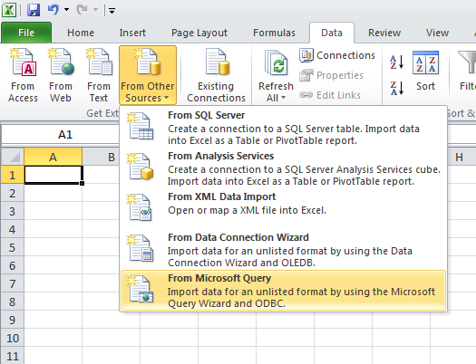

Slide 12
joining tables
percent of team yards obtained by a player.
effect of game attendance, game time, game location, etc.
player birthdates (in the players table)
does anything about a team’s defense (in the defenseandspecialteams table) predict how well an offensive player will perform?

