Slide 1
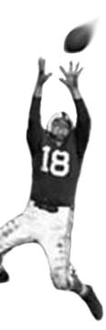
C105 PREDICTION, PROBABILITY & PIGSKIN
day 15: humans are not robots
© Ben Motz, 2013

Slide 2
midterm
average = 80

Slide 3
feed it back
Anonymous Feedback for Ben

Slide 4
readingS for this week: Blink Scorecasting

Slide 5
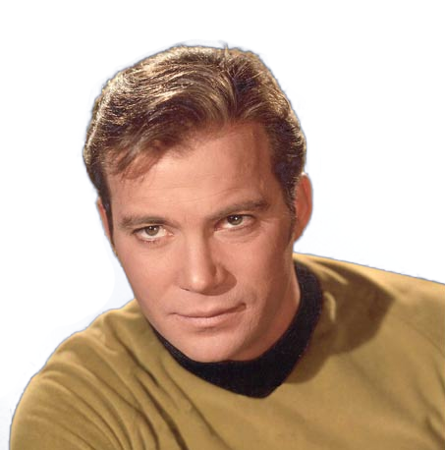
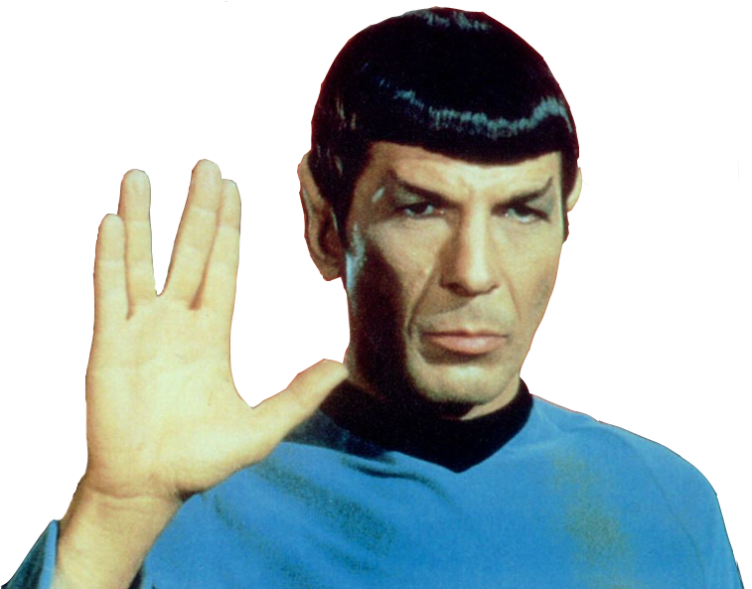
humans are not rational
rational
irrational

Slide 6

normative vs. descriptive statements
what we SHOULD do
what we DO do
Behavior deviates from normative account in systematic ways
children should eat 7 servings of fruits & vegetables daily
the average child eats less than 25% the recommended daily allowance
Notes:
Why don’t kids eat their vegetables?

Slide 7
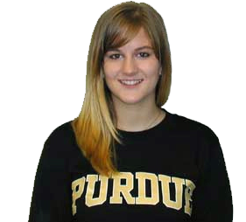
to be rational: your blind date
what is the probability that your blind date is a purdue fan, given that she’s wearing a purdue shirt?
bayes theorem: P(A|B) = P(B|A) * P(A)/P(B)
A = purdue fan
B = purdue shirt
P(B|A) = 0.1
even if she’s a big fan, it’s strange to wear a purdue shirt to a blind date
P(A) = 0.03
strange to find a purdue fan in bloomington
P(B) = 0.05
you don’t see many purdue shirts around here
P(A|B) = 0.1 * 0.03 / 0.05 = 6%

Slide 8
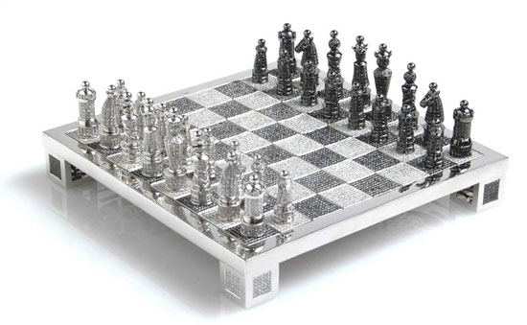
classical decision theory
the goal of human action is to seek pleasure and avoid pain; in doing so each of us uses calculations of
value: the how much benefit we receive from a decision
probability: the likelihood that we’ll receive this benefit

Slide 9
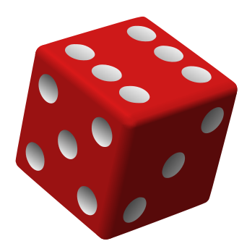
to be rational: taking a bet
gamble: if you get a six, you get $4 ... else you give me $1.
expected utility theory
add up the probabilities and values of all possible outcomes:
Getting a six = X: P(X) is 1/6, V(X) is $4
Getting anything else = Y: P(Y) is 5/6, V(Y) is -$1
[(1/6) * 4] + [(5/6) * -1] = -1/6
don’t take the bet
take the bet?

Slide 10
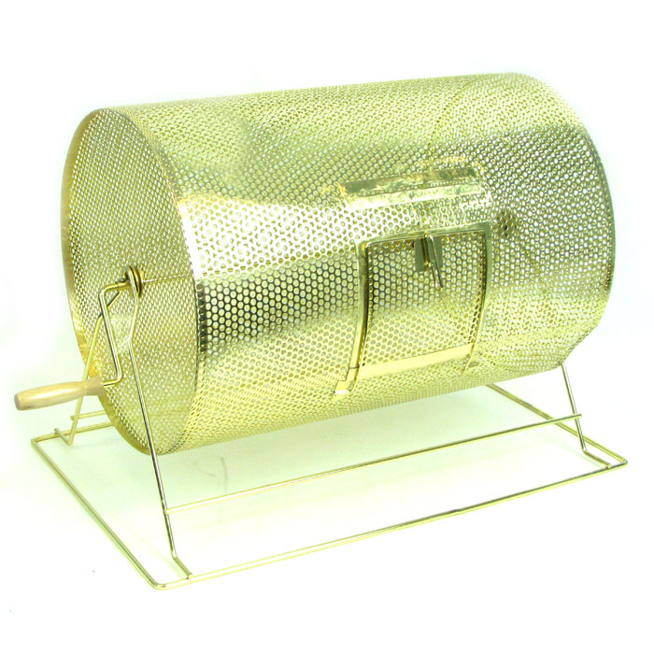
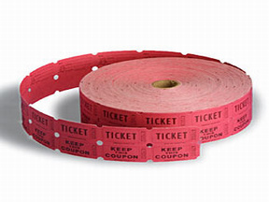
this is exactly how the lottery works and yet, people buy lottery tickets
Notes:
ask students why people buy raffle tickets if they know that the expected value is less than the expected cost. perhaps they’ll say that the value associated with losing isn’t actually so bad. the implication then: you still consider the probabilities and utility values…

Slide 11
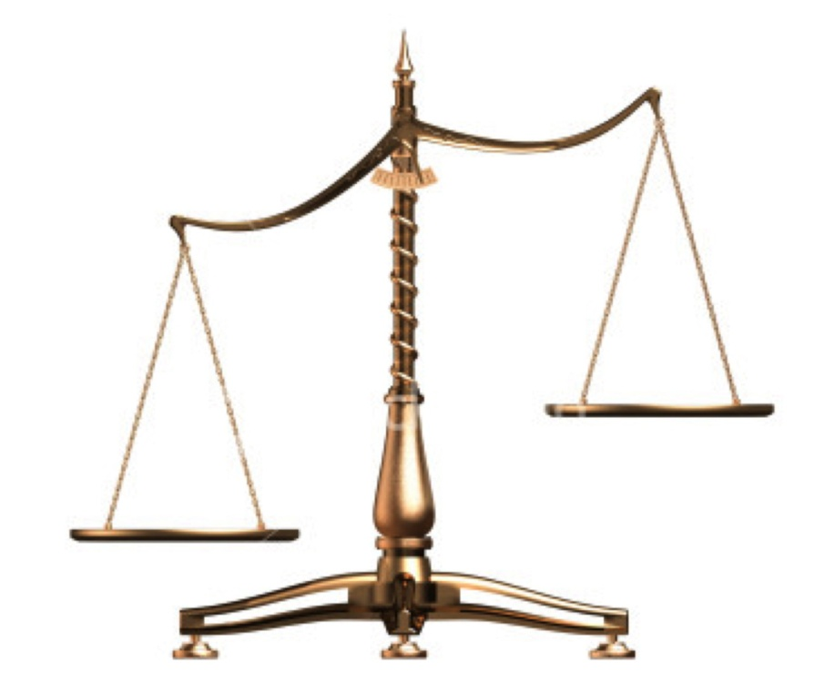
classical decision theory, again
based on the belief that people seek to reach well-reasoned decisions based on
Consideration of all possible known alternatives
Use of a maximum amount of available information
Careful weighing of costs and benefits and calculation of probability
A maximum degree of sound reasoning
However, human decision making is much more complex

Slide 12
would you rather (a) win $900 or (b) have a 90% chance of winning $1000
would you rather (a) lose $900 or (b) have a 90% chance of losing $1000
expected utilities are the same but people usually pick (a) then (b)
why might someone pick (a) then (b)?
Notes:
it’s possible that people think that they have some control over the likelihood of losing $1000.

Slide 13
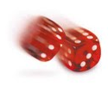
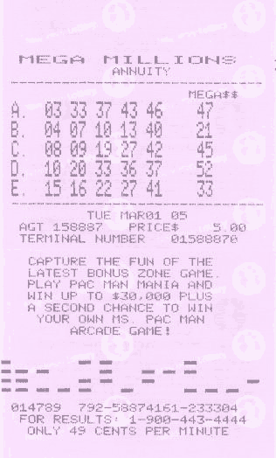
controlling probability?
Gamblers throw dice harder when they want larger numbers. Gofman & Henslin (1967)
People who pick their lottery numbers demand more than 4 times as much money for their tickets than people who are assigned numbers at random
Langer (1975)

Slide 14
would you rather (a) win $900 or (b) have a 90% chance of winning $1000
would you rather (a) lose $900 or (b) have a 90% chance of losing $1000
controlling probabilities might be part of it…
another part might be framing

Slide 15
FRAMING
You go to New York and decide to go to a Broadway play. You buy a ticket for $100 in the morning, but when you go to the theater that evening, you discover you have lost the ticket. You have plenty of money to buy another one: do you?
You go to New York and decide to go to a Broadway play and tickets cost $100. You go to the theater that evening and when you start to pay for your ticket, you discover you have lost $100. You have plenty of money to buy a ticket: do you?

Slide 16
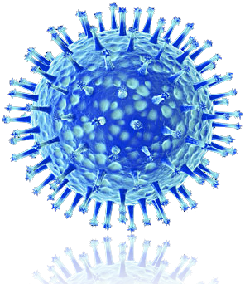
another framing example
the united states is preparing for the outbreak of an unusual asian disease, which is expected to kill 600 people. two alternative programs have been proposed to combat the disease. assume the exact scientific estimates of the consequences are:
200 people will be saved
there is a 1/3rd probability that 600 people will be saved, and a 2/3rd probability that no one will be saved.
framed differently
400 people will die
1/3rd probability that no one will die and 2/3rd probability that 600 people will die.
72%
28%
22%
78%
tversky & kahneman, 1981

Slide 17
“behavior deviates [from normative accounts] in systematic ways”
people are:
risk averse when the decision is framed in terms of benefits
risk taking when the decision is framed in terms of loses.

Slide 18
a horribly deadly flu will be going around this winter. your doctor says that there’s a 10% chance you’ve been exposed, and if exposed, you will die. but a powerful new antiviral has been developed and tested. if administered it will prevent the effects of the deadly flu, but because it’s a powerful drug, there’s a 5% chance that you will die from the antiviral. considering this information, what will you do?
Notes:
Not take the vaccine, and accept the 10% chance of dying from the flu.
Take the vaccine, and accept the 5% chance of dying from the vaccine.

Slide 19
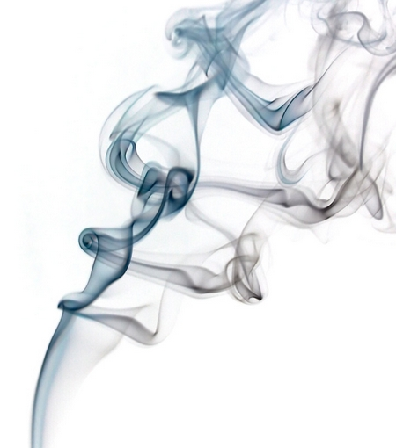
most of your decisions involve “believing” something:
I probably won’t get a touchdown.
I believe that Matt Stafford is better than Andy Dalton.
what are the ways that you generate these beliefs?

Slide 20
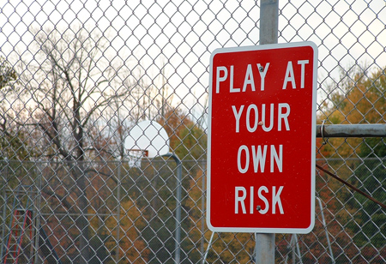
THE WAY THAT YOU PERCEIVE “RISK” WILL AFFECT HOW YOU MAKE A DECISION
Notes:
What are you going to do this weekend?
Will any of you be out drinking this weekend?
- Decision to risk arrest
- Decision not to drive home
Deciding whether to become sexually intimate with someone
Deciding where to spend your money

Slide 21
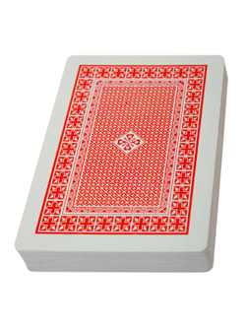
E.V.R. & The Iowa Gambling Task
Benign Deck
Low paying Rare penalties
Stinker Deck
High paying High penalties
Notes:
Ventromedial frontal damage
Used to be an accountant
Got a tumor

Slide 22
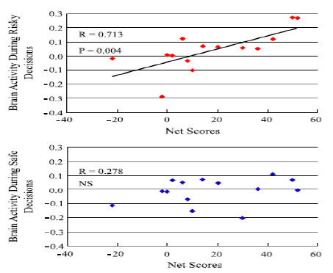
people who do better at igt have more activity in the ventro-medial pfc when they take risks

Slide 23
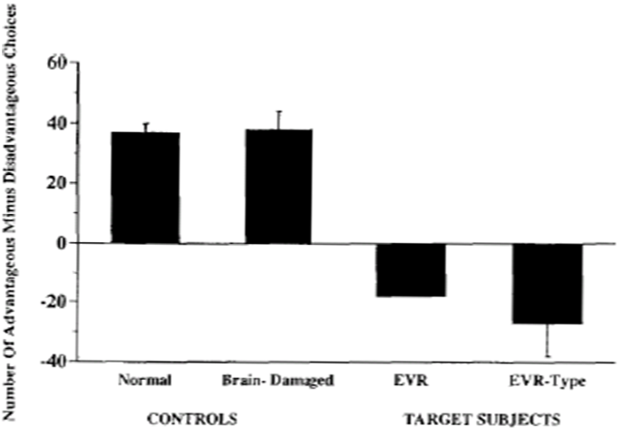
patients with damage to ventromedial pfc don’t learn to avoid risky decisions.

Slide 24
i’m telling you two things
when you make a decision, you’re probably not using rational logic.
your perception of risk (not the actual amount of risk) has a big impact on your decisions.

Slide 25
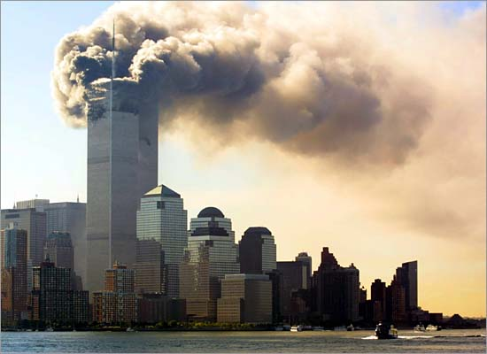
on september 11, 2001,
people became scared of air travel

Slide 26

dread risk
people tend to avoid situations in which many people may be killed at one point in time, as opposed to situations in which more may be killed, but the deaths are distributed over a longer period of time
september 11th ignited fear about the dread risk of plane crashes.
fewer people flew. more people _______ .
drove

Slide 27
gigerenzer, 2004
national miles flown by passengers decreased by 20%, 17%, and 12% in october, november, and december 2001 (compared with 2000)
monthly miles driven was up 0.9% in september 2001 (compared with 2000), but increased further to 2.9% during the next three months.
unfortunately, driving is more dangerous than flying.

Slide 28
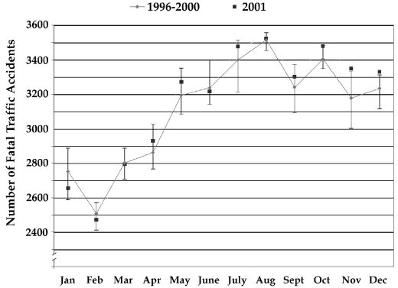
about 350 more traffic fatalities occurred as a result of fear of perceived risk from september 11th.

Slide 29
so people don’t always make the right decisions

Slide 30
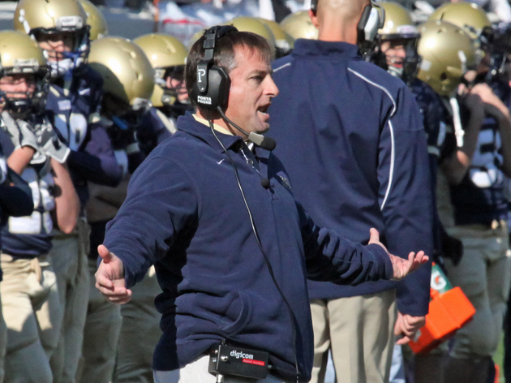
kevin kelley
Notes:
http://www.youtube.com/watch?v=rvJKST6P7Wc

Slide 31
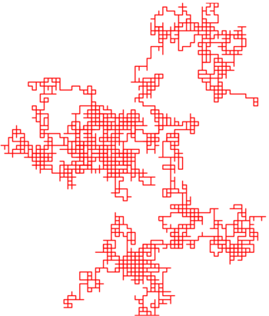
“systematic ways” decision making heuristics
behaviors stray from the normative account in systematic ways

Slide 32
where we left off
most of your decisions involve “believing” something:
I don’t think I’ll get caught.
I believe that the defendant is guilty.
your beliefs allow you to make decisions with uncertain consequences.
how do people assess the probability of uncertain events, generating beliefs about what to do?

Slide 33
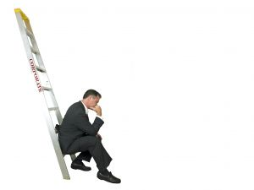
heuristics
simple rules of thumb that are likely to provide the correct answer to a problem, but aren’t foolproof.
heuristics are different from algorithms, which guarantee success.
heuristics save time and usually satisfice.

Slide 34
algorithm: find the biggest number
Assume the first item is largest.
Look at each of the remaining items in the list and if it is larger than the largest item so far, make a note of it.
The last noted item is the largest in the list when the process is complete.
156
12
6
45
9,784
2
0.35
98

Slide 35
heuristic: find the biggest number
156
12
6
45
9,784
2
0.35
98
You know that numbers with a lot of digits in them are big.
Look to see which number has the most digits.
The number should pop-out at you because it’ll take up more space than the other numbers.
Potential problems?
156
12
6
45
9,784
2
0.36567
10⁴

Slide 36
blog posts for this week:
homework
describe how one of the following heuristics might’ve caused you to make an irrational decision in your league

Slide 37
five decision-making heuristics
confirmation bias
representativeness
availability
anchoring and adjustment
escalation of commitment (sunk cost fallacy)

Slide 38
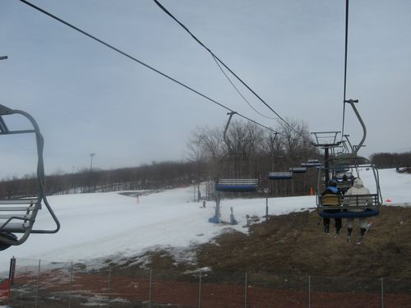
You and your best friend have purchased discount ski lift tickets, rented skis, and driven to a resort…
$35 lift ticket
$35 ski rental
-------------------
$70 spent
conditions suck, you’re gonna have a bad, painful day. but you already spent $70.
do you stay or go?

Slide 39
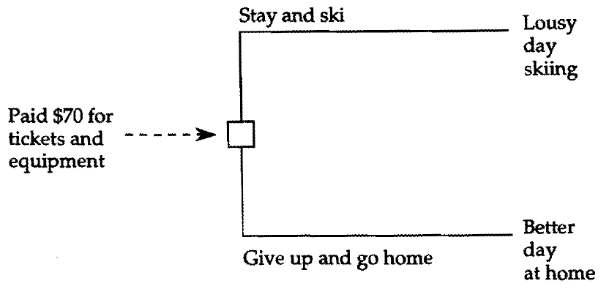
the $70: sunk costs
rationally, sunk costs should not affect decisions about the future.

Slide 40
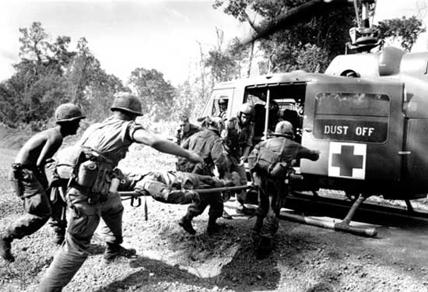
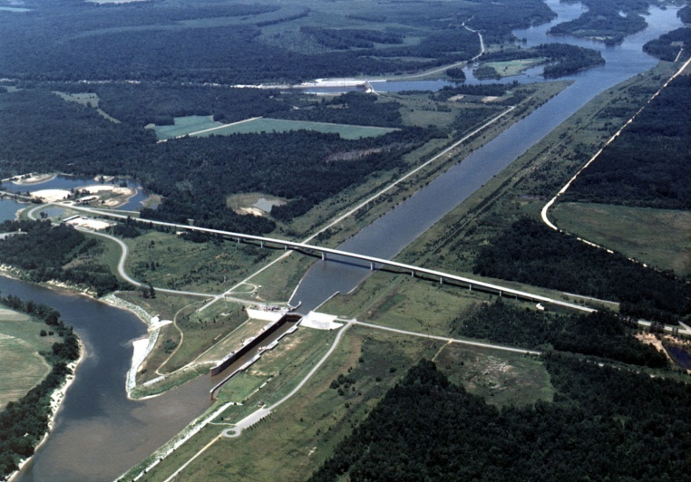
escalation of commitment everywhere
escalation of vietnam war
“our boys shall not have died in vain”
tennessee-tombigbee waterway
“terminating the project at this late stage of development would represent a serious waste of funds already invested.”
Notes:
in 1981, from the quote above, the tennessee tombigbee waterway would be worth less than the amount of money yet to be spent to complete it.
The Tennessee-Tombigbee Waterway (popularly known as the Tenn-Tom) is a 234-mile (377 km) artificial waterway that provides a connecting link between the Tennessee and Tombigbee rivers. The waterway begins at Pickwick Lake on the Tennessee River, then flows southward through northeast Mississippi and west Alabama, finally connecting with the established Warrior-Tombigbee navigation system at Demopolis, Alabama.

Slide 41
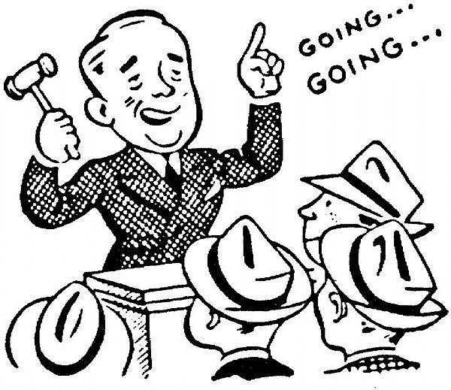
the dollar auction
i’m going to auction off a dollar bill
the catch: the second highest bidder has to pay their highest bid, but gets nothing.
one player starts bidding at $0.01
… someone else bids $0.02
the first bidder should bid again, to avoid losing 1¢.
eventually it gets to $0.99
then what happens?

Slide 42
five decision-making heuristics
confirmation bias
representativeness
availability
anchoring and adjustment
escalation of commitment (sunk cost fallacy)

Slide 43
anchoring and adjustment
provide an estimate (don’t do the math) for the following product:
1 X 2 X 3 X 4 X 5 X 6 X 7 X 8 = _________
8 X 7 X 6 X 5 X 4 X 3 X 2 X 1 = _________
correct answer is 40,320
512
2,250

Slide 44
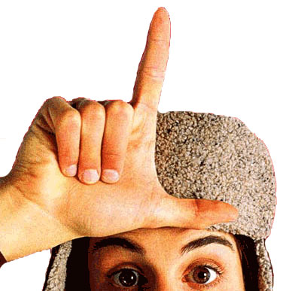
how many times have you had sex in the past week?
people provide lower reports on a 0-7 scale than on a 0-30 scale.

Slide 45
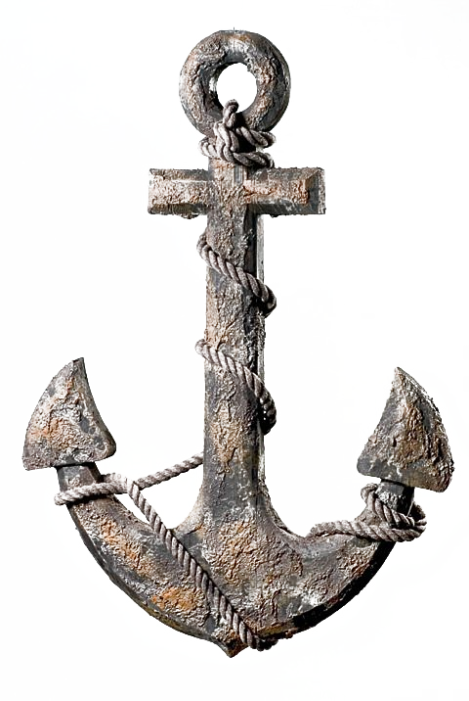
judgments of probabilities can be affected by the starting point (the anchor)
I just asked my computer to come up with a random number between 1 and 100. It came up with 87. Do you think that percentage of African countries that belong to the United Nations is greater than or less than 87%? _____. Estimate the percentage of African countries that belong to the United Nations _____.
I just asked my computer to come up with a random number between 1 and 100. It came up with 23. Do you think that percentage of African countries that belong to the United Nations is greater than or less than 23%? _____. Estimate the percentage of African countries that belong to the United Nations _____.
people tend to give a higher number to the first question, even though they know the random number is irrelevant.

Slide 46
five decision-making heuristics
confirmation bias
representativeness
availability
anchoring and adjustment
escalation of commitment (sunk cost fallacy)

Slide 47
which is more common: murder or suicide?

Slide 48
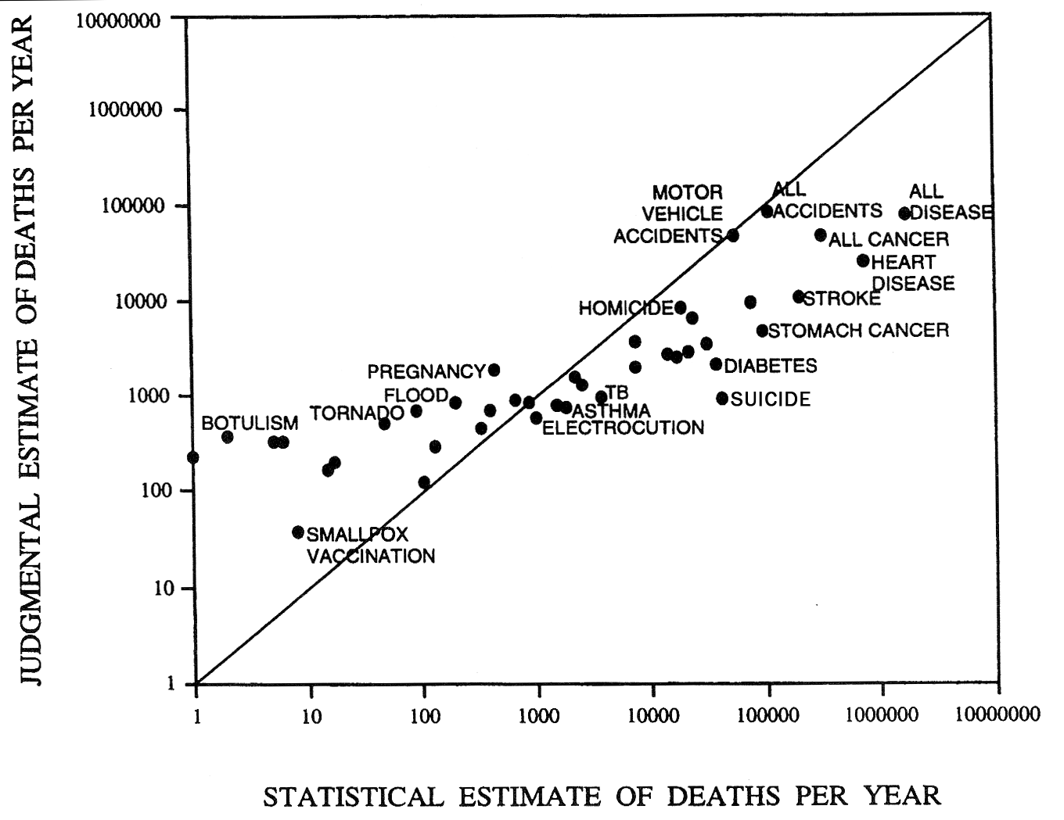
suicide is twice as common
and the ratio is probably seriously underestimated
overdoses
single-car accidents
why would people think that murders are more common?

Slide 49
availability to memory
we rely on the “ease of retrieval” of examples to generate probabilities.

Slide 50
the classic example
Approximately how many words in the English language do you think fit the pattern _ _ _ I N G ? (example TAKING) _________
Approximately how many words in the English language do you think fit the pattern _ _ _ _ N _ ? (example SHRINK) ________

Slide 51
five decision-making heuristics
confirmation bias
representativeness
availability
anchoring and adjustment
escalation of commitment (sunk cost fallacy)

Slide 52
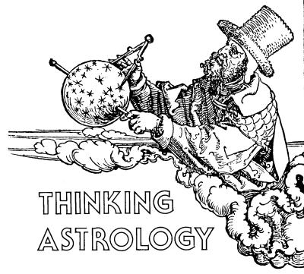
“We don’t want any of these astrology nuts around here!”
Jane is applying to graduate school.
Her combined combination of GPA and GRE scores were ranked 2nd out of 700
On the application, it asked for “other information that the admissions committee might find important,”
Jane wrote, “Being a Capricorn, I will be a careful experimenter.”
Notes:
What’s the problem with the committee member’s classification of Jane?
No consideration of how common “astrology nuts” really are.

Slide 53
representativeness
humans have a remarkable tendency to classify the things around us.

Slide 54
Imagine that some psychologists have administered personality tests to 30 engineers and 70 lawyers, all people successful in their fields. Brief descriptions were written for each of the 30 engineers and 70 lawyers. A sample description follows. Judge that description by indicating the probability that the person described is an engineer. Use a scale from 0 to 100.
Jack is a 45-year-old man. He is married and has four children. He is generally conservative, careful, and ambitious. He shows no interest in political and social issues and spends most of his free time on his many hobbies which include home carpentry, sailing, and mathematical puzzles.
The probability that the man is one of the 30 engineers in the sample of 100 is ?
?
75%

Slide 55
Imagine that some psychologists have administered personality tests to 30 engineers and 70 lawyers, all people successful in their fields. Brief descriptions were written for each of the 30 engineers and 70 lawyers. One description is selected at random. What is the probability that the person described is an engineer? Use a scale from 0 to 100.
The probability that the man is one of the 30 engineers in the sample of 100 is ?
30%

Slide 56
Imagine that some psychologists have administered personality tests to 30 engineers and 70 lawyers, all people successful in their fields. Brief descriptions were written for each of the 30 engineers and 70 lawyers. A sample description follows. Judge that description by indicating the probability that the person described is an engineer. Use a scale from 0 to 100.
Jack is a 45-year-old man. He is from Cleveland, is 5’11”, likes dogs, and has brown eyes.
The probability that the man is one of the 30 engineers in the sample of 100 is ?
?
50%

Slide 57
Linda is 32 years old, outspoken, pro-choice, socialist, went to a small liberal arts school, and is a participant in a weekly woman’s discussion group. How likely is it that
Linda is a teacher at an elementary school
Linda works in a bookstore and takes yoga classes
Linda is active in the feminist movement
Linda is a psychiatric social worker
Linda is a member of the league of women voters
Linda is a bank teller
Linda is an insurance agent
Linda is a bank teller and active in feminist organizations
How can H be more likely than F???

Slide 58
representativeness
Which solution best represents what I might consider the ideal solution?
Which birth order sequence is most likely:
BBBGGG or BGGBGB

Slide 59
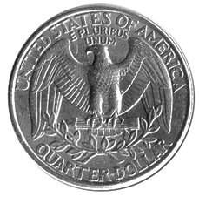
let’s say I flip a coin four times
?
tails
tails
tails

Slide 60
five decision-making heuristics
confirmation bias
representativeness
availability
anchoring and adjustment
escalation of commitment (sunk cost fallacy)

Slide 61
2 4 6
Notes:
You will be given 3 numbers which conform to a simple rule that I have in mind
Your aim is to discover this rule by writing down sets of three numbers that you believe conform to the same rule.
- I’ll tell you whether or not your numbers conform to my rule
When you feel like you’ve figured out the rule, then tell me, and I’ll tell you whether it’s the same rule that I started with.

Slide 62
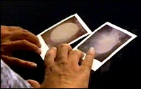
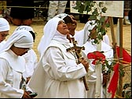
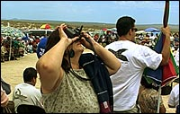
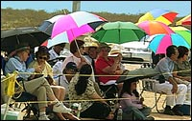
confirmation bias
Tendency to seek out and use information that supports and confirms a prior decision or belief
People avoid seeking out information that might contradict a prior belief
Notes:
CALIFORNIA CITY, Calif.-They come with lawn chairs, rosaries and religious pictures to this stark, scrubby desert. Polaroid is the camera of choice--the better to see immediately if the Virgin Mary has appeared in the sky and allowed herself to be captured in some earthly form, if only on film.
Under a sunny, cloudless sky, they are bundled against the chill of the desert wind as they pray in a circle near two huge white crosses. They hope to see Mary, but at the moment they are eagerly awaiting Maria Paula Acuna, a 45-year-old Catholic woman from California City who comes on the 13th of each month to this site--now christened Our Lady of the Rock--and declares that Mary is in their midst.
Whether it's rainy or sunny, a throng gathers. On weekends, it can number 1,000 or more. On Thursday, the crowd is 300 strong, and two vendors are selling rosaries, religious-themed jewelry and an Automatic Miracle Fold self-opening umbrella.
The faithful are veterans of this Mojave Desert trek and neophytes, predominantly Catholic and mostly Latino. They tote stacks of snapshots taken of the sky over the course of their visits and compare them like collectors at a baseball card show.
Some are part of the Marian movement--devotees of Mary--who travel to sites around the world renowned for visitations by Mary. But most are Southern Californians who simply believe that something--something blessed--happens under this desert sky on the 13th df each month.
"See, it's the Virgin," says Lissette Sandoval, 41, cradling a snapshot she took just before Acuna's arrival. She points to a vaguely diamond-shaped smudge of white light.
Maybe you could construe it to be the shape of a veiled and robed Mary in her traditional pose with outstretched arms. Suggestions that photographing the sun will result in odd shapes and blips of light carry as much weight here as any earthly apparition of Mary does.
Only Acuna claims to see the mother of Jesus with regularity and incredible clarity.
"The Blessed Mary always appears around 10, 10:30, 11, something like that," Acuna had explained over the phone Wednesday, the day before the 13th. "She looks like a big ray of light coming from the sky very slowly and then she appears in front of me. She looks like a cloud. I see her very clearly. She's a very beautiful woman, very young.. Maybe 18 years old. About 5'5".
Local Catholic authorities have officially-if gently-suggested that there is no Mary there.
"The church's official position is that there are no apparitions, and people are to be discouraged from going there," said Father Gregory Coiro of the Roman Catholic' archdiocese of Los Angeles, which spent more than a year investigating the desert case. "It was looked into and found to be wanting. It was found to be due to somebody's imagination-not anyone's bad will."
The diocese in Fresno, which has immediate authority over California City, has concurred with Los Angeles officials. But it has placed no restrictions on people gathering at the unpaved site about 10 miles northeast of California City.
Not that the devotees care about such pronouncements. They have their own research. They talk of the time when rose petals fell from the sky as Acuna prayed-- and then mystically rose back into the sky. They remember when a rainbow appeared around the sun.
Maria Morales, 34, brings her 3-year-old daughter outfitted in a little blue cape and white gown like a miniature statue of Mary. Morales says that Acuna's prayers healed her daughter's dislocated hip.
"I made: a promise to the Virgin Mary that I would dress her up as soon as she was healed," she says.
On this Thursday morning, Evelyn Velasquez, 23, waits for Acuna to arrive. "There will be a moment when she says,'Take the picture,' and everyone will go crazy with their cameras," she says. "But if you don't believe it, you won't see it."
Acuna says she doesn't know why she started coming to the desert on the 13th of each month, but suggests that there is some history of Mary appearing on that day.
In one of the most famous religious sightings of the century, a woman standing on a cloud reportedly appeared to three children on May 13, 1917, in Fatima, Portugal. She told them to return to that spot on the 13th of each month until October when she appeared and told the children that she was the Virgin Mary.
When Acuna arrives, smiling and waving from a teal Dodge Grand Caravan, she is a dark-haired woman, swathed in white veil, white gown and white gym shoes. She is attended by white-clad volunteers.
A group of children in white robes follows a procession of men carrying a statue of Mary surrounded by a bed of plastic roses. They walk slowly to a table on a small makeshift platform.
After one of Acuna's aides leads the group in a hymn, Acuna walks to the center of the circle her audience has made. They fall silent as she clutches a microphone and recites the "Hail Mary" in English and then prays in Spanish.
Softly she says in Spanish, "Our Mother is with us," and suddenly the air is filled with the whir of polaroid cameras snapping directly at the sun. Those without cameras look toward the sky, hands draped in rosaries shielding eyes from the bright sun. All that is visible to the naked eye is a trail of vapor from jets flying out of nearby Edwards Air Force Base.
"The light of the Blessed Mother looks like a crown and covers all the people here," she says in English before launching into something of a sermon--a lament for the homeless that leaves her and some of her listeners in tears.
After the prayers have been said and photos snapped, Acuna works the crowd, listening to people's problems, laying her hands on their heads as she prays, laughing and smiling with those who bring her good news. She is trailed by a volunteer in white who carries a bottle of holy water and a tin of holy oil for Acuna's use.
Seven years ago, Acuna says, she had her first vision when she went to pray in Lopez Canyon near her home in Pacoima. She went back repeatedly, bringing with her bigger and bigger crowds of people until the owners of the property complained.
"That was private property in Lopez Canyon," says one of her aides who declined to give his full name. "The Blessed Mother told her the desert is wide, so she came here."
As the morning turns to afternoon, people search their snapshots for images of the Virgin Mary. "I can't say I've stood here and looked up and seen her," admits first-time attendee Jodi Kepler from Tehachapi.
"But I feel like she's here. I'm for anything that has a positive effect."

Slide 63
happens all the time…
think of your best friend from high school.
was he/she outgoing?
are you thinking of examples when your best friend from high school might’ve been outgoing?
that won’t give you a good answer.
Notes:
… to test the hypothesis of whether your best friend is outgoing, you should be trying to think of examples where your best friend was shy, right?

