Slide 1
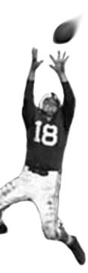
C105 PREDICTION, PROBABILITY & PIGSKIN
day 17: prediction, correlation, and regression
© Ben Motz, 2014

Slide 2
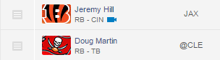
no one cares about your opinions.
Notes:
You could decide that you just prefer Torrey Smith, or dislike DeSean Jackson because of some gut instinct. And that’s great. And you’ll probably lose.
There are very few people in the world whose “gut instincts” actually have some value in a particular arena.
---Those people know who they are, they’re probably rich, and they spent decades honing those instincts.
Allow me to let you in on a secret: no one (except maybe your parents) cares about your opinions.
---The sooner you realize that your opinions are totally worthless, the better.

Slide 3
Impatient boss voice:
“Find out how many sprockets we should make next month!”
Your company’s
new product
You
Your company

Slide 5
reason > speculation

Slide 6
models > experts
TheFantasyShrink
4for4.com
FFToolbox
FootballGuys.com
DraftSharks
8. BrunoBoys
13. Dave Richard (CBSSports.com)
mathematical models
…
experts
…
2011 fantasy football overall accuracy rankings from FSTA & Fantasy Football Librarian
(most 2012 & 2013 awardees have not shared their methods)

Slide 7
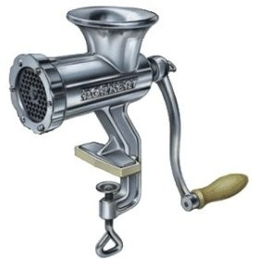
what’s a model?
location
weather
playcalling
points scored against
past performance
matchup favorability
time of day
opposing team stats
projected performance

Slide 8
9.7
6.4

Slide 9

nfl.com fantasy weekly projections
All weekly NFL matchups are simulated by the EA Sports Madden NFL 25 game engine. Projections are updated daily with the latest injury updates and player news from around the league, taking realistic projections to the next level.

Slide 10
another way…
+
recent points scored against opponent
recent points scored by player
past performance against opponent
…
+
+
+
+
+
projection = [some baseline]
linear modeling aka regression

Slide 11
something something else another number something [baseline]
+
point projection

Slide 12

something something else another number something [baseline]
+
point projection
+ noise
mental models?
Dave Richard

Slide 13
to make a good model of point projections you need to find variables that are related to point projections

Slide 14
finding relationships between variables…
correlation
provides a way to investigate relationships that you could not manipulate experimentally.
you can say:
when one number goes up, another number goes up
correlation is not causation

Slide 15
correlations
Work out the more likely chain of causation:
whenever ice cream sales rise, so do shark attacks (eating ice cream makes you tastier?)
as more economists are recruited to the treasury, inflation rises (economists cause inflation?)
in scandinavia, storks appear more often on the rooftops of families with more babies (storks bring babies?)
as vocabulary increases in infancy, so does appetite (words make you hungry?)

Slide 16
scatter plots

Slide 17
scatter plots
Notes:
Stress that the data comes in pairs (x,y)

Slide 18
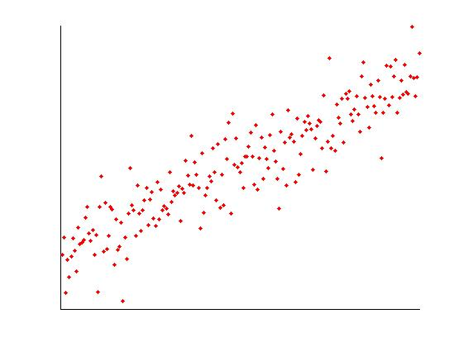
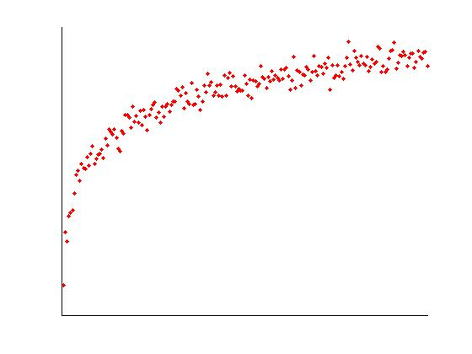
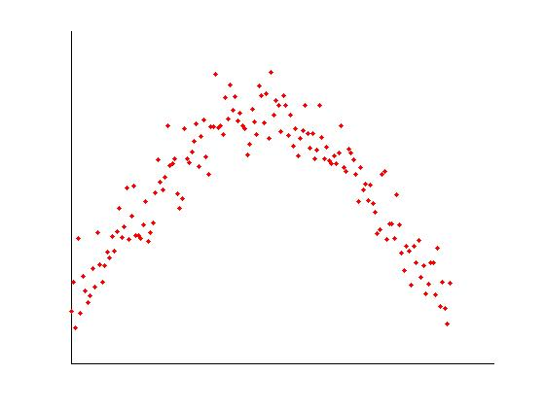
scatter plots

Slide 19
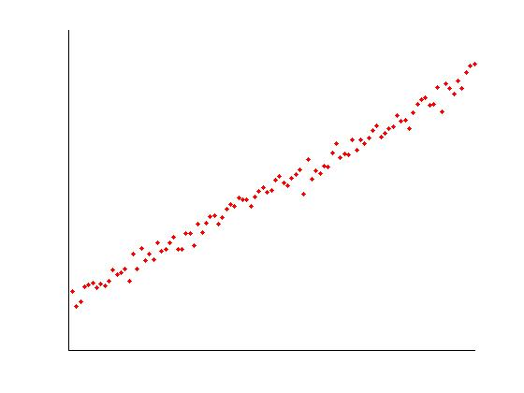
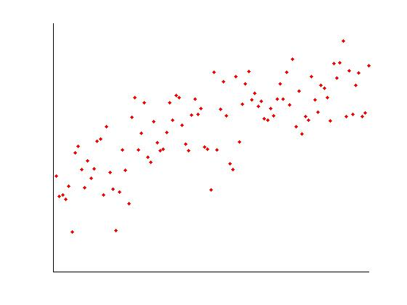
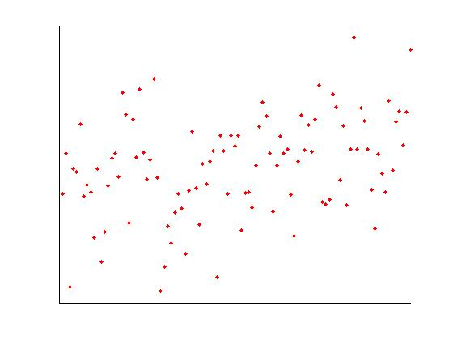
correlation strength
High
Correlation
Moderate
Correlation
Low
Correlation

Slide 20
scatter plots
Curvilinear
Relationship
Linear Correlation

Slide 21
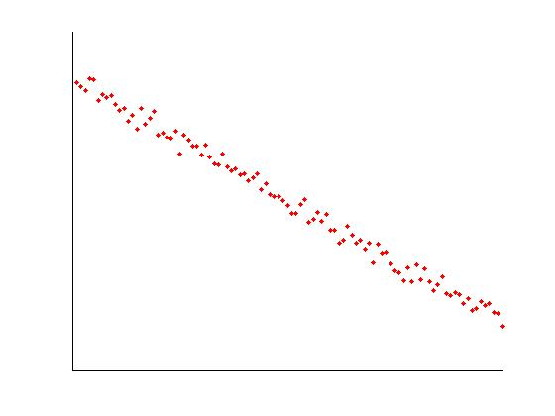
correlation direction
Positive
Correlation
Negative
Correlation

Slide 22
wouldn’t it be great if there was some way to evaluate the strength of a correlation?
r
r = 0.39281
correlation coefficient pearson correlation

Slide 23
interpreting r values
an r value of 0 means that there is no correlation between the two variables
the sign of the r value indicates the direction of the correlation.
if r is positive, then as x increases, y increases.
if r is negative, then as x increases, y decreases.

Slide 24
interpreting r values
the closer an r value is to zero, the weaker the correlation (the noisier the data look)
as r approaches ±1, it indicates a stronger and stronger correlation. the data become more tightly bunched around a straight line

Slide 25
correlation strength
If you know x
you can make
a pretty good
guess of y
If you know x
you have
almost no
idea what
y is

Slide 26
correlation strength
r = .9
r = .5
r = .1

Slide 27
r
r²
correlation coefficient pearson correlation (max = 1, min = -1)
coefficient of determination (max = 1, min = 0)
if you square the correlation coefficient you’ll get the proportion of variability in one variable that’s accounted for by another variable.

Slide 28
knowing the week 1 fantasy points can tell you 15% about the week 2 fantasy points
r = 0.39281
→ r² = 0.1543
is this value significantly different from 0?

Slide 29
if so…
then your model for week 2 points is reliably better when you take into account week 1 points.
→ r² = 0.1543
if not…
then your model for week 2 points isn’t necessarily improved by taking into account week 1 points.
is this value significantly different from 0?

Slide 30
statistical significance
perhaps the r² value that you got was just due to random chance…
maybe the r² between the 3rd digit of a player’s mobile phone number and his week 2 points is 0.1542?
what’s the likelihood that you could’ve observed this correlation due to chance?
p value
if a p-value is less than 0.05 (5%), then we’ll assume that the correlation is significantly different from 0.

Slide 31
r = 0.39281
→ r² = 0.1543
is this value significantly different from 0?
p = 0.000000003825
There is a significant correlation between week 1 and week 2 f.p.

Slide 32

given a series of x and y data points, we can use correlation to tell us if there is a relationship between the points.
r
Variable 1
Variable 2
correlation

Slide 33
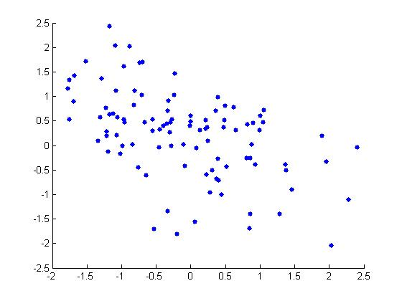
Which of the following r-values would describe the data in the scatterplot?
-0.9
-0.4
0
0.4
0.9

Slide 34
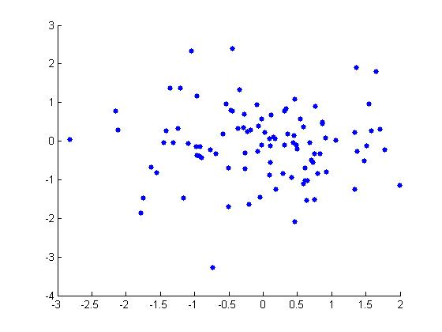
Which of the following r-values would describe the data in the scatterplot?
-0.9
-0.4
0
0.4
0.9

Slide 35
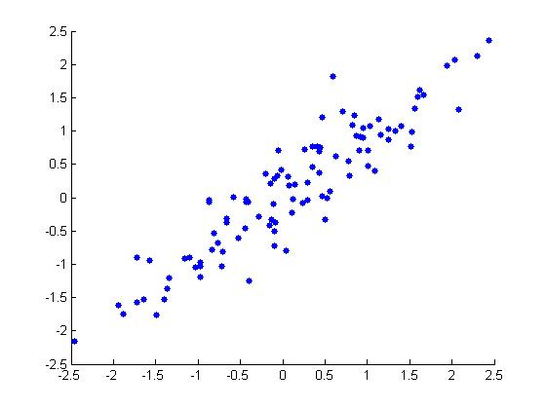
Which of the following r-values would describe the data in the scatterplot?
-0.9
-0.4
0
0.4
0.9

Slide 36
what does r tell you?
the direction of the correlation
the strength of the correlation
and if you square it, it tells you … …the proportion of variability in one variable that’s accounted for by another variable.

Slide 37
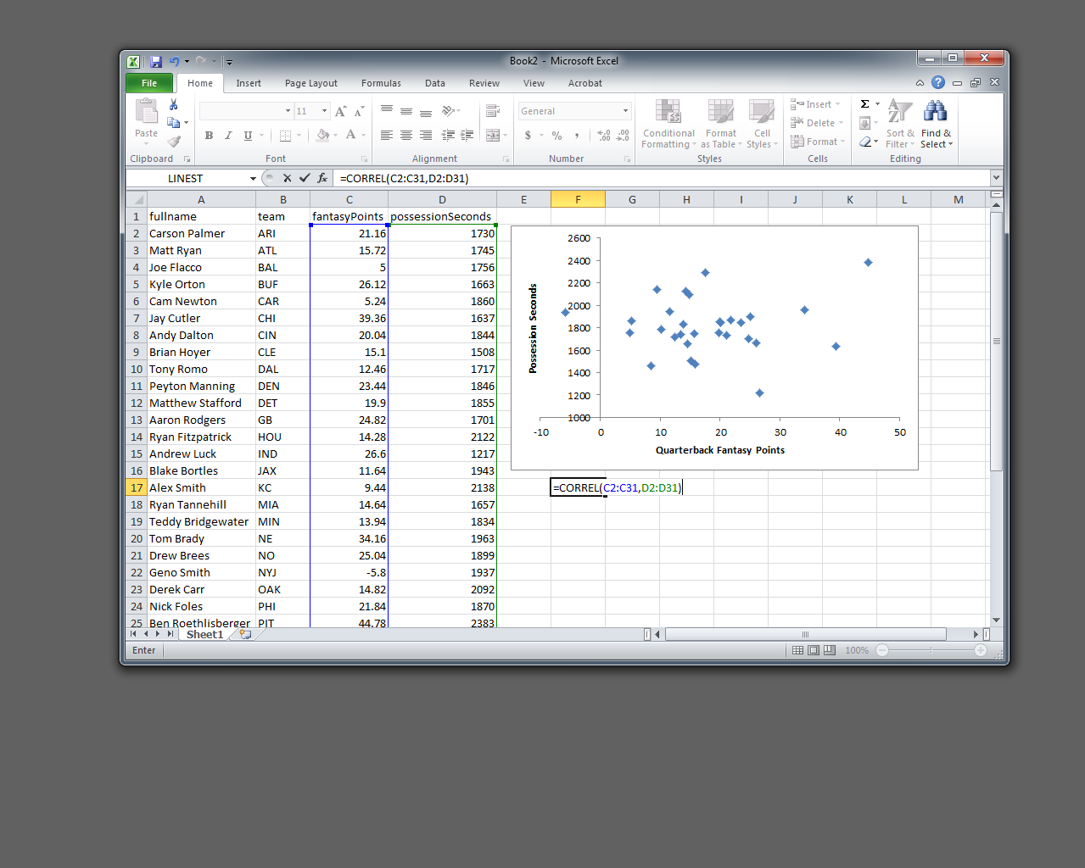
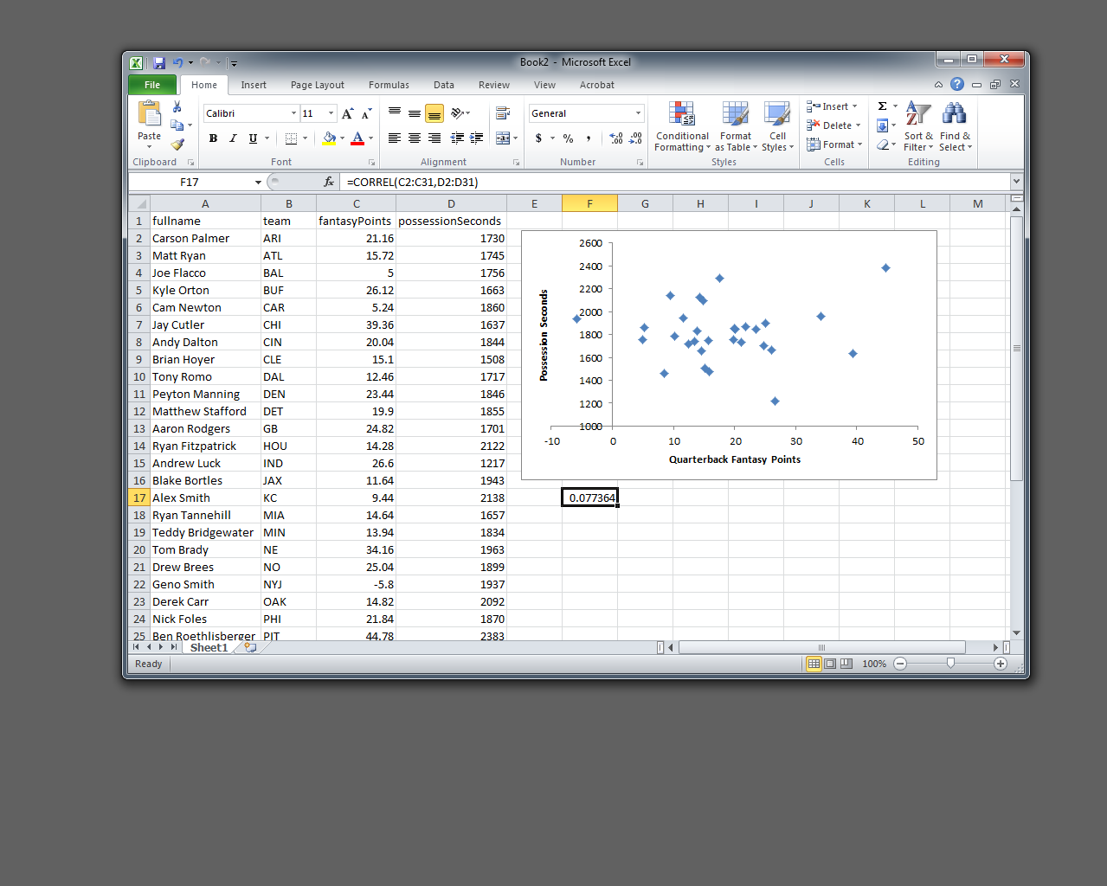

Slide 38
r = 0.55712

Slide 39
r = 0.741604

Slide 40

wouldn’t it be nice…
if we found a reliable correlation between two variables…
wouldn’t it be nice if we could use one variable to predict another?
regression

Slide 41
an approximation…
r = 0.741604

Slide 42
an approximation…
r = 0.741604
If a player got 75 points in the first eight weeks of the season…
…we’d expect him to get 50-125 points in weeks 9-17.

Slide 43
regression can tell you a precise value that you might expect, given a predictor variable.
Notes:
Mathematically, this is the average

Slide 44
more exact…
r = 0.741604

Slide 45
more exact…
r = 0.741604
If a player got 75 points in the first eight weeks of the season…
We’d expect him to get 74.17 fantasy points in the next 8 weeks…

Slide 46
equation for a line…
ŷ = a + bx
where:
ŷ = predicted points
a = intercept
b = slope (coefficient)
x = the predictor
rise
rise
= slope
run
run
intercept
ŷ = 12.115 + .8274x

Slide 47
equation for a line…
intercept = 3 & coefficient = 2
x = 4, ŷ = ?
x = 2, ŷ = ?
intercept = 30 & coefficient = 10
x = -10, ŷ = ?
x = 3, ŷ = ?

Slide 48
graphing lines…
if you were given the coefficient (b) and the intercept (a)…
plug x = 0 into the equation, and get a value for ŷ (hint: it’ll be the value “a”)
mark a point at (0, ŷ)
plug x=[something else] into the equation and get a value for ŷ.
mark a point at that new location (x, ŷ)
connect your two points with a straight line
make a graph like this
draw this line: ŷ = 7 + -2x
now this line: ŷ = 1.5 + 0.5x

Slide 49
but which line?

Slide 50
this one’s the best

Slide 51
fitting a line to data
given a set of data, how can we calculate the optimal values for the regression coefficient and the regression constant so that our predicted values are as accurate as they can be?
what we want to do is find the line that is as close as possible to each of our data points.
said another way, we want to minimize the distance between each data point (y) and our prediction line (ŷ).

Slide 52
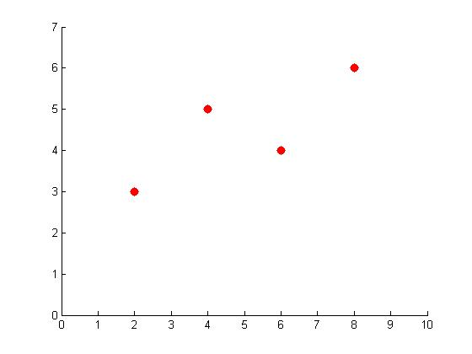
the best fit

Slide 53
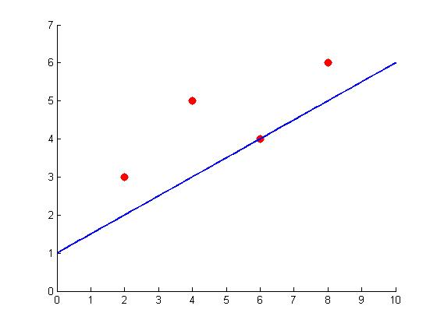
a potential line
Error: +1
Error: +2.5
Error: +1
sum of error: +4.5

Slide 54
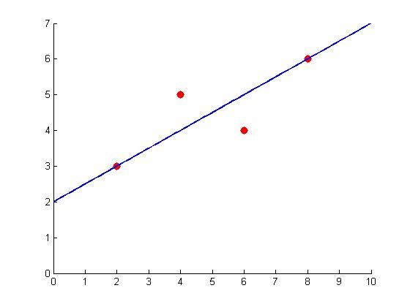
the best fit line
Error: 0
Error: +1
Error: -1
Error: 0
sum of error: +0

Slide 55
a problem

Slide 56
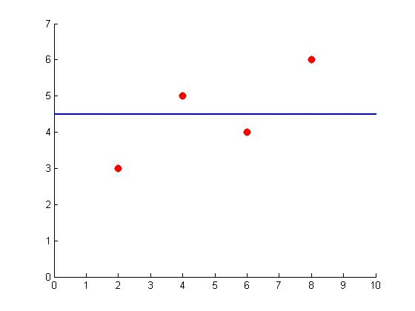
a problem
1.5
0.5
-0.5
-1.5
sum of error: +0

Slide 57
a problem

Slide 58
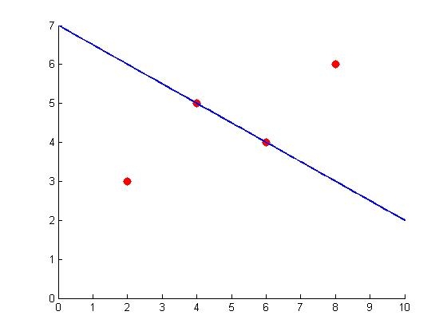
a problem
-3
3
sum of error: +0

Slide 59
squared error
Error: 0
Error²=0
Error: +1
Error²=1
Error: -1
Error²=1
Error: 0 Error²=0
sum of squared error: 2

Slide 60
minimize squared error
least squares regression
find the line that minimizes the sum of squared residuals (error) between observed data points and the regression line.

Slide 61

how do you do it?

