Slide 1
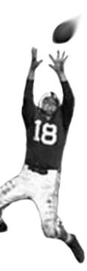
C105 PREDICTION, PROBABILITY & PIGSKIN
day 17: expert performance and automaticity
© Ben Motz, 2013
Notes:
http://www.youtube.com/watch?v=BfTMmoDFXyE

Slide 2
what to write about? use data
Critique your draft strategy. How has it worked?
What was the biggest surprise of Week X? Why was it unexpected?
Which player accounts for the largest percent of his team’s performance?
Who is the most consistent player (or position) in the league?
What site(s) have the most accurate projections? Why?
Are some positions more predictable in terms of fantasy performance?
Identify overvalued players. Why do people like 'em? (heuristics?)
What kinds of heuristics affect fantasy football gameplay?
Explore situational factors: Home field, rivalries, weather, etc.
Classify your RB (or QB, WR, etc.) using cluster analysis.
Compare and contrast linear modeling and simulation.
Is fantasy football a game of chance?

Slide 3
this week: treatise to sports psychology
Jeff Huber
PSY-P 357 Psychology of Human Performance
Spring 2014, Section 30790
MWF 10:10-11am
63 seat enrollment; 55 currently available

Slide 4
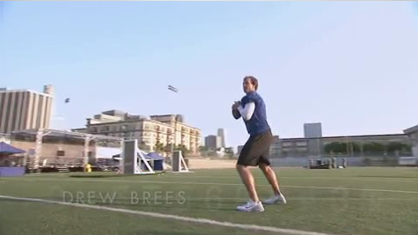

Slide 5
rubbing your belly and patting your head

Slide 6
processing with no concentration
automaticity: fast and effortless processing that requires little or no focused attention
when a process is more automatic, the less likely you are to be consciously aware of it
when’s the last time you were “conscious” of breathing?
automaticity “frees up” resources for more demanding tasks

Slide 7
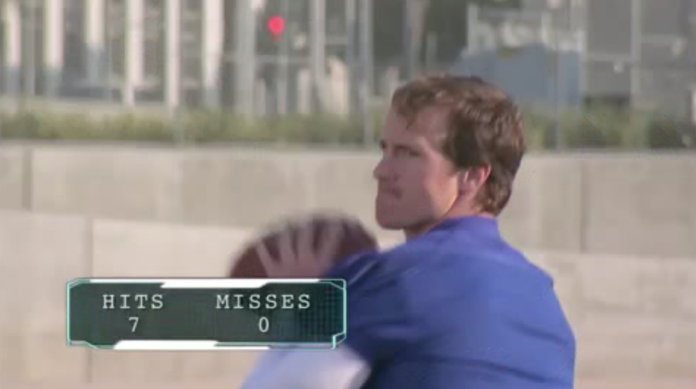
Hmm… to whom should I throw it?

Slide 8
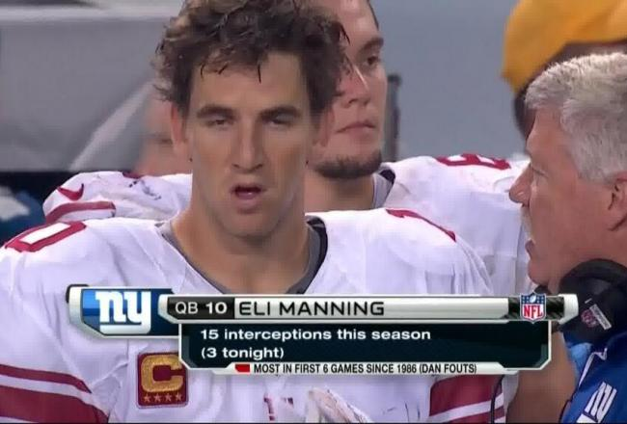

Slide 9
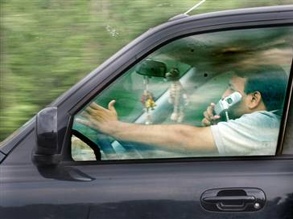
studying automaticity
situations that require us to perform two tasks at once.
does talking on a cell phone and driving drain cognitive resources and impair driving performance or does it impair conversation skills?
both tasks are highly practiced, so we might expect there to be little cost to dividing attention across these two tasks.
Notes:
- Linus and Lucy
- Stroop effect

Slide 10
many countries have banned handheld cell phones while driving
Australia | Yes | India - New Delhi | Yes | Portugal | Yes
Austria | Yes | Ireland | Yes | Romania | Yes
Bahrain | Yes | Israel | Yes | Russia | Yes
Belgium | Yes | Italy | Yes | Singapore | Yes
Brazil | Yes | Japan | Yes | Slovak Republic | Yes
Botswana | Being debated | Jersey | Yes | Slovenia | Yes
Canada | Variable | Jordan | Yes | South Africa | Yes
Chile | Yes | Kenya | Yes | South Korea | Yes
China | Yes | Malaysia | Yes | Spain | Yes
Czech Republic | Yes | Mexico | Partial | Sweden | No
Denmark | Yes | Netherlands | Yes | Switzerland | Yes
Egypt | Yes | New Zealand | Being debated | Taiwan | Yes
Finland | Yes | Norway | Yes | Thailand | Yes
France | Yes | Pakistan | Partial | Turkey | Yes
Germany | Yes | Philippines | Yes | Turkmenistan | Yes
Greece | Yes | Poland | Yes | UK | Yes
Hong Kong | Yes | Hungary | Yes | Zimbabwe | Yes

Slide 11
most states have not banned handheld cell phones while driving (only 12 + DC)
Alabama | No | Kentucky | No | North Dakota | No
Alaska | No | Louisiana | Partial | Ohio | No
Arkansas | Partial | Maine | No | Oklahoma | Partial
Arizona | No | Maryland | Yes | Oregon | Yes
California | Yes | Massachusetts | No | Pennsylvania | Partial
Colorado | Partial | Michigan | No | Rhode Island | No
Connecticut | Yes | Minnesota | Partial | South Carolina | Partial
Delaware | Yes | Mississippi | No | South Dakota | No
District of Columbia | Yes | Missouri | No | Tennessee | Partial
Florida | No | Montana | No | Texas | No
Georgia | Partial | Nebraska | No | Utah | No
Hawaii | Yes | Nevada | Yes | Vermont | No
Idaho | No | New Hampshire | Partial | Virginia | Partial
Illinois | Yes | New Jersey | Yes | Washington | Yes
Indiana | Partial | New Mexico | Partial | West Virginia | Yes
Iowa | No | New York | Yes | Wisconsin | No
Kansas | No | North Carolina | No | Wyoming | No

Slide 12
are we wrong to not ban cell phones while driving?
are other countries wrong to ban cell phones while driving?

Slide 13
keep your hands on the wheel
Almost all cell phone bans restrict the use of handheld cell phones while driving but do no restrict the use of hands-free devices.
Implicit Assumption: Any impairment to driving while talking on a cell phone is due to the use of a handheld device.
Alternative: Driving impairment with cell phone use is due to due to dividing attention. This would impact driving with both handheld and hands-free devices.

Slide 14
correlational research
this is research that looks at driving statistics to see if there is a relationship (correlations) between accidents and cell phone use
24% of a sample of 699 accidents involved drivers that had spoken on a cell phone within 10 minutes prior to the accident
the use of handheld and hands-free phone were equally associated with accidents suggesting divided attention is the problem, not the use of a peripheral device
what’s the problem with correlation research?

Slide 15
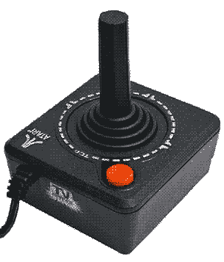
strayer and johnson, 2001
subjects had to track the position of a moving target on a computer screen.
every 10-20 seconds, the moving target would flash a color.
if the target turned red, they’d have to push a button (like braking).
if the target turned green, they wouldn’t do anything.

Slide 16
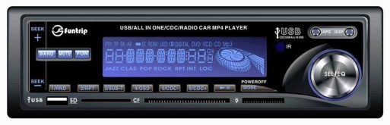
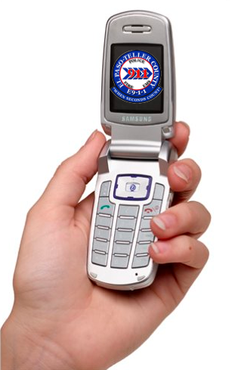
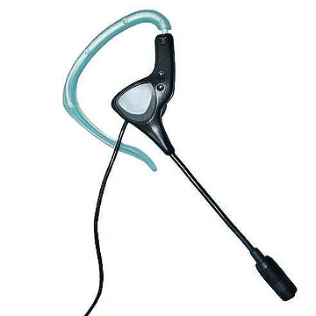
the 2nd tasks
carry on a conversation (with an experimenter) about
then-ongoing Clinton presidential impeachment
salt lake city olympic committee bribery scandal
on either
hand-held mobile phone
hands free device
or just listen to
a radio program of their choice
a book on tape

Slide 17
phases of the experiment
warm-up phase (7min) – practice tracking task
1st tracking phase (7.5min) – just tracking task
dual-task phase (15min) – tracking & 2nd task
2nd tracking phase (7.5min) – just tracking task
which is the most interesting phase?
why’d they do these other phases?

Slide 18
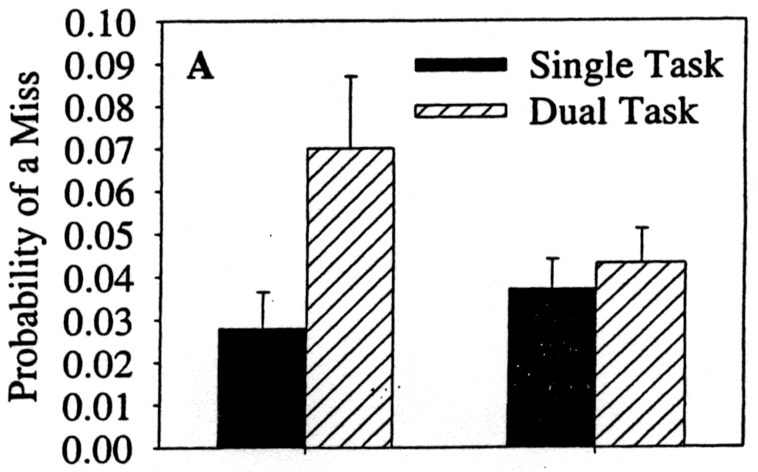
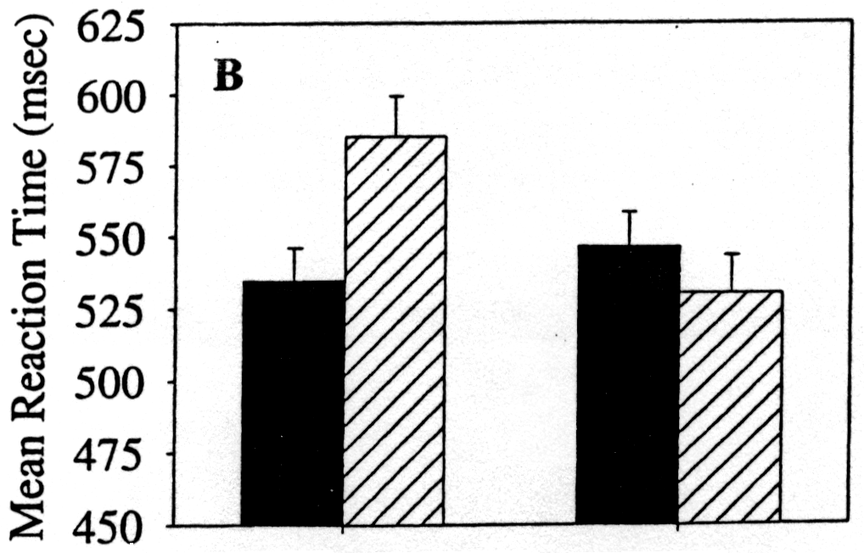
results
probability of missing a color change more than doubled for cell phone group.
reaction time increased too.
no difference for radio group.
Cell Phone
Radio

Slide 19
no difference for handheld or hands free phones

Slide 20
what’s it mean?
85% of cell phone users talk on the phone (at least occasionally) while driving.
What does it mean that we’re able to perform these two tasks simultaneously?
One of them is automatic.
(It’s not the cell phone conversation)
Talking on the phone increases the risk of accident to levels comparable to driving drunk.
The cognitive task of talking on the phone uses attentional resources that would otherwise be used for driving a car.

Slide 21
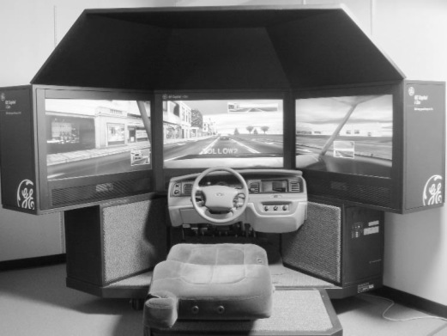
Strayer & Drew (2004)
In a more recent article, Strayer & Drew (2004) used a driving simulator instead of the tracking task from Strayer & Johnston (2001).

Slide 22
Strayer & Drew (2004)
With cell phone:
Brake onset time was 18% slower
Following distance was 12% greater
Half-recovery time was 17% longer
2 X increase in rear-end collisions
No difference in speed
Although older subjects were worse overall, the effects of cell phone use were the same for both younger and older subjects

Slide 23
more attention = better performance

Slide 24
wait wait hold on wait stop waitaminute
could drew brees be throwing better if he were focusing on his throw?

Slide 25
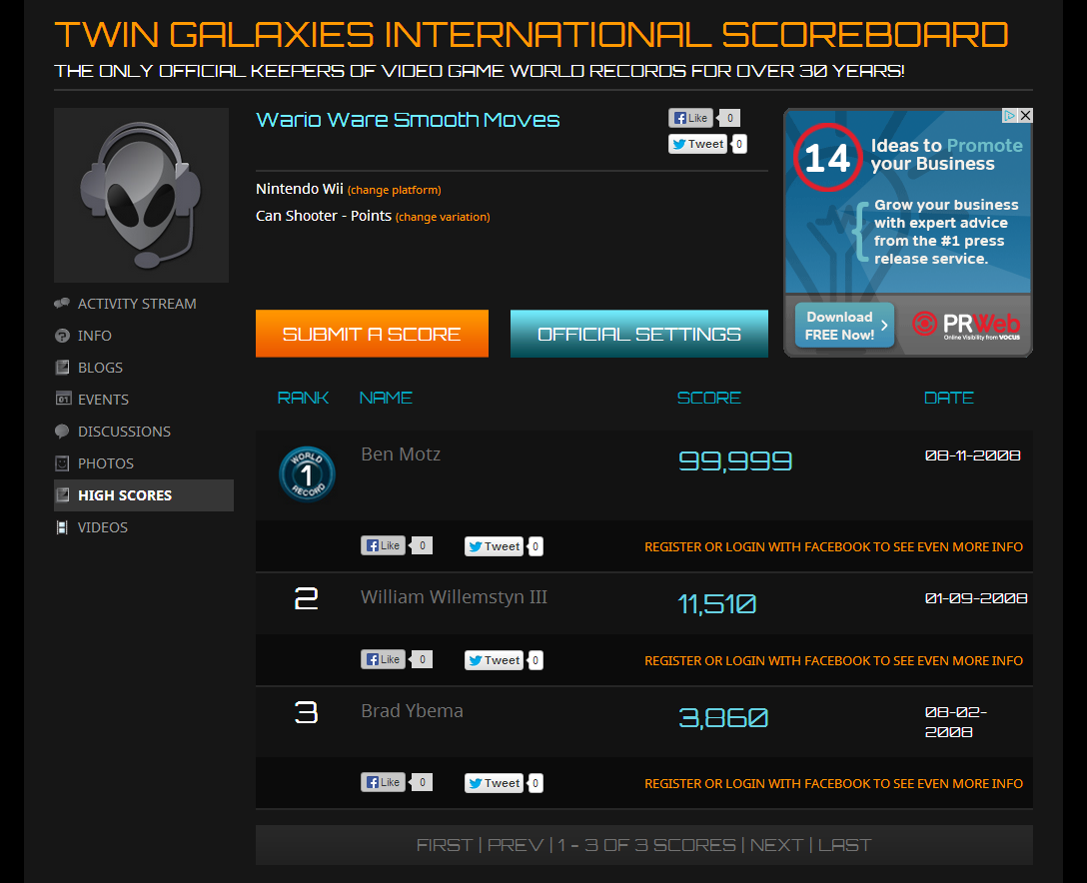
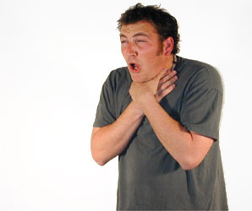
I happen to know something about skilled performance…

Slide 26
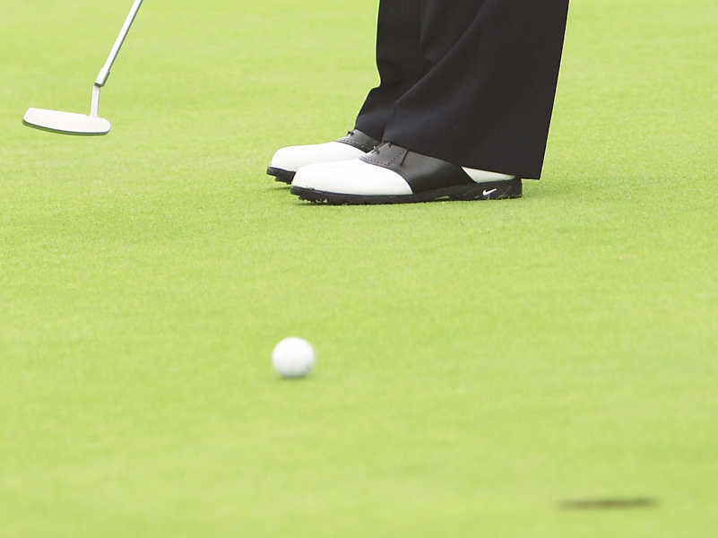
Once a process or procedure has become automatic, devoting explicit attention to it can lead to worse performance.
Beilock & Carr, 2001

Slide 27
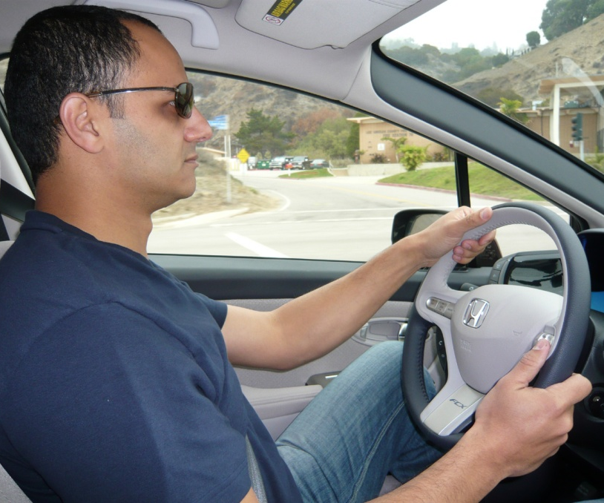
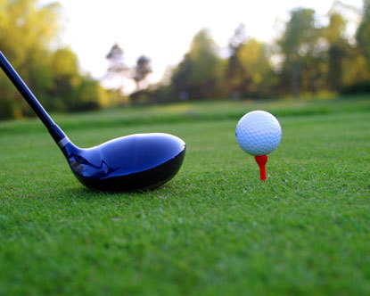
more attention
=
better performance
more attention
=
worse performance
why?

