Slide 1
graphing lines…
if you were given the coefficient (b) and the intercept (a)…
plug x = 0 into the equation, and get a value for ŷ (hint: it’ll be the value “a”)
mark a point at (0, ŷ)
plug x=[something else] into the equation and get a value for ŷ.
mark a point at that new location (x, ŷ)
connect your two points with a straight line
make a graph like this
draw this line: ŷ = 7 + -2x
now this line: ŷ = 1.5 + 0.5x

Slide 2
but which line?

Slide 3
this one’s the best

Slide 4
fitting a line to data
given a set of data, how can we calculate the optimal values for the regression coefficient and the regression constant so that our predicted values are as accurate as they can be?
what we want to do is find the line that is as close as possible to each of our data points.
said another way, we want to minimize the distance between each data point (y) and our prediction line (ŷ).

Slide 5
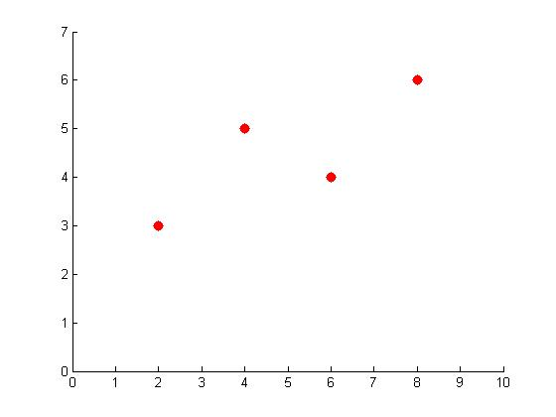
the best fit

Slide 6
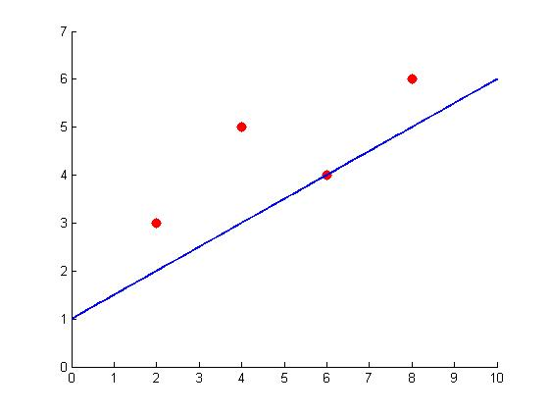
a potential line
Error: +1
Error: +2.5
Error: +1
sum of error: +4.5

Slide 7
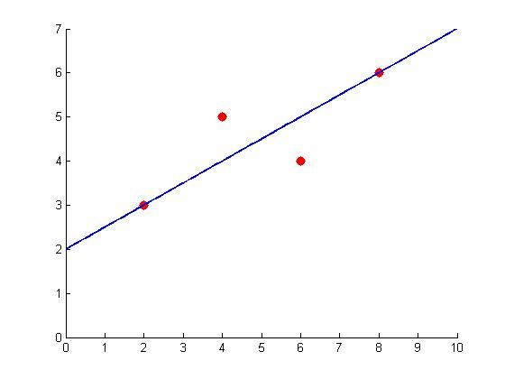
the best fit line
Error: 0
Error: +1
Error: -1
Error: 0
sum of error: +0

Slide 8
a problem

Slide 9
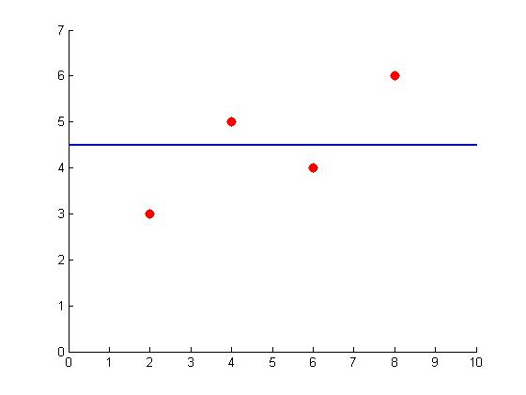
a problem
1.5
0.5
-0.5
-1.5
sum of error: +0

Slide 10
a problem

Slide 11
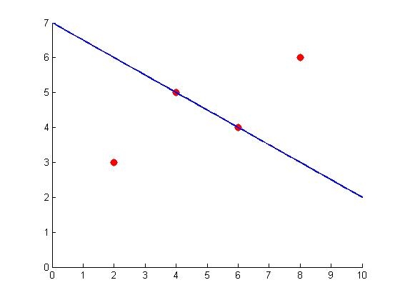
a problem
-3
3
sum of error: +0

Slide 12
squared error
Error: 0
Error²=0
Error: +1
Error²=1
Error: -1
Error²=1
Error: 0 Error²=0
sum of squared error: 2

Slide 13
minimize squared error
least squares regression
find the line that minimizes the sum of squared residuals (error) between observed data points and the regression line.

Slide 14
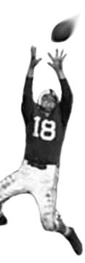
C105 PREDICTION, PROBABILITY & PIGSKIN
day 19: prediction and regression
© Ben Motz, 2014

Slide 15

given a series of x and y data points, we can use correlation to tell us if there is a relationship between the points.
r
Variable 1
Variable 2
correlation

Slide 16

we can use regression to make predictions about a variable, using a related variable.
Variable 1
ŷ = a + bx
Variable 2
regression

Slide 17
multiple regression uses more than one predictor to calculate ŷ.
Variable 1
Variable 2
Variable 3
ŷ = …
Variable 4
multiple regression

Slide 18
ŷ = β₀ + β₁x₁ + β₂x₂ + … + β_{n}x_{n}
another equation…
all the way up to “n” predictors
intercept
given x₁, x₂, …, x_{n}, what intercept and coefficients will minimize the sum of least squares for y?
the value you’re trying to predict.
the first predictor variable.
the 2nd predictor variable.
the first predictor’s coefficient
(parameter)
the 2nd predictor’s coefficient (parameter)

Slide 19

how good is the model?
for simple regression, you’d use r²
for multiple regression, use adjusted r²
why?
r² will always increase if you add more x- variables, even if the variables are uncorrelated with y.
adjusted r² “penalizes” the use of additional x-variables (and can even be negative).

Slide 20
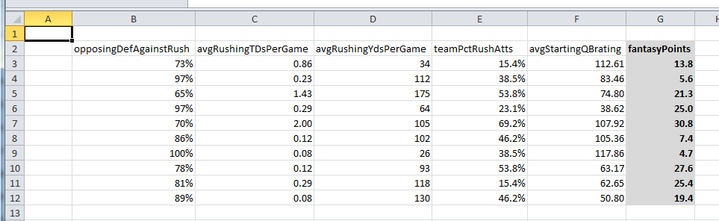
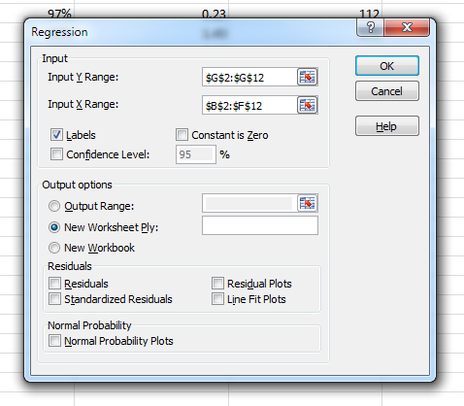
how to do it?
Note: totally fabricated data

Slide 21
