Slide 1
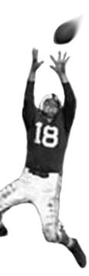
C105 PREDICTION, PROBABILITY & PIGSKIN
day 19: factor analysis
© Ben Motz, 2014

Slide 2
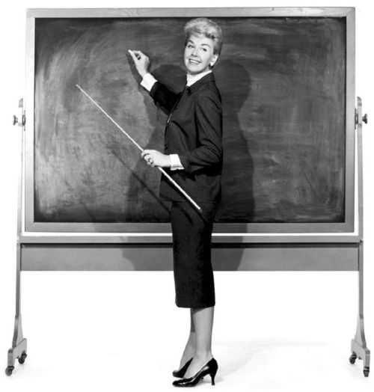
think about every “class” you’ve ever taken
at least 75 since kindergarten
pretend that exactly 1/3 of students get As, Bs, & Cs.
…each time you take a class, are you equally likely to earn A, B, or C?
and you’ve earned at least this many grades

Slide 3
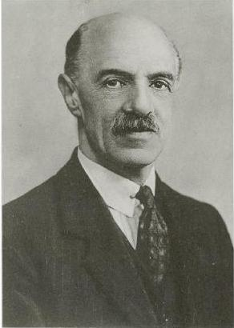
charles spearman
noticed that children’s grades on seemingly unrelated school subjects tended to be correlated.
maybe there’s just one kind of intelligence:
g-factor

Slide 4
spearman, 1904: correlation matrix
 | Classics | French | English | Math | Pitch | Music
Classics | 1
French | .83 | 1
English | .78 | .67 | 1
Math | .70 | .67 | .64 | 1
Pitch discrimination | .66 | .65 | .54 | .45 | 1
Music | .63 | .57 | .51 | .51 | .40 | 1
g | .958 | .882 | .803 | .750 | .673 | .646

Slide 5
what factor analysis does
something over here
something else
another thing
and what about this
don’t forget this too
underlying factor(s)
another example: personality

Slide 6
Think of a pet you have, or have known. Ignore its physical appearance.
how would you describe this pet?
would people agree with your description?
how do you know about your pet’s personality?

Slide 7
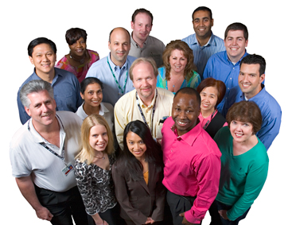
personality: the set of characteristics that distinguishes us from others, and leads us to act consistently across situations
Goofball
Depressed
Deranged Psychopath
Notes:
There are, without a doubt, different personalities.
Click thru
Again, the point of this little lecture is to discuss how to study these differences.
- The first goal should be: HOW ARE PEOPLE DIFFERENT FROM ONE-ANOTHER?
Give me some ideas of how you might study this, scientifically?

Slide 8

just ask people about themselves.
How happy are you?
Are you satisfied in life?
Are you depressed?
Do you think you smile often?
If someone bumps into you, do you get mad, or assume it was a mistake?

Slide 9
factor analysis
main question: which terms vary together statistically?
terms that go together probably reflect a general personality characteristic.
cattell measured 16 basic personality characteristics

Slide 10
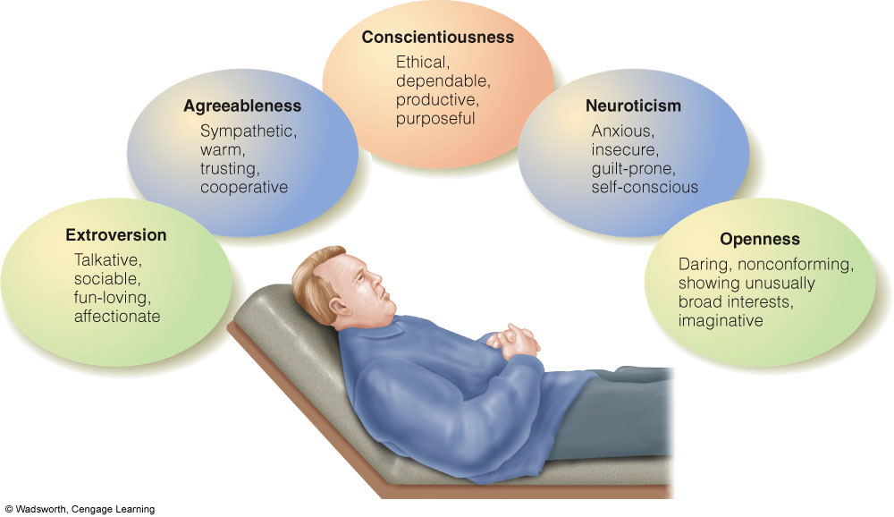
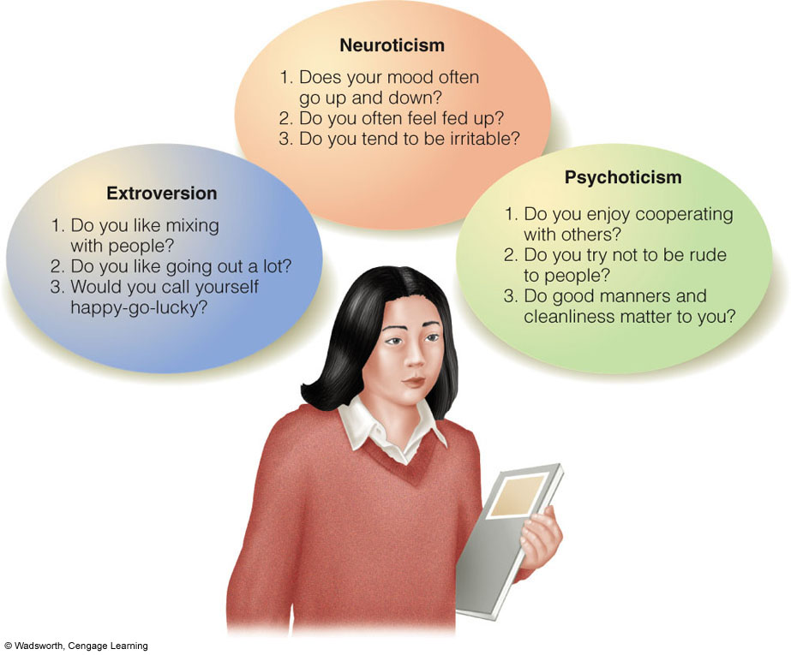
Eysenck’s Three Primary Dimensions
Notes:
Extroversion: how outgoing and social you are
Neuroticism: Anxiety, worry, moodiness
Psychoticism: uncaring insensitive or cruel tendencies

Slide 11
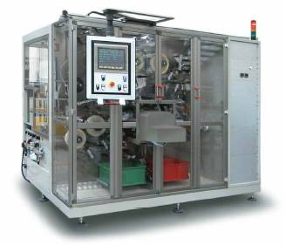
the basic idea
observed variable #1
observed variable #2
observed variable #3
observed variable #4
observed variable #5
observed variable #6
observed variable #7
observed variable #8
observed variable #9
observed variable #10
observed variable #11
observed variable #12
observed variable #13
observed variable #14
observed variable #15
observed variable #16
observed variable #17
observed variable #18
…
factor analysis
latent factor 1 latent factor 2
…

Slide 12
multiple factors?
 | V1 | V2 | V3 | V4 | V5 | V6
V1 | 1
V2 | .987 | 1
V3 | .801 | .765 | 1
V4 | -.003 | -.088 | 0 | 1
V5 | -.051 | .044 | .213 | .968 | 1
V6 | -.190 | -.111 | 0.102 | .789 | .864 | 1
Q1-3 correlate strongly with each other and hardly at all with 4-6
Q4-6 correlate strongly with each other and hardly at all with 1-3

Slide 13
“factor analysis”…
…is sometimes called:
data reduction
dimensionality reduction
…is more a concept than a technique...
principal factor analysis
principal component analysis
huh?

Slide 14
principal factor analysis: only “common variance” principal component analysis: doesn’t give a crap …and both usually yield similar results.
“do you think you smile often?”
specific variance: variance unique to the variable itself
people might worry about having food in their teeth.
error variance: variance due to measurement error
people might misunderstand the question.
common variance: variance shared with other variables
people might have differences in “happiness”
Notes:
…also: factor analysis is complicated. Principal component analysis isn’t as complicated, and lots of people use it.

Slide 15

factor analysis: what’s in it for me?
a way to study something that can’t be observed directly.
how many factors underlie the variables that i’ve collected?
what do these underlying factors represent? (needs a little more digging)

Slide 16
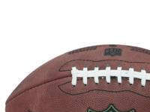
pigskin & factor analysis?
factors underlying attendance patterns
factors underlying results of on-field tests following possible concussions
factors underlying performance at combine
…and of course…
latent factors underlying team performance

Slide 17
example for discussion:
which team has the best defense?
Notes:
there are lots of ways to evaluate a team’s defense

Slide 18
lots of ways to measure a team’s defense
tackles per game
sacks per game
interceptions
fumbles recovered
defensive TDs
points allowed
passing yards / TDs
rushing yards / TDs

Slide 19
one latent factor accounts for variance in multiple variables
36% of all variance between defenses (another 2 latent factors explain 28% more)
what is this factor?

Slide 20
PC#1
rush yards allowed (+)
rush TDs allowed (+)
pts allowed (+)
sacks (-)
interceptions (-)
(loadings are kinda like coefficients)
2006 BAL
2010 PIT
2008 BUF
2008 DET
2011 SF
2008 KC
-3
3

Slide 21
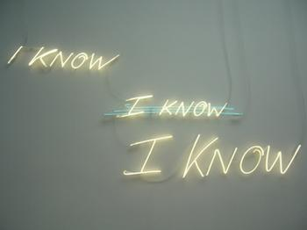
what if you already know (or think you know) about a latent factor?
so far I’ve been describing exploratory factor analysis…
confirmatory factor analysis sees how well data fit a theory or hypothesis.

Slide 22

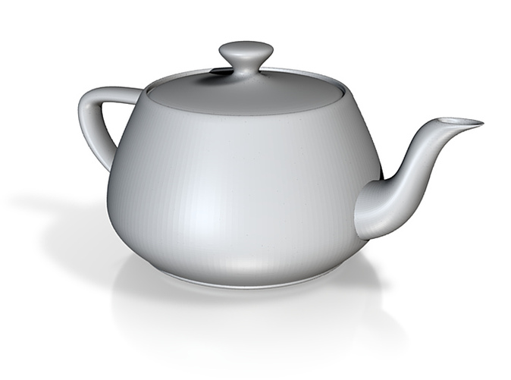
how do you take a picture to capture the most information about the teapot?
Notes:
http://www.youtube.com/watch?feature=player_detailpage&v=BfTMmoDFXyE#t=22s
http://www.youtube.com/watch?v=4pnQd6jnCWk

Slide 23
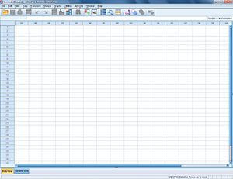
principal components analysis (PCA)
Reading: Week11_DiscoveringStatsUsingSPSS_FactorAnalysis.pdf
This is a reference.
In Windows STC labs and on iuanyware.iu.edu
SPSS

Slide 24
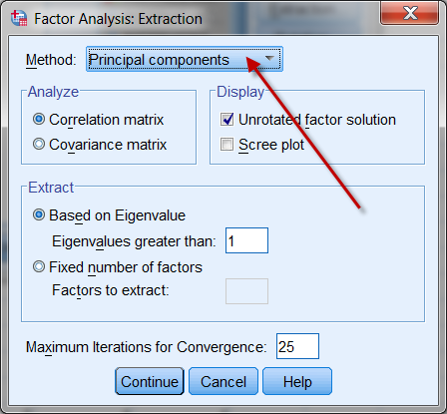
guide to PCA in SPSS
What the heck is SPSS?
How do I get SPSS to do PCA?
What the &$%@ does it spit out?
How do I make sense of it all?

Slide 25
SPSS: Statistical Package for the Social Sciences
A computer program used for statistical analysis.
Not just for “Social Sciences”
IBM now owns SPSS
It’s part of IBM’s portfolio of applications for Business Intelligence
SPSS can open Excel files!
Big difference:
In Excel variable names are in the first row of data
In SPSS, you define the entire column as a variable

Slide 26
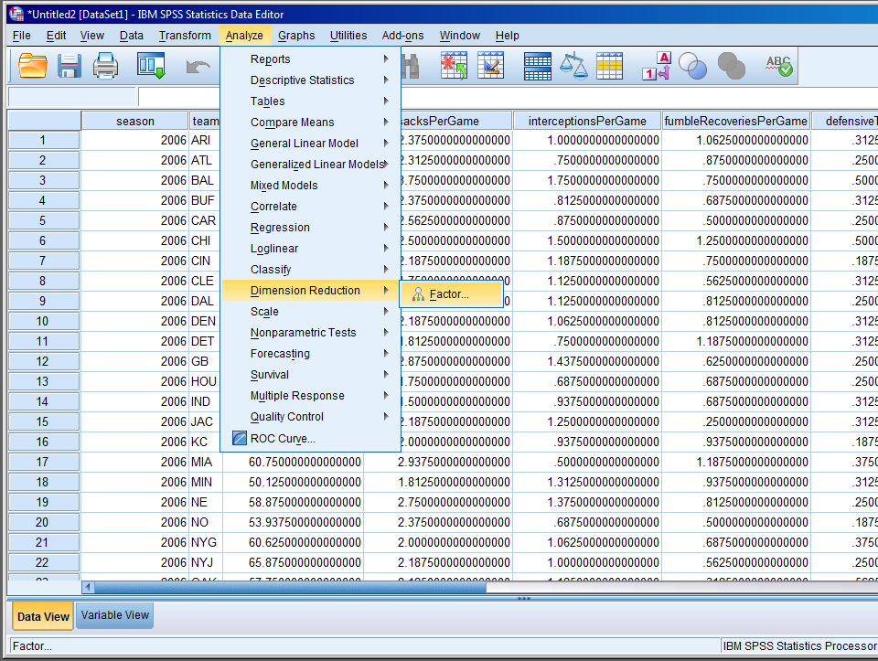
walkthru

Slide 27
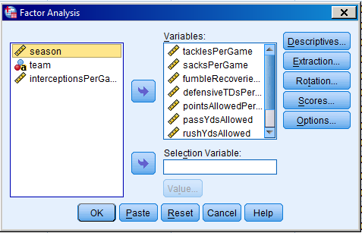
what were those settings again?
DESCRIPTIVES: select “coefficients” under correlation matrix; so that you can see the correlation matrix.
EXTRACTION: select “Scree Plot” under Display; so that you can see the Scree plot.
ROTATION: depending on your data, select Varimax or Promax.
Varimax when components are uncorrelated with each other.
Direct Oblimin when components may be correlated with each other (which is usually the case)
SCORES: if you’re all settled, you can ask SPSS to save the factor scores as variables.

