Slide 1
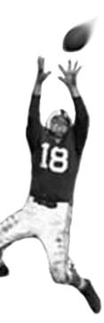
C105 PREDICTION, PROBABILITY & PIGSKIN
day 23: cluster analysis
© Ben Motz, 2014

Slide 2
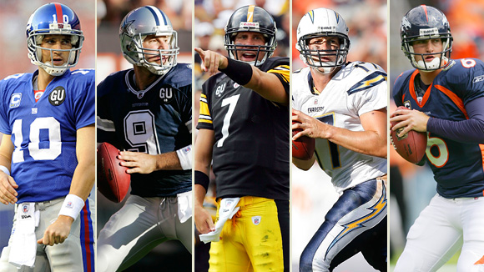
different kinds of quarterbacks?

Slide 3
cluster analysis
when you need to classify data

Slide 4
factor analysis vs. cluster analysis
factor analysis would find a latent factor that describes your data
(latent = not directly observed)
this data point has a high score on the factor
this data point has a low score on the factor

Slide 5
factor analysis vs. cluster analysis
cluster analysis tells you how to segment the data
this data point is in cluster “1”
this data point is in cluster “2”

Slide 6


couldn’t you do this?
yes you could, with one or two variables…
…but it’s hard with multidimensional data

Slide 7
back to quarterbacks
you can’t draw a line in 8 dimensions

Slide 8
back to quarterbacks
you need a computer to do it for you

Slide 9
the basic idea
generate groups which are similar within, and different between.
homogeneous within the group and as much as possible heterogeneous to other groups
can you give me more examples?

Slide 10
imagine a bunch of demographic data
Census Block | Income (000s) | Age of Adults | Number of Children | …
05860 | 42 | 55 | 2
05896 | 67 | 60 | 2.5
06220 | 54 | 39 | 1
06616 | 23 | 30 | 0
06634 | 89 | 65 | 2.4
06706 | 46 | 65 | 1.7

Slide 11
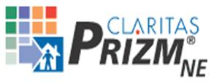
claritas prizm
Using census data, survey data, geographical data, purchasing data…
Claritas classifies each block of the US into one of 62 clusters: Blue Blood Estates, New Homesteaders, Middle America, God's Country, etc.
Blue Blood Estates: America’s richest suburbanites; consume imported beer at a rate nearly three times the national average
Zip code lookup: www.claritas.com/MyBestSegments/Default.jsp

Slide 12
other applications
more consumer marketing
are there different kinds of customers that should get different messages?
insurance
distinct insurance policy premiums for different kinds of customers?
finance
which stocks have similar price fluctuations?

Slide 13
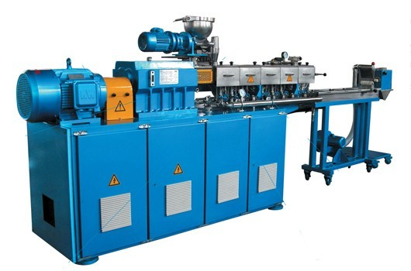
Clustering: in and out
observed variable #1
observed variable #2
observed variable #3
observed variable #4
observed variable #5
observed variable #6
observed variable #7
observed variable #8
…
the number of clusters you want it to find. (K)
Cluster 1
Cluster 2
…
Cluster K

Slide 14
how many clusters?
6
2
4

Slide 15
Clustering: in and out
observed variable #1
observed variable #2
observed variable #3
observed variable #4
observed variable #5
observed variable #6
observed variable #7
observed variable #8
…
the number of clusters you want it to find. (K)
Cluster 1
Cluster 2
…
Cluster K

Slide 16
how k-means works
K=3

Slide 17
how k-means works
K=3
random initial cluster centers

Slide 18
how k-means works
K=3
assign points to the nearest cluster center

Slide 19
how k-means works
K=3
assign points to the nearest cluster center

Slide 20
how k-means works
K=3
move the cluster center to the middle of the assigned points

Slide 21
how k-means works
K=3

Slide 22
how k-means works
K=3

Slide 23
how k-means works
K=3

Slide 24
how k-means works
K=3

Slide 25
how k-means works
K=3

Slide 26
how k-means works
K=3

Slide 27
how k-means works
K=3

Slide 28
how k-means works
K=3

Slide 29
how k-means works
K=3

Slide 30
how k-means works
K=3
no movement of cluster centers.
algorithm has “converged”

Slide 31
do it

Slide 32
1
2
3
Name:
4
5
6

Slide 33
1
2
3
Name:
4
5
6

Slide 34
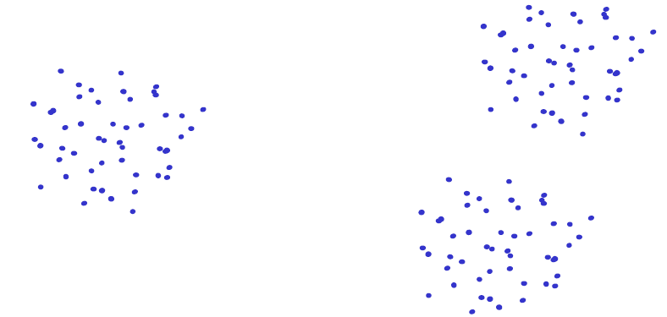
k-means
con: dependent on initialization

Slide 35
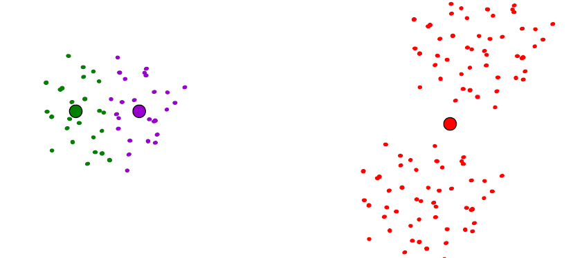
k-means
con: dependent on initialization

Slide 36
how do you do it with SPSS?

