Slide 1
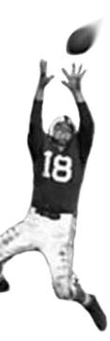
C105 PREDICTION, PROBABILITY & PIGSKIN
day 25: simulation & the monte carlo method
© Ben Motz, 2014

Slide 2
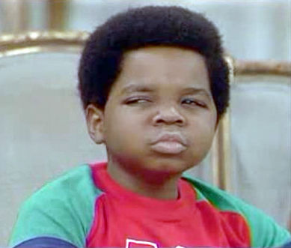
so far: modeling
a model is a representation of the behavior of a system, given some context… e.g., ŷ = a + bx
next up: simulation
a simulation is the observation of a system’s behavior under different contexts…
whachutalkinabout?

Slide 3
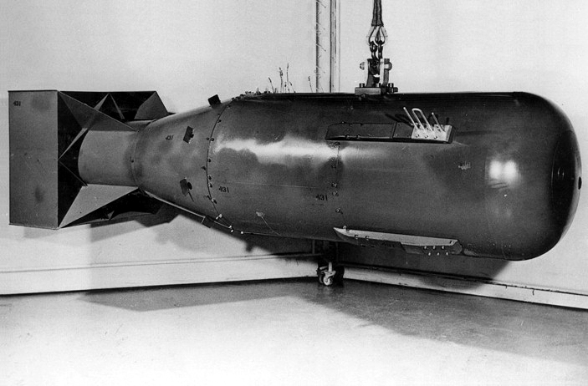
The first thoughts and attempts I made to practice [the Monte Carlo Method] were suggested by a question which occurred to me in 1946 as I was convalescing from an illness and playing solitaires. The question was what are the chances that a Canfield solitaire laid out with 52 cards will come out successfully? After spending a lot of time trying to estimate them by pure combinatorial calculations, I wondered whether a more practical method than “abstract thinking” might not be to lay it out say one hundred times and simply observe and count the number of successful plays. This was already possible to envisage with the beginning of the new era of fast computers, and I immediately thought of problems of neutron diffusion and other questions of mathematical physics, and more generally how to change processes described by certain differential equations into an equivalent form interpretable as a succession of random operations…
Stanisław Ulam

Slide 4
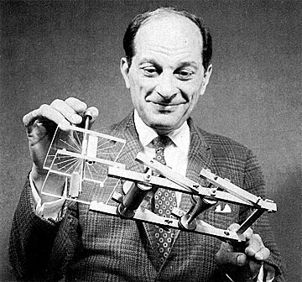
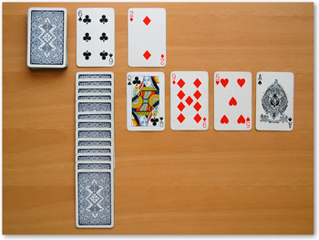
what ulam meant…
anyone taking finite should be able to figure out the probability of winning at a card game.
but it’d be a pain to work out.
why not just play the game a whole bunch of times, and look at what percent are won?
→ simulation

Slide 5
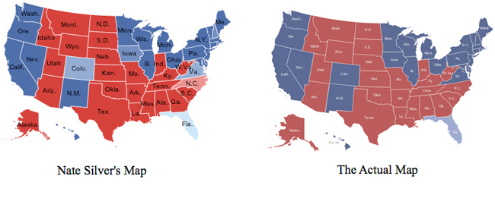
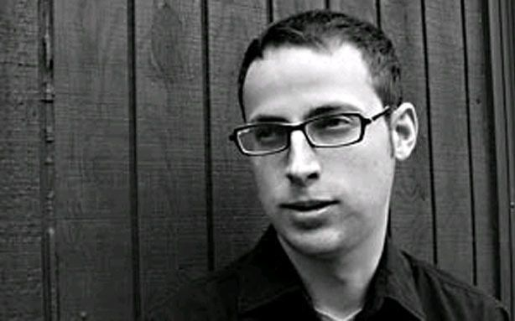
created regression models that would predict the outcome in each state.
some of the variables were unknowns, and depended on each other.
simulated the election 100,000 times to determine the most likely outcomes.
When Alexander Bell invented the telephone he had 3 missed calls from Nate Silver.
Nate Silver can delete the Recycling Bin.
Nate Silver once got bit by a rattle snake. After three days of pain and agony... the rattle snake died.
Nate Silver can suffocate a pillow with a man.
Nate Silver can build a snowman out of rain.
Nate Silver beat the sun in a staring contest.

Slide 6
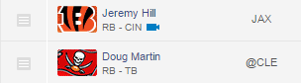
9.7
6.4
[actually, you HAVE MADE]
you could make a model that takes input, and deterministically calculates outcomes.
alternatively you could make a model that takes variable input, and simulates outcomes.
in a word: a stochaistic model

Slide 7

nfl.com fantasy weekly projections
All weekly NFL matchups are simulated by the EA Sports Madden NFL 25 game engine. Projections are updated daily with the latest injury updates and player news from around the league, taking realistic projections to the next level.

Slide 8
accuscore: DAL @ CHI (thursday)
Expect a close game with the Dallas Cowboys winning 42% of simulations, and the Chicago Bears 58% of simulations. In close games, turnover margin is especially important. The Dallas Cowboys commit fewer turnovers in 40% of simulations and they go on to win 67% when they take care of the ball. The Chicago Bears wins 76% of the simulations in which they commit fewer turnovers. Tony Romo is averaging 255 passing yards per sim. If he can have a great game with better than average passing yards and at least a 2 to 1 TD to INT ratio (36% chance) then he helps his team win 52%. Jay Cutler is averaging 287 passing yards per sim. If he can have a great game with better than average passing yards and at least a 2 to 1 TD to INT ratio (33% chance) then he helps his team win 67%.

Slide 9
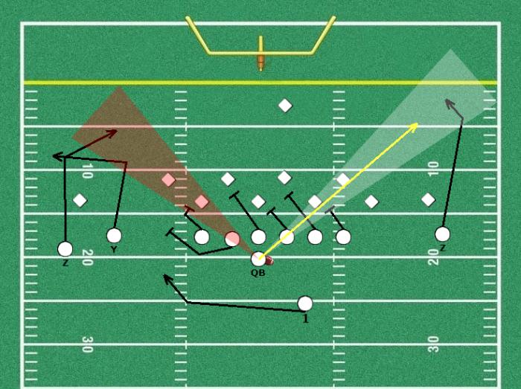
hypothetical play-by-play model
each play generates an outcome.
what factors influence (or predict) that outcome?

Slide 10
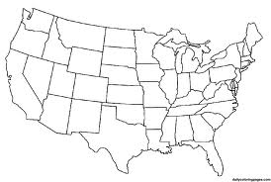
map coloring problem
Color the map so that …
Each state is one of 4 colors.
No state is adjacent to a state with the same color

Slide 11
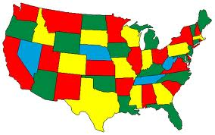

Slide 12
travelling salesman problem
Find a round trip across cities with minimal cost
Find a route around 13,503 cities so that…
The salesman returns to the original city
The distance travelled is minimal

Slide 13
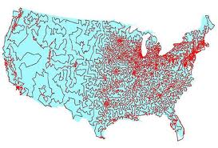

Slide 14
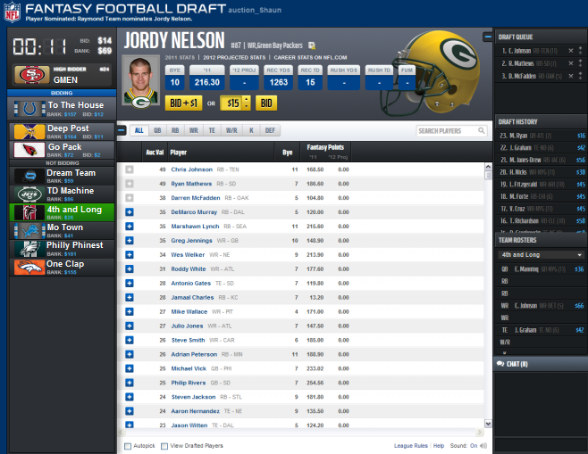
fantasy football auction
Get the best possible team that:
Contains a reasonable quantity at each position.
Doesn’t exceed the salary cap.

Slide 15
Monte Carlo Steps
Define a domain of possible inputs.
Generate inputs randomly over the domain.
Perform a computation on the inputs.
Aggregate the results.

Slide 16

Variable (Randomly selected) input
Different
outcomes
Monte carlo

Slide 17
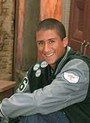
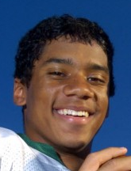
Who to start?
How would a linear model generate a fantasy football projection?
points = 0.987x + 0.015y + 2.45z + 5
How is this different from what you’d do with a simulation?
simulations use models

Slide 18
points = 0.987x + 0.015y + 2.45z + 5
X = Average Fantasy Points Per game
Y = Average Passing Yards allowed by opponent
Z = Average Passing TDs allowed by opponent
simple modeling: plug in the averages
simulation: randomly select realistic observations of these values, and re-run the simulation many times.
Brain teaser:
Wouldn’t you always get the same basic result from a simulation as with just plugging in the averages?

Slide 19
accuscore
inputs for each play are dependent on
the state of the game
the outputs of the previous play
Notes:
Video

Slide 20
Monte Carlo advantages
When inputs are correlated with each other
or dependent on each other
Monte Carlo methods give you a more realistic measure of the outcomes of a model.
You get more than just a single number.
a frequency distribution

Slide 21
Frequency Distributions
Quarterback 1
Quarterback 2
fantasy points
fantasy points
Same averages. Who do you start?

Slide 22
Monte Carlo: An Example
Expected fantasy points for a running back:
ŷ = 2 + 0.75a + 0.05b + 1.0c
Where
ŷ = projection
a = avg fantasy points
b = fantasy points allowed by opponent
c = percent of rush attempts

Slide 23
Modeling Approach
ŷ = 2 + 0.75a + 0.05b + 1.0c
Plug and chug: Matt Forte on THU
a (average fp) = 16.31
b (fp allowed by DAL) = 18.49
c (pct of team rush att) = 0.73
ŷ = 2 + (0.75 * 5.8) + (.05 * 18.49) + (1 * 0.73)
ŷ = 15.89

Slide 24
Instead of plugging averages…
a
16.9
3.6
7.6
17.1
20.6
27.7
22.9
24.8
8.1
17.5
23.2
5.8
b
17.6
4.3
17.9
16.8
30.8
7.2
8.4
19.3
28.4
20.5
22.7
28
c
0.789
0.625
0.864
0.813
0.810
0.913
0.692
0.826
0.750
0.875
0.560
0.821
ŷ = 2 + (0.75 *
) + (.05*
) + (1*
)

Slide 26
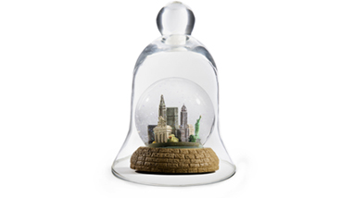
Practical Applications
Lots of Math & Engineering
Insurance & Risk Assessment
AI and Simulated Gameplay
Decision Science
Notes:
http://demonstrations.wolfram.com/MonteCarloEstimateForPi/

Slide 27
lebron getting schooled http://www.youtube.com/watch?v=-fCVxTTAtFQ

Slide 28
Our Project with Monte Carlo
Input:
Draft results
Weekly ESPN projections
Weekly fantasy points
Model: A fantasy football manager (x10) (no trades)
Output:
Frequency distribution of win/loss record

Slide 29
what do you think?
Will managers generally do better than their simulated outcomes?
Notes:
http://bleacherreport.com/articles/1867851-fantasize-me-fantasy-football-sleepers-for-week-13

