Slide 1
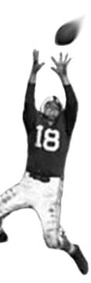
C105 PREDICTION, PROBABILITY & PIGSKIN
day 27: gambling, law, and fantasy sports
© Ben Motz, 2014

Slide 2
a question for you.
http://www.polleverywhere.com/multiple_choice_polls/NDEyOTI5MTE2

Slide 3
Why is gambling [generally] illegal?
Does it injure others?
Does it injure the gambler?
Is it immoral?
Not in any illegal way
No more than _
Maybe?

Slide 4
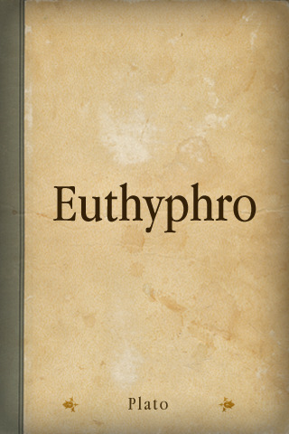
the trouble with morality: what’s moral?
socrates meets euthyphro (a high-born priest of athens) on the steps of the law courts.
socrates is being charged with corrupting the youth of athens.
euthyphro is seeking to prosecute his father for murder.
Notes:
Euthyphro’s father had punished a servant who, while drunk, had killed a slave. He tied up the servant and left the servant in a ditch while he went in search of advice concerning what to do with the miscreant. The servant died before Euthyphro’s father returned. Euthyphro, a priest, is confident that his father committed murder, albeit accidentally, and should be brought to justice. Euthyphro believes, with great confidence that the moral thing to do is to prosecute his father.
Socrates points out the flaw:
It is moral to bring a murderer to justice.
It is immoral to antagonize one’s aging and well-meaning father.

Slide 5
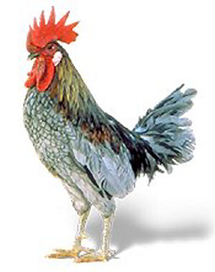
A man goes to the supermarket once a week and buys a dead chicken. But before cooking the chicken, he has sexual inter- course with it. Then he cooks it and eats it.
Should this man be stopped?
Notes:
Ask for discussion on what factors might cause someone to feel that it should be stopped.
try to finish discussion on the intentions of the man.

Slide 6
intentions:
We don’t court martial military personnel who denounce their country while being tortured as prisoners of war.
what you do
why you do it
First Degree Murder: An intentional killing by means of poison, or by lying in wait, or by any other kind of willful, deliberate and premeditated action.
Second Degree Murder: Homicide committed by an individual engaged as a principal or an accomplice in the perpetration of a felony.
Third Degree Murder: Any other murder (e.g. when the intent was not to kill, but to harm the victim).
Children are not held accountable for acts which would constitute criminal conduct from an adult.

Slide 7
History of Gambling in USA
British parlor games & lotteries → colonies
But also Puritanism and distain for gambling
Lottery scandals and Civil War (effects on riverboats) ended most forms of legal gambling.
Great depression led to increasing legalization of gambling, for purposes of stimulating the economy, added revenue for states.

Slide 8
games of chance / elements of chance
In most states “[t]he test of the character of the game is not whether it contains an element of chance or an element of skill, but which is the dominating element that determines the result of the game.”
In general, the rule for determining whether an activity is gambling rests on the answers to two questions:
Is the result of an activity separable from the element of chance, so that skill can be determinative, at least in some cases?
Is the result always sufficiently affected by the operation of chance that chance could always account for the result?

Slide 9
In Indiana (as well as Wisconsin, New Jersey, and New York) gambling is legal if it involves a game of skill rather than of chance.
For example, it would be legal to create prize money pool for a chess tournament in such states, but not legal to create a prize money pool for a bingo tournament. One could argue, in these states, that one’s ability to evaluate talent (players in fantasy leagues, teams, or horses) is the material factor in the game, rather than luck.

Slide 10
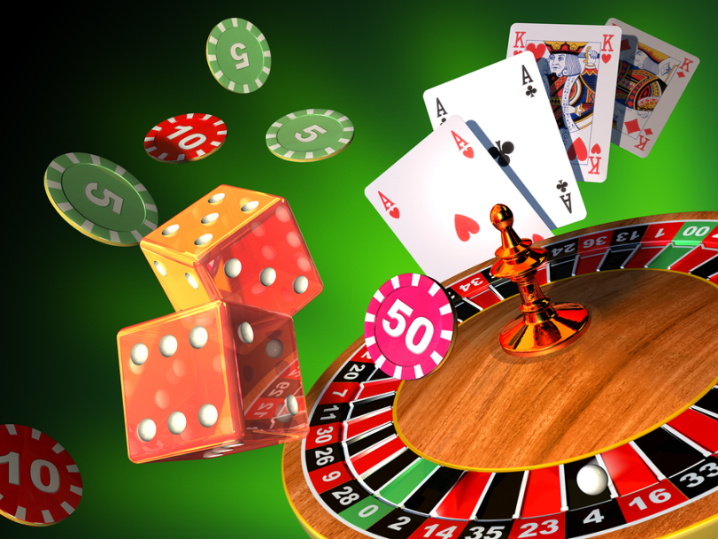
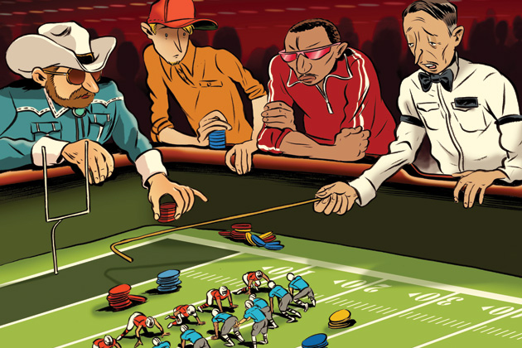
gambling
not gambling?

Slide 11
picking winning players ≠ picking winning teams

Slide 12
How does sports betting work?
ARI at STL -3.5
Spread is always relative to the home team
The expected point difference
St. Louis is expected to win by 3.5 points.
Beat the spread to earn money
“spread”

Slide 13
What does the NFL say?
The National Football League is fully against any sort of legalization of sports betting-- The NFL strongly protests it as to not bring corruption into the game.
The NFL goes a step further in support of fantasy football by allowing active players to participate in fantasy football. Although the league is aware that significant sums of money are at stake in many of these leagues, the NFL has no rules keeping players, officials, or anyone else from participating in fantasy football… NFL Spokesman: “Fantasy football is a game of skill, and gambling is not.”

Slide 14

NCAA
NCAA bylaws define participation in fantasy leagues that have entry fees as sports wagering and institutions (including full-time & part-time staff and student workers of these institutions) are prohibited from this.
Are you involved in NCAA in any way?

