Slide 1

1
Artificial Intelligence
UNIT - IV
Knowledge representation: Introduction, approaches to knowledge representation, knowledge representation using semantic network, extended semantic networks for KR
Advanced knowledge representation techniques: Introduction, conceptual dependency theory, script structure.
Mr.B V RAMANA

Slide 2
2
Artificial Intelligence
Knowledge representation:
Humans are best at understanding, reasoning, and interpreting knowledge.
Human knows things, which is knowledge and as per their knowledge they perform various actions in the real world.
But how machines do all these things comes under knowledge representation and reasoning.
Mr.B V RAMANA

Slide 3
3
Artificial Intelligence
It is responsible for representing information about the real world so that a computer can understand and can utilize this knowledge to solve the complex real world problems.
Such as diagnosis a medical condition or communicating with humans in natural language.
It is also a way which describes how we can represent knowledge in artificial intelligence.
Knowledge representation is not just storing data into some database, but it also enables an intelligent machine to learn from that knowledge and experiences so that it can behave intelligently like a human
Mr.B V RAMANA

Slide 4
4
Artificial Intelligence
What to Represent:
Object:
All the facts about objects in our world domain.
Events:
Events are the actions which occur in our world.
Performance:
It describe behavior which involves knowledge about how to do things.
Meta-knowledge:
It is knowledge about what we know.
Facts: Facts are the truths about the real world and what we represent.
Knowledge-Base:
The central component of the knowledge-based machine. It is represented as KB. The Knowledge base is a group of the Sentences.
Mr.B V RAMANA

Slide 5
5
Artificial Intelligence
Knowledge:
Knowledge is awareness or familiarity gained by experiences of facts, data, and situations.
Mr.B V RAMANA

Slide 6
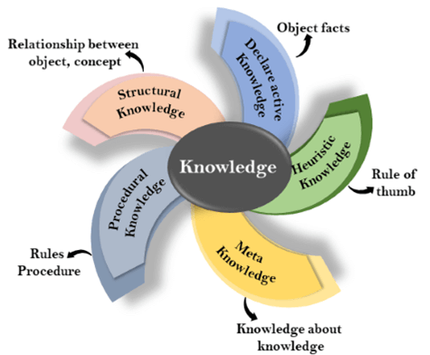
6
Artificial Intelligence
Types of knowledge
Mr.B V RAMANA

Slide 7
7
Artificial Intelligence
Approaches to knowledge representation:
1.Relational knowledge:
It is the simplest way of storing facts which uses the relational method, and each fact about a set of the object is set out systematically in columns.
This approach of knowledge representation is famous in database systems where the relationship between different entities is represented.
This approach has little opportunity for inference.
Mr.B V RAMANA

Slide 8
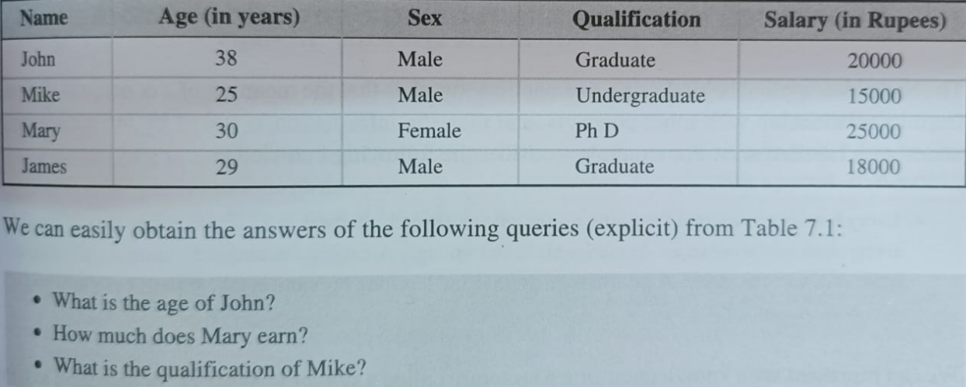
8
Artificial Intelligence
Mr.B V RAMANA

Slide 9
9
Artificial Intelligence
2. Inheritable knowledge
In the inheritable knowledge approach, all data must be stored into a hierarchy of classes.
All classes should be arranged in a generalized form or a hierarchal manner.
This approach contains inheritable knowledge which shows a relation between instance and class, and it is called instance relation.
Every individual frame can represent the collection of attributes and its value.
In this approach, objects and values are represented in Boxed nodes.
We use Arrows which point from objects to their values.
Mr B V RAMANA

Slide 10
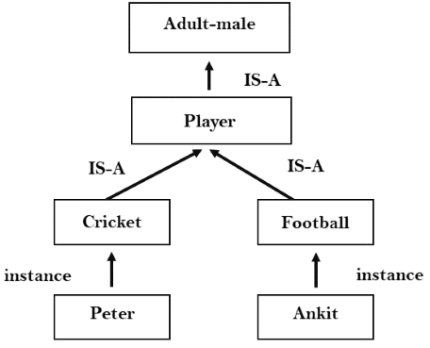
10
Artificial Intelligence
Mr.B V RAMANA

Slide 11
11
Artificial Intelligence
3. Inferential knowledge:
Inferential knowledge approach represents knowledge in the form of formal logics.
This approach can be used to derive more facts.
It guaranteed correctness.
Example: Let's suppose there are two statements:
a) X is a man
b) All men are mortal man(X) ∀x = man (x) ----------> mortal (x)s
Mr.B V RAMANA

Slide 12
12
Artificial Intelligence
4. Procedural knowledge:
Procedural knowledge approach uses small programs and codes which describes how to do specific things, and how to proceed.
In this approach, one important rule is used which is If-Then rule.
In this knowledge, we can use various coding languages such as LISP language and Prolog language.
We can easily represent heuristic or domain-specific knowledge using this approach.
Mr B V RAMANA

Slide 13
+-
13
Artificial Intelligence
Properties of knowledge Representation :
1. Representational Accuracy: KR system should have the ability to represent all kind of required knowledge.
2. Inferential Adequacy: KR system should have ability to manipulate the representational structures to produce new knowledge corresponding to existing structure.
3. Inferential Efficiency: The ability to direct the inferential knowledge mechanism into the most productive directions by storing appropriate guides.
4. Acquisitional efficiency:
The ability to acquire the new knowledge easily using automatic methods.
Mr.B V RAMANA

Slide 14
14
Artificial Intelligence
Knowledge Representation Using Sematic network
The Information is stored in by interconnecting nodes with lablled arcs.
Every human and animal is living thing who can breathe and eat.
Every men and women are human who have two legs.
A cat has fur and is an animal.
All animals have skin and can move.
A girafee is an animal and has long legsand is tall.
A parrot is a bird and is green in colour.
Mr.B V RAMANA

Slide 15
15
Artificial Intelligence
We can represent such knowledge using a structure called a semantic network( or Semantic Net).
Nodes represent concepts or objects.
Arcs represent relation between two object.
isa - This relation connect two classes.Ex: Man isa Human, that is Man subclass of the Human.
inst- This relation relates specific members of a class,such as Jhon is an instance of Man.
Mr.B V RAMANA

Slide 16
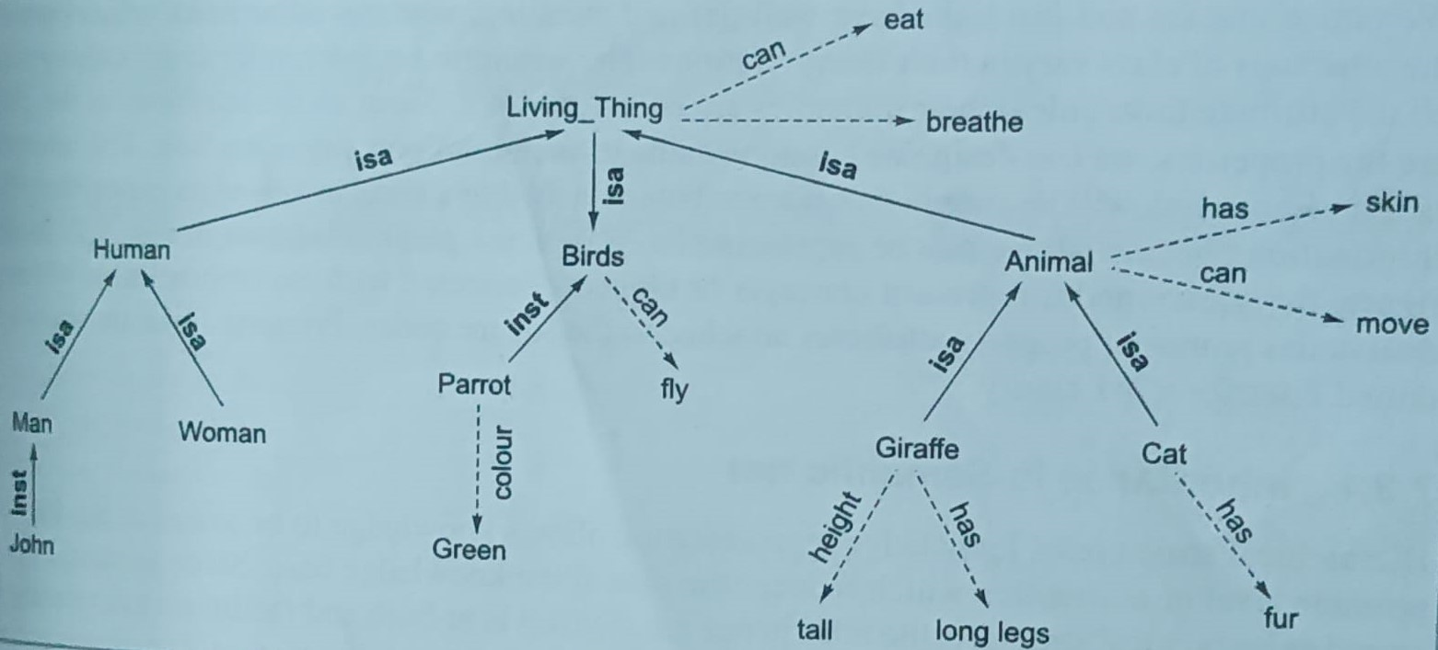
16
Artificial Intelligence
Knowledge Representation Using Sematic network
Mr.B V RAMANA

Slide 17
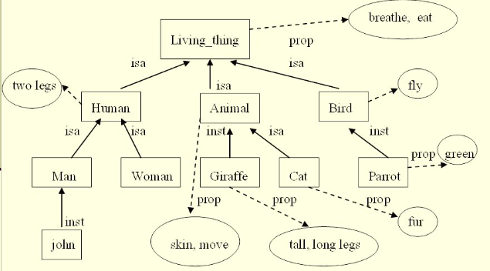
17
Artificial Intelligence
Knowledge Representation Using Sematic network with prop link
Mr.B V RAMANA

Slide 18
18
Forward Chaining(Data-driven search)

Slide 19
19
Backward Chaining(Goal-driven search)

Slide 20
20
Artificial Intelligence
Characteristics of Problem
Mr.B V RAMANA

Slide 21
21
Artificial Intelligence
Characteristics of Problem
Mr.B V RAMANA

Slide 22
22
Artificial Intelligence
Characteristics of Problem
Mr.B V RAMANA

Slide 23
23
Artificial Intelligence
Characteristics of Problem
Mr.B V RAMANA

Slide 24
24
Artificial Intelligence
Search Algorithms in Artificial Intelligence
Mr.B V RAMANA

Slide 25
25
Artificial Intelligence
Search tree:
Mr.B V RAMANA

Slide 26
26
Artificial Intelligence
Properties of Search Algorithms
Mr.B V RAMANA

Slide 27
27
Artificial Intelligence
Constraint Satisfaction Problems(CSP)
Mr.B V RAMANA

Slide 28
28
Artificial Intelligence
Uninformed/Blind Search
Mr.B V RAMANA

Slide 29
29
Artificial Intelligence
Informed Search
Mr.B V RAMANA

Slide 30
30
Artificial Intelligence
Uninformed/Blind Search
Mr.B V RAMANA

Slide 31
31
Artificial Intelligence
Advantages:
Mr.B V RAMANA

Slide 32
32
Artificial Intelligence
Ex :
Mr.B V RAMANA

Slide 33
33
Artificial Intelligence
Time Complexity:
Mr.B V RAMANA

Slide 34
34
Artificial Intelligence
Completeness:
Mr.B V RAMANA

Slide 35
35
Artificial Intelligence
Depth-first Search
Mr.B V RAMANA

Slide 36
36
Artificial Intelligence
Advantage:
Mr.B V RAMANA

Slide 37
37
Artificial Intelligence
37
Ex :
Mr.B V RAMANA

Slide 38
38
Artificial Intelligence
Completeness:
Mr.B V RAMANA

Slide 39
39
Artificial Intelligence
Depth-Limited Search Algorithm:
Mr.B V RAMANA

Slide 40
40
Artificial Intelligence
Advantages:
Mr.B V RAMANA

Slide 41
41
Artificial Intelligence
Ex :
Mr.B V RAMANA

Slide 42
42
Artificial Intelligence
Completeness:
Mr.B V RAMANA

Slide 43
43
Artificial Intelligence
Iterative deepening depth-first Search(IDDFS)
Mr.B V RAMANA

Slide 44
44
Artificial Intelligence
Advantages:
Mr.B V RAMANA

Slide 45
45
Artificial Intelligence
Example:
Mr.B V RAMANA

Slide 46
46
Artificial Intelligence
Constraint Satisfaction Problems(CSP)
Mr.B V RAMANA

Slide 47
47
Artificial Intelligence
Completeness:
Mr.B V RAMANA

Slide 48
48
Artificial Intelligence
Constraint Satisfaction Problems(CSP)
Mr.B V RAMANA

Slide 49
49
Artificial Intelligence
Bidirectional Search Algorithm
Mr.B V RAMANA

Slide 50
50
Artificial Intelligence
Advantages:
Mr.B V RAMANA

Slide 51
51
Artificial Intelligence
Constraint Satisfaction Problems(CSP)
Mr.B V RAMANA

Slide 52
52
Artificial Intelligence
Completeness:
Mr.B V RAMANA

Slide 53
53
Artificial Intelligence
Heuristics function:
Mr.B V RAMANA

Slide 54
54
Artificial Intelligence
Constraint Satisfaction Problems(CSP)
Mr.B V RAMANA

Slide 55
55
Artificial Intelligence
A* Search Algorithm
Mr.B V RAMANA

Slide 56
56
Artificial Intelligence
Algorithm of A* search
Mr.B V RAMANA

Slide 57
57
Artificial Intelligence
Constraint Satisfaction Problems(CSP)
Mr.B V RAMANA

Slide 58
58
Artificial Intelligence
Solution:
Mr.B V RAMANA

Slide 59
59
Artificial Intelligence
Advantages:
Mr.B V RAMANA

Slide 60
60
Artificial Intelligence
Disadvantages:
Mr.B V RAMANA

Slide 61
61
Artificial Intelligence
Constraint Satisfaction Problems(CSP)
Mr.B V RAMANA

Slide 62
62
Artificial Intelligence
Iterative deepening A* (IDA *)
Mr.B V RAMANA

Slide 63
63
Artificial Intelligence
IDA * Algorithm
Mr.B V RAMANA

Slide 64
64
Artificial Intelligence
Constraint Satisfaction Problems(CSP)
Mr.B V RAMANA

Slide 65
65
Artificial Intelligence
Constraint Satisfaction Problems(CSP)
Mr.B V RAMANA

Slide 66
66
Artificial Intelligence
Constraint Satisfaction Problems(CSP)
Mr.B V RAMANA

Slide 67
67
Artificial Intelligence
Constraint Satisfaction Problems (CSP) Representation
Mr.B V RAMANA

Slide 68
68
Artificial Intelligence
A Cryptography problem
Mr.B V RAMANA

Slide 69
69
Artificial Intelligence
The n-Queen problem
Mr.B V RAMANA

Slide 70
70
Artificial Intelligence
70
70
Thank you
Mr.B V RAMANA

