Slide 1

JOB QUEST -Using Django
Presented by:
T.SRI SWETHA

Slide 2


AGENDA
Introduction
Objectives
Features of Job Quest
Job Roles
Tools Used
Interface
Conclusion
Department of Electronics and Communication Engineering Vignan’s Institute of Engineering for Women, Visakhapatnam​

Slide 3

INTRODUCTION
An impressive and dynamic way to connect job seekers with recruiters, a "Job Quest" powered by Django represents a sophisticated web platform or application designed for the purpose of job searching and recruitment.
It's built using a powerful tool called Django, which not only makes the job search easier but also makes it possible to create other useful web applications.

Slide 4

OBJECTIVES
To create a platform that efficiently connect job seekers along with recruiters by providing a user friendly experience.
To create dynamic and user centric job quest using Django that empowering individuals in their career journeys, assisting recruiters in finding the best talent and contributing to the growth and the workforce.

Slide 5







FEATURES OF JOB QUEST
5
Job Listings
Search Filters
Company Profiles
Networking Tools
Resume Upload
Saved Searches
Salary Information
Privacy and Security
Alerts, Notifications

Slide 6

JOB ROLES
Job Roles: This provides functionalities related to Job Seekers .They can post vacancy details and update the details when necessary. Recruiters can search through applicant resumes based on different criteria.
Jobs: In this session employers can post the job and manage the jobs.
Candidate list: Employer can view the list of applied candidates and send msg to selected ones.
Job category: admin can manage job category(add/update/delete) list of employer: admin can view the list of recruiters and see the details of individuals.

Slide 7






TOOLS USED
Language Used:
CSS
bootstrap
python Django
SQLite database
Software Used:
python interpreter
text editor
chrome or browser

Slide 8
PROJECT INTERFACE
Home
Trending Jobs
User Login
Recruiter Login
Admin Login
Contact

Slide 9
HOME PAGE

Slide 10
TRENDING JOBS

Slide 11
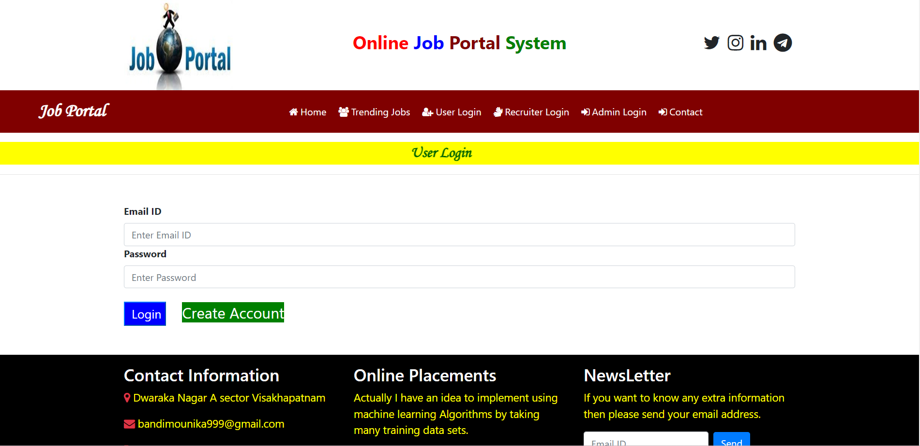
USER LOGIN
A user login page is a secure online gateway where individuals provide their credentials, typically a username and password, to access a protected account.

Slide 12
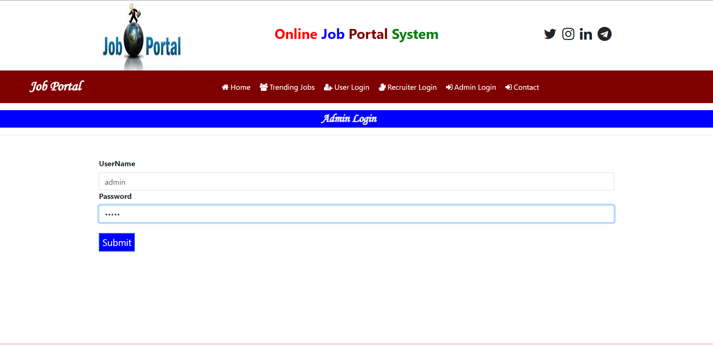
ADMIN LOGIN
An admin login page is a special webpage that only certain authorized people can use to access and control important parts of a website or system, keeping everything safe and organized.

Slide 13
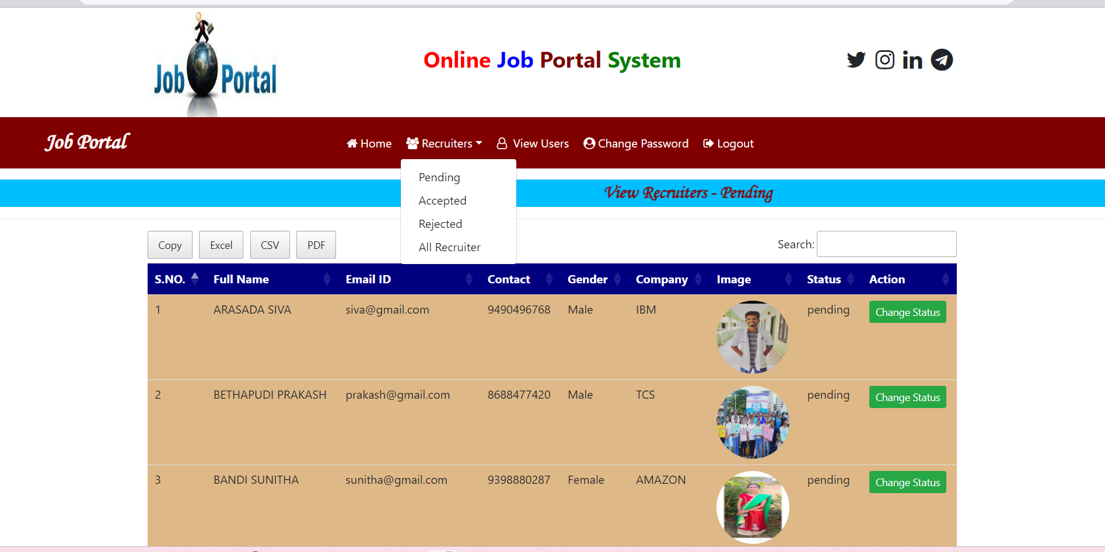
RECRUITER LOGIN
A recruiter’s login page is a web portal where hiring professionals log in to access candidate profiles, post job listings, and manage the hiring process efficiently. It's a dedicated space for recruiters to find and connect with potential job candidates.

Slide 14
OUTPUT

Slide 15

BENEFITS
Increasing Job Opportunities:
Job portals provide many different job options from the best companies and it is convenient using this portal, you can apply for a job easily.
Get Regular Notifications:
A job portal sends you regular notifications about new job openings.

Slide 16
CONCLUSION
Job Quest is a user friendly webpage that connect job seekers and recruiters. By using Job Quest one can achieve their preferable job based on their Qualification. This also provides the direct communication between job seekers and recruiters . Whether you're a job seeker looking for the right career opportunity or a recruiter seeking top talent, Job Quest is the go-to platform to achieve your goals effectively and conveniently.

Slide 17

THANKYOU

