Slide 1





Explicitly estimating shifts in optimum positions of multiple species along environmental gradient
Bastien Mourguiart, Benoit Liquet, Thibaut Couturier, Jérôme Mansons, Damien Combrisson, Yoan Braud, Kerrie Mengersen & Aurélien Besnard

Slide 2






Context: One application
1985
2018
Based on a case of study: Shifts in Orthoptera community

Slide 3
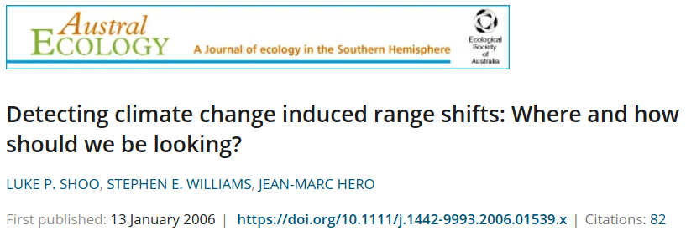
Context: One application
1985
2018
Based on a case of study: Shifts in Orthoptera community
Focus on optimum positions

Slide 4
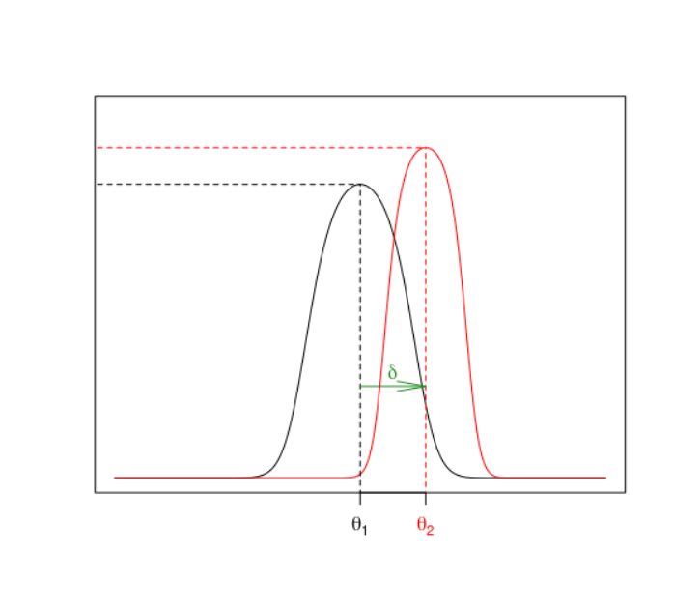
Context: Optimum shift modelling
Optimum shift

Slide 5
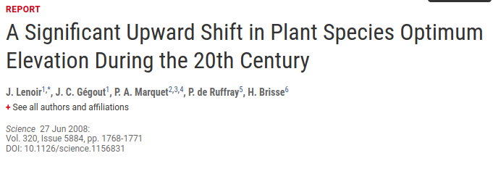
Context: Optimum shift modelling
Optimum shift
Multiple applications

Slide 6
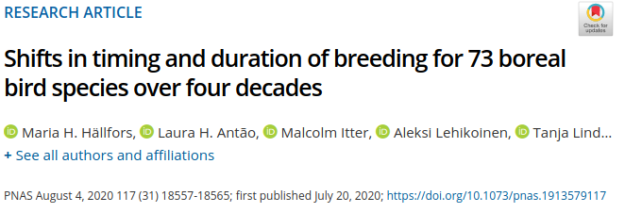

Context: Optimum shift modelling
Optimum shift
Multiple applications

Slide 7
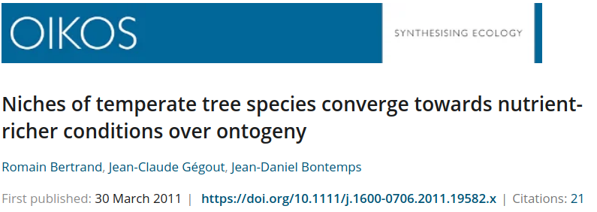

Context: Optimum shift modelling
Optimum shift
Multiple applications

Slide 8
Context: Optimum shift modelling
No consensus method
  Multivariate methods → Not specific

Slide 9
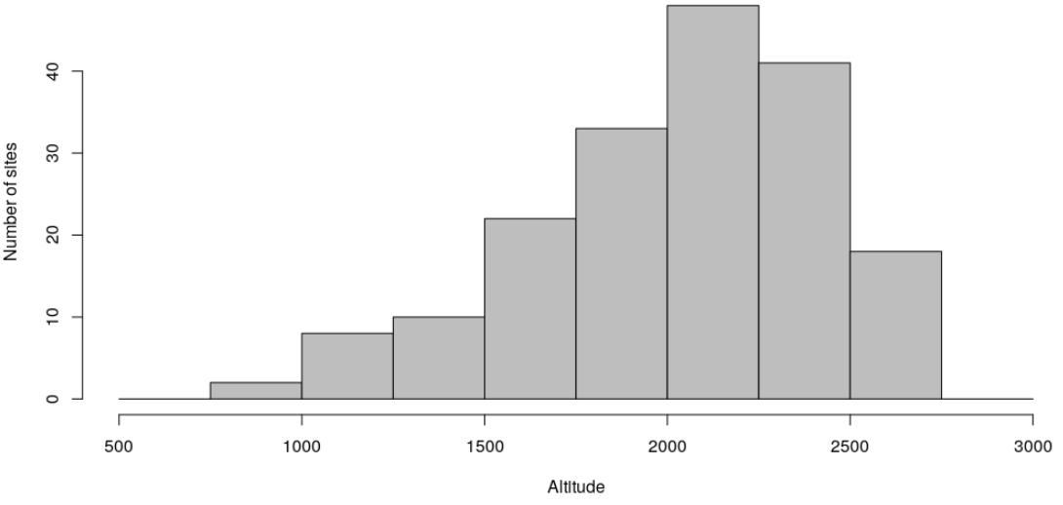
Context: Optimum shift modelling
No consensus method
  Multivariate methods → Not specific
  T-test based methods → Sampling effort dependent?

Slide 10
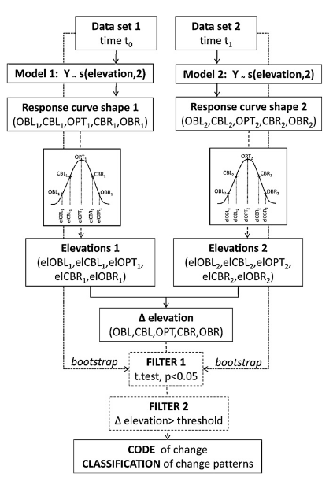
Context: Optimum shift modelling
No consensus method
  Multivariate methods → Not specific
  T-test based methods → Sampling effort dependent?
  Regression methods → No uncertainty around estimates

Slide 11
Context: Optimum shift modelling
No consensus method
  Multivariate methods → Not specific
  T-test based methods → Sampling effort dependent?
  Regression methods → No uncertainty around estimates
We propose an extension of a Bayesian hierarchical model

Slide 12
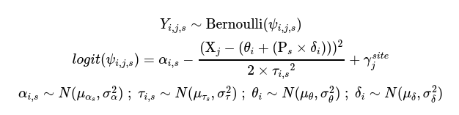
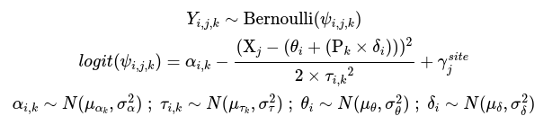
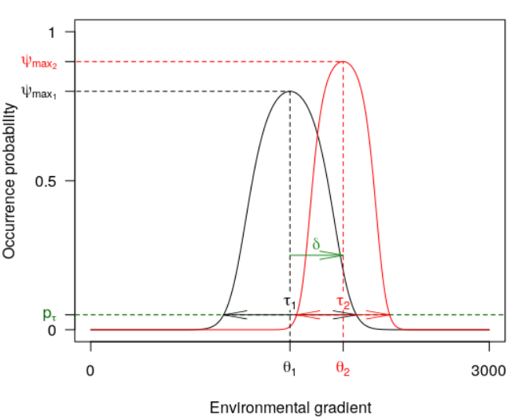
Models
Explicit Hierarchical Model of Optimum Shift (EHMOS)
Species i = {1,2,...,N}
0/1
Period k = {1,2}
X
(Alti)
Y = 0/1
Site j = {1,2,...,J}

Slide 13
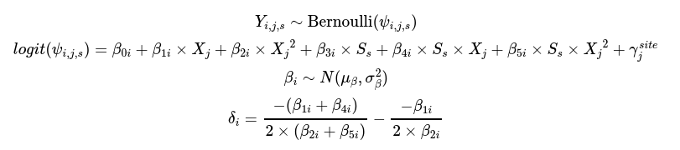
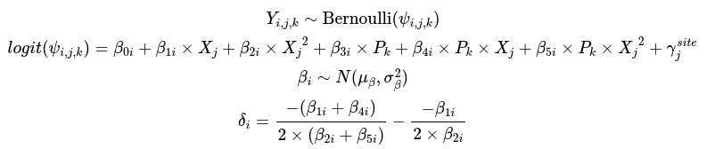
Models
Explicit Hierarchical Model of Optimum Shift (EHMOS)
Species i = {1,2,...,N}
0/1
Period k = {1,2}
X
(Alti)
Y = 0/1
Site j = {1,2,...,J}
Basic Generalized Linear Mixed Model (b-GLMM)
Mean comparison method (T-test)
T-test between occupied altitudes of the two periods

Slide 14
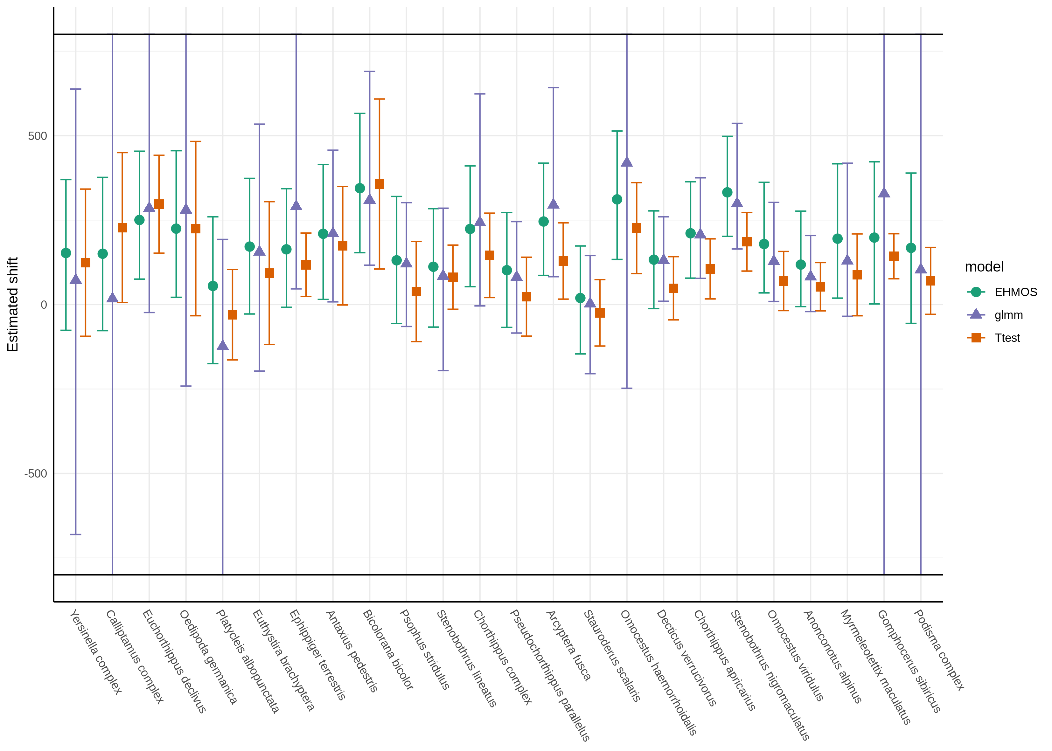

Application results
  Data
134 sampling sites
24 species
Two periods
  Results
Unrealistic GLMM estimates
Differences between methods
  Lower estimates with T-test
Scope with what expected under climate change

Slide 15
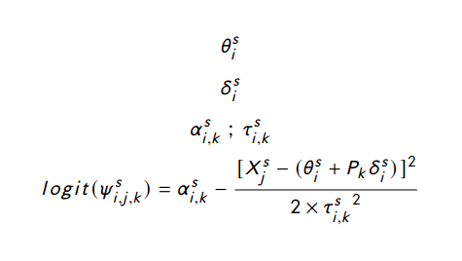


Simulation analysis
Optimum type
sub-scenario
Sampling
sub-scenario
Ecological type
sub-scenario
Simulation design :
  8 scenarios
    Combination of 3 sub-scenarios
    Repliacted 30 times
  20 virtual species
    Shifts :
    70 % ↑, 15 % ↓, 15 % =
  300 simulated sampling sites
  Altitudinal gradient = [1000 m ; 3000 m]
x30

Slide 16
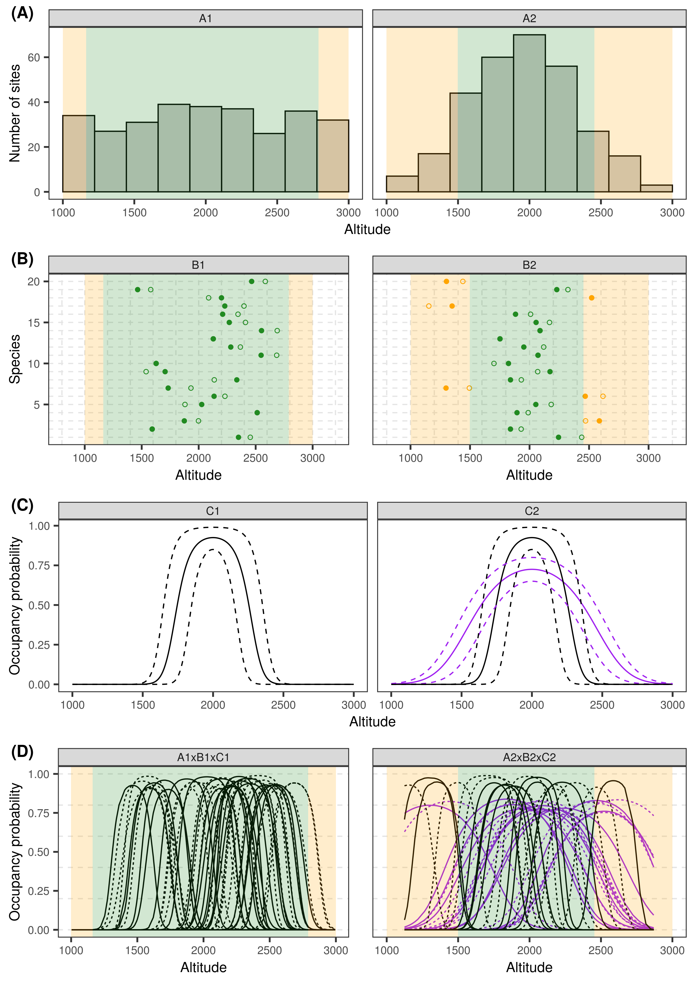
8 scenarios = combinaisons of sub-scenarios
Sampling sub-scenario
x30
Optimum sub-scenario
100 %
15 %
70 %
15 %
Specialization
sub-scenario
100 %
50 %
50 %

Slide 17
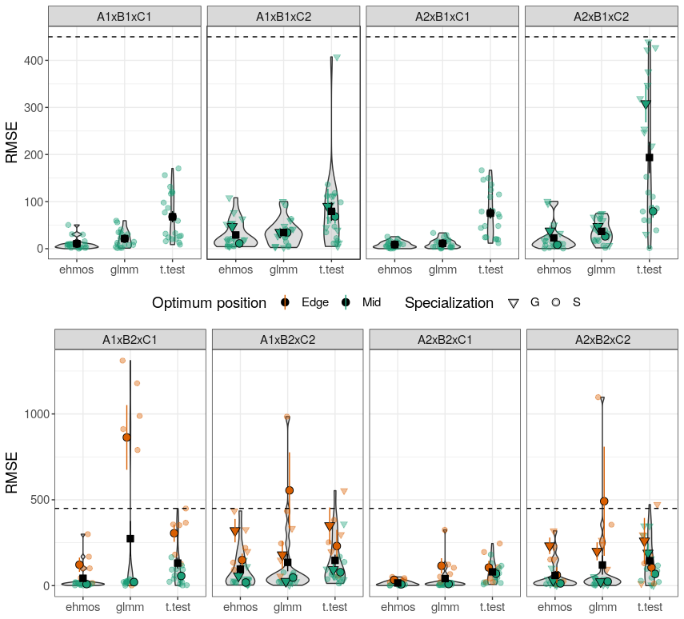
Simulation results
→ EHMOS better in average
→ GLMM bad with edge species
→ T-test underestimate shifts of generalist species
→ All sensitive to optimum optimum positions, especially under uniform sampling

Slide 18
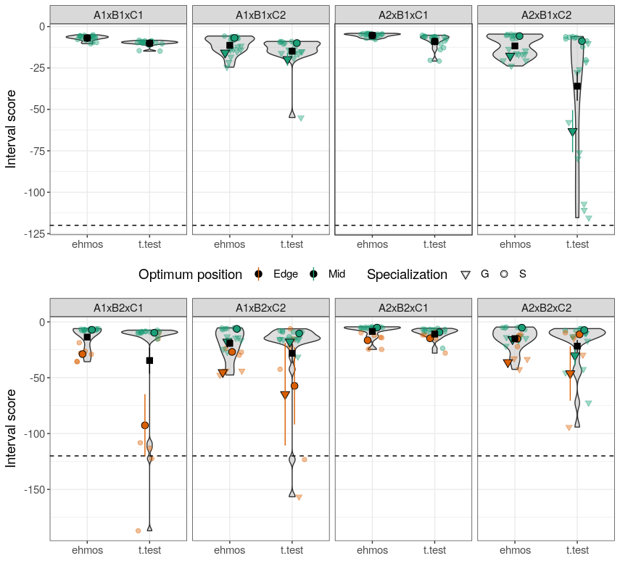
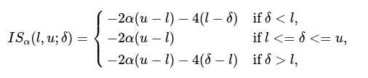
Simulation results
→ Really poor IS for GLMM due to edge species
→ Low coverage for generalist and edge species with T-test
→ In average, better IS for EHMOS

Slide 19
Conclusion - Perspectives
Limit of T-test and GLMM
Usefulness of EHMOS under simulation scenario
EHMOS could be perturbated in other context than unimodal symmetric response curves
Interest of explicitly estimating shift for future application

Slide 20
Thank you for your attention!

Slide 21
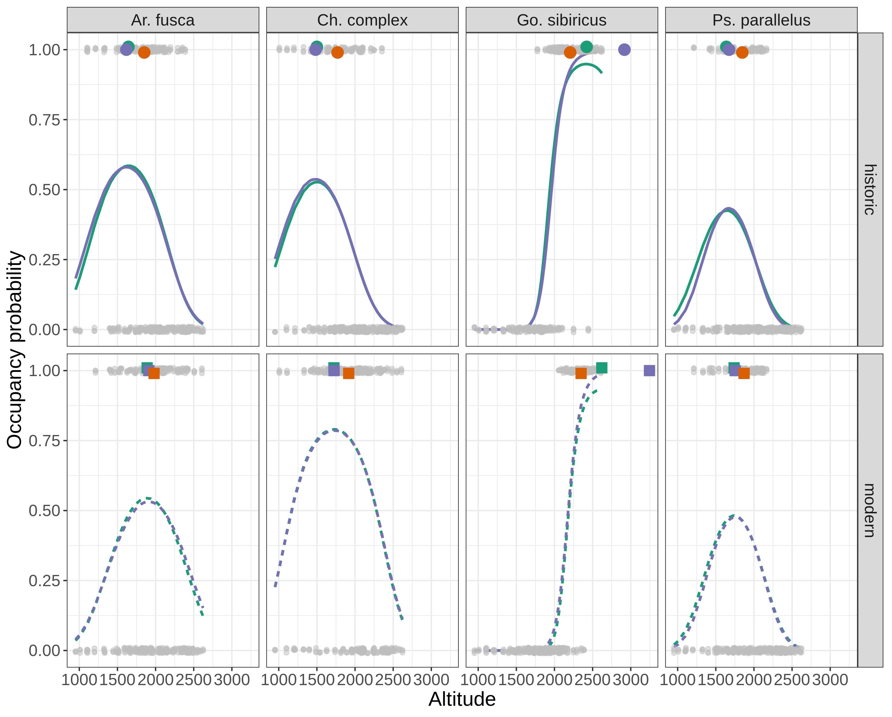
Unrealistic GLMM estimates for species close to the sampling edges

Slide 22
