Slide 1
(CH-359) Project of Computational Chemistry
TA Beatriz Mouriño
beatriz.buenomourino@epfl.ch
Prof. Berend Smit
Laboratory of Molecular Simulation (LSMO)

Slide 2
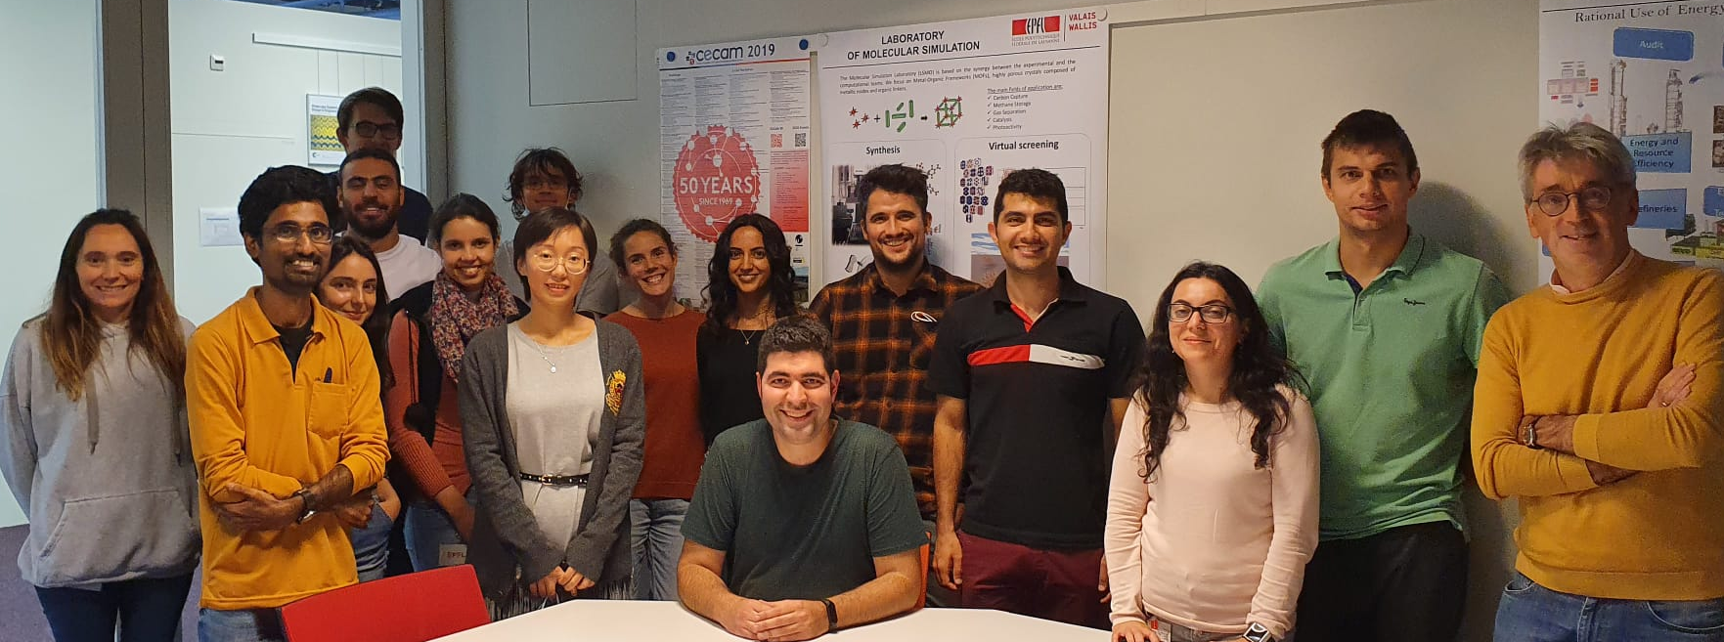
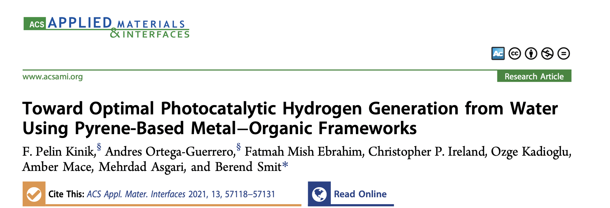
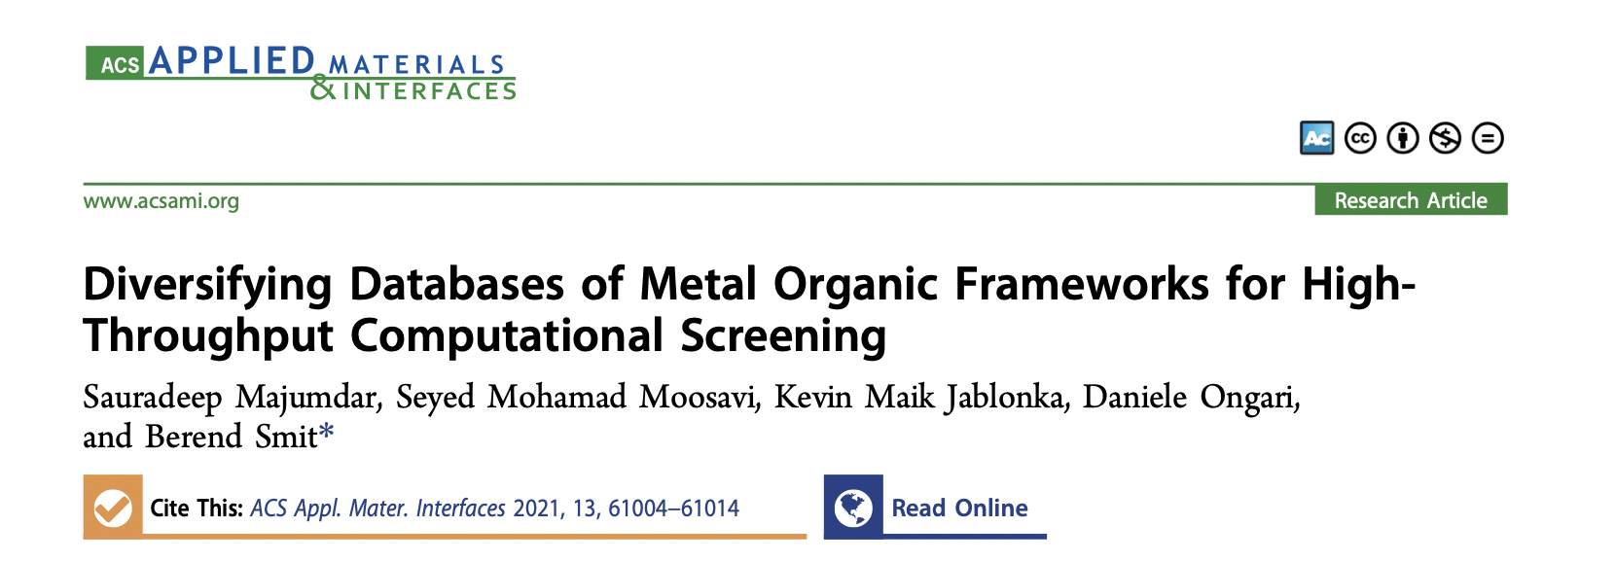
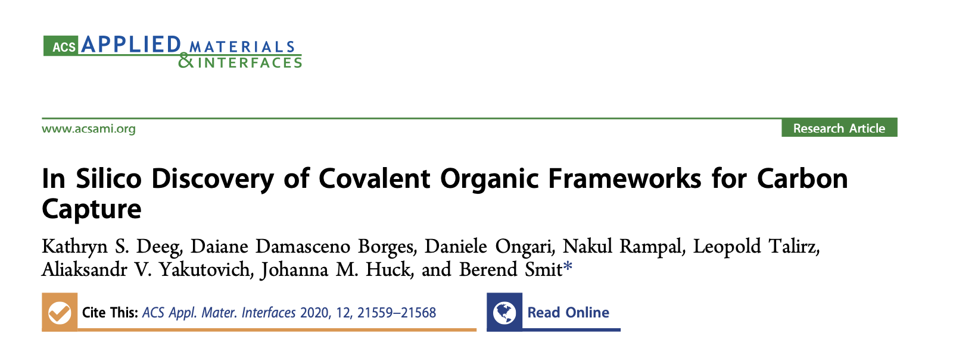
LSMO
Molecular simulation is a common topic;
Metal organic frameworks (MOFs), covalent organic frameworks (COFs);
Different approaches:
Molecular dynamics (MD), Monte Carlo (MC);
Density functional theory (DFT);
Machine learning (ML).

Slide 3

Exploring the properties of MOFs and COFs
Why are MOFs and COFs interesting?
How can we use computational tools to assess their properties and retrieve chemical information?
General goals:
Compare geometric properties of the pores before and after a DFT optimization;
Analyse electronic properties of the material;
Interpret the results and answer: what can the material be used for?
Want to know more about MOFs and COFs?
@MOF_papers @COF_papers

Slide 4
Exploring the properties of MOFs and COFs
Technical goals:
Handle CIF files of MOFs/COFs (visualize, check, clean, convert);
Calculate geometrical parameters of the pores;
Submit calculations on a cluster;
Perform DFT optimization of the material;
Calculate electronic properties with DFT;
Plot graphs and analyze data.
Thank you! Questions?
beatriz.buenomourino@epfl.ch
COF-5 from CURATED COFs database
https://doi.org/10.24435/materialscloud:z6-jn

